Slide 1
Kentucky Office of Adult Education
Reentry Employment Services
Workforce Attraction and Retention Task Force
September 12th, 2024

Slide 2
Presenters
Aaron Poynter, Director, Reentry and Employment Services Branch
Myra Wilson, Director, Cumberlands Workforce Development Board

Slide 3
Topics to Discuss
Reentry and Employment Services Branch
Putting Kentuckians First
Operations
Data & Statistics
Notes:
Reentry and Employment Services Branch/ Putting Kentuckians First
Mission statement and goals
Timeline and growth
Operations
Putting Kentuckians First
Identification Program
Operations with local/regional detention centers – Pre-Release Classes, Reentry Bootcamps, Credential Training Programs
Behavioral Health Conditional Dismissal Program
Data & Statistics

Slide 4
Reentry and Employment Services Branch
Mission Statement
Empowering Kentuckians to achieve personal success, met goals, and establish self sufficiency through the Putting Kentuckians First initiative which provides employment, recovery resources, education and training, career services, vocational rehabilitation, and court-ordered programs focused on diversion and re-entry pathways to Kentucky’s workforce.
Vision
Removing barriers for those in diversion and reentry pathways to Kentucky’s workforce through collaborative resource alignment among state, regional, and local agencies to help Kentuckians achieve their education, employment, and training goals effectively and efficiently.
Notes:
We develop, facilitate and deepen the effectiveness of the partners and organizations focused on the reentry populations, while building a sense of community for participants and providers.
Alignment of State, Regional and Local Partners to serve the Reentry Population – Addressing "Reentry and Recidivism" via by diversionary/ alternatives to confinement for individuals at the local level as a preventative measure and serving individuals who are returning to society.

Slide 5
Reentry and Employment Services Branch
In Summary
Develop, facilitate and deepen the effectiveness of the partners and organizations focused on the reentry populations, while building a sense of community for participants and providers.
Alignment of State, Regional and Local Partners to serve the Reentry Population.
Addressing "Reentry and Recidivism" via diversionary alternatives to confinement for individuals at the local level as a preventative measure and serving individuals who are returning to society.
Notes:
We develop, facilitate and deepen the effectiveness of the partners and organizations focused on the reentry populations, while building a sense of community for participants and providers.
Alignment of State, Regional and Local Partners to serve the Reentry Population – Addressing "Reentry and Recidivism" via by diversionary/ alternatives to confinement for individuals at the local level as a preventative measure and serving individuals who are returning to society.

Slide 6
Timeline and Growth
2019 – Statewide Reserve Application submitted for Cumberlands & South-Central Workforce Boards Personnel
Targeted local judicial level
Focus on employment
2020-2022 – Expansion and refinement of best practices
Putting Kentuckians First Pilot
Targeted local expansion
2023 – Elevation to the Department of Workforce Development’s Office of Adult Education
Hiring of additional staff
Continued expansion
2024 – Reentry and Employment Services Branch

Slide 8
Reentry and Employment Services (RES) Operations
Putting Kentuckians First
Facilitate targeted orientation classes partnering with local judicial entities (Judges, Jailers, County Attorney Offices, Probation and Parole, Specialty Courts) to create referral and accountability pipelines for individuals using a county-by-county approach.
Behavioral Health Conditional Dismissal Program (SB 90)
Oversee a component of SB 90 which provides eligible Kentuckians with a behavioral health disorder treatment and recovery support services instead of incarceration, resulting in dismissal of the charges upon successful completion.
ID Services for Individuals enrolled in Reentry Activities/KYAE
Coordinate with the Kentucky Department of Transportation to facilitate the completion of ID requests for individuals participating in a credentialed training program, Adult Education program or work-release program.
Notes:
Fix spacing

Slide 9
RES Operations for Incarcerated Individuals
Pre-release Classes in Local/Regional Detention Centers
An educational forum is presented at local detention centers to individuals who are 30/60/90 days from release.
The pre-release classes are open to both state and county inmates.
Organizations are allowed into the facility to present information to individuals that will assist them on their transition back into society.
Reentry Bootcamps
Facilitated with Local Workforce Development Boards, individuals participate in a weeklong program including soft skills, financial literacy, OSHA 10, CPR/first aid.
The week ends with an onsite job fair with local employers.
Post-release connectivity and support provided by RES Branch.

Slide 10
RES Operations for Incarcerated Individuals
Credential Training in Local Detention Centers
Plan, coordinate and fund credential training programs at local detention facilities in with local adult education provider and community and technical college.
Apprenticeship & Pre-Apprenticeship Training (Adult Institutions)
Partnership with Kentucky Department Of Corrections to offer pre-apprenticeship training in Adult Institutions beginning with Trade Unions. Projected start Early 2025.

Slide 11
Reentry and Employment Services
Customer Centered Design
Participants – Align resources, meeting participants where they are
Employers – Pipeline development, employer education and support
County Specific Approach
Ensure the most relevant and accessible resources and support are available
Judicially Motivated vs. Punitive

Slide 12
Reentry and Employment Services Data
More than 2,100 individuals served/impacted in FY 24:
1,004 incarcerated individuals served with pre-release classes
420 enrolled in Putting Kentuckians First
318 enrolled in SB 90
400 provided with general employment referral assistance (Non-PKF Referrals)
103 identification credentials obtained
70%-80% employment retention
100% Graduation rates from Credential Programs in Detention Centers #5, #6, #7 – Welding, OSHA, CPR, Forklift.
Notes:
83% increase in referrals
82% of referrals participating in Putting Kentuckians First

Slide 13
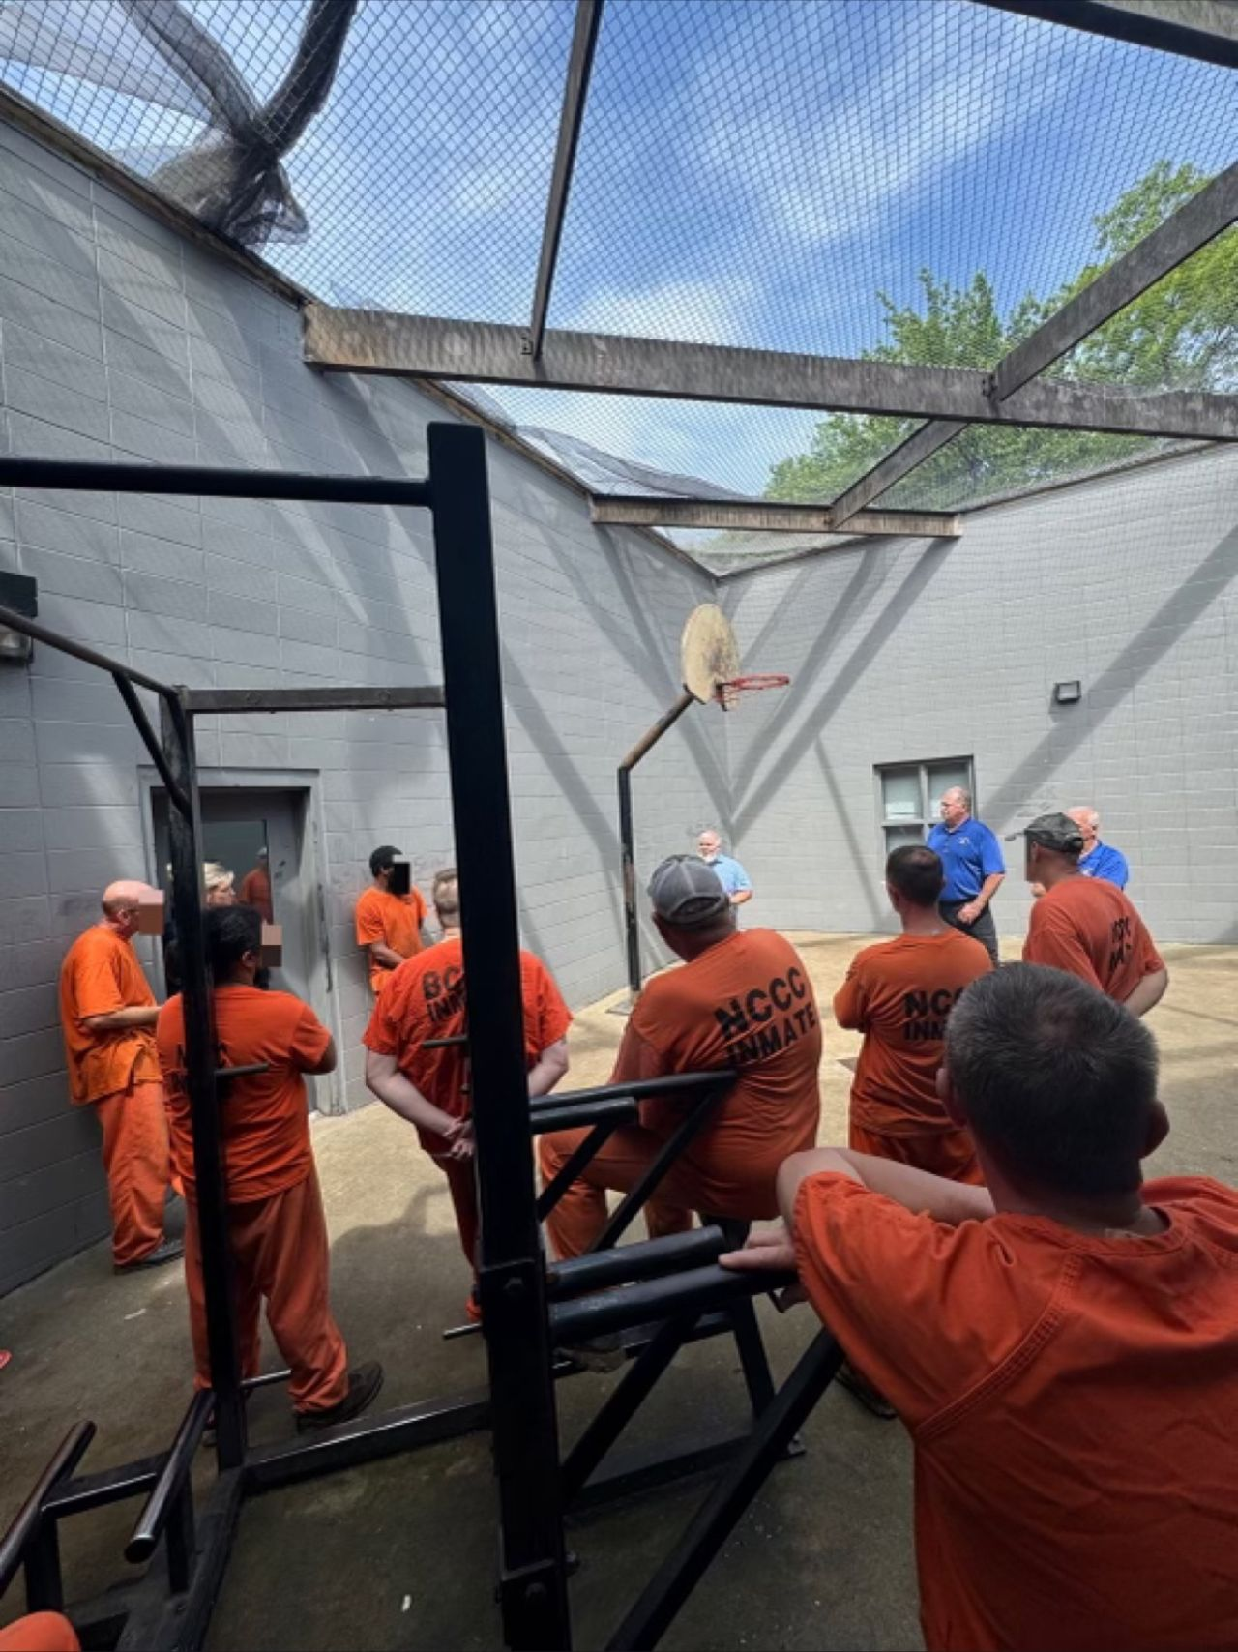
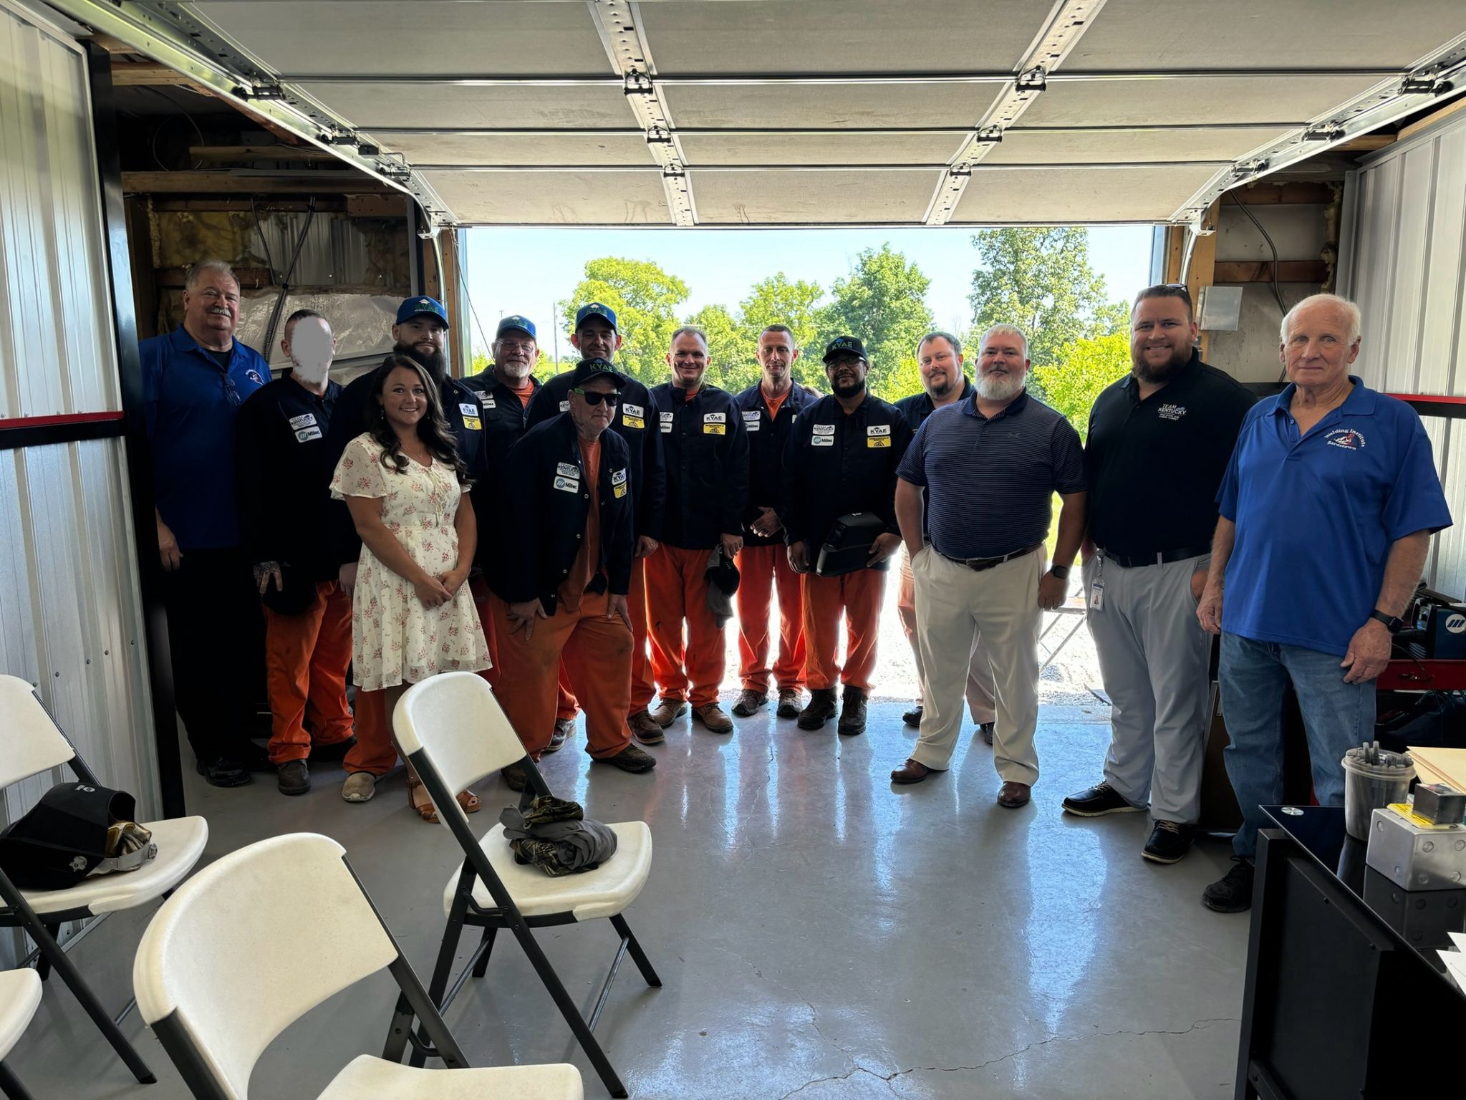
Nelson County Welding Cohort
Notes:
July 2024 – First photo was the information session – 2nd photo was graduation day
2 individuals have been released and within 48 hours of their release they were employed. Salary data?

Slide 14
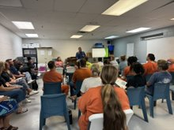
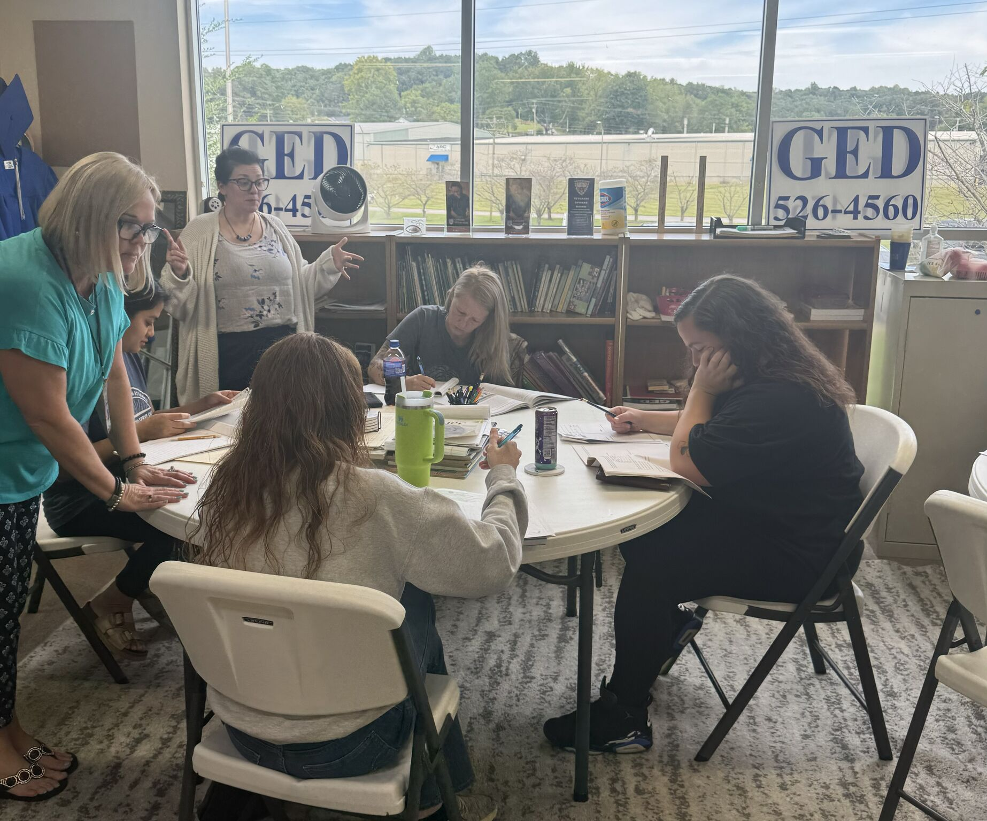
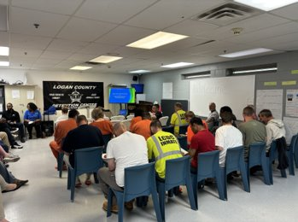
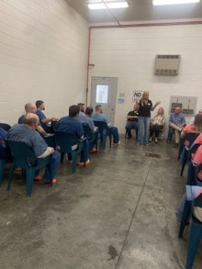
Pre-Release and Targeted Orientation

Slide 15
Thank You!

