Slide 1
Workforce Attraction and Retention Task Force Brief
September 12, 2024
KY VALOR Executive Director: Molly Bode MSW, CSW
an initiative of

Slide 2
AGENDA
Why Hire A Veteran?
Benefits to Hiring a Veteran
Workforce Disconnects
Kentucky VALOR Brief

Slide 3
HIRING MILITARY
200K
Transition annually
Equally likely to:
relocate
stay near base
return to home of origin
Veterans currently living in Kentucky
295K
VA (2017); DOD (2021)
Notes:
https://www.governing.com/now/2021-military-active-duty-personnel-civilians-by-state
https://www.va.gov/vetdata/docs/SpecialReports/State_Summaries_Kentucky.pdf

Slide 4
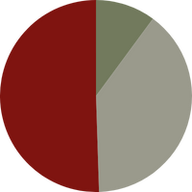
HIRING MILITARY
Single
(with no
Dependents)
10%
Average Degree
8%
Married
51%
Children
39%
Associates
15%
Bachelors
8%
Masters or Higher
VA (2017); DOD (2021)
Notes:
https://www.governing.com/now/2021-military-active-duty-personnel-civilians-by-state
https://www.va.gov/vetdata/docs/SpecialReports/State_Summaries_Kentucky.pdf

Slide 5
BENEFITS TO HIRING A SERVICE MEMBER
Skilled Workforce
Efficient
Committed
Military Culture
& Discipline
Federal Tax Credit

Slide 6
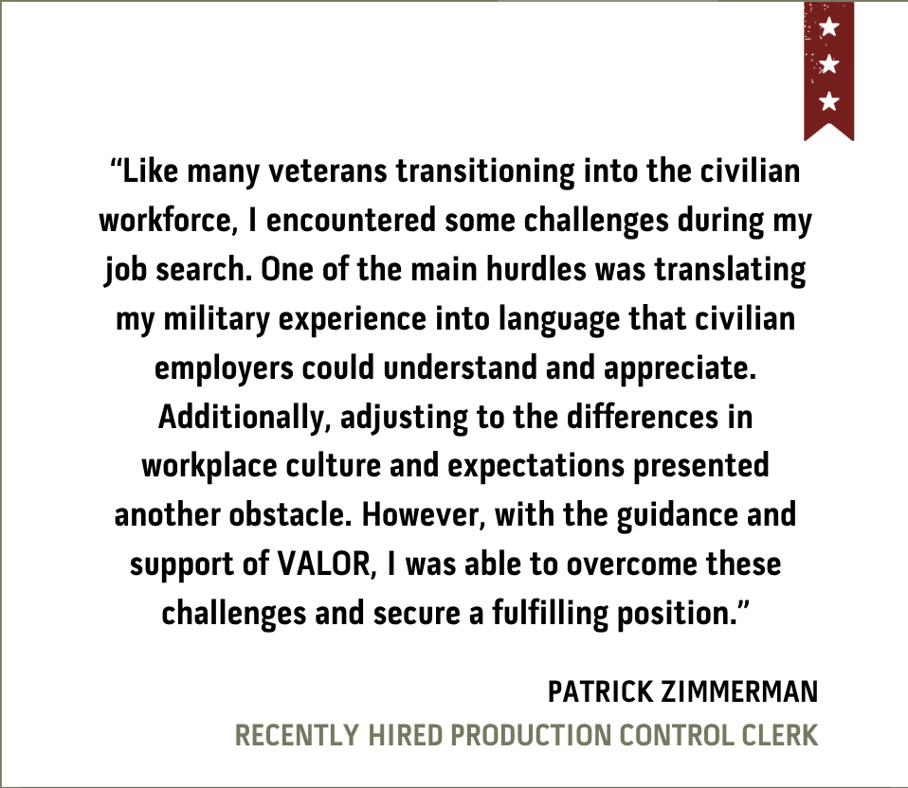
WORKFORCE DISCONNECTS
Translating Military Skills to Civilian Experience
Interpreting JSTs/DD214s
Understanding Military-Specific Challenges
Transition Timelines
Post-Service Career Guidance
Spouses and Families Move Frequently
Finding Veteran Talent

Slide 7
VETERANS ACCELERATED LICENSURE OCCUPATIONAL RECRUITMENT
Kentucky Workforce
Veterans & Families
Assess KY workforce needs
Engage with employers
Provide Kentucky employers access to nationwide talent
Sell KY as “home” for vets & their families, nationwide
Case mgt. for post-service careers
Assist with accelerated pathways & civilian occupational licensure
Grow Kentucky’s workforce
with veteran talent

Slide 8
DEVELOP WORKFORCE PARTNERSHIPS
Key Communicators & Government Groups
Employer Partnerships
Total to date: 260
Total to date: 115
Institutes of Higher Education
Total to date: 5

Slide 9
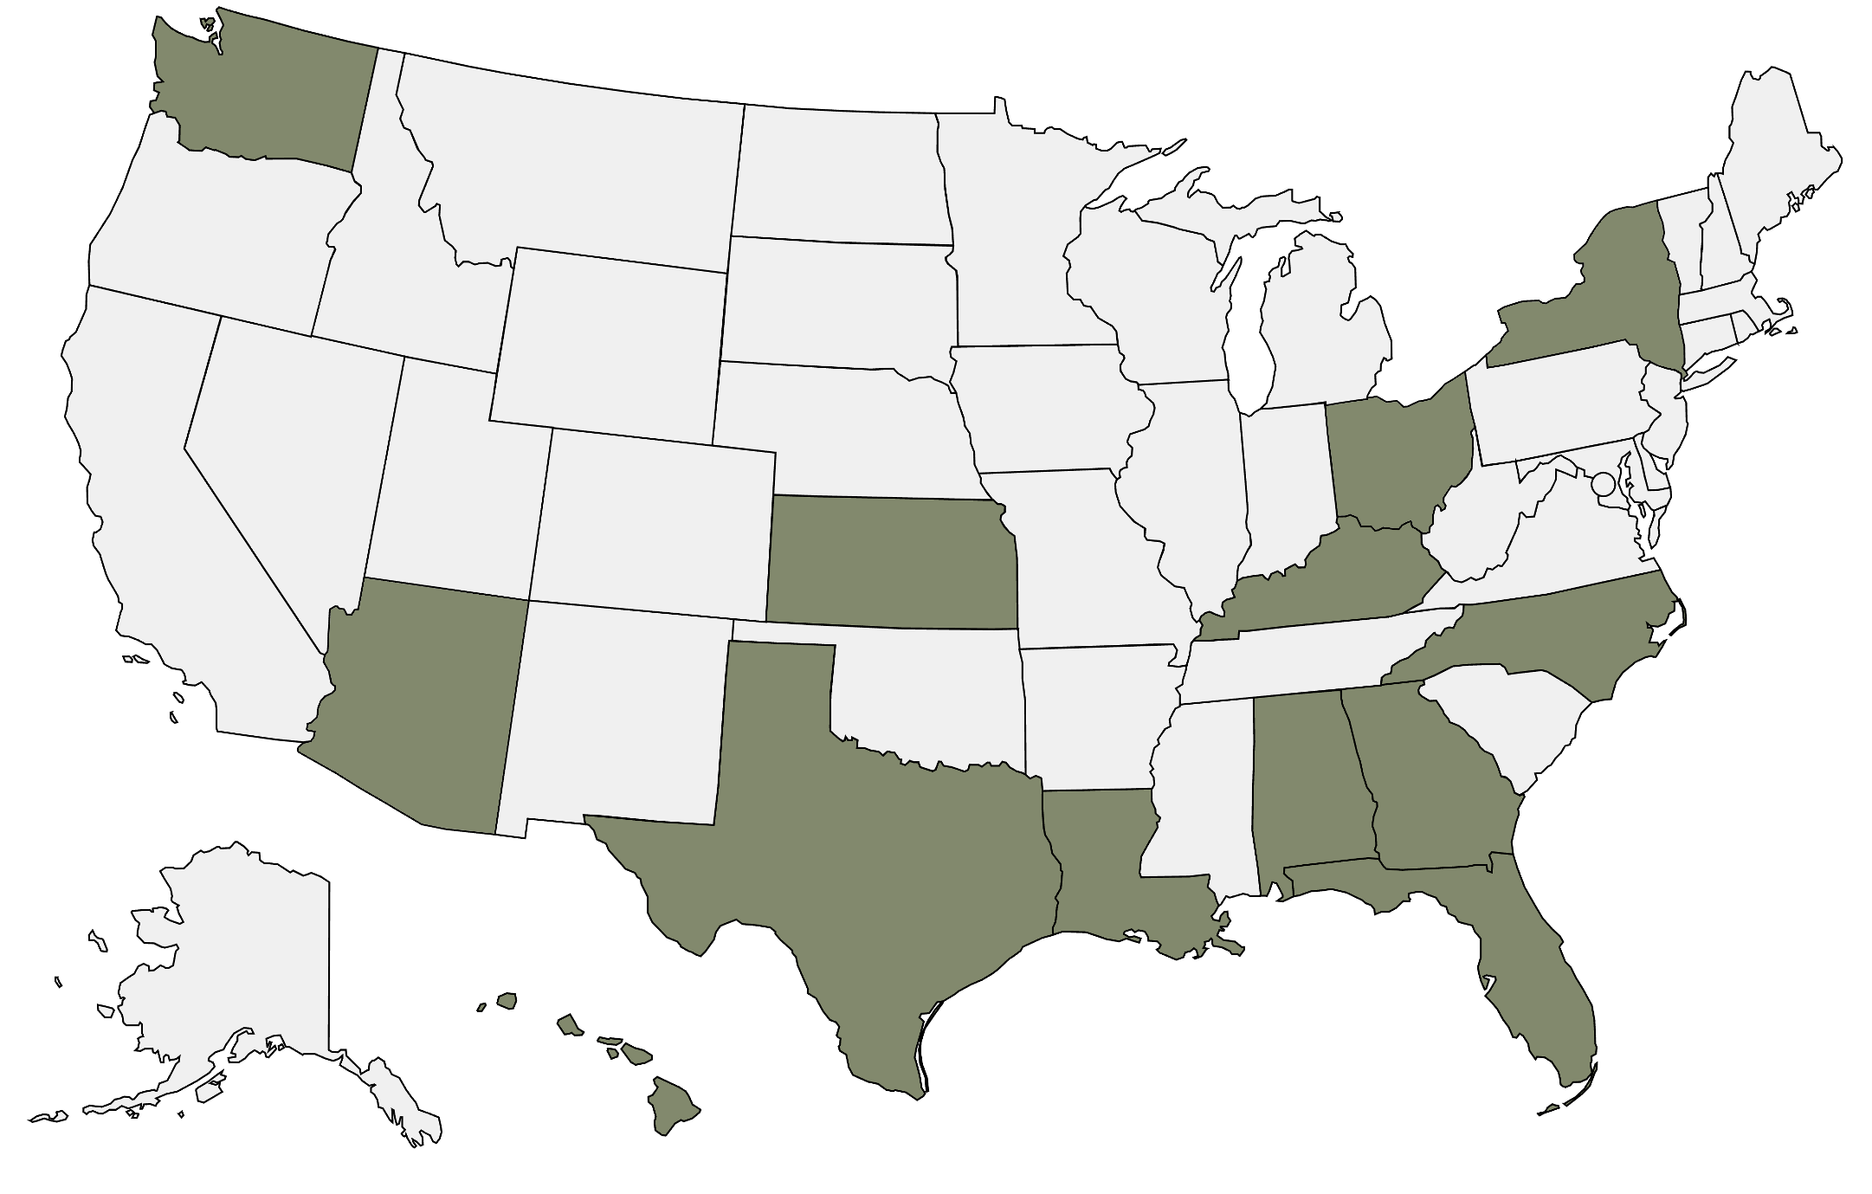
MILITARY BASE VISITS
Consistent expansion of military base visits
Fort Campbell*
Fort Knox*
KY National Guard
KY Bluegrass Army Depot
Fort Sam Houston
Fort Bliss
Fort Cavazos
Joint Base Lewis McCord
Fort Gordon
Fort Liberty
Fort Polk
Fort Novosel
Fort Leavenworth
MacDill AFB
Dyess AFB
Eglin AFB
Joint Base Pearl Harbor
Schofield Barracks
Marine Corp @ Kaneohe Bay
Fort Eisenhower
Camp Lejeune
Wright Patterson AFB
Fort Huachuca
Davis Monthan AFB
Luke AFB
Overseas Bases:
Mildenhall AFB: England
Ramstein AFB: Germany
USAG Stuttgart: Germany
USAG Bavaria: Germany
USAG Vicenza: Italy

Slide 10
LICENSED PATHWAYS
First Responders
EMT/A-EMT
Paramedic
Firefighter
Education
Teacher K-12
Teacher Higher Ed/Career & Technical
Child Development Associate (CDA)
Medical
Nurse (2)
Phlebotomy
Medical Imaging
Respiratory Therapist
Social Work (3)
Counseling
Psychology
Dental Hygienist
Physician Assistant
Veterinarian
Skilled Trades
HVAC (2)
Plumbing
Electrical
Welding
Diesel Mechanic
Industrial Maintenance
Building Inspector (7)
Home Inspector
Electrical Inspector (2)
Pathways: 44
Licensed Occupations: 55
Business
Project Management (PMP)
Certified Associate in Project Management (CAPM)
Certified Business Analysis Professional (CBAP)
Aerospace and Transportation
Aircraft Mechanic
Air Traffic Controller
Aircraft Pilot
Truck Driver (CDL)
Merchant Mariner
Military Occupational Codes: 180+

Slide 11
FACTS & FIGURES
1,000+ service/ family members in our pipeline
35% of our pipeline are in their 6-month transition period -- active job searches.
Additional 26% in interview processes are spouses
81% of our 2023 CM found a job in Kentucky
Average Salary: $58K
98% of our placements are still employed
Help match folks to ALL regions of Kentucky

Slide 12
CONNECT WITH US!
KY VALOR Executive Director
Molly Bode CSW, MSW mbode@kstc.com
an initiative of

Slide 13
SOURCES
https://www.gao.gov/products/gao-19-438r#:~:text=About%20200%2C000%20servicemembers%20transition%20to,apply%20to%20a%20civilian%20job.
https://www.statista.com/statistics/250329/number-of-us-veterans-by-state/
https://usafacts.org/topics/veterans/
https://hiring.monster.com/resources/blog/the-roi-of-veteran-hiring-how-investing-in-veterans-pays-off/
https://www.ncbi.nlm.nih.gov/books/NBK547615/#:~:text=Overall%2C%20about%2050%20percent%20of,and%2039%20percent%20have%20children.
https://www.shrm.org/topics-tools/news/inclusion-equity-diversity/embracing-value-veterans-workforce

