Slide 1
Live in Lou!
Christine Tarquinio
VP, Talent, Workforce & Brand Strategies
Greater Louisville Inc.

Slide 2
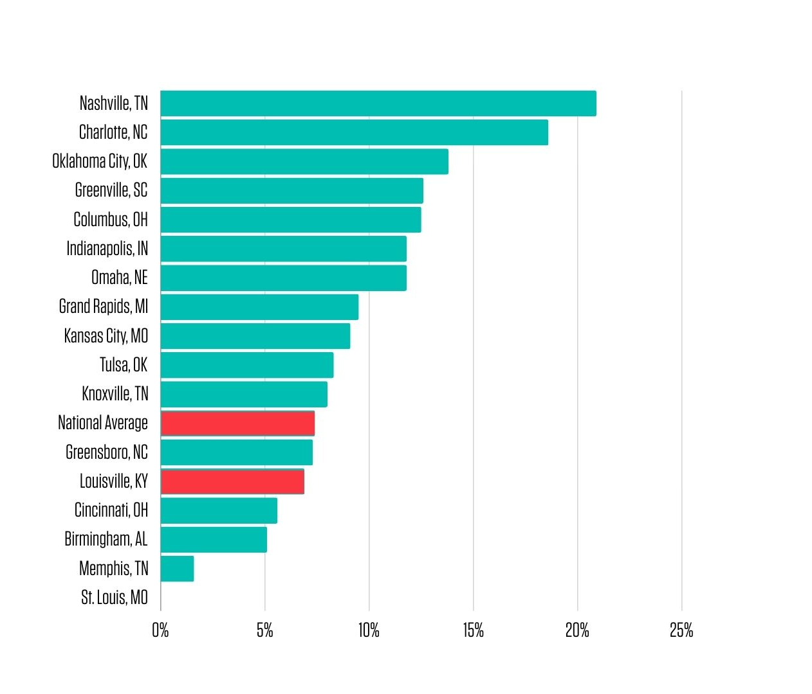
We Need Talent

Slide 3
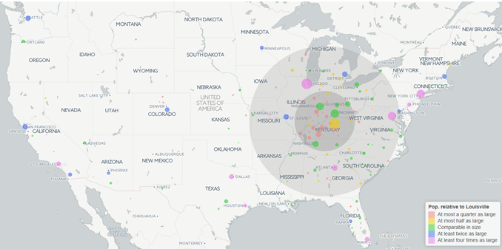
Talent is Close

Slide 4
Motivators for Moving
A25-34
A35-54
Availability of good jobs and business opportunities
Ability to make a difference
Abundant recreational opportunities
Suitability for raising children
Availability of desirable housing
Suitability for raising children
Strength of schools and recreational opportunities
Availability of good jobs and business opportunities
Reasonableness of commuting times
Ability to make a difference

Slide 5
Talent Outreach Strategy
Brand development, website and social media
Outreach to employers / HR / recruiters
Collection of workforce and relocation resources
City Champs brand ambassadors
Targeted university outreach
Extending the talent pipeline with the Academies of Louisville
Targeted talent attraction campaigns

Slide 6
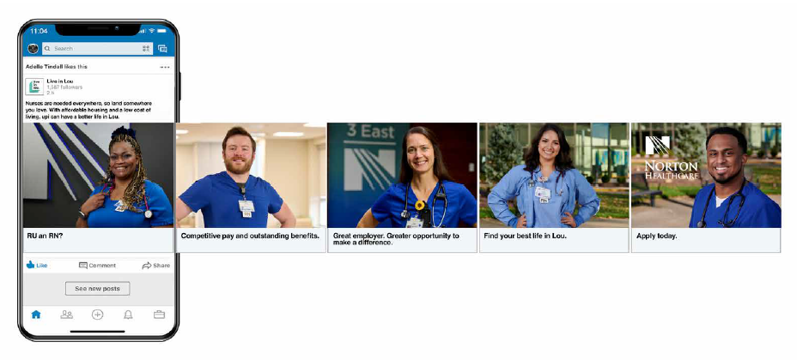
Talent Attraction Campaigns
Overall Campaign Results:
Total Campaign Impressions: 1,217,202
Total Clicks: 22,980
Campaign Click Thru Rate (CTR): 1.89%
Total Pageviews: 27,373
Unique Users: 25,574
Total Conversions: 836
Total Budget: $50,000
Campaign Cost per Click (CPC): $2.18
Campaign Cost per Conversion (CPCon): $59.81

Slide 7
Talent Attraction Campaigns
Overall Campaign Results:
Total Campaign Impressions: 2,682,999
Total Clicks: 50,919
Campaign Click Thru Rate (CTR): 1.90%
Total Pageviews: 20,991
Unique Users: 18,982
Total Conversions: 389
Total Budget: $55,000
Campaign Cost per Click (CPC): $1.08
Campaign Cost per Conversion (CPCon): $141.39

Slide 8
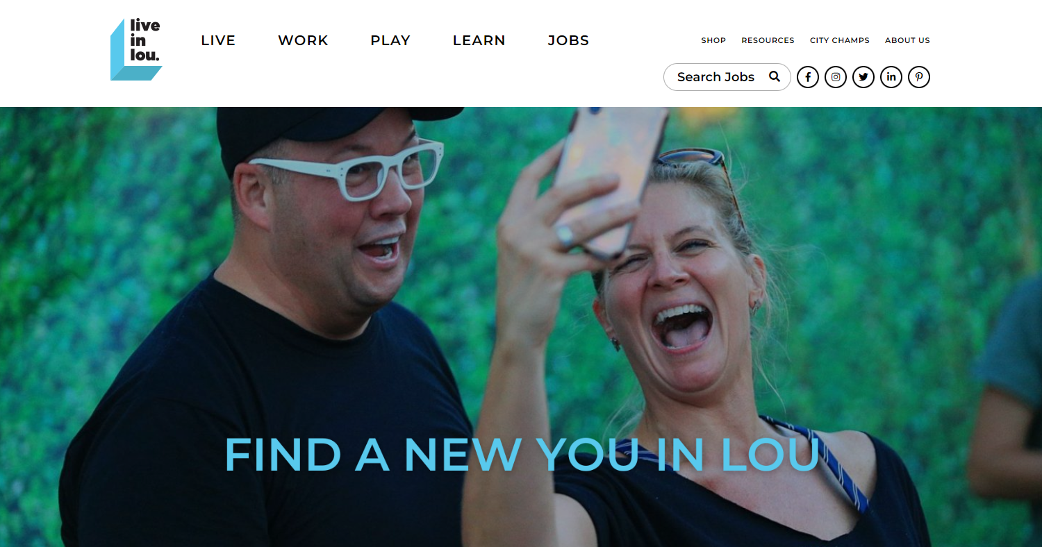
Live in Lou
Home base for living, working, and playing in the region
Region’s largest local only job board
LiveinLou.com/jobs
Neighborhoods, schools, educational institutions, workforce resources, things to do, and more

Slide 9
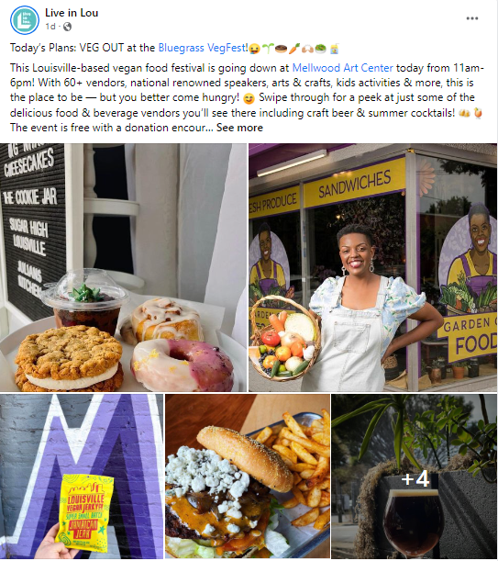
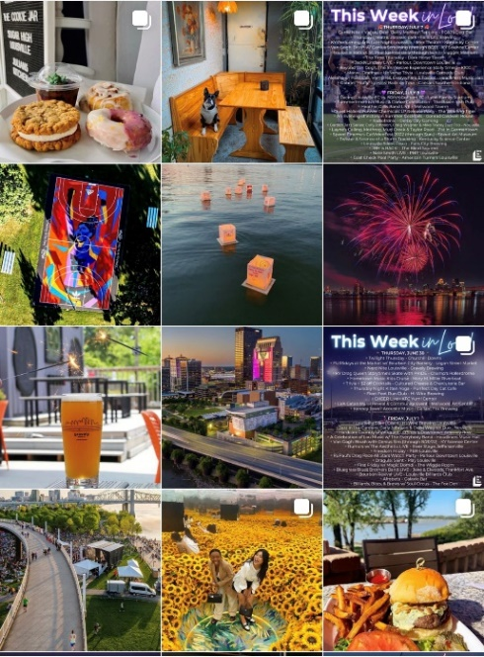
@liveinlou
21,000+ Facebook
38,600+ Instagram
3,100+ LinkedIn
69,000+ Total Followers
Jan-Dec 2021: +10,566
Jan-Dec 2022: +14,929
Jan-Dec 2023: +13,312
Jan-Sept 2024: +9,014

Slide 10
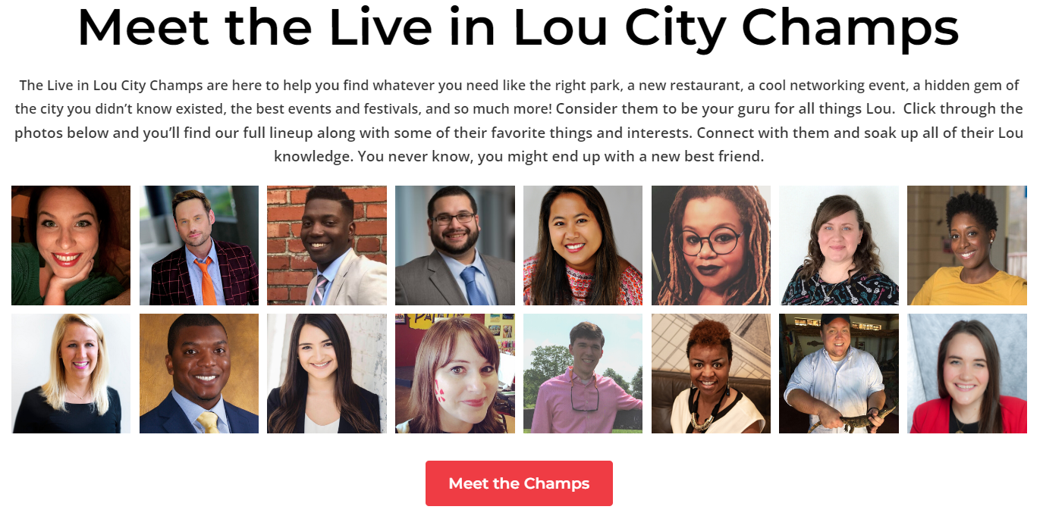
City Champs
More than 160 trained City Champs!

Slide 11
Workforce Ecosystem Hub
Resources for Employers and Job Seekers
Training and workforce support
Startups and small business resources
Apprenticeships
Community organizations
Higher education
Refugee assistance
Chambers of commerce
Community assistance
Financial support for training

Slide 12
Finding You, In Lou
Professional and leadership development program for college students
Leadership skills
Networking & connections
Personal branding
Showcase of Louisville
Content includes
Building your network and making connections
Listening, learning and leading
Build you brand and sell yourself
What’s next for you in Lou
Presented by the University of Louisville

Slide 13
Questions?
Thank you!

