Slide 1
Regional Competitiveness Plan
Greater LEX Talent Campaign
Notes:
I’m Andi Johnson, the Chief Policy Officer and Director of Regional Engagement for Commerce Lexington. I’m joined by my colleagues, Betsy Dexter, who is leading our talent/workforce efforts, and Anthony Allen, VP for Public Policy.
We’re here today to share about the Greater Lex Regional Competitiveness Plan, and specifically the Greater Lex Talent Attraction campaign.
Our goal is to share a best practice in the “process” of creating workforce attraction strategy to meet business needs and grow the regional economy.
So that… the state may consider a similar process to developing its own talent attraction marketing strategy that could elevate every region of Kentucky.

Slide 2
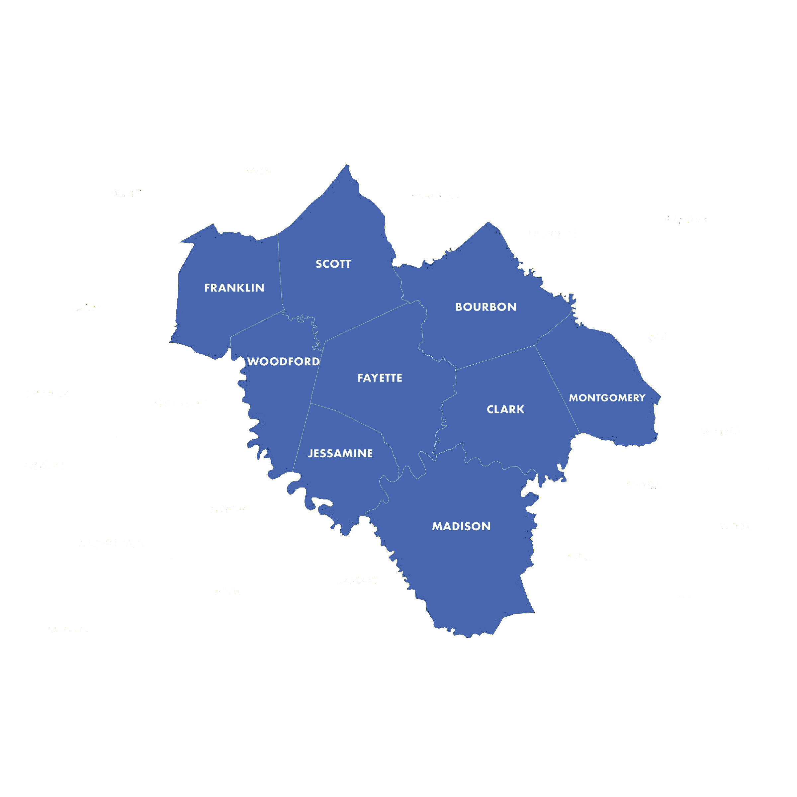
HISTORY & cONTEXT
For many years, Commerce Lexington has partnered with leaders in the region on collaborative efforts and programs.
^{Job Recruitment}
^{Public Policy}
^{Leadership Development}
Notes:
As brief background… for many years, Commerce Lexington has worked in a 9-county region in Central Kentucky for job recruitment and retention activities and public policy and leadership development.
Our economic development professionals have worked together for a long time to market the region so that we can compete against much larger metros (workforce, job sites, housing, etc). Our tourism professionals have also worked together to market the region to visitors.

Slide 3
COLLABORATION Process
Ted Abernathy, Economic Leadership LLC
Development Counsellors International (DCI)
45+ Regional Leader Advisory Group
Business, Higher Education, Local Government, Economic Development
Notes:
Given the rapidly changing economic landscape post pandemic, Commerce Lexington, along with regional leaders, recognized the need to reposition ourselves and be more intentional in our collaborative efforts to attract jobs and people to the region.
In 2021, a Regional Advisory Committee was formed consisting of 45 regional leaders who represented the 9-counties and consisted of leaders in business, economic development, government and education.
We engaged with two of the nation’s top economic and workforce development strategy experts – Ted Abernathy with Economic Leadership and Development Counsellors International. Both experts helped us evaluate economic trends, our regional economy, workforce strategies and provided guidance on next steps we could take to take to make our region more competitive.

Slide 4
A STRATEGY Rooted in COLLBORATION & RESEARCH
150+
9
6
REGIONAL LEADERS
Regional Stakeholder meetings
leadership advisory meetings
2
1,700
3
2
Perception surveys
Survey respondents
Focus groups
Stakeholder workshops
Notes:
We also engaged with internal stakeholders as we worked on a strategy, hosting numerous briefings with key leaders in every community.
We wanted to make sure the process was rooted in collaboration and research.

Slide 5
Competitor Metros
 |  | Cost and
 |  | Business
 | Momentum | Climate | Future | Talent | Quality of | Total | Overall
MSA | Index | Index | Index | Index | Place | Score | Rank
Nashville, TN | 1 | 1T | 1 | 1 | 1 | 5 | 1
Knoxville, TN | 3 | 1T | 3 | 3T | 5T | 15 | 2
Indianapolis, IN | 2 | 4T | 2 | 6 | 8T | 22 | 3
Cincinnati, OH | 5 | 8 | 5T | 5 | 3T | 26 | 4
Columbus, OH | 7 | 9T | 7 | 2 | 3T | 28 | 5
Richmond, VA | 4 | 7 | 8 | 3T | 8T | 30 | 6
Greenville, SC | 6 | 9T | 4 | 7T | 5T | 31 | 7
Lexington, KY | 11T | 6 | 9 | 7T | 2 | 35 | 8
Louisville, KY | 9 | 3 | 5T | 9 | 10T | 36 | 9
Greensboro, NC | 10 | 4T | 10 | 11T | 7 | 42 | 10
Virginia Beach, VA | 8 | 9T | 12 | 11T | 10T | 50 | 11
St. Louis, MO | 11T | 13 | 11 | 10 | 12T | 57 | 12
Huntington, WV | 13 | 12 | 13 | 13 | 12T | 63 | 13
COMPETITOR METROS
Source: EL Metro Indexes March 2022
Notes:
We analyzed how our region ranked against some of our competitors cities or cities of a similar size based on competitiveness indexes.
Our key takeaways were threefold.
We are in the middle of the pack. Status quo.
We have a quality of life/place strengths that needs to be leveraged.
We needed to address our momentum challenge.
Our momentum as a region was slowing. Our growth was slowing. We were below the national average in job creation, wages, GDP, workforce growth.
We were also not increasing our retentin/attraction of young professionals – which was surprising given we have 10 colleges and universities in the region, and 20k graduates coming out per year.

Slide 6
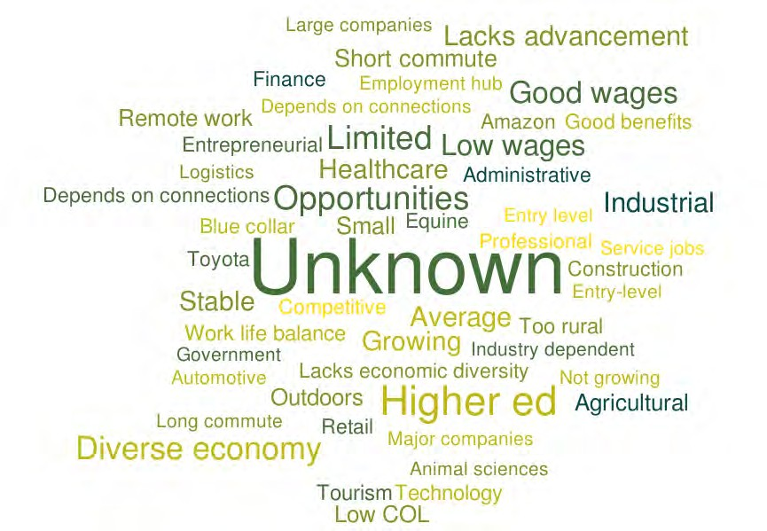
Top Associations with the Region as a Place to Work
Notes:
We also surveyed 1,700 young professionals in target external markets where we knew workers were migrating to from Lexington. These markets are: Cincy, Indy, Nashville and Chicago.
What we found is that the Lexington region is unknown. People don’t know who we are and what opportunities exist in the region as a place to live or work.

Slide 7
Regional assessment
challenges
strengths
Lack of build ready land for development projects
^{Housing availability}
^{Lack of skilled labor}
^{High development costs}
Relatively unknown to external audiences
Marketing investment to people and businesses
^{Access to healthcare}
^{Location and accessibility}
^{Public Safety}
Public schools & higher education
^{Cost of living}
^{Quality of life}
Notes:
Regional leaders further evaluated challenges and strengths compared to competitors.
We also found that were not investing in marketing to businesses and workforce at the same rate as competitor cites or regions.

Slide 8
Regional competitiveness plan MEASURABLE goals
#1
Increase regional jobs, wages & GDP growth rates to the national average.
#2
Increase the regional labor force including the attraction and retention of young professionals.
Attract state and federal funding and advocate for policy improvements to support the plan.
#3
Notes:
Regional leaders agreed to three overarching goals for the Regional Competitiveness Plan. With regard to talent,
Increasing our regional labor force, specifically young professionals in the 25-55 range.
Data showed we were only growing the workforce at 600+ people per year.
The goal is to double that number - 1,500 people per year.

Slide 9
7 action items
Create a regional brand identity
Increase investment in site selector awareness of regional assets and support multi-jurisdictional product development strategy
Provide economic development education to key leaders in the region
Develop a regional talent recruitment/attraction marketing campaign
Develop a strategy to connect businesses with students
Coordinate advocacy for federal and state infrastructure, product development, talent marketing funding.
Advocate for improved polices related to key competitiveness issues
Determined by regional leaders
Notes:
Regional leaders committed to executing and properly resources 7 specific action items.
These action items were selected because they are mutually beneficial to all communities (wins for everyone),
The focus of today’s presentation is #4 – developing a talent recruitment/attraction marketing campaign.

Slide 10
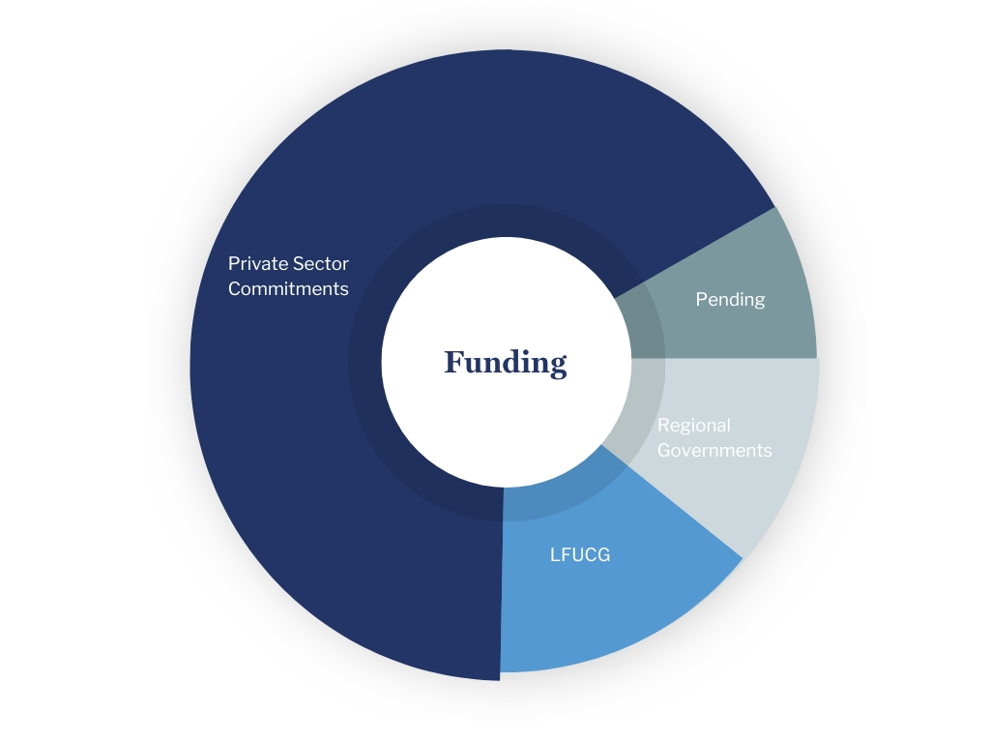
Funding Breakdown
Commitments
Private sector (business) | $1,000,000
City of Lexington | $322,000
Regional Governments | $275,000
Total | $1,597,000​
Pending
Regional Governments | $50,000
Notes:
This is a $1.6M strategy supported by 2 to 1 - business to government.
We’ve raised over $1M in annual investment from business. This is a five-year commitment.
Our regional government partners have invested nearly $600,000 annually. This is based on a $1 per capita model.

Slide 11
Funding Breakdown
Commitments
Regional Governments:
^{City of Lexington}
^{City of Berea}
^{Madison Fiscal Court}
^{City of Richmond}
^{Scott County Fiscal Court}
^{City of Georgetown}
^{City of Versailles}
^{City of Midway}
^{Woodford County Fiscal Court}
^{Bourbon Fiscal Court}
^{City of Nicholasville}
^{City of Frankfort}
^{Jessamine County Fiscal Court}
Franklin County Fiscal Court (pending)
^{City of Winchester (pending)}
Private sector (business) | $1,000,000
City of Lexington | $322,000
Regional Governments | $275,000
Total | $1,597,000​
Pending
Regional Governments | $50,000

Slide 12
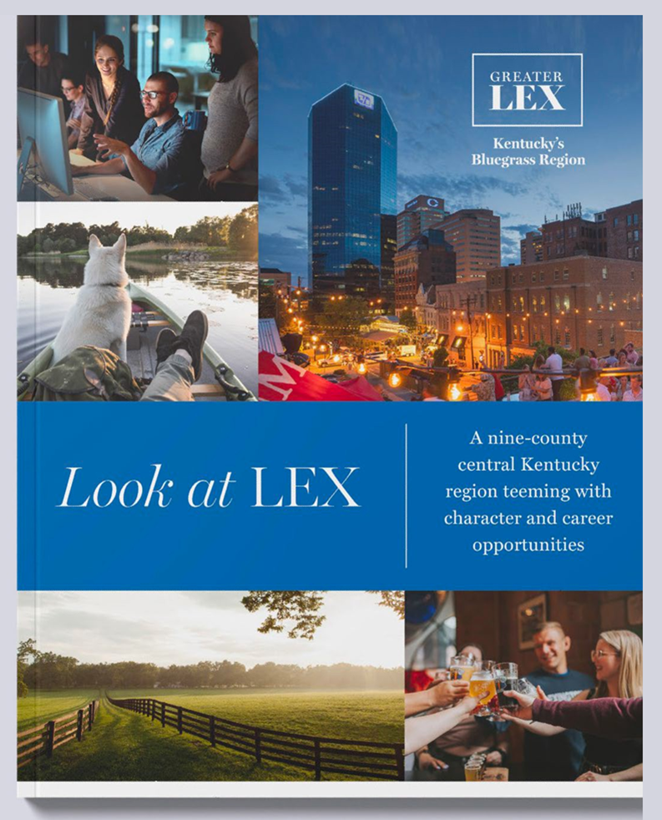
Talent Attraction Marketing Strategy Process Overview
Develop a clear, multi-faceted marketing strategy, timeline, budget and execution plan.
Create a regional brand identity
Develop a talent attraction website
Launch talent social media and digital marketing to target audiences
Develop data analytics and reporting
Notes:
Let’s talk about the Greater Lex talent attraction strategy and the process we’ve followed to get this action item off the ground.
It was intentional. It was collaborative. It represents all 9-counties both urban and rural strengths.
We worked with DCI to develop a clear, multi-faceted marketing blueprint.
The formula is simple. We worked with DCI to develop a marketing plan that leveraged our job and quality of life strengths. This included key messages that we knew were going to resonate with external audiences, tactics. We needed a regional brand entity, a website to serve a digital entry point, and social/digital media (Facebook, LinkedIn, Instrgram).
That is the most efficient way to target workers. And, we also developed a clear timeline and budget for execution with ROI measurables.

Slide 13
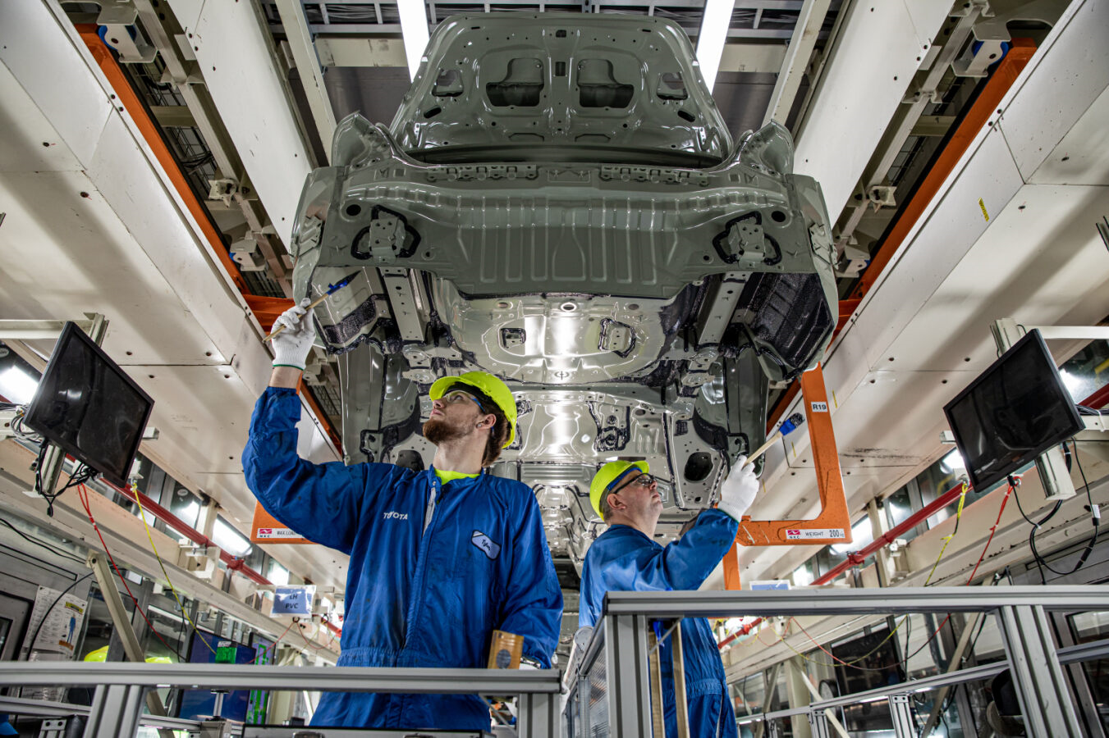
Key Industry Targets
Advanced Manufacturing
Healthcare
Life & Bio Sciences
Software, IT, Ag Technology
Business & Professional Services
Logistics
Global Headquarters
Notes:
While we need workers across all trades, Greater Lex has a growing demand for skilled workers in targeted sectors for economic growth.
The sectors we’re focusing for worker attraction include advanced manufacturing, healthcare and life sciences, technology – software and IT, ag/bio tech, business and professional services and distribution/logistics.

Slide 14
Key Quality of Place Messages for External Audiences
Job Opportunities
Education & Training
Outdoor, Entertainment, Culinary
Cost of Living
Healthcare
Central Location
Notes:
We are focusing on delivering content the data showed us that people care about when deciding whether to relocate.
Job Opportunities: Jobs search board and profile key industries and employers in the region
Education & Training: Greater LEX is home to 10 colleges and universities and numerous top public and private schools.
Quality of Life: Bourbon, craft beer, outdoors, horse racing college sports, Red River Gorge, culinary scene
Cost of Living: Cost of living calculator to compare the region to other cities.
Access to worldclass healthcare
Central location being 75 miles from Cincy and Louisville, small town and urban amenities. Easy access to three airports and 100 direct flights.

Slide 15
Target External Audiences
Greater LEX Alumni
Graduates of the region’s colleges and universities living outside the state
Working age (22-55+) with skill sets in alignment with open jobs/key sectors
Recent/Prospective Tourists
Planning a visit or recently visited regional tourism sites.
Demographics fit skilled workforce needs
Notes:
With limited resources, we decided to focus the first phase on “warm audiences.” These are people who have already experienced the region and likely have a positive impression.

Slide 16
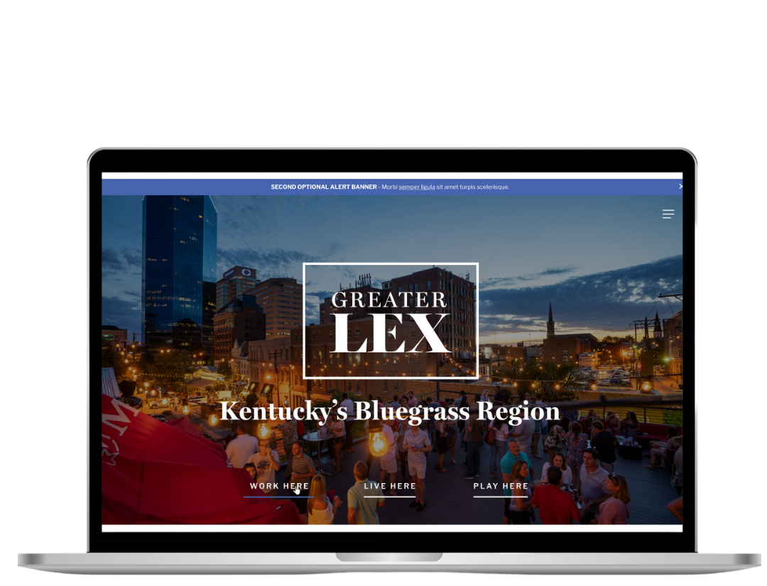
New Talent Attraction Website lookatLEX.com
Notes:
Creating the regional brand and the website were the first two deliverables. Commerce Lexington worked with DCI and our regional tourism and economic development partners on new live work play website where all the resources important to people are housed in one location.
This development process started in January and we launched it live Sept. 1.
This is our digital entry point (front door) to the region.
This site is very robust. It has 30 pages of information. It is resource for anything you’d want to know about living, working or playing the region.

Slide 17
Notes:
We are also working with a local marketing firm in Lexington – Kismet Marketing. It is hard to show a website.
This is a snapshot of the website’s key highlights. It does a much better giving you a feel for the campaign.

Slide 18
Measuring Success
Website Visits
Impressions & Engagements
Reach
Followers
Video Views
Top Performing Posts
Overall Goal:
1,500 professionals/workers annually
Increase regional labor force to national average
Notes:
We will be closely watching the data/analytics, and can adjust as needed to make sure we’re reaching the right people.
But, marketing is a long-game. And, each year we are going to be looking at the workforce data to see if we’re moving the needle.

Slide 19
why TALENT ATTRACTION MARKETING ?
WE NEED TO ATTRACT SKILLED WORKERS TO GROW THE ECONOMY.
Notes:
We believe “talent attraction marketing” is an important economic development tool that Kentucky needs to add to its competitiveness strategy – in order to help businesses find skilled workers.
We don’t have enough have people to fill jobs. This is short term and a long-term game.
We’re already market KY to businesses through the Cabinet for Ec Deve. and to visitors through the Toursim Cabinet. We need to take the next steps and align those messages with a marketing campaign to workers – like Michigan.
Greater Lex story is the Kentucky story. We represent both urban and rural communities in the 9-county. We are committed to making sure every community is represented in the marketing.
We have to tell our story. We know we’re unknown based on the data. We’re better together.
We are recommending the state follow a similar process of doing the research, developing intentional marketing plan – and collaborating with stakeholders across the Commonwealth through that process. Then, let’s decide who we want to talk to, how we wanted want to do it and then invest in that strategy.
If we don’t tell our story, no one else is going to do. We have to get in the people attraction game.

