Slide 1
The Value Proposition of Attracting more Military Retirees
Presented to the Special Committee
Workforce Attraction & Retention Task Force
November 14, 2024
Rep. Shawn McPherson – District 22 State representative
Jon Sowards – President / CEO, South Central Kentucky Workforce Board
Carter Hendricks – Executive Director, Southwest Kentucky EDC
Taylor Hayes- President / CEO,
Christian County Chamber of Commerce

Slide 2
Attracting more Military Retirees and veterans to live and work in the state provides an unfilled potential benefiting Kentucky’s workforce and the Economy …
State of Workforce Perspective
The Value Proposition for attracting Military Retirees
Declining military retiree / veteran population and importance of mitigating the decline
The next logical step

Slide 3
The State of Workforce in South Central Kentucky
South Central Workforce Development Board covers the 10-county Barren River area
The region has experience 10 years of sustained growth
Job Postings last 30 days: 12,100
General Workforce System Challenges:
Employers want people pre-loaded with skills and qualifications… and “3-5 years of experience”
Employers are using Applicant Tracking Systems to narrow down the most qualified candidates
Applying for a job online requires tremendous digital literacy and patience, even for manual labor roles
Military Veterans, New Americans, individuals with disabilities and the justice-involved are LARGE demographic groups that difficulty entering the workforce
Regional Workforce Challenges:
Regional Labor Force Participation Rate is 60.55%
SCWDB anticipates Zero Net Gain in workforce the next five years
Bottomline:
Our labor market will continue to tighten
We need every available resident that can work, to work
We need to attract talent to Kentucky!
Great reference regarding current state of the workforce:
https://lightcast.io/resources/research/the-rising-storm
Notes:
military often experience a profound sense of purpose and belonging
they often seek employers that provide a similar sense of fulfillment and camaraderie. Once they have found an employer that aligns with their values and provides a supportive work environment, they are committed to staying with that employer for the long term
“Companies investing in mentorship programs and professional development opportunities for veterans will likely witness improved employee retention as veterans find a sense of belonging and growth within the organization.”
military spouses can also embody a similar level of dedication to their employers

Slide 4
The Value Proposition for attracting Military Retirees to the Commonwealth of Kentucky
Workforce. In a tightening and turbulent labor market, Military Retirees…
can put effective Veteran hiring and onboarding programs in place
are imbued with strong leadership, planning and problem-solving skills to help navigate change
are very effective in mentorship and training roles
“Brain Gain” – a high percentage of retirees have some college, if not a bachelor’s degree or higher.
Spending power. Military retirees, especially those that enter the civilian workforce, often have tremendous spending power / disposable income.
GI Bill benefits for self or family members. This benefit is worth TENS OF THOUSANDS of dollars to our post-secondary institutions and surrounding communities
Professional Network. Military retirees will have a broad network of professional contacts across numerous industries that if leveraged, can bring additional people, programs or resources to the state
Community contributors. Military retirees serve their communities – donating their time, money or resources to Veteran Serving Organizations, non-profit organizations, schools, churches, museums and other causes
Notes:
military often experience a profound sense of purpose and belonging
they often seek employers that provide a similar sense of fulfillment and camaraderie. Once they have found an employer that aligns with their values and provides a supportive work environment, they are committed to staying with that employer for the long term
“Companies investing in mentorship programs and professional development opportunities for veterans will likely witness improved employee retention as veterans find a sense of belonging and growth within the organization.”
military spouses can also embody a similar level of dedication to their employers

Slide 5
Declining veteran population means declining revenue
As of Jan 31, 2023, Kentucky has 29,037 military retirees and 230K veterans.
77,064 KY Veterans are receiving VA disability compensation.
There has been a 26% decrease in veteran population between 2012 (315.5K) and 2022 (233.4K) according to the census bureau.
40% of Kentucky Veterans are Vietnam veterans.
In Fiscal year 2023, Compensation and Pension benefits brought in near $2 billion dollars annually to the state of Kentucky. This is non-taxable federal revenue spent by veterans and their families.
9,493 education beneficiaries. Student veterans and dependents using the G.I. Bill attend Kentucky Colleges and Universities and this along with other veteran-related educational programs generated over $120 million in revenue for Kentucky in fiscal year 2023.
Military retirees, veterans and families are an economic generating force.

Slide 6
Mitigating the decline in the military retiree / veteran population will play a huge role on the economy and in filling the workforce needs
A REAL EXAMPLE ECONOMIC / WORKFORCE IMPACT:
An Army CSM retired after 32 years at the rank of E9. He was not originally from Kentucky, but his last station was at Fort Knox.
He brought his wife and two sons, purchased a $293k home, procured employment starting at $90k and continued to advance in a new career with pay raises. He has fully settled into his new home and community.
Both sons attended the University of Louisville and graduated. The eldest commissioned in the Army with intent to return to Kentucky after service. The youngest son, now 25, graduated with an engineering degree, was hired by Toyota in Georgetown making a decent wage and just bought his first home.
While an assumption, this is fairly similar of the 29k+ retirees identified last year in Kentucky.
However, with the decline in the veteran population through aging and other situations, we need to focus on what Kentucky can do to attract and keep retirees, veterans and their families here.

Slide 7
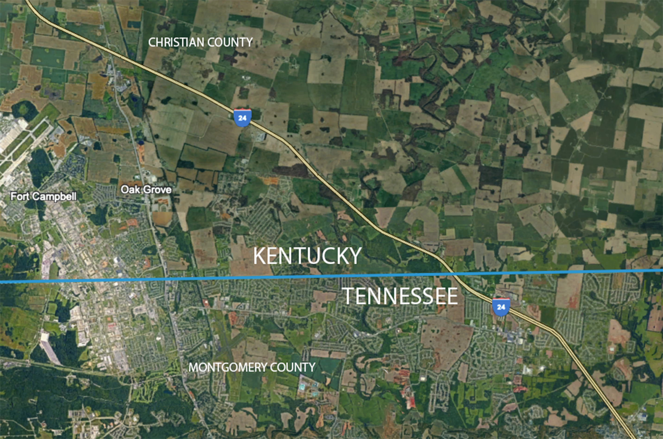
Since 2020 TN has grown 10 to 1 over KY
TN = 200K
KY = 20K

Slide 8
The next logical step …
The military retiree tax exemption issue is a military friendly measure as we have noted Kentucky’s poor ranking against other states and our declining retiree population.
Kentucky has a larger problem with the Commonwealth’s slow population growth failing to produce a large enough workforce to meet future needs.
Many believe the primary barrier to population growth has been the state’s income tax. We fully support the state’s plan to eliminate the state income tax for all resident
South Central and SWK are keenly aware of the income tax disadvantage as we’ve witnessed TN’s explosive growth. While KY has population pockets of growth, TN seems to be growing in every region, especially along the KY border. Clarksville has grown by 170,000 people since 1970.
State leadership has already done the smart thing exempting active-duty military and most military retiree pensions.

Slide 9
What we’re asking …
We’re asking you to take the next logical step by fully exempting military retiree pensions and taking another incremental step toward the full elimination of the state’s income tax.
Let’s set a ten-year goal…let’s make it easy for 10% of the annual military retirees to decide to come home to Kentucky and help build a better Bluegrass state…that’s 20,000 new retirees per year for the next ten years!
By doing so, you will continue to advance toward the shared goal of being the most military friendly state in the nation while unlocking the full potential of the experienced and skilled military retiree workforce.

Slide 10
Connect with us.
Jon Sowards
President / CEO
South Central Workforce Board
jon@southcentralworkforce.com
Carter Hendricks
Executive Director
Southwest KY EDC (SWK EDC)
chendricks@southwesternky.com
Taylor Hayes
President – Christian County Chamber
thayes@christiancountychamber.com

Slide 11
Additional information and resources in the following slides

Slide 12
To attract and retain more
from this population how does Kentucky be more competitive and move from being
Military/Veteran FRIENDLY to Military/Veteran READY?

Slide 13
How does Kentucky Become more attractive?
Reaching 0% income tax level is the primary key factor.
Allow 100% exemption on pension pay NOW vs. waiting
KY is one of only 11 states that tax some or all military pensions
Continue to create Interstate occupational licensure compacts
9 of 16 are already in place in KY
Continue to address the supply of quality Childcare
Childcare is the #1 barrier to spouse employment
Kentucky one of the first states receiving federal approval allowing DOD to up to $1500 per month
Review statutes involving property taxes on veterans
Notes:
military often experience a profound sense of purpose and belonging
they often seek employers that provide a similar sense of fulfillment and camaraderie. Once they have found an employer that aligns with their values and provides a supportive work environment, they are committed to staying with that employer for the long term
“Companies investing in mentorship programs and professional development opportunities for veterans will likely witness improved employee retention as veterans find a sense of belonging and growth within the organization.”
military spouses can also embody a similar level of dedication to their employers

Slide 14
Resources veteran statistics
USA Facts (veterans in Kentucky) link: Veterans in Kentucky: Statistics, rankings, and data trends on population, demographics, and more | USAFacts
Department of Veteran Affairs: Department of Veterans Affairs Open Data Portal
National Center for Veterans Analysis and Statics: Additional Sources of Information About Veterans - National Center for Veterans Analysis and Statistics
Great reference regarding current state of the workforce:
https://lightcast.io/resources/research/the-rising-storm

Slide 15
Resources for hiring veterans
KY Career Center Veteran Services link: https://kcc.ky.gov/veterans/Pages/default.aspx
KCC / DOL Military Spouse link: https://www.dol.gov/agencies/vets/veterans/military-spouses (Leads to this link: https://www.dol.gov/agencies/vets which leads to this link: https://www.dol.gov/agencies/vets/veterans/military-spouses -- information about licensure).
SHRM Veteran Hiring Factsheet: https://www.shrm.org/content/dam/en/shrm/foundation/inclusion-captains-veterans-vaw-overview-factsheet.pdf
Institute for Veterans and Military Families published a brief https://ivmf.syracuse.edu/wp-content/uploads/2016/06/The-Business-Case-for-Hiring-a-VeteranACC_2.21.18.pdf
Employer Guide to Hiring Veterans https://www.dol.gov/sites/dolgov/files/VETS/files/Employer-Guide-to-Hiring-Veterans2022.pdf
Blue Star Families – Military Family Life Survey https://bluestarfam.org/research/mfls-survey-release-2023/#reports
Kentucky Valor Program - https://kyvalor.com/
DOD Transition Assistance Program - https://www.dodtap.mil/dodtap/app/home

