Slide 1
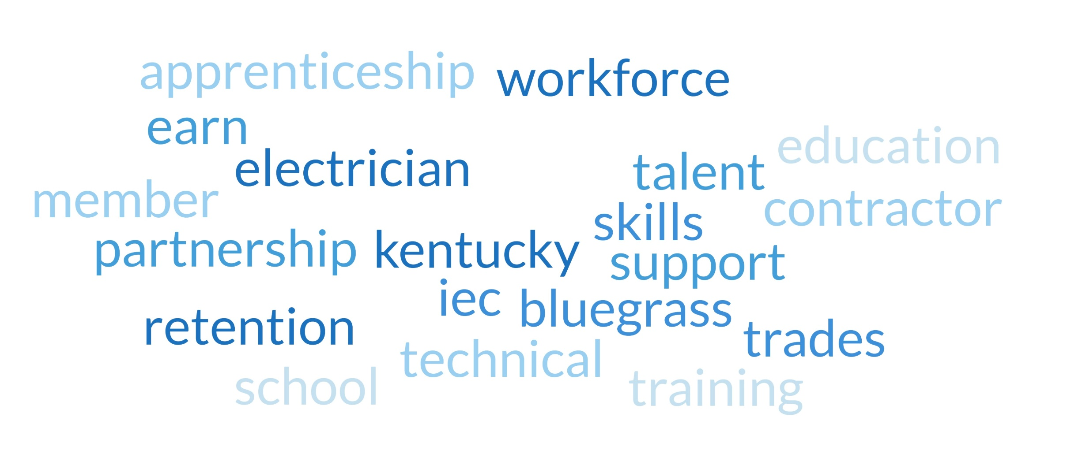

Slide 2
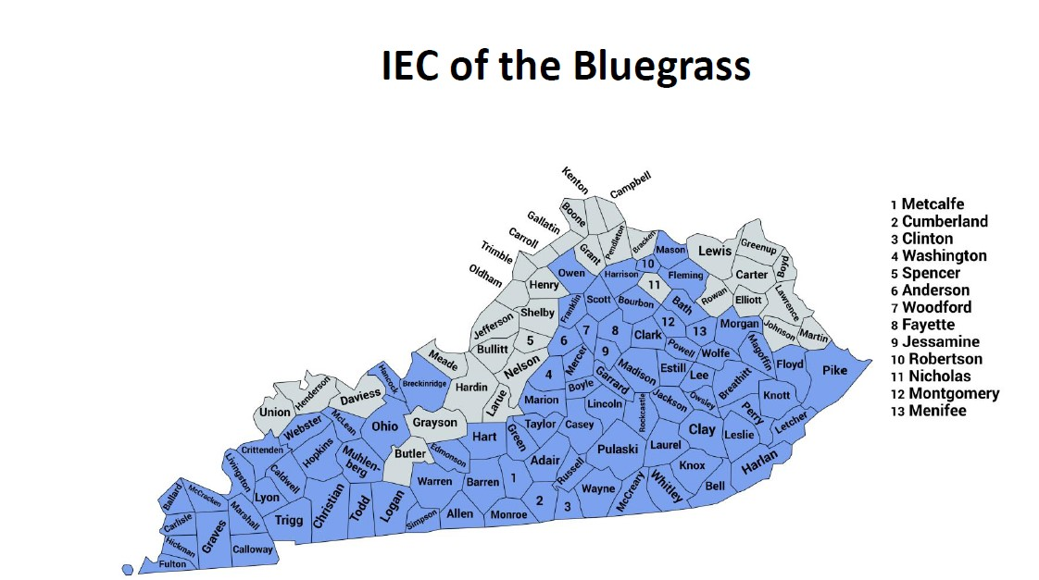
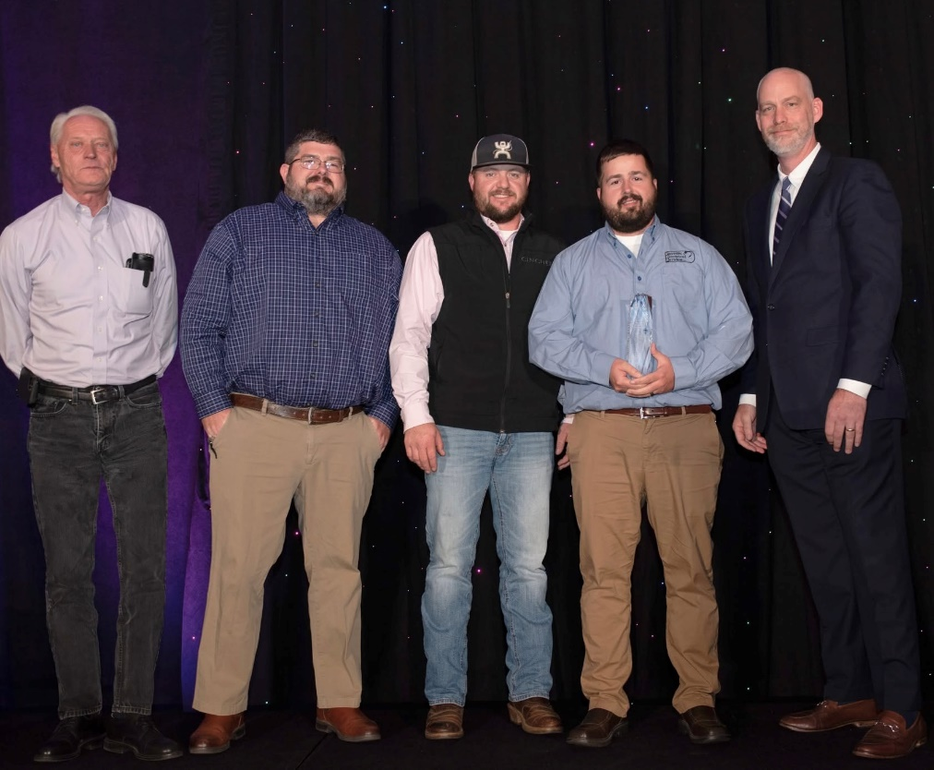
Who We Are
Non-profit trade association dedicated to independent electrical contractors
We represent 86 counties in Kentucky
32 Contractor Members that employ 700 field employees
18 Regional Associate Members, 100+ National Partners
4 year Apprenticeship Program
200+ enrolled apprentices

Slide 3
Our Commitment to Kentucky’s Workforce
Our Mission is to create a skilled, certified, and safe electrical workforce
Our Focus is workforce development, safety, skill-building and community impact
Align with Kentucky’s workforce development goals
Retention within the workplace
Growth within the Electrical Trades

Slide 4
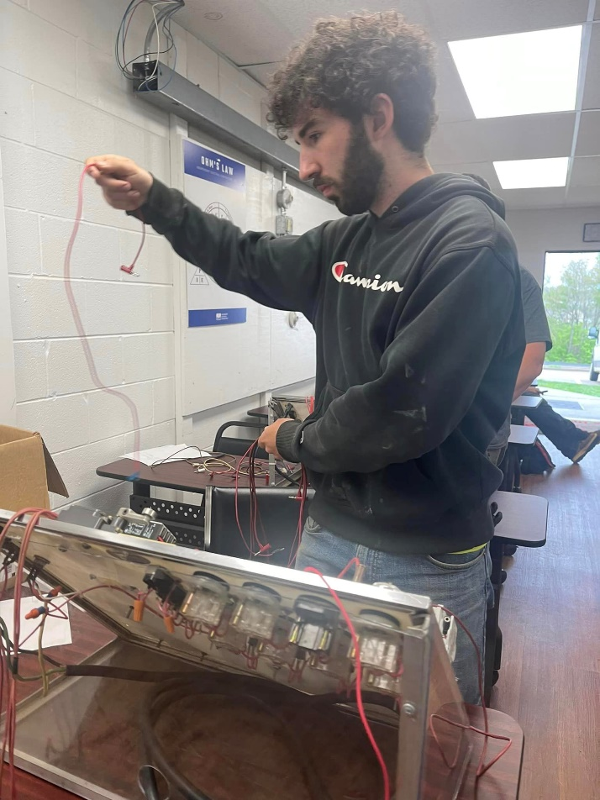
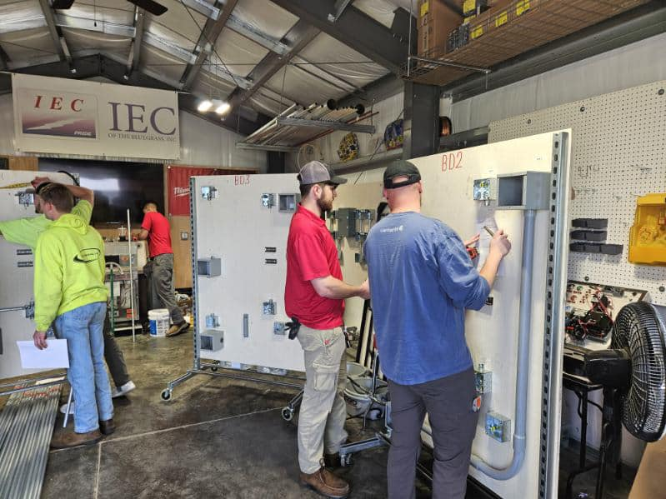
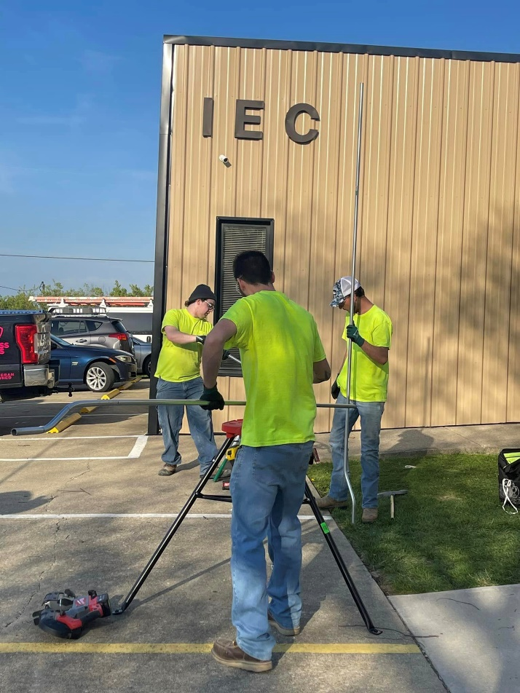
Apprenticeship Program at a Glance
Department of Labor accredited apprenticeship program
Four year program consisting of classroom instruction and on-the-job training
Earn while you Learn – Employers pay apprentices to work on the job site during the day and also pay for their tuition to attend IEC
576 total hours of classroom instruction
8,000 total hours of on-the-job training
Journeyman’s license available to apprentices in a 4-year program after completion of 2 years classroom instruction and 4,000 hours of on-the-job training

Slide 5
Statewide Reach and Community Impact
202 apprentices enrolled for the 2024-2025 school year
Our largest first year class of 88 apprentices
Many apprentices found their jobs with Electrical Contractors that are members of the IEC
The IEC of the Bluegrass covers 86 of the 120 counties in the state of Kentucky. Our apprentices live and work all over the state.

Slide 6
Empowering Career Growth in Skilled Trades
The IEC of the Bluegrass and Contractor Members offer the following:
Competitive Wages
Certifications – Journeyman Electrician, Master Electrician, OSHA 10, First Aid & CPR, Foreman Leadership Training, Professional Development Training
CAREER STABILTIY

Slide 7
Supporting State Goals Through Skilled Trades
IEC of the Bluegrass is aligned with Kentucky’s Legislative Goals by actively partnering with community to enhance:
Economic Growth and Impact
Workforce Development
Local Job Retention
Filling workforce gaps
Creating lasting career pathways for Kentuckians through education and training.

Slide 8
Thank You & Contact Us
Thank you so much to the Committee Members for your time today. The IEC of the Bluegrass is committed to supporting your workforce objectives and look forward to working with you in the future!
We gladly extend the invite to visit our facility to see our apprentices in action!
Rebecca Barnes, Executive Director
859-266-4968
rbarnes@iecbluegrass.org
www.iecbluegrass.org

