Slide 1
July 19, 2023
Interim Joint Committee on General Government, Finance, Personnel, and Public Retirement
The Cost of Elections for Counties and The State Board of Elections
2022 General Election and 2023 Primary Election

Slide 2
Division of Election Administration in Kentucky
State Board of Elections – Independent agency that administers federal and state election laws and disperses pass-through finances to County Clerks and Fiscal Courts for the administration of elections.
County Clerks and County Boards of Election – Conduct local elections, oversight and inspection of voting machines, training of local election officers, public outreach, and direct interaction with voters.
Secretary of State – Chief Election Official/SBE Chair
Kentucky Registry of Election Finance – Independent agency that administers campaign finance laws.

Slide 3
SBE In-House Electronic Services Assisting County Clerk’s Offices
Voter Registration System (VRS) – Electronic Election Management System provided by SBE to 120 counties to manage voters
Online Voter Registration (OVR) – Online voter registration portal for citizens
Electronic Transmission System (ETS) – Online portal for military/overseas citizens to register to vote, as, well as, request and receive absentee ballots
Voter Information Center (VIC) – Website where voters can check their registration and absentee ballot status in real-time
Election Night Reporting (ENR) – Statewide repository of unofficial election-night results received directly from counties and posted for the public/media
Absentee Ballot Request Portal (ABR) – Secure website used by voters to submit a mail-in absentee ballot request directly to their County Clerk

Slide 4
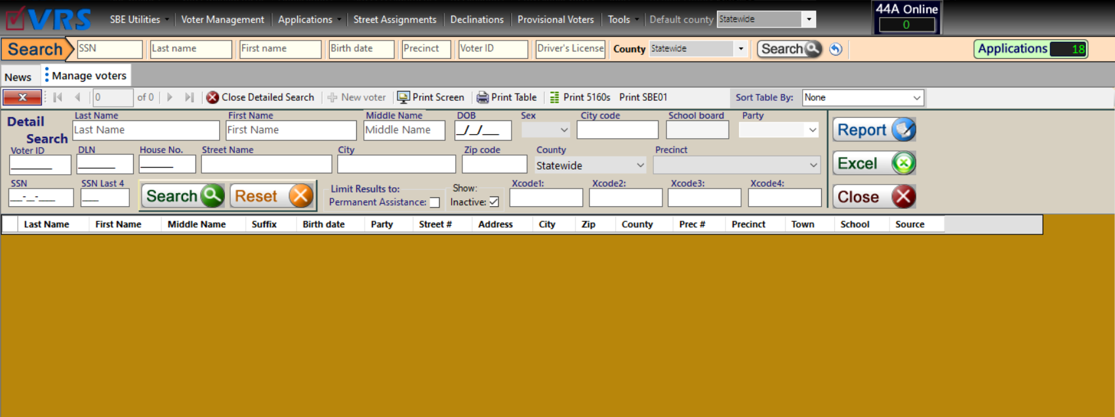
Voter Registration System

Slide 5
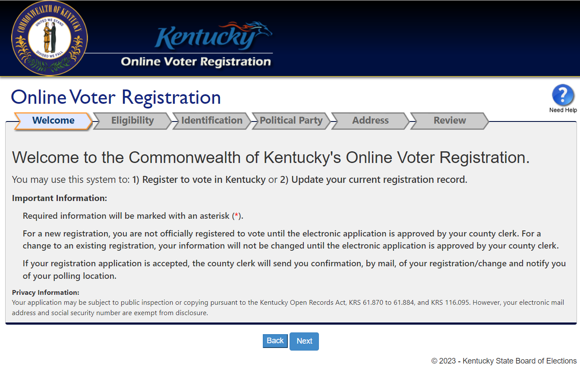
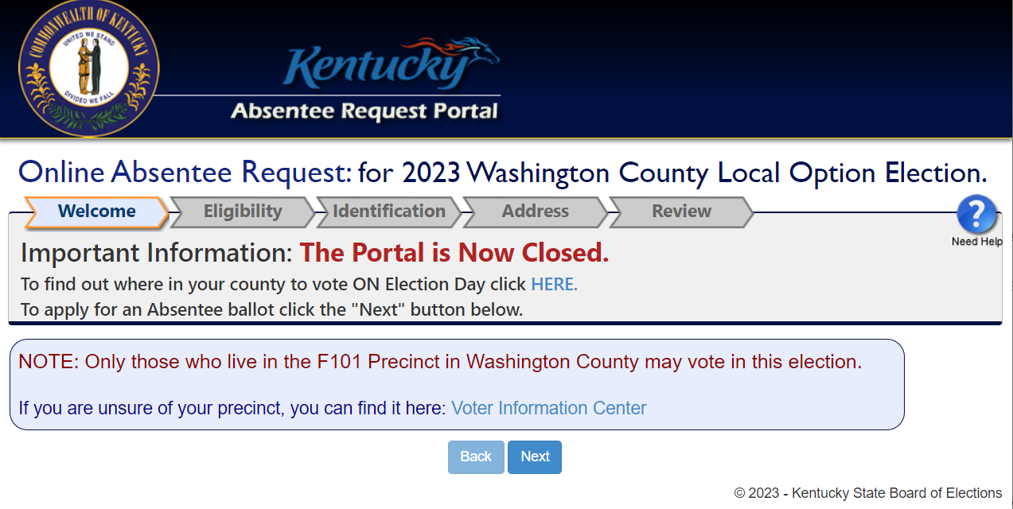
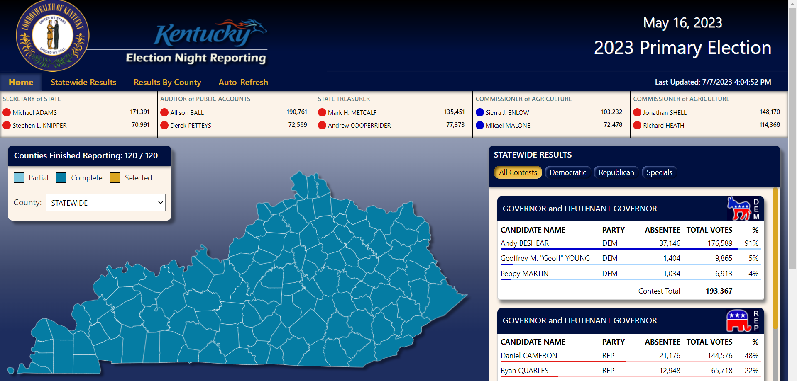
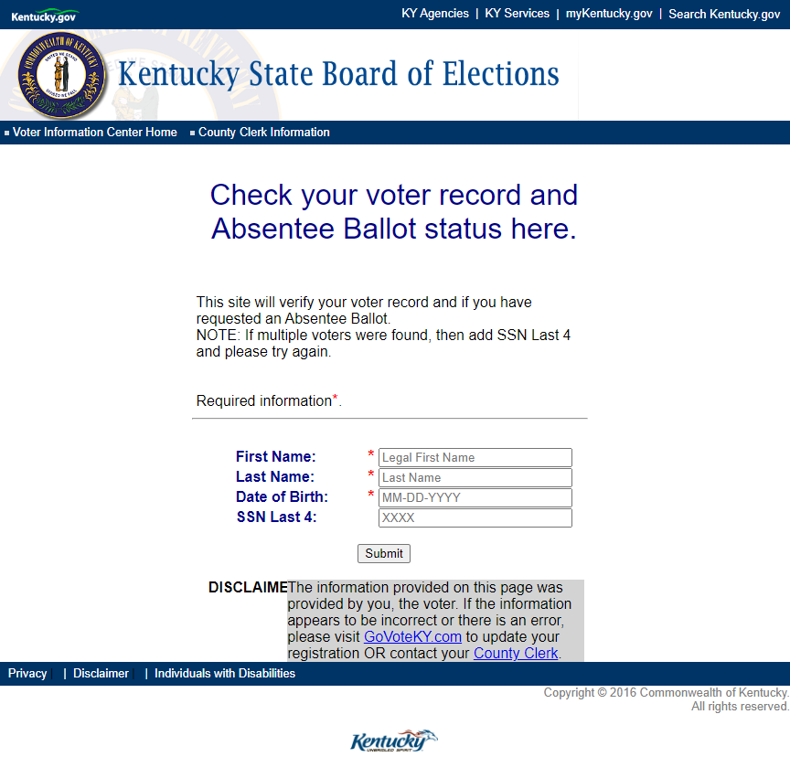
Publicly Accessible Websites

Slide 6
SBE Costs Associated with Elections
 | FY23 | FY22 | FY21 | FY20 | FY19
General Administration and Support Allotment | $2,090,200.00 | $1,725,600.00 | $2,594,296.60 | $2,253,299.65 | $1,604,762.75
 | FY23 | FY22 | FY21 | FY20 | FY19
General Funding for Statutory Requirements | $3,681,511.90 | $1,786,866.00 | $3,610,868.65 | $1,937,295.46 | $2,632,353.69
 | FY23 | FY22 | FY21 | FY20 | FY19
Federal Funding | $3,350,040.35 | $3,354,648.39 | $10,159,535.08 | $6,589,601.50 | $4,014,207.33
 | FY23 | FY22 | FY21 | FY20 | FY19
Total Agency Expenditures | $11,253,271.90 | $7,164,741.81 | $18,425,917.27 | $13,265,637.48 | $8,406,323.77

Slide 7
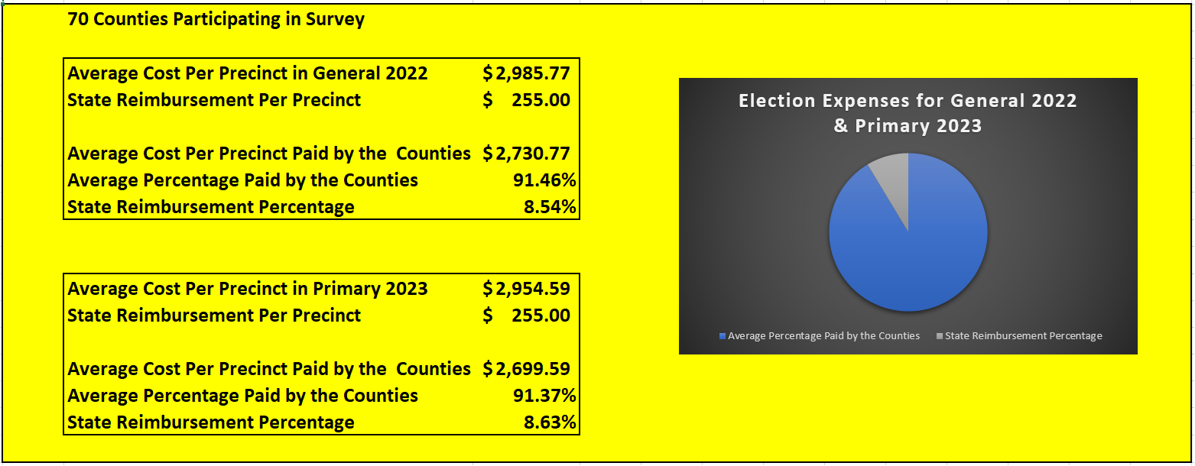
Costs for Counties to Conduct a Single Election
* Dollar amounts reflect only the direct cost of conducting the specified elections and do not include required, on-going, daily election administration costs.

Slide 8
SBE Election Administration
SBE as Pass-through for Counties
to Receive Statutorily Mandated Election Funds
KRS 117.345: $255 per precinct for “the cost of any election”
SBE was allotted $1,883,000 to distribute to 120 counties during the last biennial budget
KRS 117.343: $0.50 per registered voter in the county per year “for the cost of employing office personnel necessary for the conduct of elections, including the registration and purgation of voters in the county”
KRS 116.145: $0.25 registration fee “for each person registered”
SBE was allotted $1,717,800 to be distributed to 120 counties to comply with KRS 117.343 and KRS 116.145 during the last biennial budget

Slide 9
KY County-level Election Administration
Duties that fall on County Clerks and County Boards of Election include:
The Obvious
Follow federal and state laws to ensure our elections are safe, accessible, and secure
Voter registration and coding voters for the correct ballot face
Selecting voting locations that meet all the requirements of a voting location
Creating and approval of election plans each election
Staffing election offices and voting locations
Providing voting locations with sufficient voting equipment
Local candidate filings
Submission of unofficial election night results
Production of post-election reports and certifications
Availability and accountability to voters of our counties
Organizing and ordering supplies to ensure accurate inventory for elections
Delivery of Election Equipment

Slide 10
KY County-level Election Administration
Duties that fall on County Clerks and County Boards of Elections include:
The Not So Obvious
Working with Fiscal Courts to ensure adequate funding
Voting location and security oversight/planning
Complying with DOJ requirements for ADA
Workflow and election security management
Responding to open records requests
Continuous training of election laws, changes, and updates
Publication of notices in newspapers
Printing of ballots and other election materials such as signage
Voting machine accuracy testing, inspections, and security
Open and close all polling locations each day of in-person voting
Daily documentation of election equipment during voting hours
Secure voting materials
Ongoing communication with our election vendors
Annual report to receive state funding

Slide 11
Shared Election Administration Objective
The State Board of Elections, County Clerks, and the County Boards of Election work to ensure secure, accurate, and accessible elections during each election cycle through the administration of federal and state election laws.

Slide 12
July 19, 2023
Interim Joint Committee on General Government, Finance, Personnel, and Public Retirement
Questions?

