Slide 1
Kentucky Personnel Cabinet Overview
Mary Elizabeth Bailey
Kentucky Personnel Cabinet Secretary

Slide 2
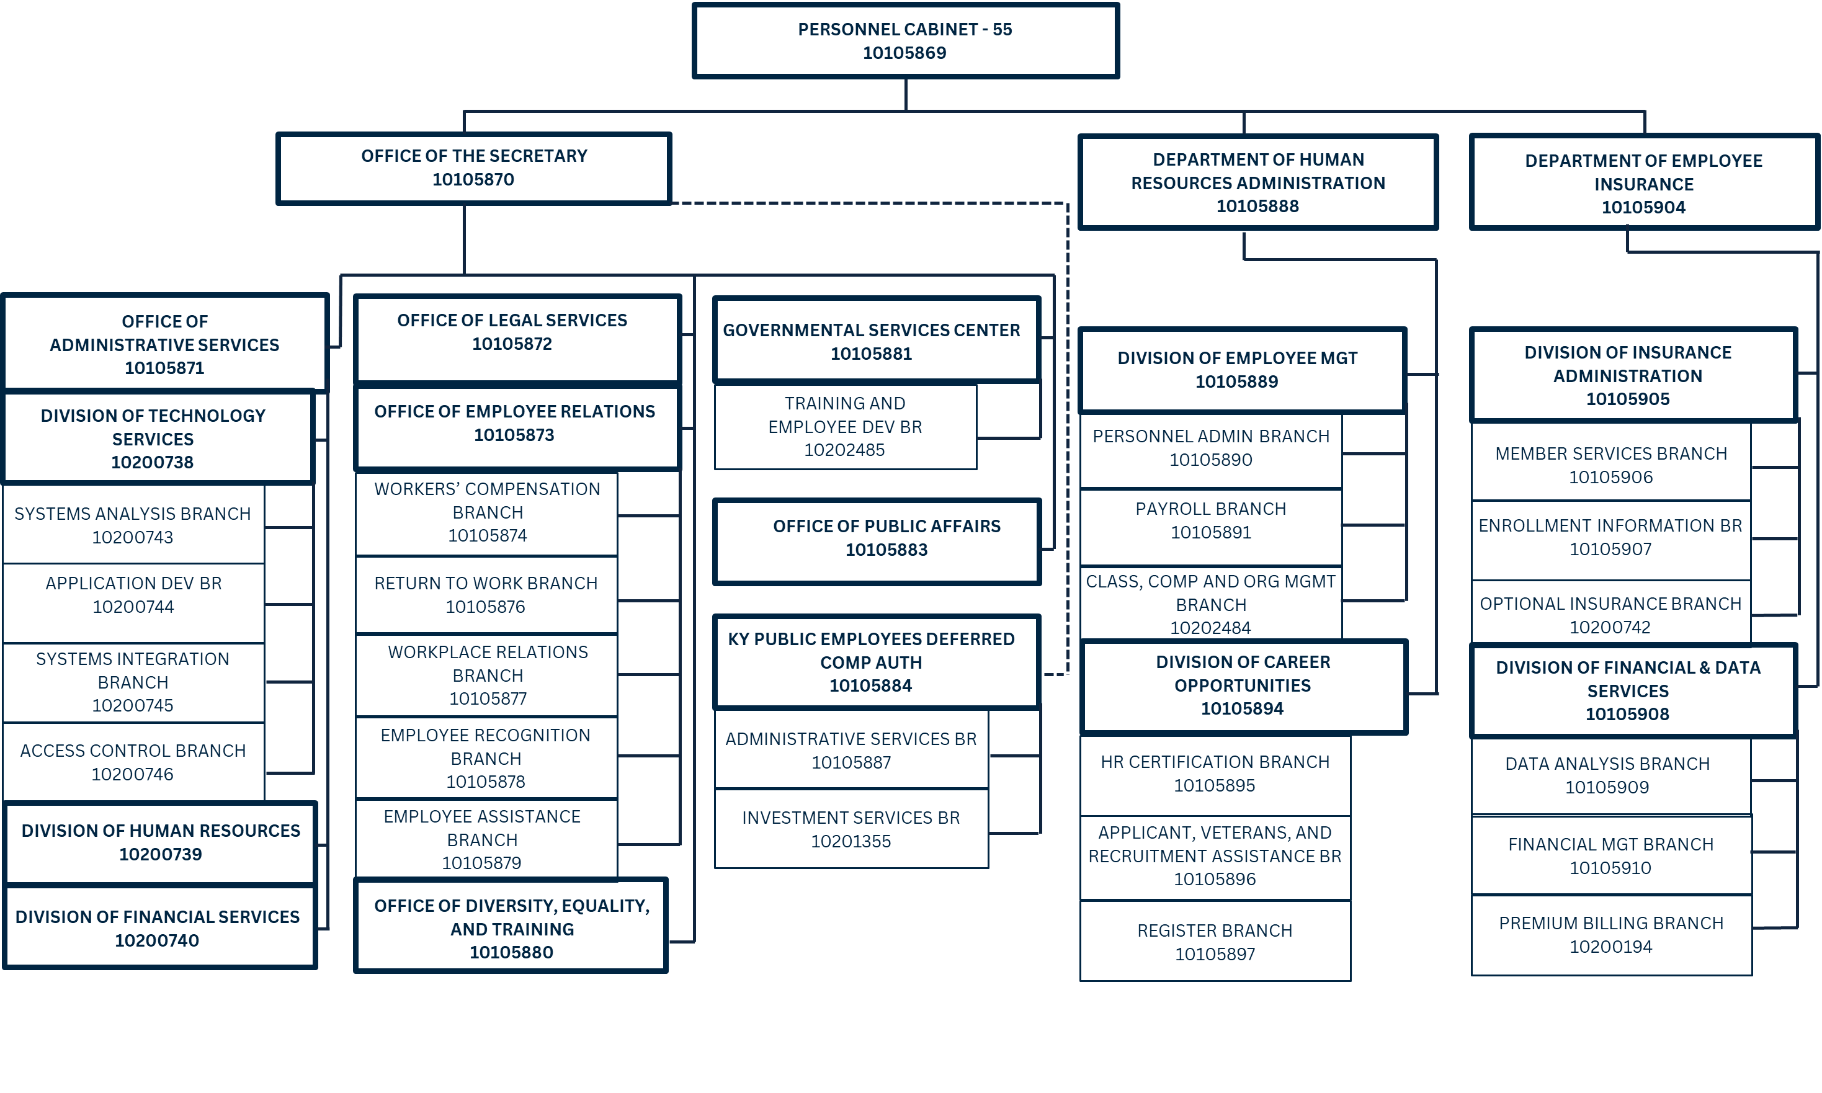
Personnel Cabinet Organizational Chart

Slide 3
Department of Employee Insurance
The Kentucky Employees’ Health Plan (KEHP) is a $2 billion, self-funded health insurance and flexible spending account program that provides benefits to more than 290,000 public employees, retirees under the age of 65, and their dependents, making it one of the largest self-insured health insurance programs in Kentucky. The KEHP represents school boards, retirees under age 65, state agencies, judicial and legislative branches, and quasi-governmental groups.
KEHP Overview
KEHP offers 14+ tailored benefit programs to address the health needs of our members, many of which are at no additional cost to the member (e.g., diabetes, tobacco cessation, telehealth, joint and back pain, behavioral health, maternal support, family counseling, drug-free pain management, etc.)
DEI administers health reimbursement arrangements and flexible spending accounts which offer tax savings to members on over $142M.

Slide 4
Dep. of Human Resources Administration
The Department of Human Resources Administration (DHRA) oversees the hiring process, state payroll functions, classification and compensation system, personnel administration for employees, and the statewide Performance Management Program for the Executive Branch. DHRA also ensures Executive Branch adherence to the Fair Labor Standards Act.
Fiscal Year 2023 Overview
Personnel Actions Processed: 114,437
Applicant Support: 8,739
Veteran Assistance: 6,989
New Applicants: 25,085
Total Payroll Processed: $1.7 Billion
Recruitment Overview
Supportive Services to Other Agencies
Social media recruitment through Facebook, LinkedIn and Handshake
Career Fairs with colleges and universities
Internship opportunities
Diversity recruitment opportunities through community partnerships
Engagement with our Military installations – Fort Knox and Fort Campbell
DHRA also supports the Legislative and Judicial Branches as well as 24 county offices through payroll processing and modified human resource support.

Slide 5
Kentucky Public Employees' Deferred Compensation Authority
The Kentucky Public Employees' Deferred Compensation Authority (KDC) is the official supplemental retirement system for the employees of the Commonwealth, public education, and local programs. KDC is authorized by KRS 18A.230-18A.350 and is self-funded through participant fees, receiving no general fund appropriation.
KDC consists of the following three branches: Executive Branch, Administrative Services Branch, and Investment Services Branch.
$3.6 Billion Assets Under Management
82,198 Plan Participants
KDC Auto Enrollment Program has enrolled 13,000 participants; with a 94% retention rate (leading the nation in Governmental DC Plans).
The Authority services over 1,100 Employers throughout the Commonwealth of Kentucky.
KDC offers a no fee Financial Planning Service to Plan Participants
Free Consultations and Financial Webinars with license representatives.
Conduct virtual and in-person meetings with both individuals and groups.
Maintain Compliance in accordance with Federal tax law; CARES, SECURE 1.0, SECURE 2.0. etc.
Plan Offerings:
457(b) plan — pre-tax/Roth
401(k) plan — pre-tax/Roth
Deemed IRAs — pre-tax/Roth

Slide 6
Office of Employee Relations
Employee Recognition Branch
The Office of Employee Relations (OER) provides leadership and support to other state agencies through the coordination of a variety of different programs and services including workers’ compensation (WCP), the return-to-work program (RTW), employee assistance, and employee recognition.
Includes a variety of work-related incentive programs for state employees. Notably, this branch is responsible for administering the Adoption Benefit Program and the Kentucky Employees Charitable Campaign (KECC).
Workers’ Compensation Program &
Return-to-Work Program
Office of the Ombudsman
In conjunction with the RTW, the WCP covers approximately 60,000 citizens within 184 agencies and independent entities.
These include but are not limited to the State Active-Duty National Guard; nineteen (19) Sheriffs and Clerks Offices; Executive, Legislative, and Judicial Branch employees; volunteer firefighters; and emergency management volunteers.
The WCP manages a fund in excess of $20 million on behalf of state employees.
Administers the Kentucky Employee Mediation Program (KEMP), which is a resource to resolve workplace conflicts informally under the supervision of a certified mediator.
Kentucky Employee Assistance Program
KEAP is a confidential source to assist employees with personal concerns such as family issues, emotional distress, substance misuse, financial concerns or job stress challenges.

Slide 7
Office of Diversity, Equality & Training
The Office of Diversity, Equality & Training (ODET) is responsible for the development and implementation of progressive statewide workforce management programs and initiatives in the areas of equal employment opportunity, affirmative action, retention, inclusion, and diversity.
Governor’s Leadership, Equality, Accessibility and Diversity Conference (LEAD)
Features interactive workshop sessions conducted in the areas of leadership, professional development and human resources best practices.
Office of Diversity, Equality & Training Programming and Services
Governor’s Minority Management Trainee Program (GMMTP)
Recruitment and professional development tool established to increase the representation of minority managers within state government.
Participants receive in-depth, practical training through virtual trainings, online courses, mentorship, and networking events.
Executive Branch EEO/ADA consultation
Oversees Executive Branch diversity recruitment initiatives
In-person and virtual workshops
Employee Resource Groups and Diversity Councils

Slide 8
Office of the Secretary
Office of Administrative Services
The Office of Administrative Services is responsible for the internal administration of the Cabinet including budgeting, accounting, purchasing, human resources, payroll, benefits, internal audit, and facilities.
The office, through the Division of Technology Services, is also responsible for the design, development, implementation and maintenance of enterprise systems for human resources including the Kentucky Human Resource Information System (KHRIS), MyPURPOSE talent management system and all technology in the Personnel Cabinet.
Office of Legal Services
The Office of Legal Services (OLS) serves as the primary representative of the Cabinet in any legal matters. OLS also provides legal guidance and assistance to Executive Branch agencies on the KRS Chapter 18A merit system and employment legal matters.

Slide 9
Office of the Secretary
Office of Public Affairs
The Office of Public Affairs (OPA) provides communication planning and marketing services for the Personnel Cabinet, promoting employee benefits, programs and services, policies, and new initiatives.
OPA is also responsible for media relations, website design and maintenance, social and electronic media, publications, and all communication distributed from the Cabinet.
Governmental Services Center
The Governmental Services Center (GSC) is responsible for creating, coordinating, and implementing training and employee development courses conducted on behalf of the Executive Branch, including consultations and customized training for all agencies including legislative and judicial branches. Additionally, GSC offers over 1,200 on-demand trainings available in our learning management system.

Slide 10
Mary Elizabeth Bailey Personnel Cabinet Secretary ​marye.bailey@ky.gov 502.564.6798

