Slide 1
Unified Prosecutorial System
Biennial Budget Presentation Interim A&R Budget Review Sub-committee
2024 - 2026
November 2, 2023

Slide 2
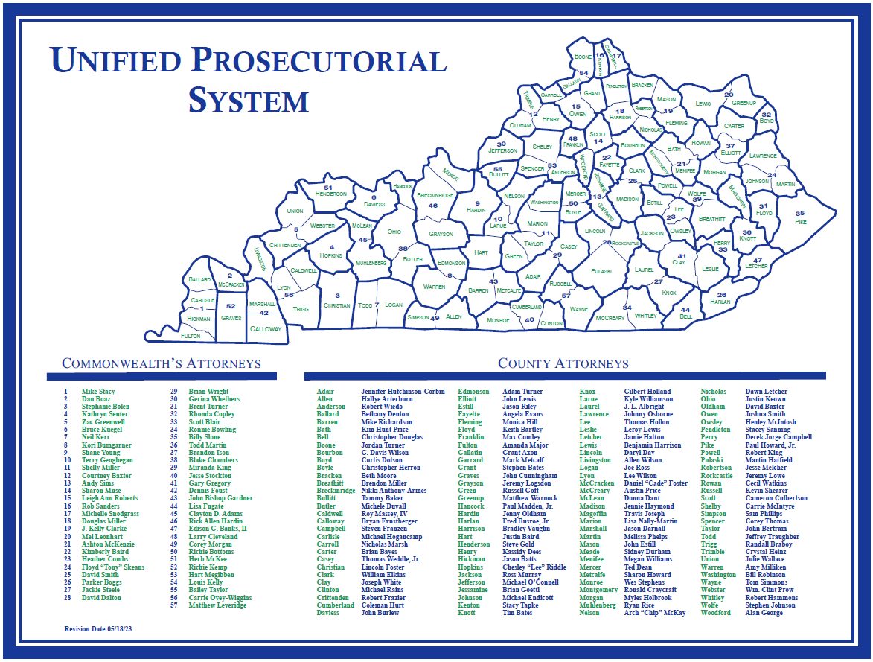

Slide 3
County
Attorneys
Overview
KRS 15.725: Prosecute ALL violations of criminal and penal laws in District Court
Represent the interests of the Commonwealth in Specialty Courts such as:
Family Court, Drug Court, Veterans Court, Mental Health Court
Shall review ALL criminal complaints
Frequently mediates local complaints (currently cannot capture aggregate data on the number)
96% of FY23 General Fund expenses were dedicated to personnel costs.

Slide 4
County
Attorneys
Base Budget
Supports 120 offices
307 full-time (including the elected) positions
331 part-time positions
40 quarter-time positions
Operating budget $8,000/office annually which must cover rent, utilities, supplies, copiers, computers, etc.
96% of FY23 General Fund expenses were dedicated to personnel costs.
HB8 Actuarily Accrued Liability Compensation Subsidy for 32 offices currently.
FY23 expended ~$1.7M
FY24 budgeted $1.9M
County Attorney Rocket Docket Programs
$742k for FY24 in general funds to support 44 positions in 23 offices
Savings to the state for FY23 ~$30M in local jail costs
Estimated $210M since inception in FY2016
Additional funding provided in previous budget
87 positions added or upgraded status
VOCA grant cuts – 14 victim advocate positions assumed

Slide 5
County
Attorneys
Additional Budget Requests
Request Type | FY25 | FY26
Salary Compensation Standardization | $8,278,500 | $9,262,500
Marsy’s Law – Advocates | $7,222,200 | $7,633,600
Additional Positions Requested (From Budget Surveys) | $9,097,400 | $9,609,900
Unified Case Management Software (SaaS) | $1,432,500 | $1,756,900
PAC Administrative Staff Funding | $1,060,300 | $1,119,000
SB90 Program Coordinators | $855,400 | $904,400

Slide 6
County
Attorneys
Challenges/Solutions
Challenge:
Attrition/Turnover – 12% in 2023
Salaries are not competitive
Cannot compete with private/other agencies
Remote work opportunities not possible
Solution:
Guaranteed Annual Increments
Salary Compensation Standardization
Additional Positions

Slide 7
County
Attorneys
Challenges/Solutions
Challenge:
New legislation impacting workload
Marsy’s Law
Casey’s Law
Tim’s Law
AOC caseload stats may not capture
Solution:
Victims Advocates for the remaining 84 counties w/out one
Additional Positions – Prosecutors, Paralegals & Administrative
Unified Case Management System

Slide 8
Commonwealth’s
Attorneys
Overview
KRS 15.725: Attend each circuit court and present evidence to the grand jury
Average of 3 times per month
Average of 52 cases per grand jury
Total number of cases presented does not represent total number of cases reviewed.
Felony prosecution of the most serious crimes
Must also respond to Motions for post-conviction relief and shock probation

Slide 9
Commonwealth’s
Attorneys
Base Budget
Supports staff in 56 full-time and 1 part-time office
443 full-time (including the elected) positions
57 part-time positions
80 quarter-time positions
Operating budget
All operating expenses for 56 of the 57 offices
Expert Witness expenses
Legal Research
Information Technology
Commonwealth’s Rocket Docket Programs
$1.8M for FY24 in general funds in addition to $2M from Justice Cabinet to support 132 positions in 49 offices.
+ 48,000 cases completed in 8 years
+ 38,000 treatment referrals
Savings of over $210M since inception
Additional funding provided in previous budget
73 positions added or upgraded status
VOCA grant cuts – 5 victim advocate positions assumed

Slide 10
Commonwealth’s
Attorneys
Additional Budget Requests
Request Type | FY25 | FY26
Salary Compensation Standardization | $2,944,900 | $3,349,200
Marsy’s Law – Advocates | $4,900,800 | $5,178,300
Additional Positions Requested (From Budget Surveys) | $8,260,200 | $8,726,400
Rocket Docket Funding (Restricted Fund Replacement) | $2,000,000 | $2,144,800
Unified Case Management Software (SaaS) | $1,214,100 | $1,528,000
PAC Administrative Staff Funding | $1,060,300 | 1,119,000
Expert Witness (202c) | $175,000 | $400,000
SB90 Program Coordinators | $855,400 | $904,400
Victim Witness Protection Funding | $25,000 | $25,000

Slide 11
Commonwealth’s
Attorneys
Challenges/Solutions
Challenge:
Attrition/Turnover – 15% in 2023
Salaries are not competitive
Cannot compete with private/other agencies
Demanding work and remote work opportunities not possible
Solution:
Guaranteed Annual Increments
Salary Compensation Standardization
Additional Positions

Slide 12
Commonwealth’s
Attorneys
Challenges/Solutions
Challenge:
Caseload and Backlogs
Rise in more violent crimes – requiring more resources
Still working through pandemic backlog
Impacted by several natural disasters in 2023
Staff burnout
Solution:
Guaranteed Annual Increments
Salary Compensation Standardization
Additional Positions
Unified Case Management System

Slide 13
Commonwealth’s
Attorneys
Challenges/Solutions
Challenge:
Uncertain Funding for Rocket Docket
Solution:
Replace Restricted Funds with Permanent General Fund Appropriation

Slide 14
Commonwealth’s
Attorneys
Challenges/Solutions
Challenge:
Changes to KRS 202C Involuntary Commitment Hearings
Commonwealth’s Attorney must initiate proceedings when certain serious crimes are charged
Mental health experts for evaluation and testimony
Estimated cost per evaluation is $3,000
Estimated cost per testimony is $10,000
Current expert witness budget is insufficient
Solution:
Appropriation for Mental Health Experts in 202C Hearings

Slide 15
Commonwealth’s
Attorneys
Challenges/Solutions
Challenge:
Victim Witness Protection Funding
No additional funding in over 20 years
Current balance below $10,000
Solution:
Restricted Fund replacement with annual General Fund appropriation

Slide 16
Commonwealth’s
Attorneys
And
County Attorneys
Challenges/Solutions
Challenge:
Behavioral Health Conditional Discharge Pilots (SB90)
Resources required for extensive reporting requirements
Solution:
Program Coordinator positions for each of the 11 pilot counties

Slide 17
Commonwealth’s
Attorneys
And
County Attorneys
Challenges/Solutions
Challenge:
Funding for a Unified Criminal Justice Case Management System
Current system under utilized and not available for the County Attorneys
Unable to access or share information with other criminal justice partners
Marsy’s Law notification requirements
Solution:
Appropriation to fund Case Management System for Commonwealth’s and County Attorneys
Reduced costs through streamlined workflow both internal and external
Improved collaboration and information flow with criminal justice partners
Faster case resolution through efficiencies
Improved communication with victims

Slide 18
Commonwealth’s
Attorneys
And
County Attorneys
Challenges/Solutions
Challenge:
Prosecutors Advisory Council administrative division UNDERSTAFFED for years
14 full-time staff to support 177 offices and 1250 employees
Payroll/Personnel – 2
Procurement – 1
Training – 1
Payment Processing – ~2
IT support – including nights and weekends – 2.25
Addt’l mandates such as data collection - .5
Budget and Accounting - 2
Solution:
Additional PAC administrative staffing positions
19 positions requested
Many to address growing list of mandates and initiatives

Slide 19
Commonwealth’s
Attorneys
And
County Attorneys
Challenges/Solutions
Challenge:
Attracting and retaining prosecutorial staff to positions in the Commonwealth’s and County Attorneys offices.
Lack of funding for a minimum pay scale for prosecutors and staff.
Lack of funding for additional classifications within the Unified Prosecutorial System to allow for career advancement opportunities.
Solution:
Funding to implement the recommendations in the 2020 Salary Scale, Classification and Compensation report for the Commonwealth’s and County Attorneys with the updated pay scale.

