Slide 1
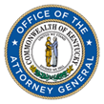
Body Armor Grant Program
Kentucky Office of the Attorney General
Department of Criminal Investigations

Slide 2
Body Armor Grant Program
Restricted Fund Created by House Bill 6
$5,000,000 in fiscal year 2024-2025
$10,000,000 in fiscal year 2025-2026
For the purchase of:
Body Armor
Duty Weapons
Ammunition
Electronic-control Devices
Body-worn Cameras

Slide 3
Body Armor Priority
20% of police officers have either no ballistic vest or an expired ballistic vest.
Our mission is to reduce that number to zero in fiscal year 2024-2025.
Therefore, applications for soft body armor have been given absolute priority.
Once we accomplish our mission, we will begin to focus on armor enhancements, such as rifle plates, ballistic helmets and shields

Slide 4
Application Process
Online application completed by requesting agency
Agency must submit a copy of its mandatory wear policy with the application
Agency must submit individual officer information with the application (POPs #)
Ballistic vest purchases are tracked by officer
Currently, we are accepting applications for officers with no vest, an expired vest, or vests that expire in calendar year 2024
We began accepting applications July 15, 2024

Slide 5
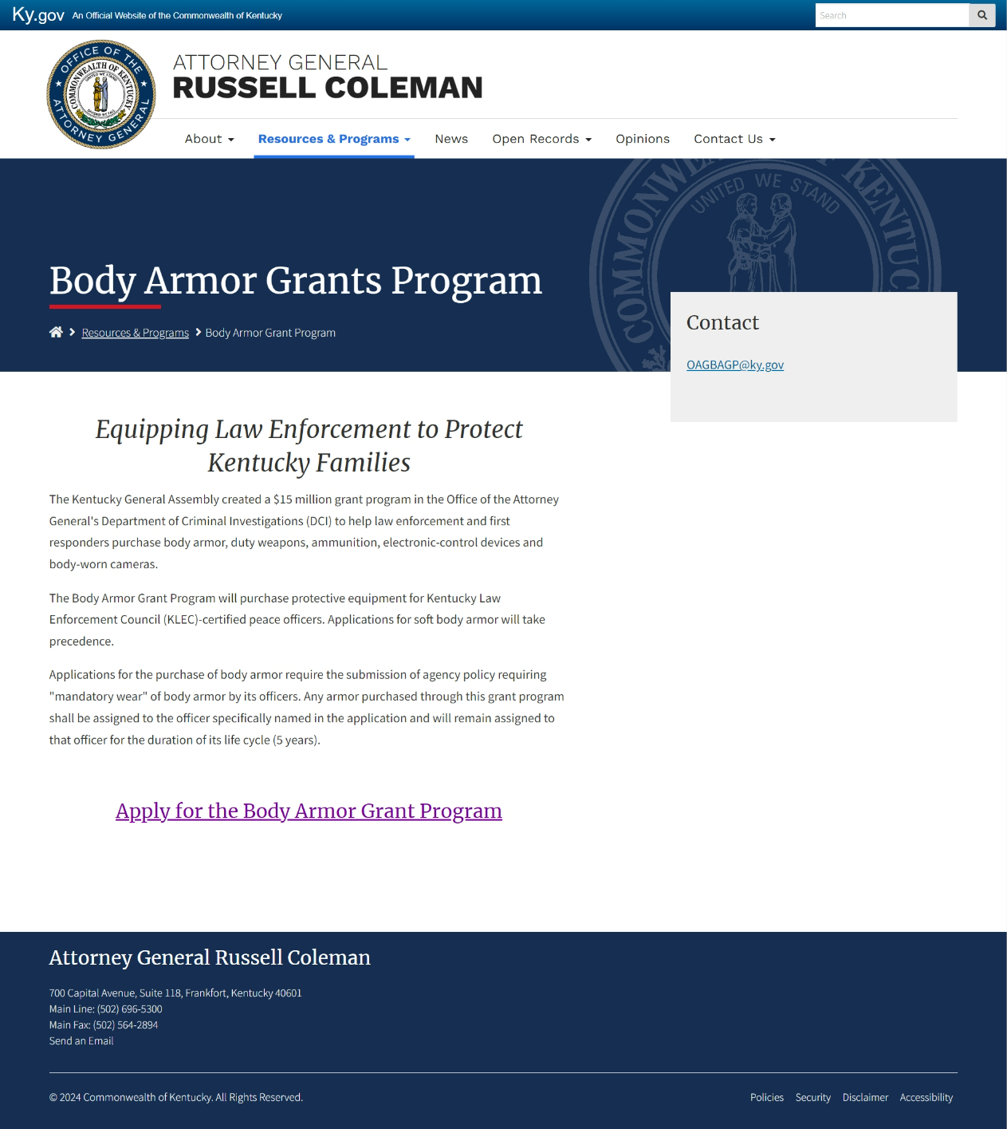

Slide 6
Review & Order Process
Agency applications are reviewed at DCI
If approved, the application is sent to Galls to schedule sizing for the officer
After agency officers are sized, Galls provides DCI with a quote for that agency
DCI generates a delivery order, and Galls orders the product
Once the product is delivered to the agency, Galls sends an invoice to DCI
DCI then creates a purchase order to pay Galls for the product

Slide 7
Statistics as of 8/16/2024
68 total applications
50 applications for soft armor
4 applications for helmets
4 applications for rifle plates
4 applications for shields/carriers
5 applications for Tasers

Slide 8
Statistics As of 8/16/2024
40 agency applications for soft armor have been approved and sent to Galls for sizing
Totaling 253 vests

Slide 9
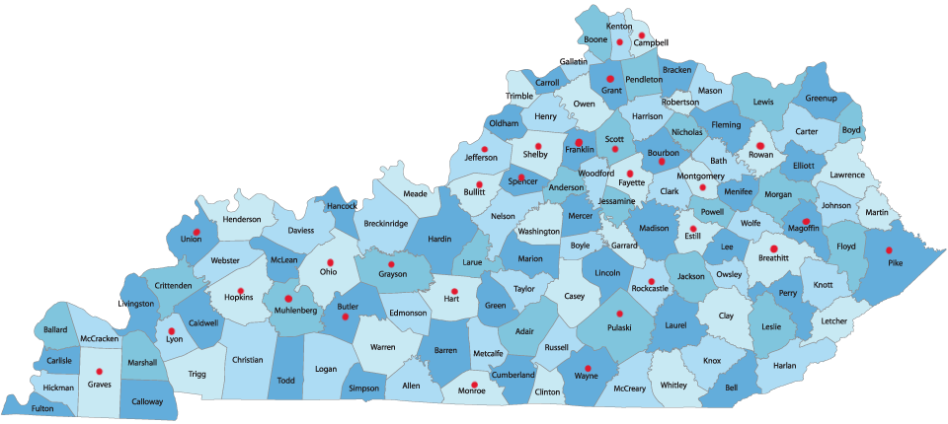

Slide 10
Projected Spending
Independence PD - $1,635.34
Spencer Co. SO - $4,088.35
Villa Hills PD - $903.32
Somerset PD - $1,635.34
Montgomery Co. Schools Police - $693.12
Butler Co. SO - $2,453.01
Mt. Sterling PD - $3,207.68

Slide 11
Projected Spending
Leitchfield PD - $2,151.68
UKPD - $1,540.20
Whitesburg PD - $1,635.34
Graves Co. SO - $4,303.36
Lyon Co. SO - $11,743.16
Southgate PD - $2,295.72
Shelbyville PD - $6,023.90

Slide 12
Projected Spending
Hart Co. SO - $7,359.03
Horse Cave PD - $9,182.88
Monticello PD - $6,023.90
ULPD - $14,922.18
Hopkins Co. SO - $3,270.68
Elkhorn City PD - $1,322.34
Magoffin Co. SO - $4,819.12

Slide 13
Projected Spending
Estill Co. School Police - $346.56
Ft. Wright PD - $4,906.02
Edgewood PD - $3,085.46
KY ABC - $27,800.78
Stamping Ground PD - $2,409.56
Wayne Co. SO - $9,682.56
Union Co. SO - $4,107.20

Slide 14
Projected Spending
Hillview City PD - $3,443.58
Tompkinsville PD - $881.56
Audubon Park PD - $9,476.25
Mt. Vernon PD - $8,433.46
Hawesville PD - $440.78
Bourbon Co. Schools Police - $2,453.01
Jackson PD - $1,763.12

Slide 15
Projected Spending
Campbell Co. SO - $6,023.90
Dry Ridge PD - $2,295.72
Rowan Co. SO - $18,071.70
Central City PD - $7,359.03
KY Dept. of Insurance Fraud - $4,548.60

Slide 16
Projected Spending
Total once product is delivered
$208,738.50

Slide 17
https://youtu.be/NWG7J1JcbjQ

