Slide 1
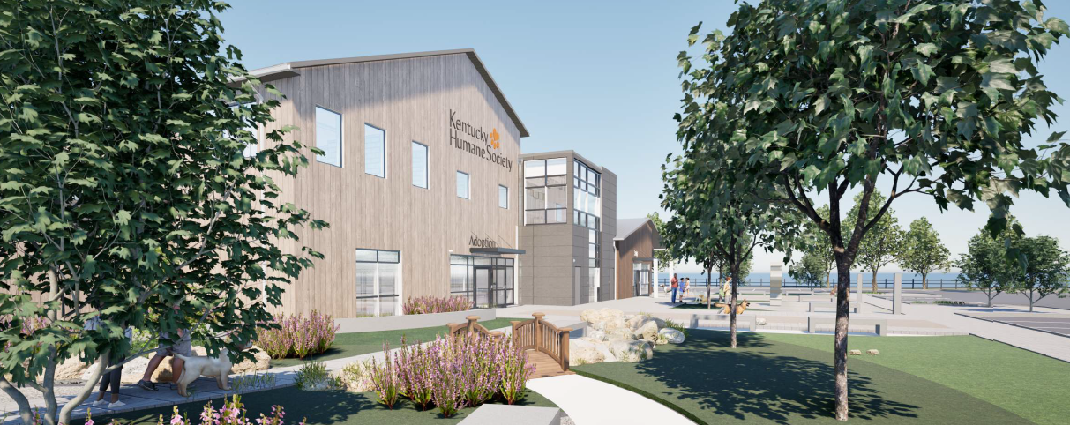
Introducing All In Campaign
Our Animals, Our Community, Our Future

Slide 2
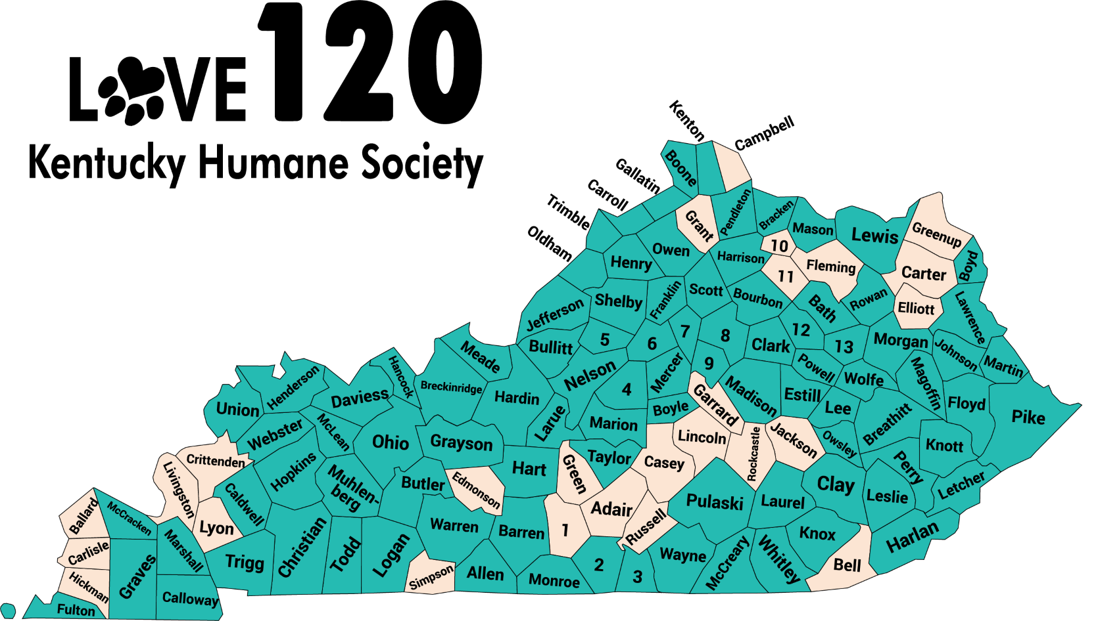

The Kentucky Humane Society
Proving Support Across 96 Kentucky Counties & Growing
Since 1884, the Kentucky Humane Society (KHS) has been a trusted resource for Kentucky’s dogs, cats, horses, and the communities that care for them. Each year, KHS takes in more than 6,000 animals in need
Based in Louisville and working across the Commonwealth, KHS supports county animal shelters, delivers veterinary care to underserved areas, and responds during times of crisis
As an independent nonproﬁt – not affiliated with any national organization – KHS is committed to creating a more humane Kentucky through collaboration and compassion
Through our Love 120 Initiative, launched in 2019 to reach all 120 counties, KHS has already improved the lives of pets and people in 96 counties and counting. This project will allow and support expansion into the remaining counties

Slide 3
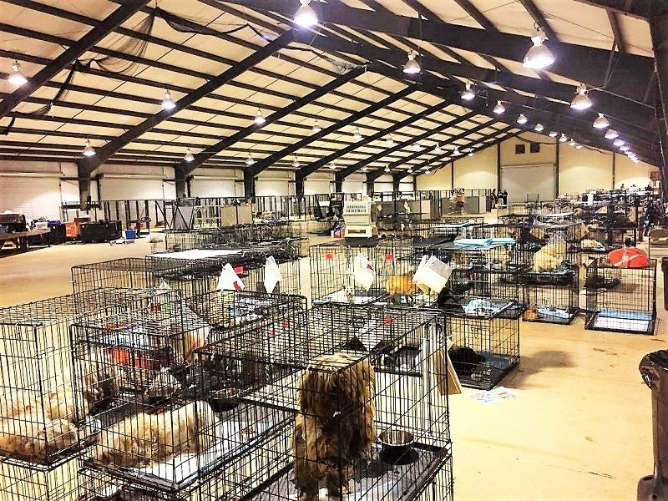
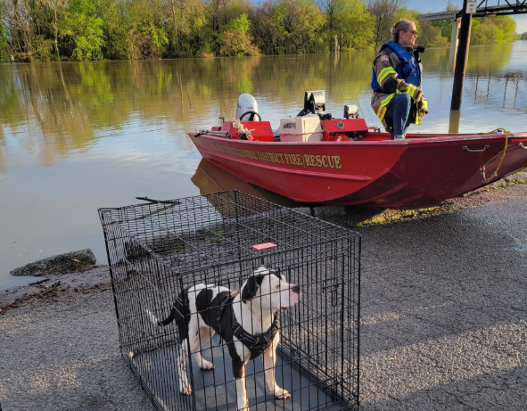
Disaster Response & Emergency Aid
KHS is Kentucky’s only organization serving as a central hub for animal disaster response providing critical grants, essential supplies, and hands-on support when it’s needed most. The Animal & Community Campus will include a dedicated space equipped to provide immediate temporary housing for up to 100 animals at a time in the aftermath of a disaster.
WKY Tornadoes (2021): shelters in Graves, Hopkins, Ohio, Muhlenberg, Caldwell, Warren, Logan and Grayson Counties received $164,000 in cash support, and transports out of 600 pre-storm pets
EKY Flooding (2022): KHS provided $70,000 in funding and supplies to shelters in Perry, Letcher, Knott, Breathitt and Floyd Counties, and transports out of hundreds of pre-storm pets
EKY Tornadoes (2025): KHS provided transport assistance for 100 animals from local rescues in Pulaski and Laurel Counties
WKY & EKY Flooding (2025): shelters in Anderson, Caroll, Estill, Floyd, Hopkins, Johnson, Lee, Martin, Magoffin, McLean, Owsley, Pike and Wolfe Counties received supplies or help transporting out hundreds of pre-storm pets

Slide 4
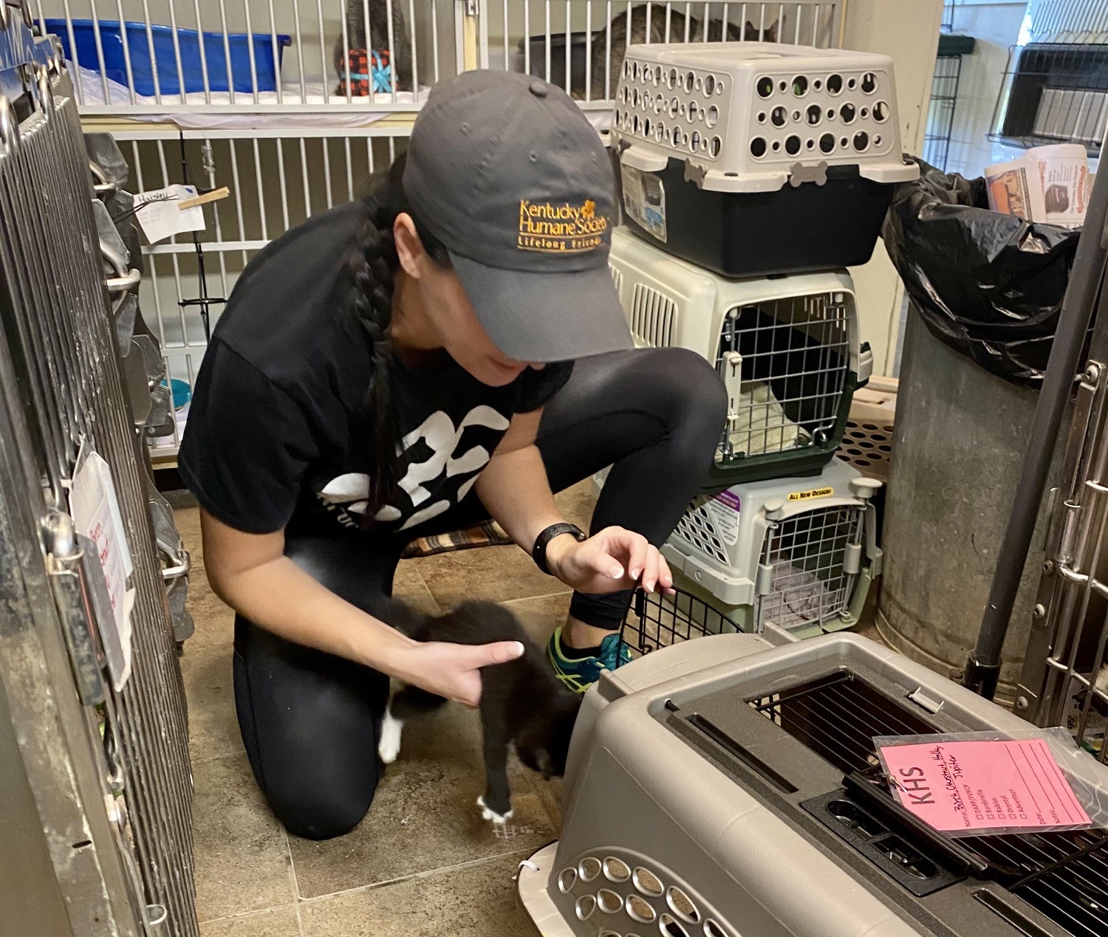
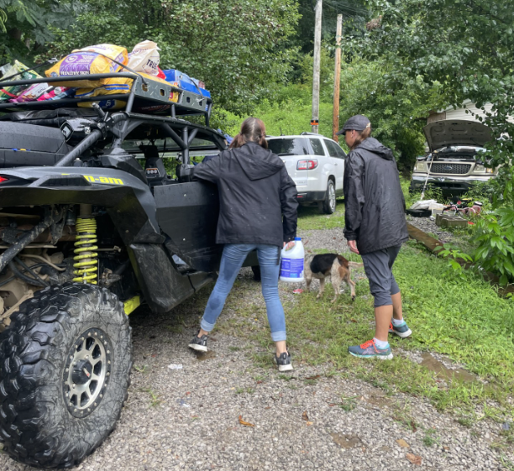
Floyd County Impact
Provided support to the county animal shelter during 2022 and 2025 flooding, including animal transports, financial assistance, and supplies
Hosted a CARE-a-van mobile clinic visit in 2025, offering free spay/neuter surgeries, vaccines, and microchips for local pets
Partnering with South Beaver community through our Pets for Life program to provide free veterinary care (including spay/neuter surgeries), preventatives, pet food, and other supplies — now in year one of a three-year funding commitment. As part of this effort, KHS hired Tonya, a Floyd County resident, and trusted community leader, to serve as our boots on the ground in the area
Purchased standing AC units for the Floyd County Animal Shelter when their system went out
In non-disaster times, continue to supply vaccines, preventatives, and parvo tests to the county shelter
Since 2019, transported 335 animals from the Floyd County Animal Shelter to KHS for adoption

Slide 5
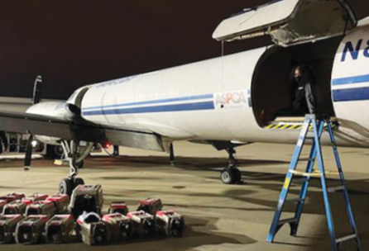
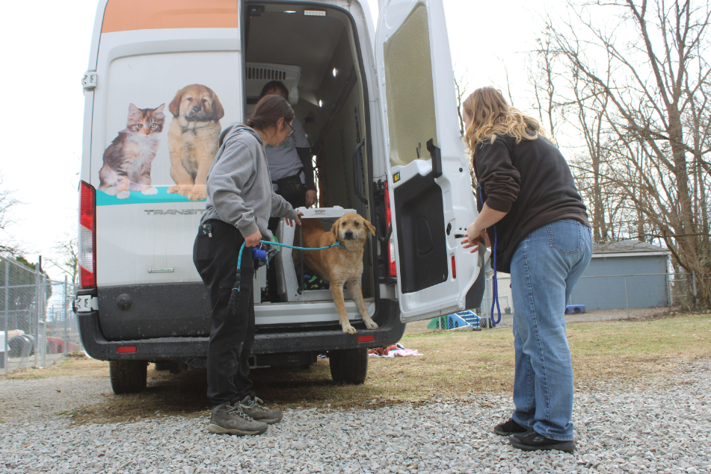
Animal Rescue & Shelter Relief
KHS partners with under-resourced county animal shelters across Kentucky to increase their live-saving capacity while saving taxpayer dollars.
Transferring shelter animals to KHS saves counties money and reduces euthanasia rates.
Over 20,000 animals transported from Kentucky shelters to KHS for adoption (2019–2024).
KHS invested $8 million in private funds to provide medical and daily care to prepare these 20,000 pets for adoption—relieving counties of this burden.
Shelter partners receive hands-on mentorship, including guidance on operations, fundraising, transport logistics, and connecting with new resources and regional partners.

Slide 6
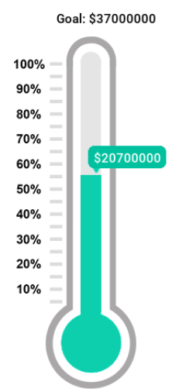
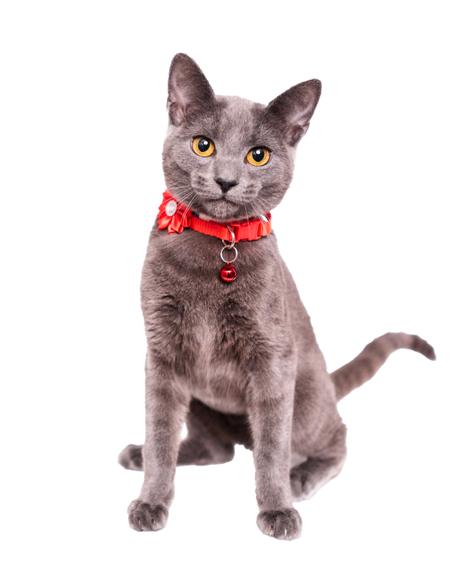
ALL IN: Campaign at a Glance
KHS Contributions and Investments secured thru Sept 2025:
$20.7 million
Matching ask from Kentucky General Assembly:
$5 million
Total Project Cost:
$37 million
Local and National Support includes:
$12M from KHS Property Sales and Investments
$1M from Louisville Metro Government
$1.5M from Louisville’s Swope Family
$2M from Gauntt Foundation of Florida
$1M from Art for Animals Foundation of New York
$470k from Republic Bank Foundation/Trager Family Foundation
$385k from Board of Directors
$2.4M from Local Fundraising Campaign

Slide 7
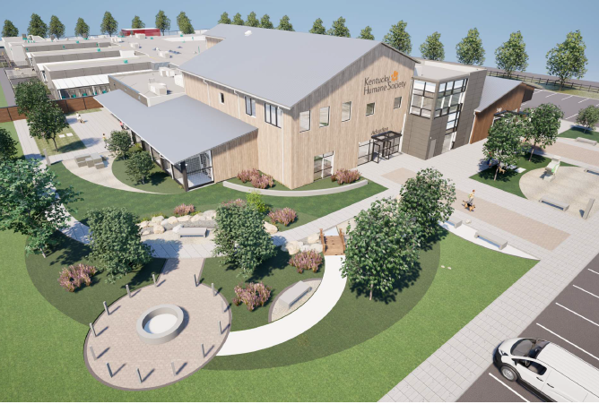
Kentucky’s Future Flagship Animal
& Community Campus
The Kentucky Humane Society (KHS) is raising funds to build a new Kentucky Animal & Community Campus to expand urban and rural services, improve statewide animal welfare outcomes, and help save taxpayer dollars.
This new campus will:
Provide a dedicated space to respond to disasters and large-scale cases of cruelty and neglect
Reduce overcrowding and euthanasia at municipal shelters across Kentucky
Address pet overpopulation
Expand our impact in rural Kentucky
Put less strain on local governments
Create more humane housing for KY’s shelter pets
Provide accessible and affordable veterinary care to pet owners, reducing financial stress
Educate veterinary students and shelter leaders across KY, creating a pipeline for new talent

Slide 8
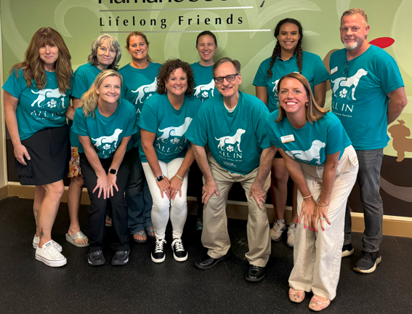

Questions?
Alisa Gray,
President & CEO
502-515-3131
agray@kyhumane.org
We are proud to have 100% staff participation, with all 116 team members contributing to support this project through personal donations.

