Slide 1
Update on Artificial Intelligence Legislation
Kate Shanks
Senior Vice President, Public Affairs
Kentucky Chamber

Slide 2
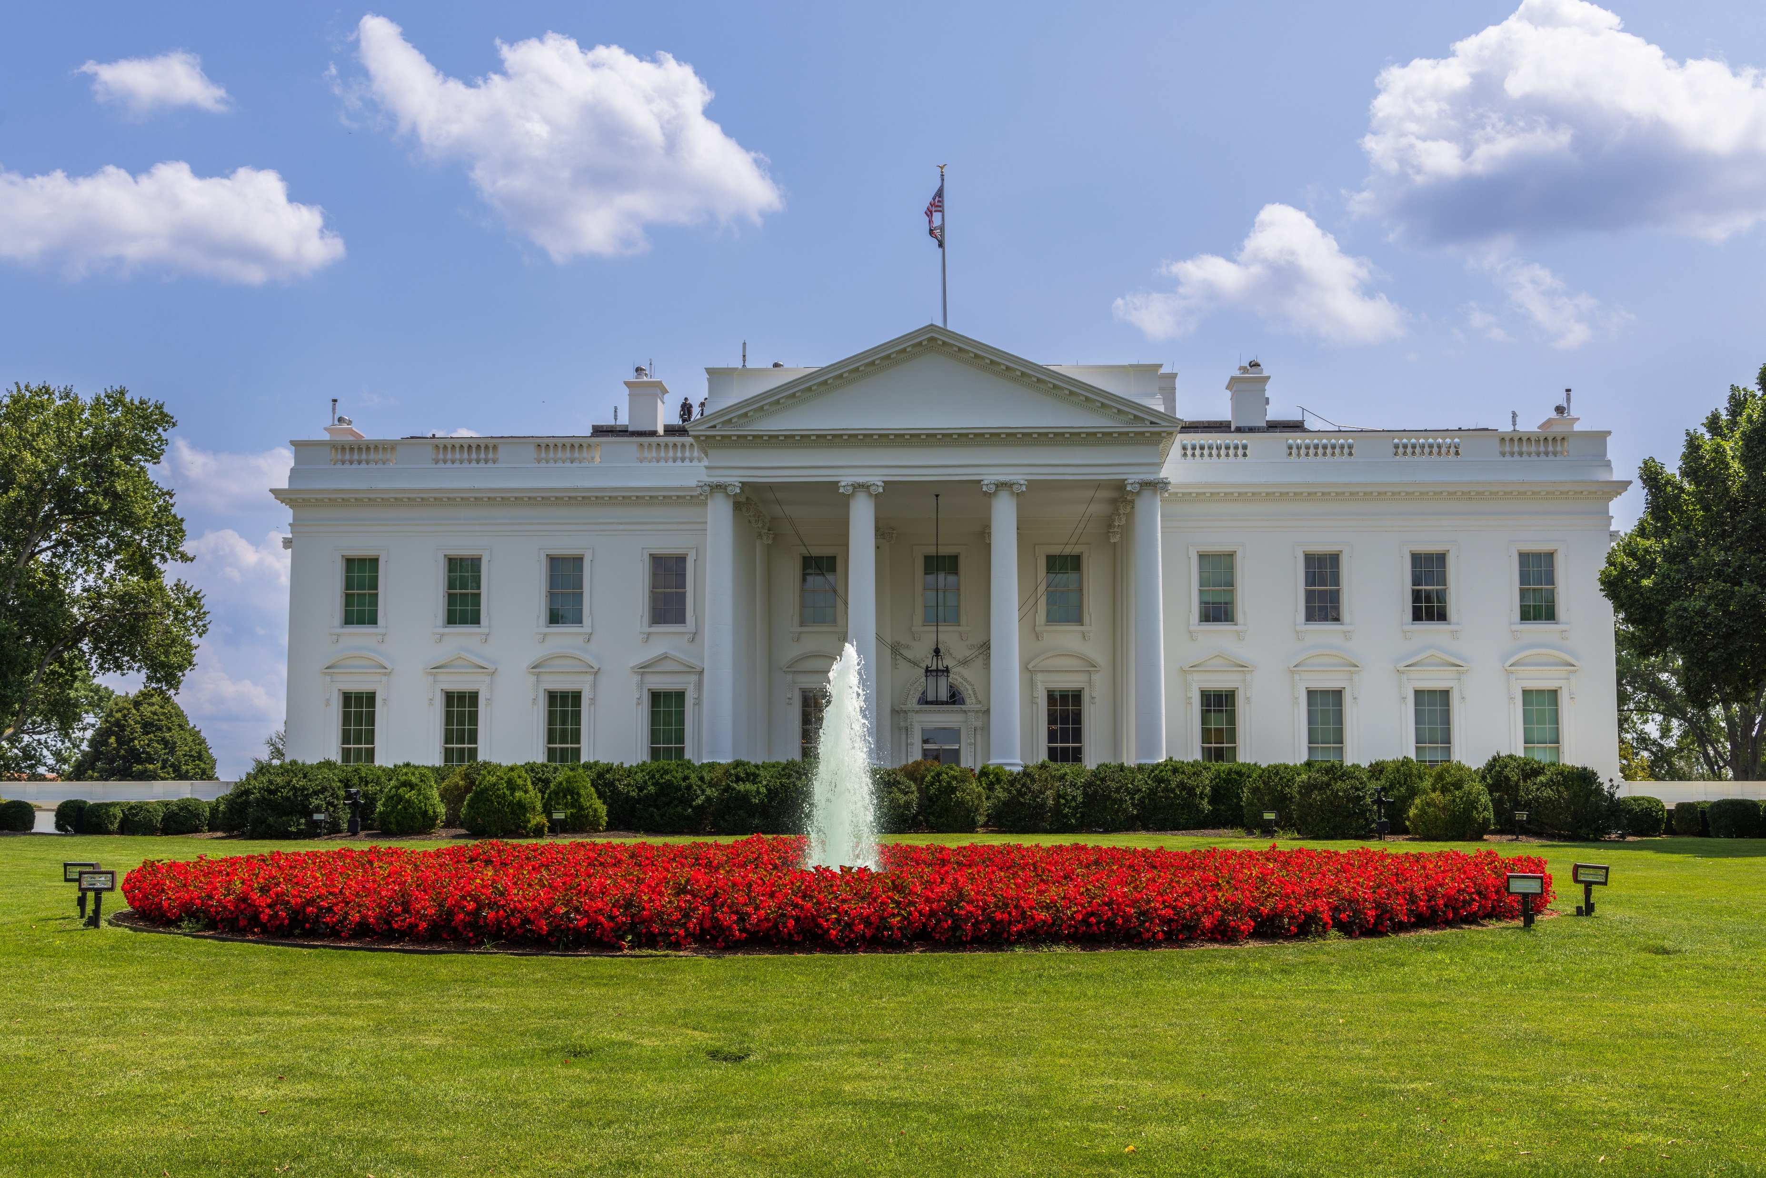
Federal Level: Executive Branch
President Trump’s Executive Order
Rescinds President Biden’s order from 2023.
The tone of President Trump’s order is much different.
Artificial Intelligence Action Plan
The U.S. AI Safety Institute is now called the Center for AI Standards and Innovation (CAISI).

Slide 3
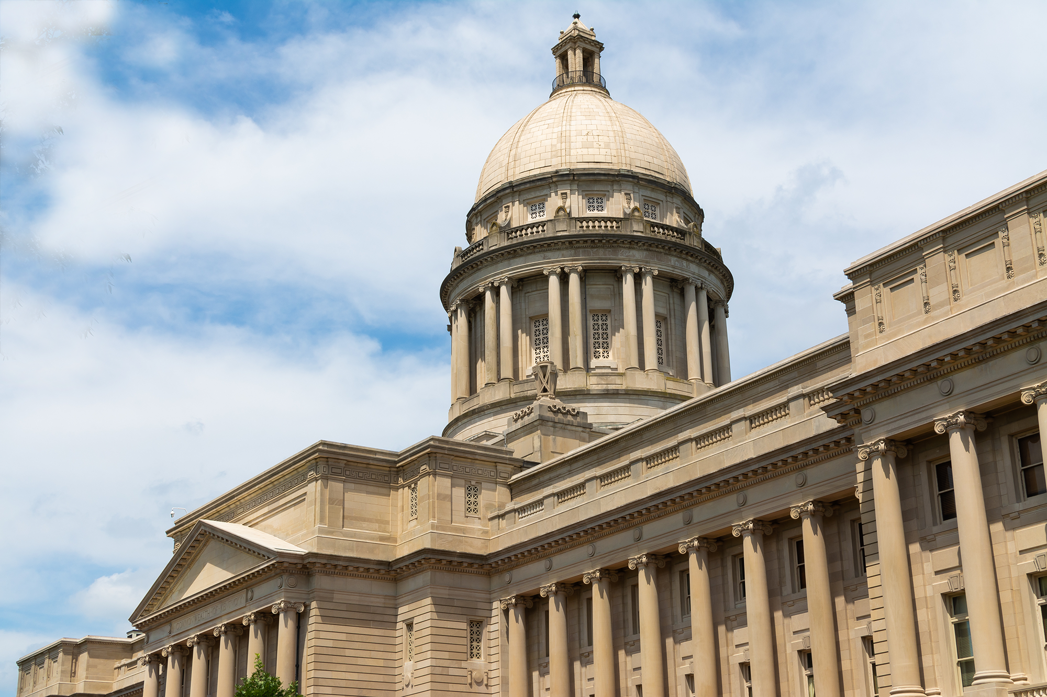
Federal Level: Legislative Branch
Big Beautiful Bill and AI:
“No state or political subdivision thereof may enforce, during the 10-year period beginning on the date of the enactment of this Act, any law or regulation of that State or a political subdivision thereof limiting, restricting, or otherwise regulating artificial intelligence models, artificial intelligence systems, or automated decision systems entered into interstate commerce.”
Senate version and new BEAD funding
The bill does NOT limit states from removing legal impediments, promoting growth, including regulatory streamlining.
It also addresses taxes, fees, bonding, and civil liability.

Slide 4
AI Legislation Enacted in the States

Slide 5
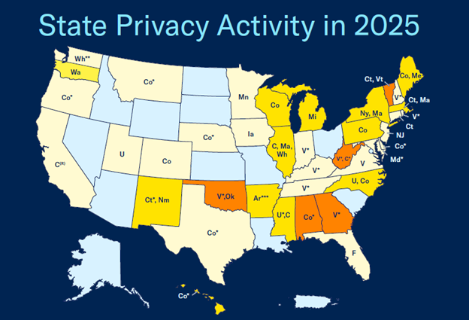
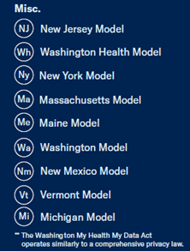
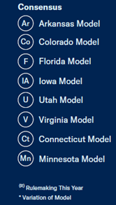
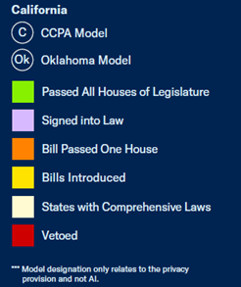
Remember Data Privacy

Slide 6
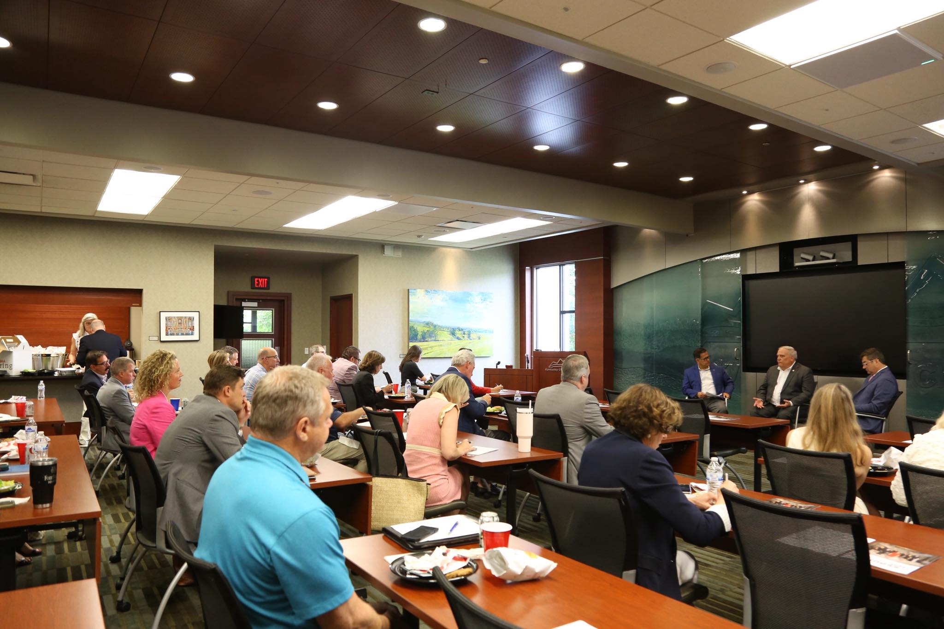
Kentucky Chamber’s Perspective
“Ideally, the United States will adopt a federal approach to any new regulatory framework to avoid the patchwork of laws that businesses have faced in other areas. As policymakers attempt to develop a new regulatory framework, it is critical that any new rules take into consideration existing laws that may be applicable to AI, avoid conflict with existing law, allow for industry engagement and expertise, be flexible to accommodate a rapidly changing landscape, and proceed incrementally so as not to stifle innovation.”

