Slide 1

Commission on AI in Education:
An Overview of the Work to Date
Jeff Gagné, Policy Director

Slide 2
The Commission’s Charge
The Commission will evaluate research, industry data and advice from experts to determine how education can successfully adopt and integrate AI across the region and lead the nation.
The Commission will then develop recommendations for
policies regarding the use of AI in K-12 and postsecondary education,
use of AI in instruction to promote AI literacy among students, educators, and the workforce and
the development of skills and seamless pathways in the education-to-workforce system to meet industry and state needs.

Slide 3
AI Commission Subcommittees
AI Policy
PSE AI Instruction
K-12 AI Instruction
AI Skill Development

Slide 4
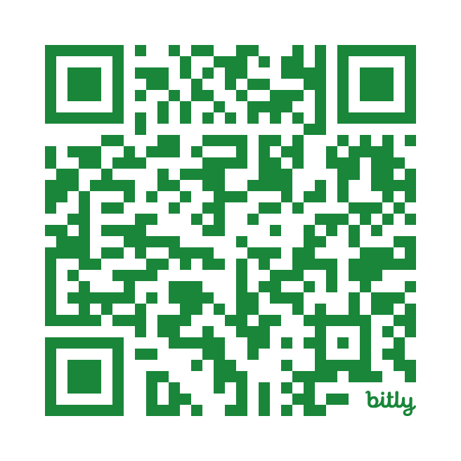
Adopted Policy Recommendations to date
1- State Networks
2- Targeted Guidance
3- Professional Development
4- Standards & Curricula
5- Local Capacity Assessments
6- Resource Plans
7- Risk Management
8 - Procurement
Notes:
https://www.sreb.org/ai-commission-recommendations

Slide 5
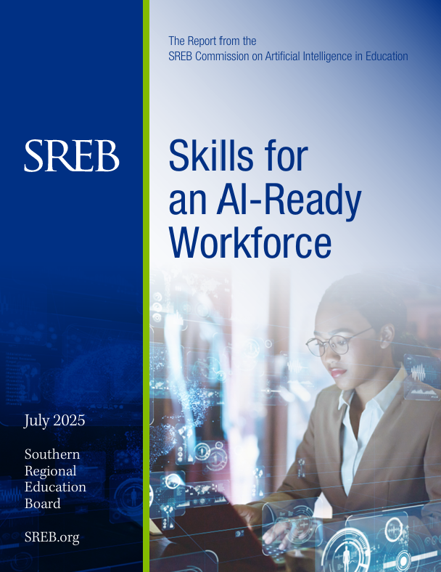
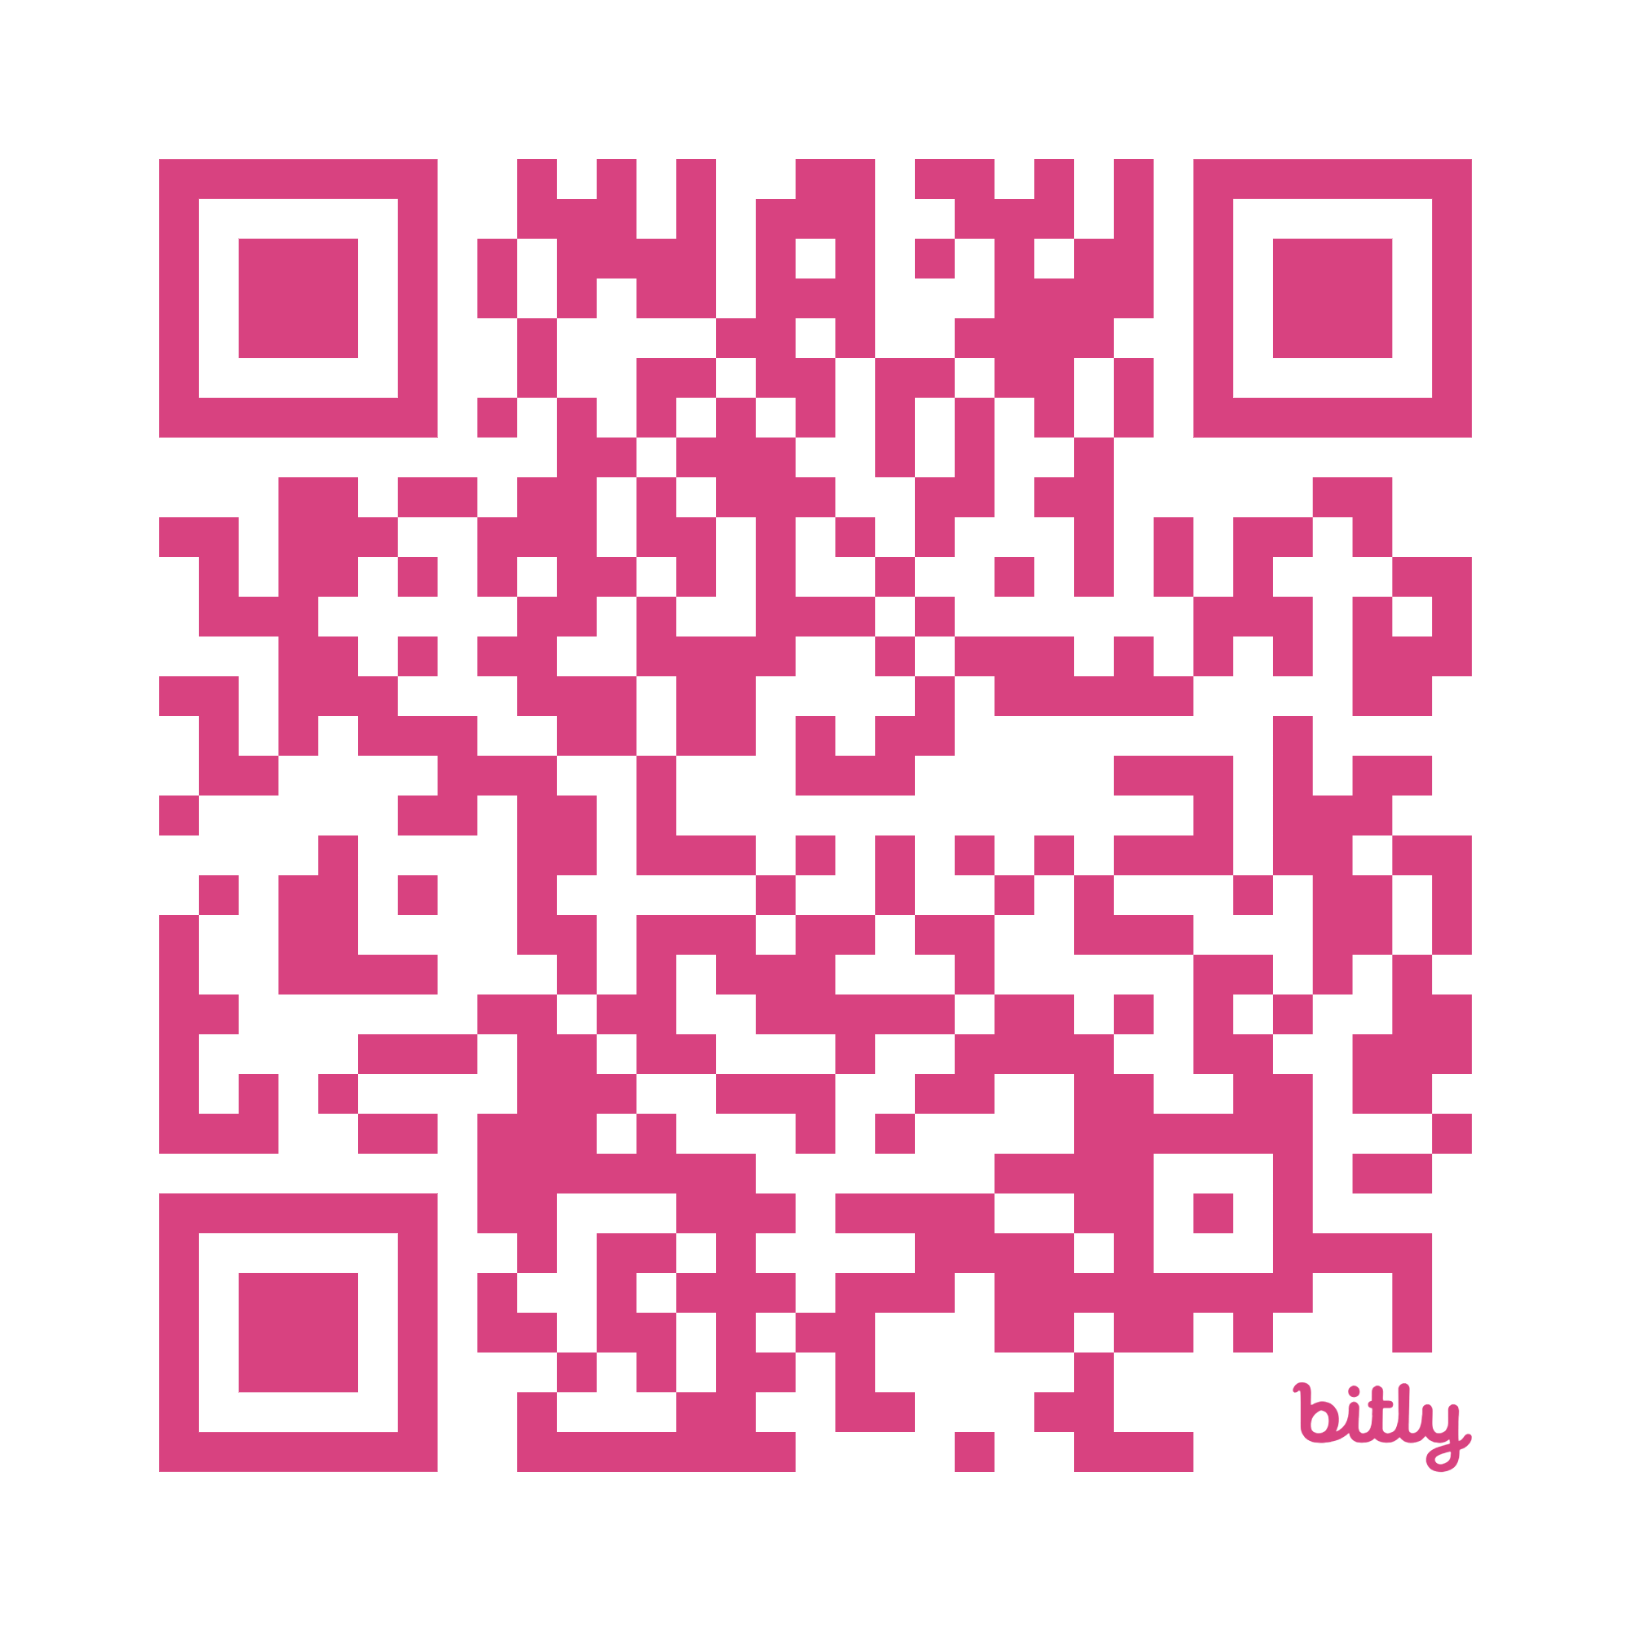
AI Skill Development
Notes:
https://www.sreb.org/publication/skills-ai-ready-workforce-0

Slide 6
Recommended Actions
Embed AI Across Core Content and Career and Technical Education Standards
Strengthen and Modernize Digital Learning and Computer Science Standards
Strengthen Collaboration with Industry, Workforce Agencies, and Economic Development Organizations
Embed AI-Ready Competencies Across Workforce Training and Upskilling Programs
Provide Comprehensive AI Professional Development for Educators
Establish Monitoring and Evaluation Mechanisms for AI Readiness

Slide 7
SREB’s Skills for an AI-Ready Workforce
Industry Baseline Skills
Success Skills
Technical Skills

Slide 8
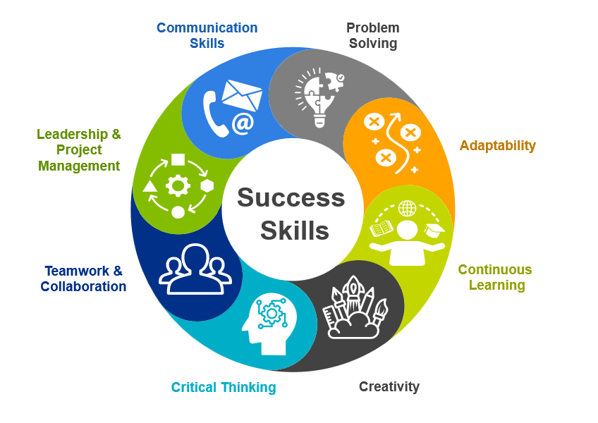
Success Skills

Slide 9
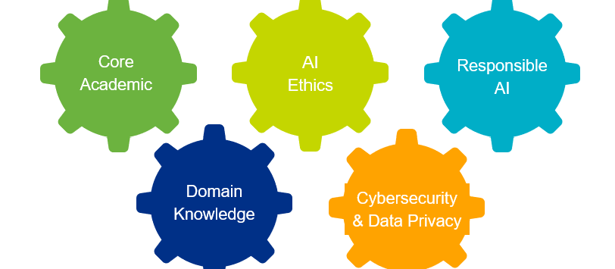
Industry Baseline Skills

Slide 10
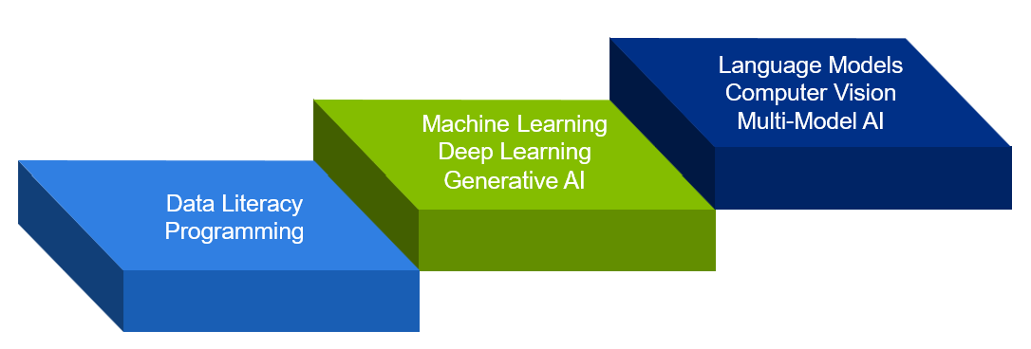
Technical Skills

Slide 11
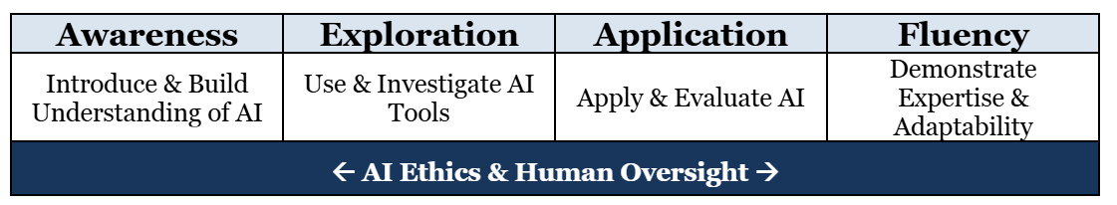
AI Learning Progressions

Slide 12
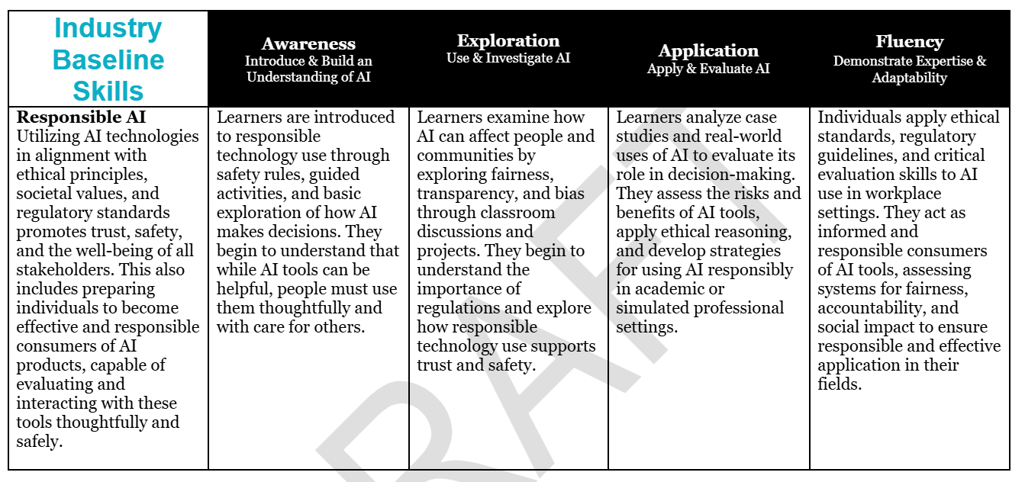
Sample Skill and Progression

Slide 13
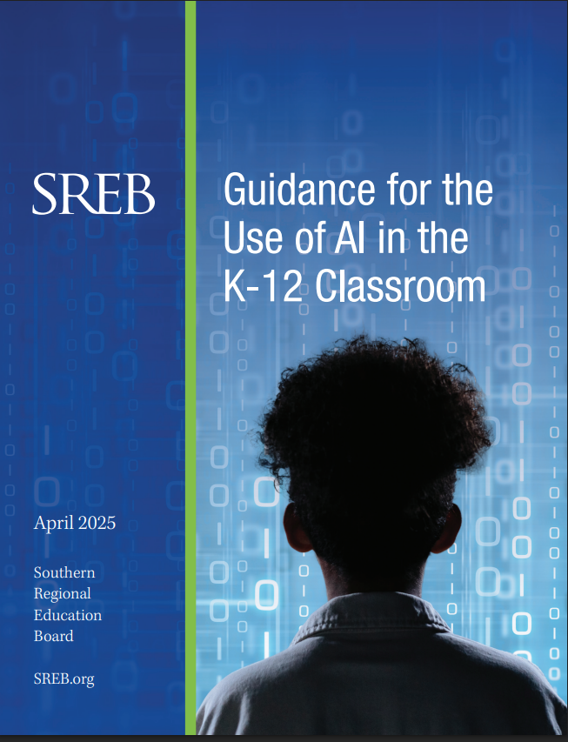
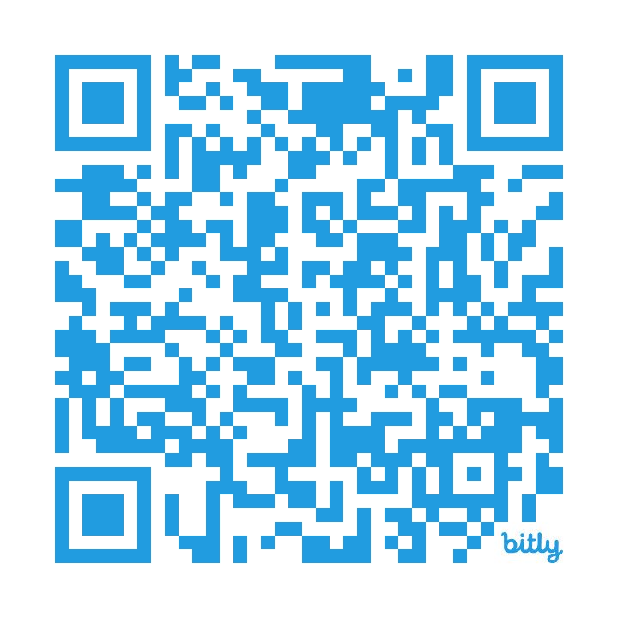
Promotes thoughtful and responsible adoption of AI in education
Highlights opportunities to enhance personalized learning and improve data-driven decision-making
Addresses data privacy and bias
Focuses the human element in teaching
Notes:
Link to website: https://www.sreb.org/sites/main/files/file-attachments/2025_ai_in_k-12classroom_guidance.pdf?1744905120

Slide 14
Four Pillars of AI Use in the Classroom
Powerful Teaching and Learning
Cognitively Demanding Instruction
Support Teacher Administrivia
Support Personalized Learning
Students Ethical and Proficient Users of AI
Pillars of AI Use in the K-12 Classroom

Slide 15
Pillar 1: Enhancing Cognitive Demand with AI Creating Engaging, High-Level Tasks
Use AI-infused tools to develop more cognitively demanding tasks that increase student engagement with creative problem-solving and innovative thinking.
Opportunities:
AI as a Lesson Planning Partner
Critical Thinking Skills
Project-Based Learning and Interdisciplinary Assignment Creation
Interactive Simulation and Scenario Creation
Student-Generated Content
Counter Perspective

Slide 16
Pillar 2: Streamlining Teacher Administrative Work Reducing Administrative Burden with AI
Use AI to streamline teacher administrative and planning work.
Opportunities:
AI as a Planning Partner
Improve and Enhance Current Assignments
Help with Providing Feedback on and Grading Student Work
Support with Other Aspects of Teaching
Behavioral Insights
Notes:
One area where AI shines is in lesson planning. Tools like ChatGPT can provide initial ideas aligned with pedagogical goals or generate examples tailored to specific student needs. This not only saves time but can enhance the quality and personalization of educational content.
AI also supports administrative work, such as translating materials for multilingual classrooms or drafting routine communications. By handling these background tasks, AI empowers teachers to focus on what matters most: fostering student engagement and learning.

Slide 17
Pillar 3: Supporting Personalized Learning with AI Tailoring Education to Individual Needs
Use AI to support personalized learning.
Opportunities:
Supporting Students with Special Needs
Intelligent Tutoring Systems
Predictive Analytics
Automated Feedback
Customizable Learning Resources
Enhanced Collaboration Tools
Natural Language Processing for Support
Early Monitoring of Students
Language Translation and Support
Adaptive Learning Platforms

Slide 18
Pillar 4: Developing Ethical and Proficient AI Users Building Responsibility in AI Use
Develop students as ethical and proficient AI users.
Opportunities:
Planning Stages of Academic Work
Critical Media Literacy
Cross-Disciplinary Learning
Student-led AI Ethics Committees

Slide 19
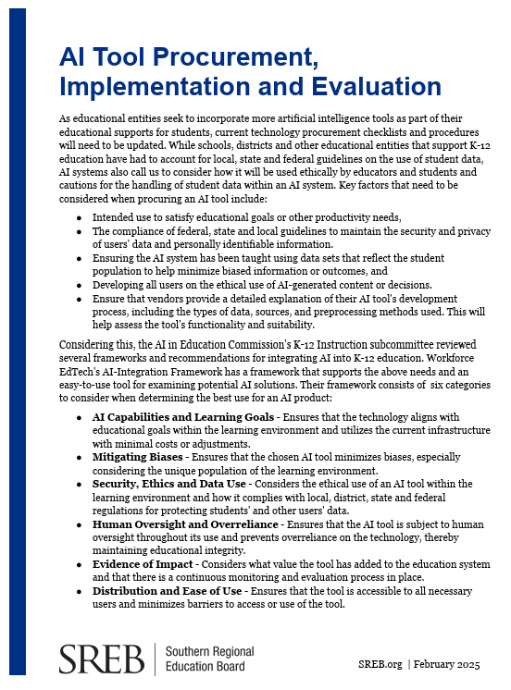
Procurement Tool
SREB created this checklist to help K-12 educators, schools and districts implement AI tools safely, effectively and ethically. It includes practical and targeted questions to:
Know what to ask before adopting new AI tools.
Protect data privacy and student safety.
Align AI use with educational goals.
Stay compliant with regulations.
Notes:
https://www.sreb.org/publication/ai-tool-procurement-implementation-and-evaluation-checklist

Slide 20
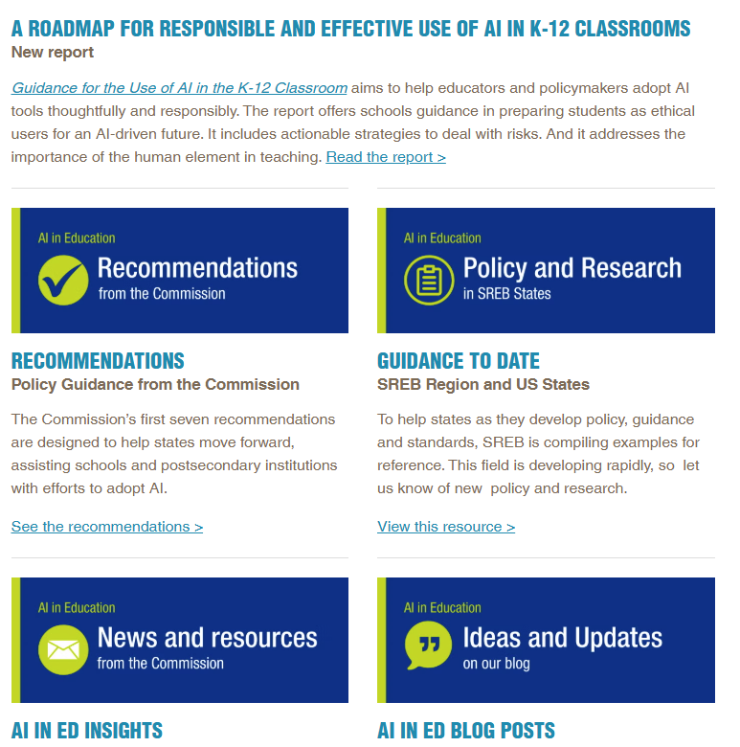
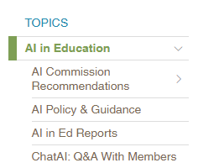
SREB | AI in Education
https://www.sreb.org/topic-ai-education-0

Slide 21
For more information, please contact
Jeff Gagne, Policy Director
jeff.gagne@sreb.org
and
Ivy Coburn, Division Director Education and Workforce
Ivy.Coburn@sreb.org

