Slide 1
Founders Fund
August 2025

Slide 2
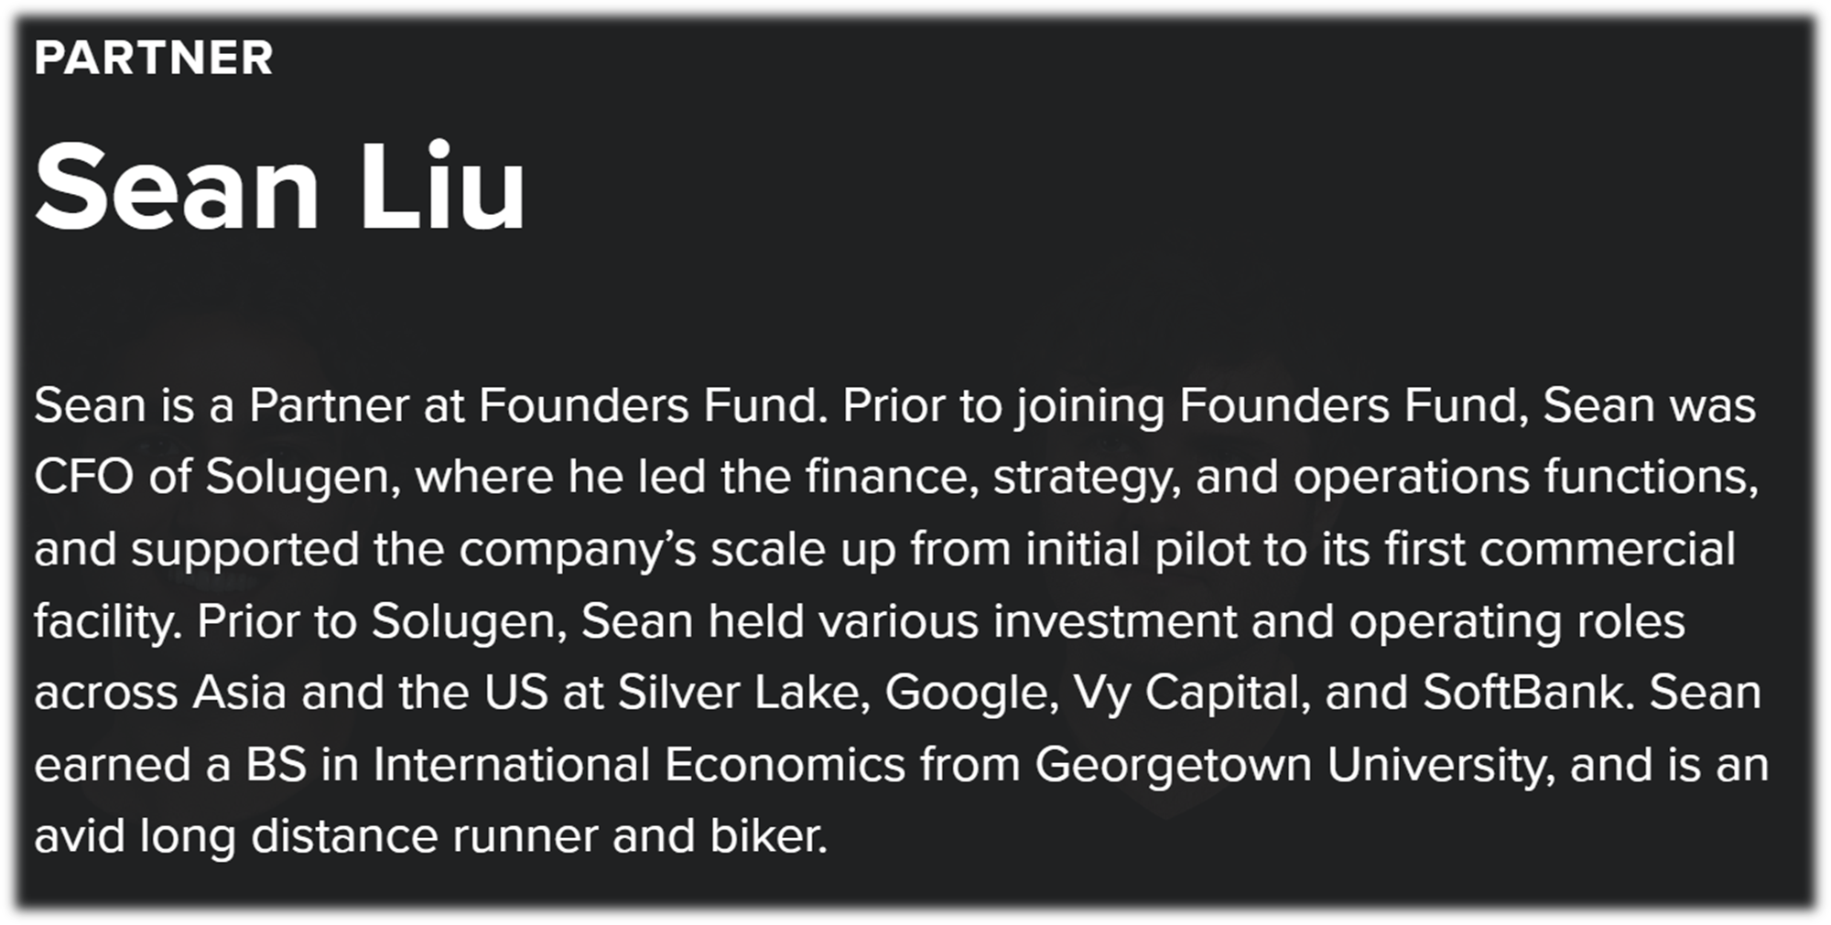

Introduction

Slide 3
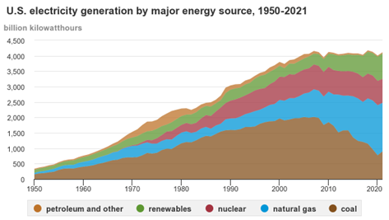
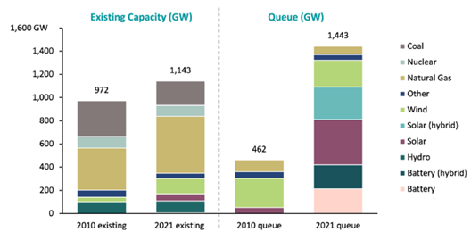
Powering AI - Lagging Grid & Generation Capacity in the US
US generation capacity peaked for >20 years…
…with lagging ability to bring on new power

Slide 4
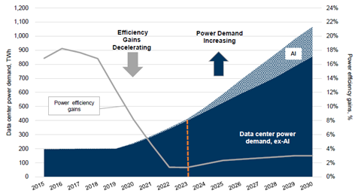
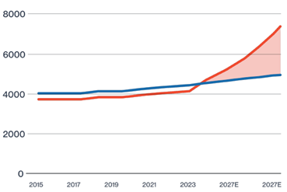
Powering AI - Surging Demand from AI Forecasted to Cause Grid Stress
AI factory power demand will
increase 3x in the next 5 years…
…and coupled with reindustrialization, will lead to large supply / demand mismatches

Slide 5
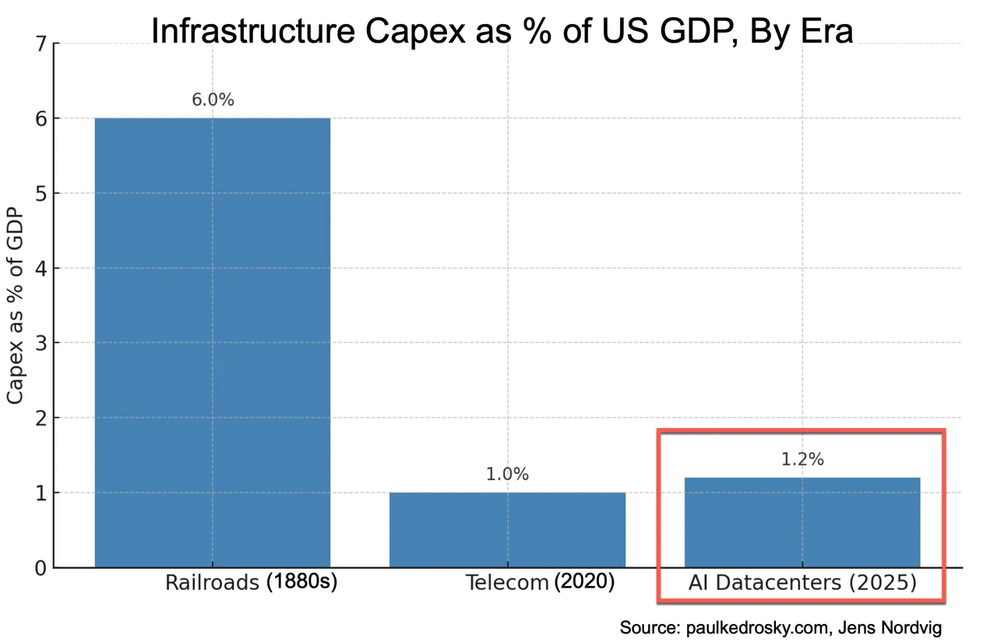
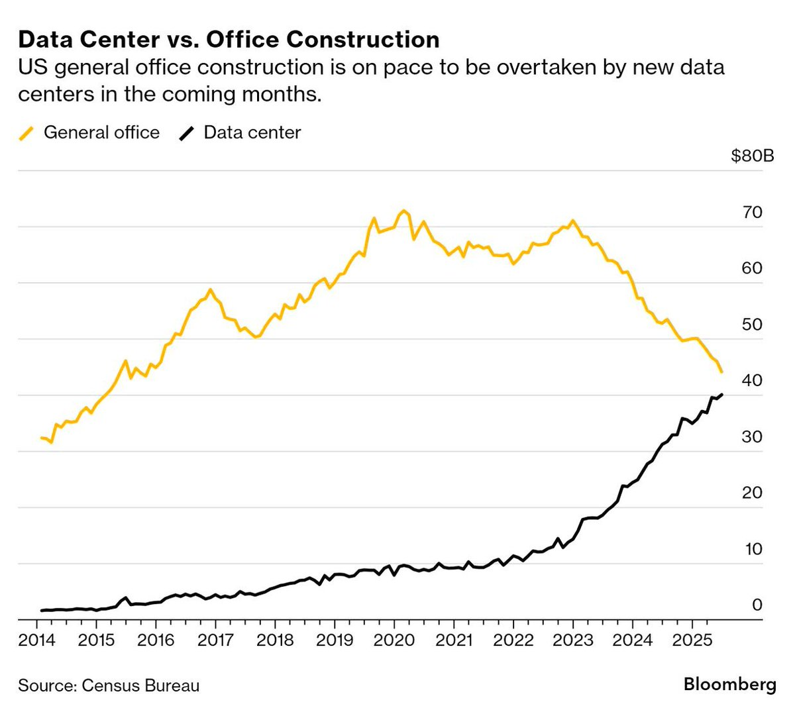
Deploying AI - Still In its Early Innings but Already Large $$$s
AI is the next industrial revolution and we are still in the early innings vs. past cycles…
…but the absolute $$$s are larger than anything we have seen in the past

Slide 6
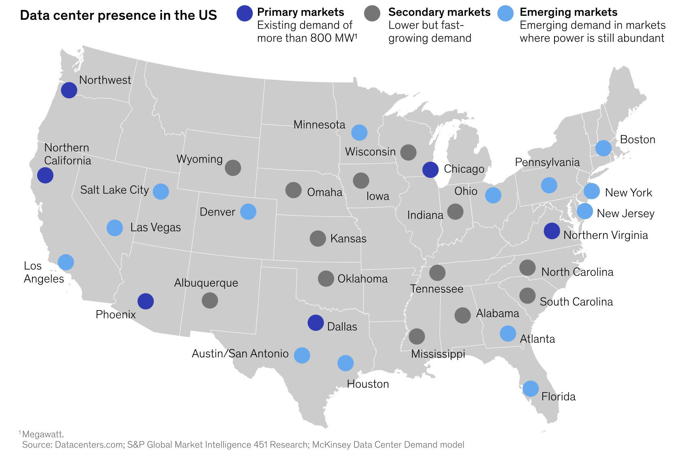
Deploying AI - The Battle for Energy, Talent and Support (1/3)
AI’s need is redrawing the opportunity map in the US, and creating new emerging markets where energy is abundant

Slide 7
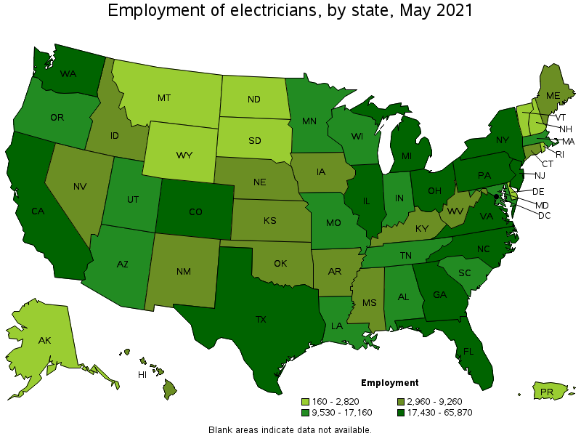
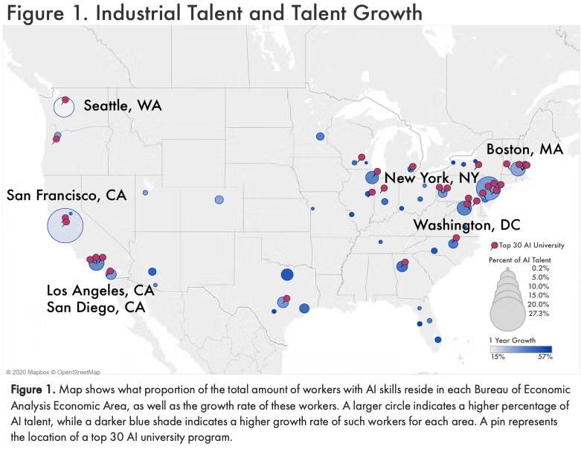
Deploying AI - The Battle for Energy, Talent and Support (1/3)
AI research firms are battling for research talent, who largely resides in San Francisco…
…but the long-term battle is one in the physical world - over electricity, HVAC, steel, and water
Notes:
Crusoe’s Data center is creating 5000 jobs in texas

Slide 8
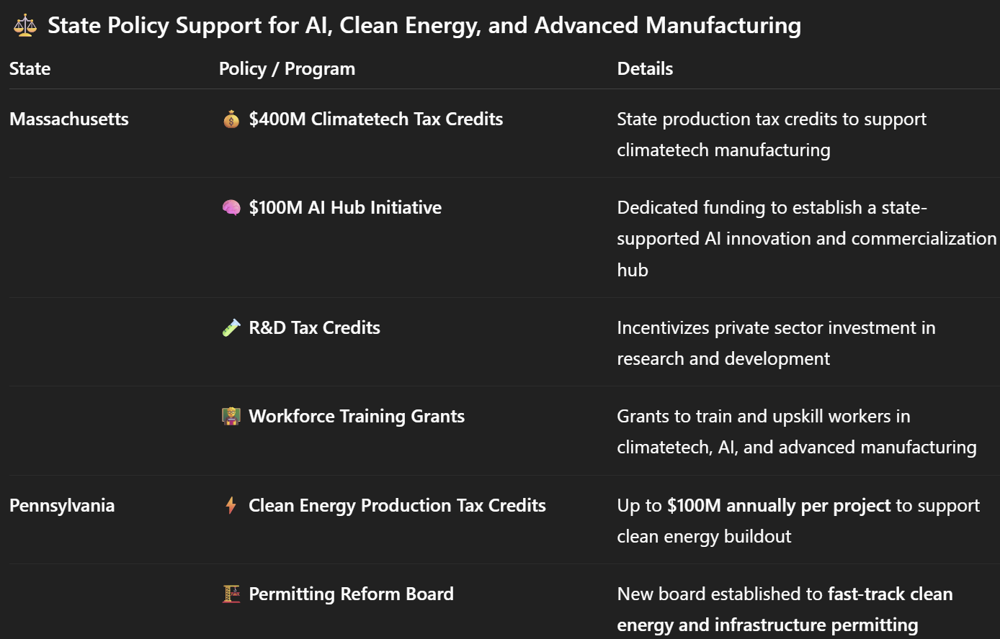
Deploying AI - The Battle for Energy, Talent and Support (1/3)
States are wooing AI across 4 areas:
ITC / PTC energy tax subsidies
Support for energy producers (both fuel and IPPs)
Speed to power / approval (permitting reform)
Workforce training programs

Slide 9
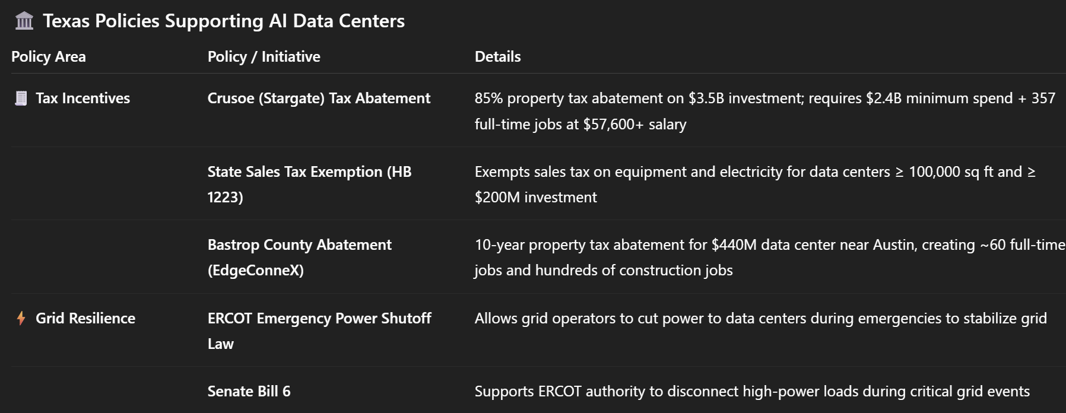
Deploying AI - A Case Study of Crusoe in Abilene Texas
Big AI $$$s requires big support and states that are winning are the fastest in moving …

