Slide 1

Fueling American Intelligence
Kentucky AI Task Force
1
August 14, 2025

Slide 2
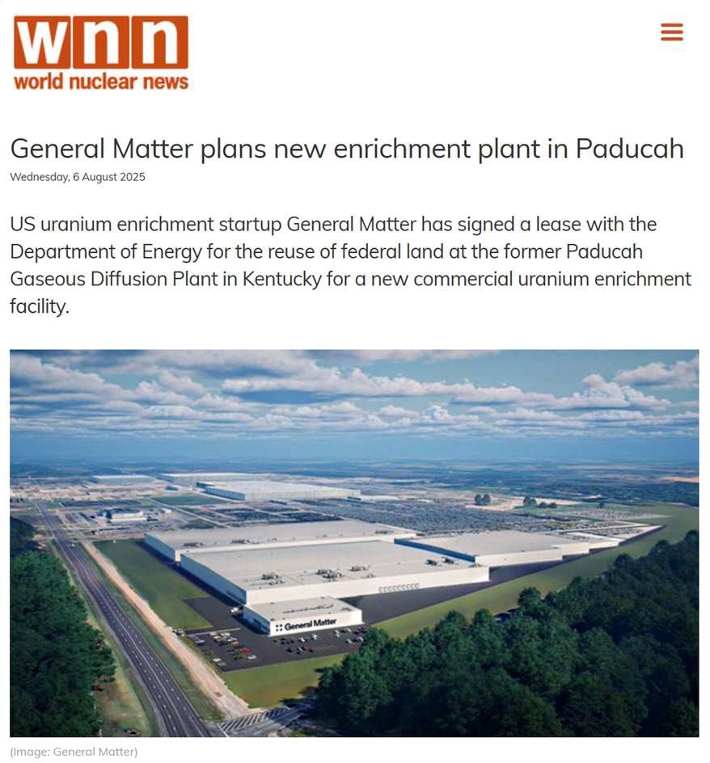
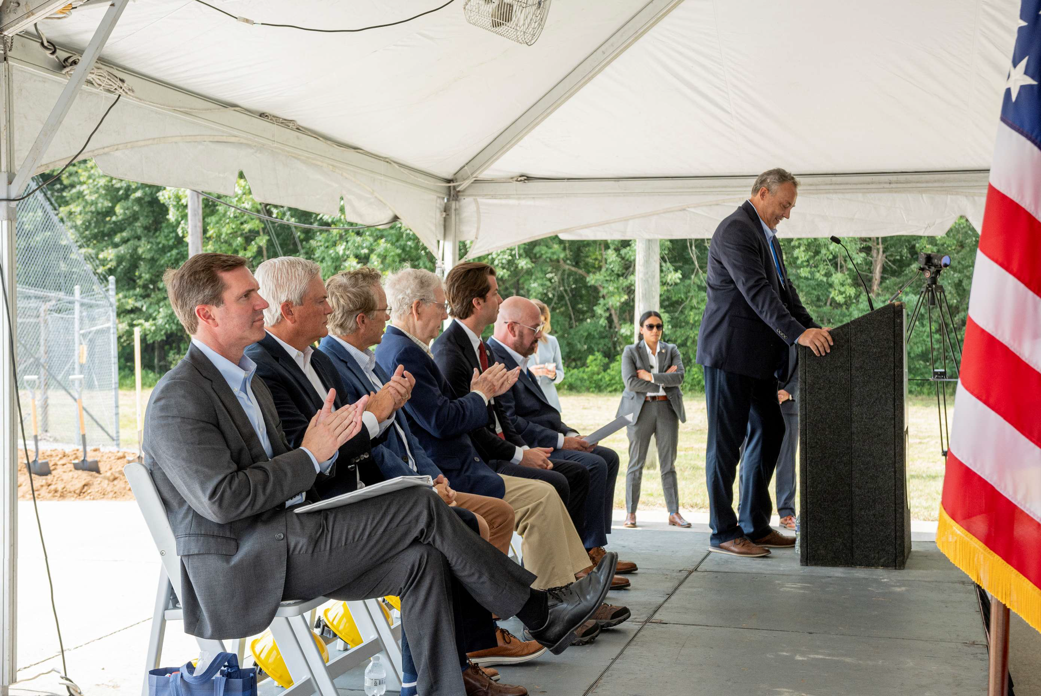
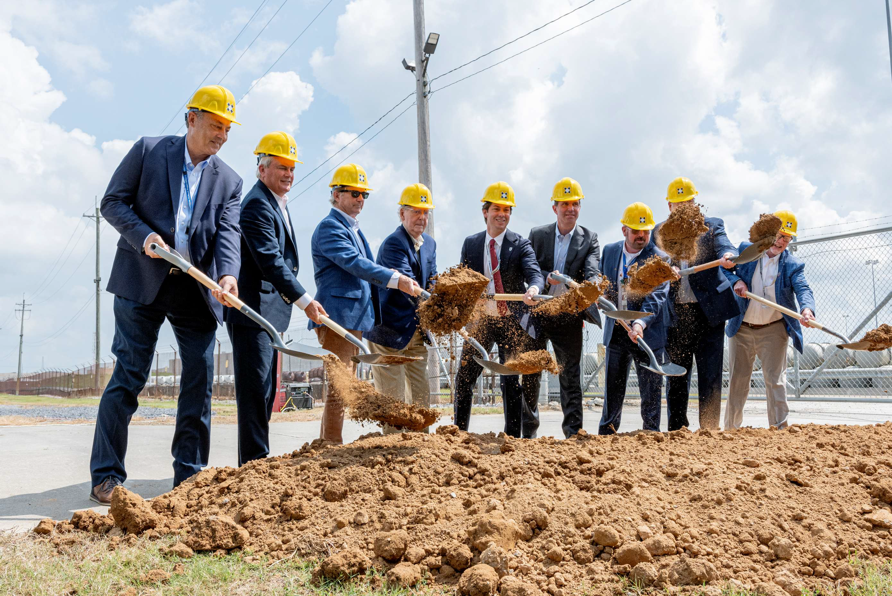
Last week we announced our first enrichment site, in Paducah
Fueling American Power
2

Slide 3
We are restoring US leadership in nuclear fuel production
Fueling American Power
3
01
02
03
04
05
Mining/ Milling
Fuel Fabrication
Conversion
Enrichment
Deconversion
Paducah UF6
Paducah LEU

Slide 4
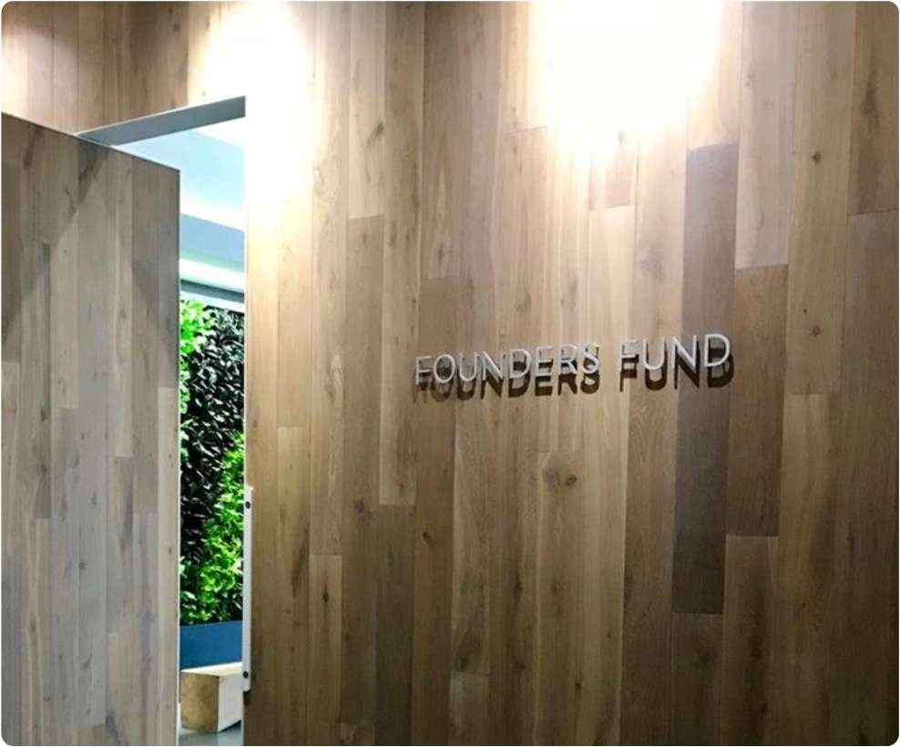



We are backed by Founders Fund, a leading VC known for partnering with the government to transform critical industries
Fueling American Power
4
Global leader in launch services Enabled by NASA COTS program Now 15,000 employees; $10B+ raised
Leading big data intelligence software Catalyzed by early CIA partnership Now 5,000 employees; $2B+ raised
Autonomy-focused defense prime Launched with DHS contracts
Now 5,000 employees; $3B+ raised

Slide 5
AI relies on three inputs, with power the scaling bottleneck
Fueling American Power
5
“Eventually the cost of intelligence, the cost of AI, will converge to the cost of energy. And [in the end] it’ll be how much you can have the abundance of it will be limited by the abundance of energy.
Algorithms
“So, in terms of long-term strategic investments for the US to make, I can’t think of anything more important than energy.”
- Sam Altman, CEO, OpenAI
Power
"Then, the next shortage will be electricity. They won't be able to find enough electricity to run all the chips. I think next year, you'll see they just can't find enough electricity to run all the chips.”
Chips
- Elon Musk, CEO, xAI

Slide 6
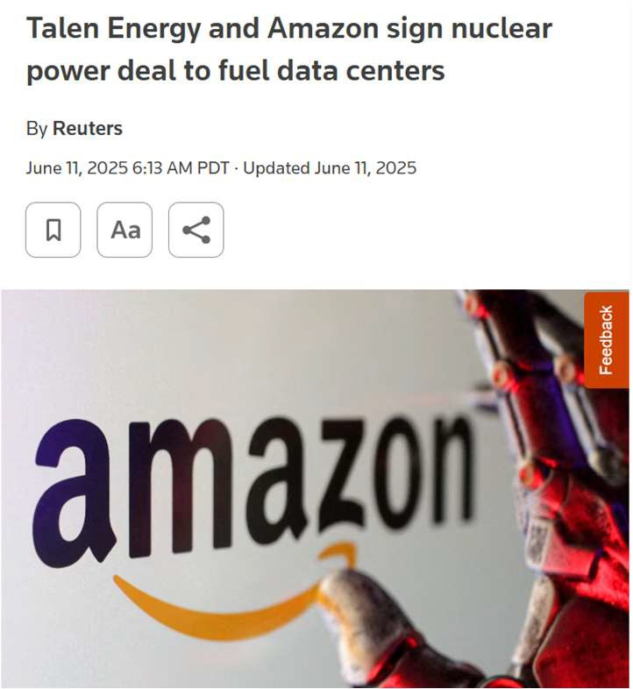
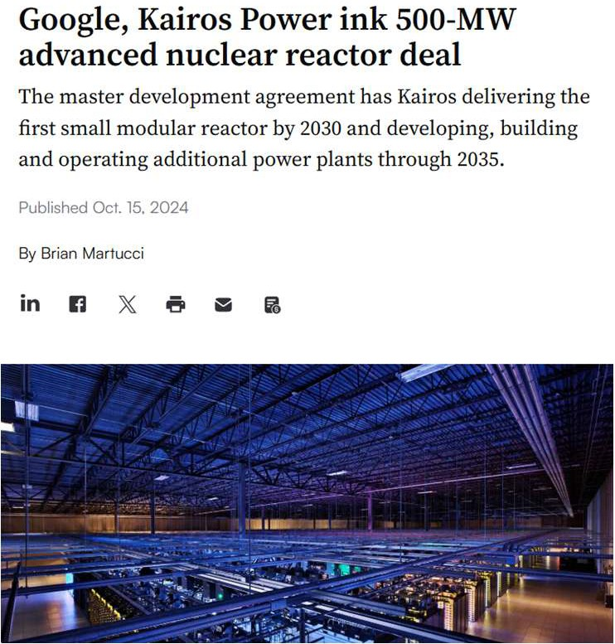
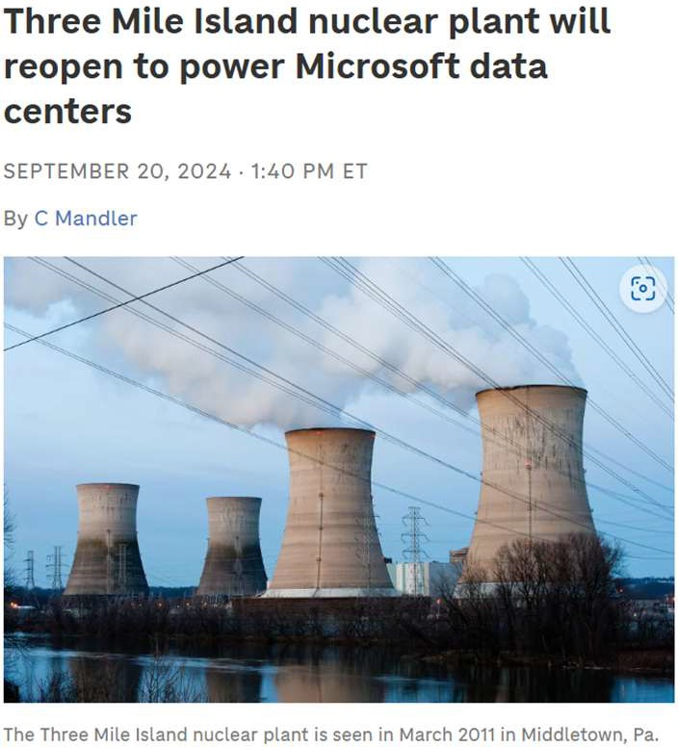
To scale, data centers are relying on clean, safe nuclear power
Fueling American Power
6

Slide 7
Leadership in nuclear energy therefore enables leadership in AI
Fueling American Power
7
Nuclear Fuel
Nuclear Reactors
Data Centers

Slide 8
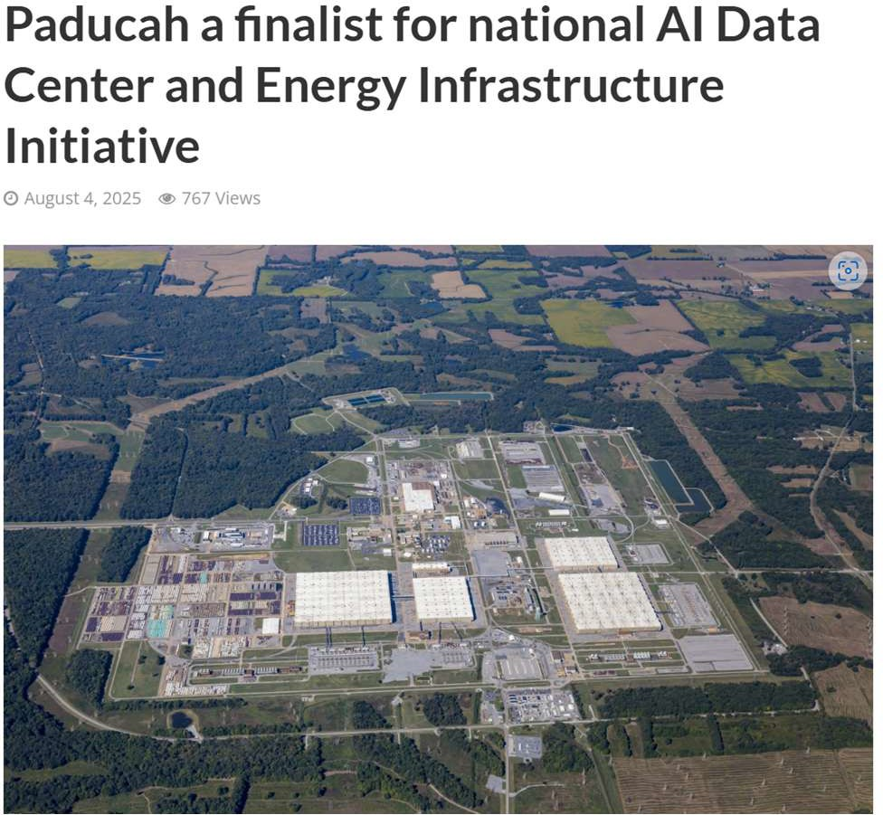
The DOE picked Paudcah as one of four AI infrastructure sites…
Fueling American Power
8

Slide 9
….because it has most of the attributes AI data centers look for
Fueling American Power
9
Power
Gigawatt-scale energy resources
Community
Workforce, permitting, local support
Water Ample water for chip cooling
Tax burden
Compelling financial profile

Slide 10
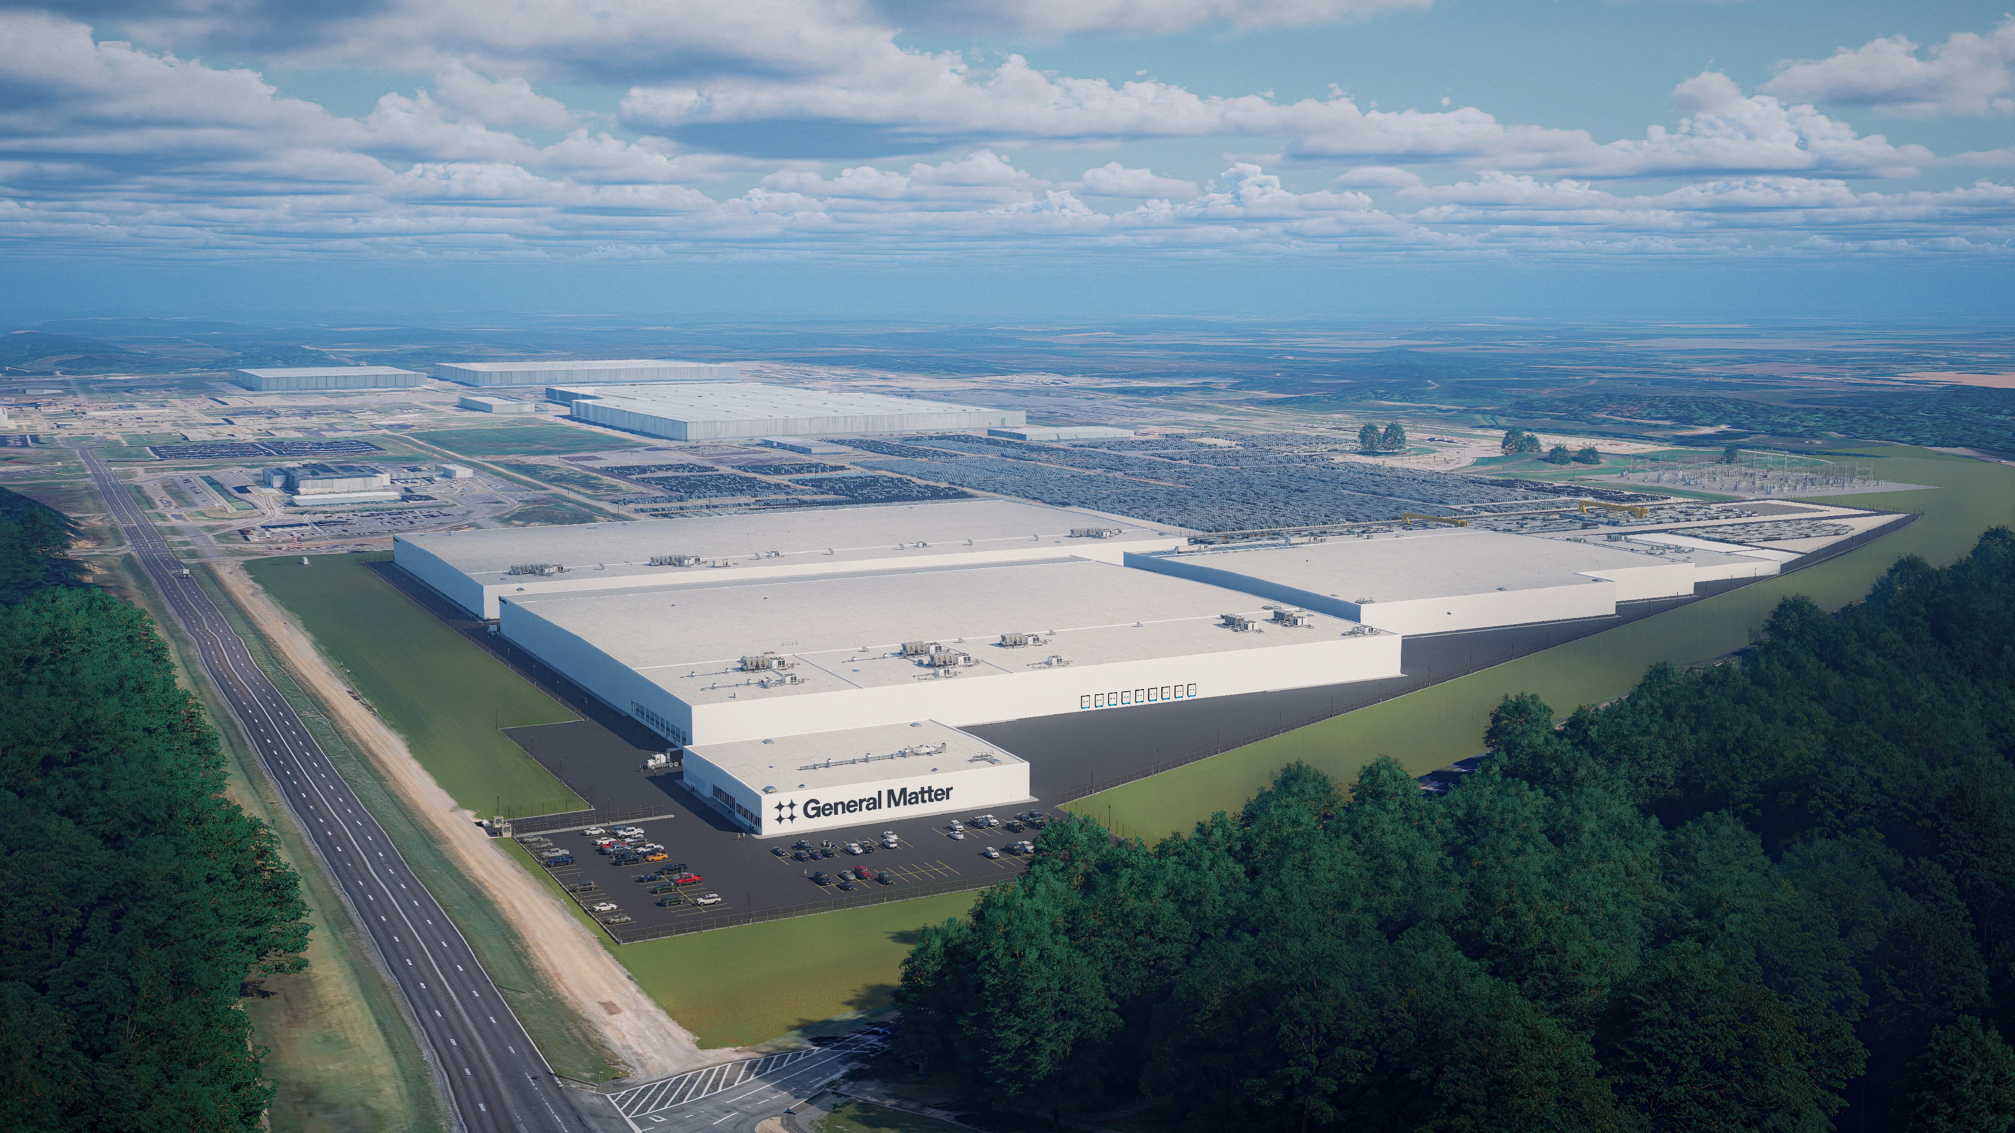
We are eager to support your work and to host you in Paducah
Fueling American Power
10

Slide 11

Clean energy is a… Energy growth is a…. Energy security is a…. National security is a…
Fueling American Power
General Matter

