Slide 1
LG&E and KU Helping Power Kentucky’s Growth
John Bevington, Sr. Director
AI Task Force — Roundtable

Slide 2
Overview
LG&E & KU Overview
An overview of our economic development pipeline
AI and Cloud data center, site selection process and benefits
LG&E and KU obligation to serve and how we're preparing to maintain a competitive advantage with energy

Slide 3
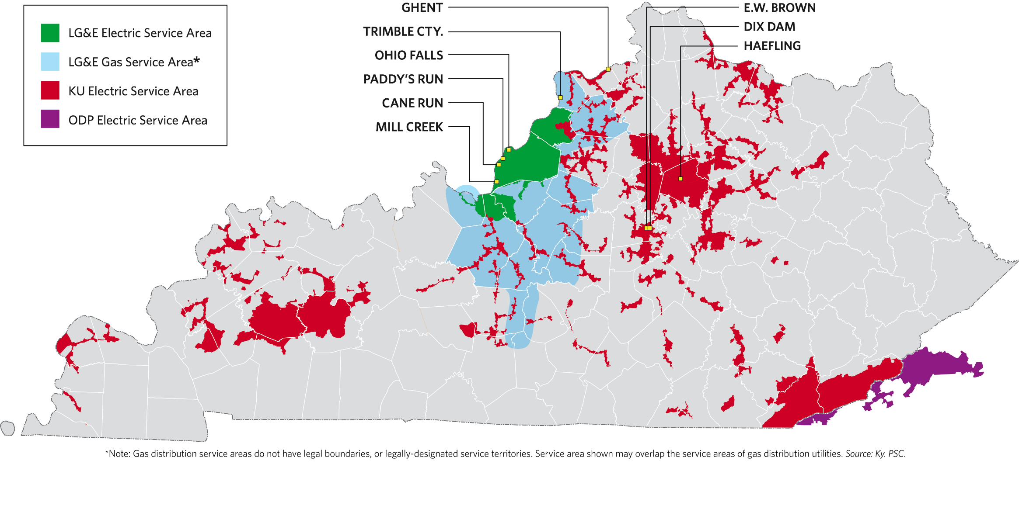
Company Overview
Vertically-integrated utilities with territory in 90 Kentucky counties in Kentucky plus 5 in Virginia
Over 1.3 million customers
7.5GW of owned/ regulated power

Slide 4

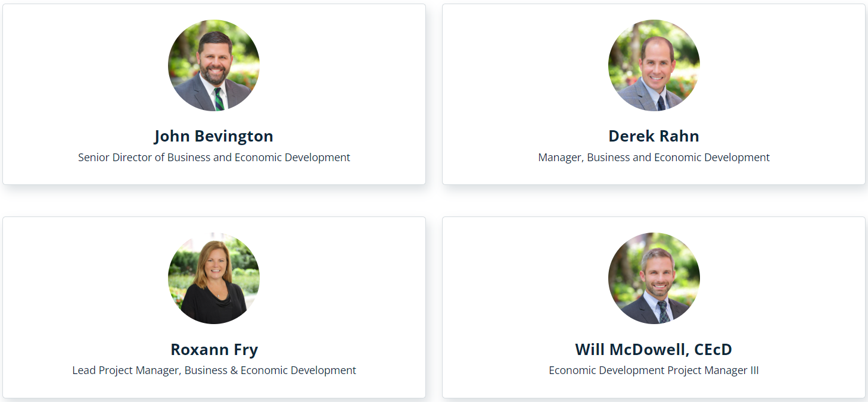
LG&E-KU Business & Economic Development
Our energy goes to powering businesses and empowering growth.
Top U.S. utility for corporate facility investment and job creation
LG&E and KU supported 76 projects in 2024
$2.8 billion investments
3,113 new jobs announced
Companies in our service territories accounted for 45% of statewide investment announcements, with 39% of the investments and 34% of the jobs landing in LG&E and KU’s service territories

Slide 5
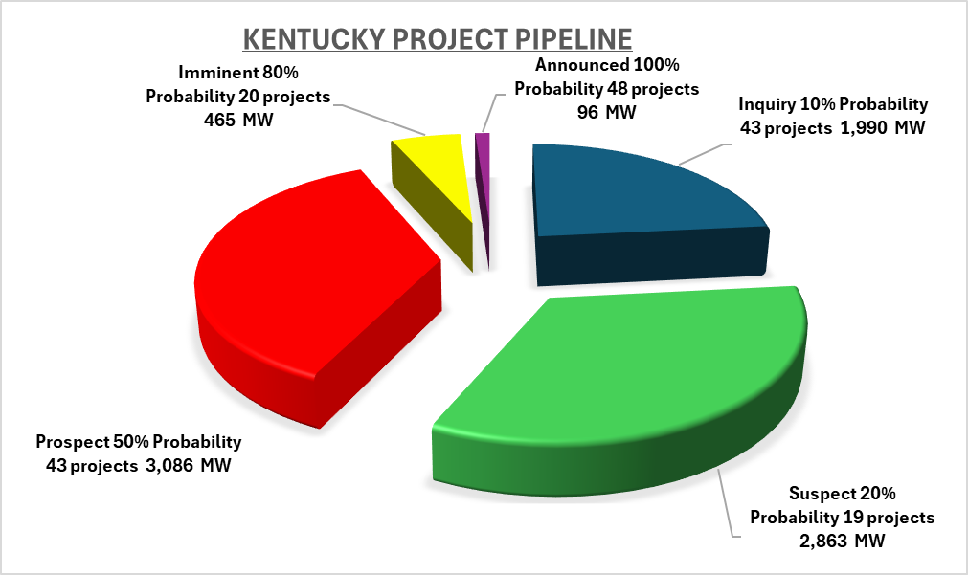
The Project Pipeline
The current pipeline of projects for Kentucky includes ~8.5 GW of new load potential from industrial expansion, new manufacturing projects, public benefits and healthcare investments, and data centers.
Data Centers represent 2/3 of the capacity requests in the pipeline

Slide 6
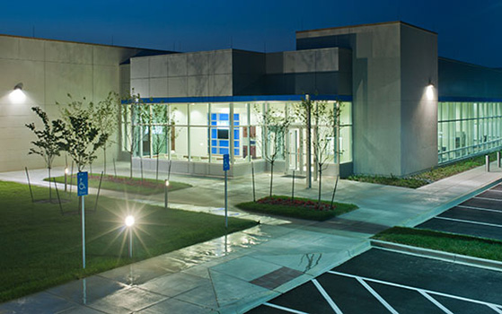

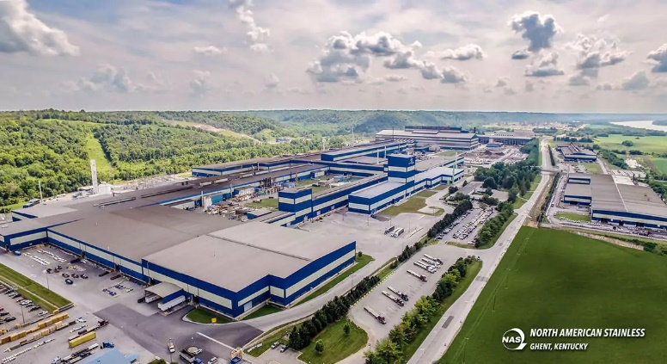

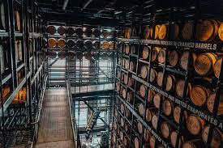
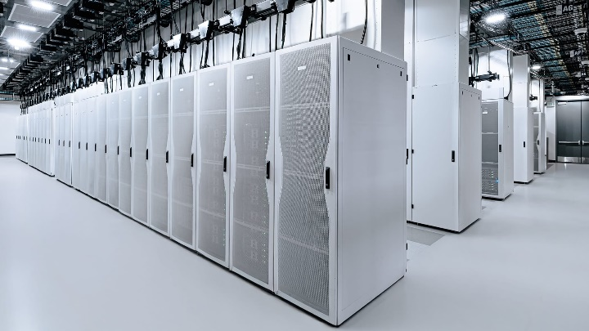

The Project Pipeline
Over 170 Projects totaling 8.5 GW of power has been requested!
New and existing Customer Expansions:
88 projects totaling 452 MW
24 (96MW) of which have been announced. To name a few: — Toyota – New Paint Line — North American Stainless – New mill —Univ of Kentucky – Expansions —GE Appliances
New Economic Development: (non-data center)
57 projects totaling 2.4 GW
27 (26MW) of which has or may be announced:
Automotive
Distilleries
Packaging
And more…
Data Center: (new and expanding)
20 projects totaling 5.6 GW
1 (525MW) of which has been publicly announced.
Stats are as of 7/14/2025 that was filed with the KPSC in Case 2025-00045.

Slide 7

Economic Site Selection Process
Traditional Process
Request for sites/acreage/building
Highway access
Rail/River access
Workforce access
Utility access
Short-list
Site visits
Negotiations/incentives
Final selection/announcement
vs.
Data Center Process
Find land near transmission infrastructure
Study lines capacity
Determine needed infrastructure upgrades
Seek needed regulatory approvals
Perform site due diligence
Sign agreements for financial protection
Procure long-lead investments
Announce project/begin construction

Slide 8
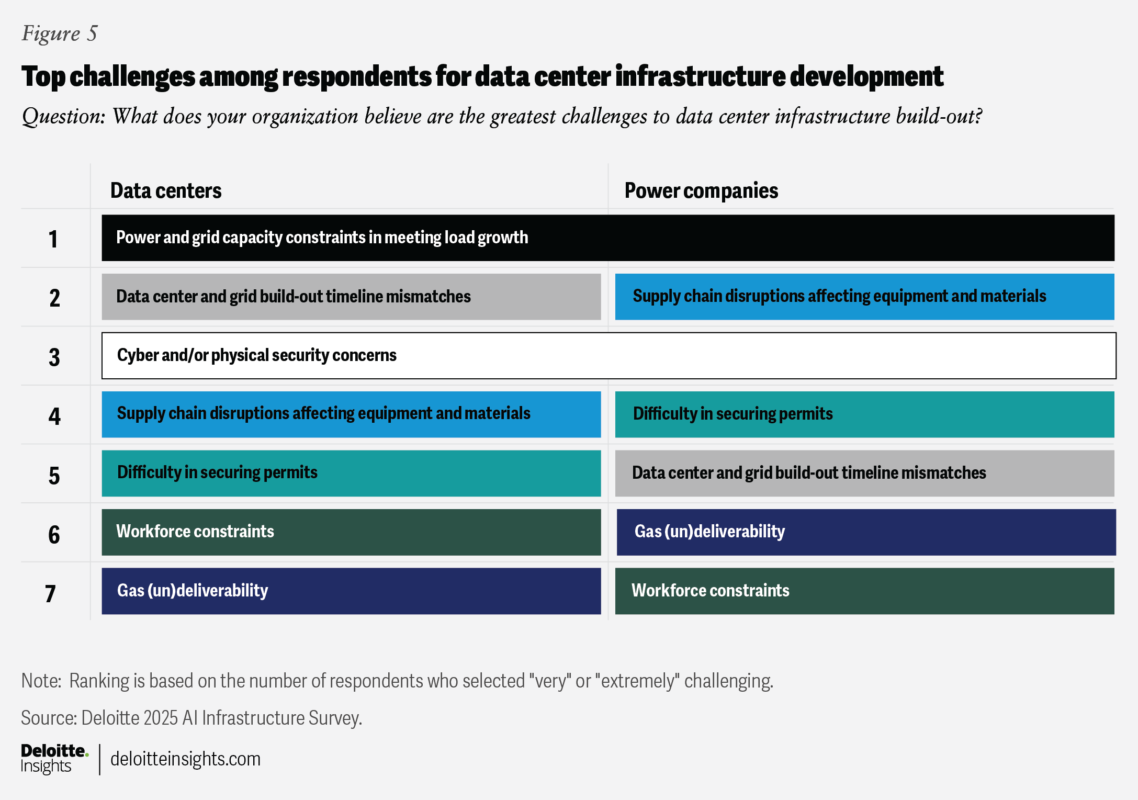
The Challenge/Opportunity

Slide 9
Additional Data Center Opportunities – Economic Development
According to a 2023 Data Center Coalition and PwC report:
Each data center job accounts for 6 jobs elsewhere in the economy (similar to manufacturing)
Total contribution to the US GDP grew 37% between 2017 and 2021 to $486 billion
Labor income earned directly from the data center industry grew by 74% between 2017-2021 from $43 billion to $75 billion
Ohio’s data center industry directly and indirectly generated $2.6 billion in state and local tax revenues from 2017-2021

Slide 10
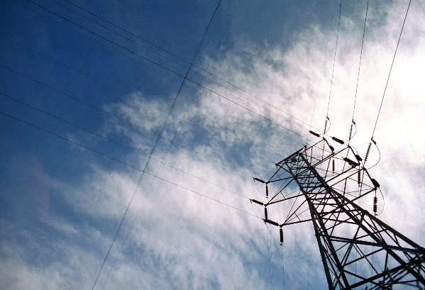
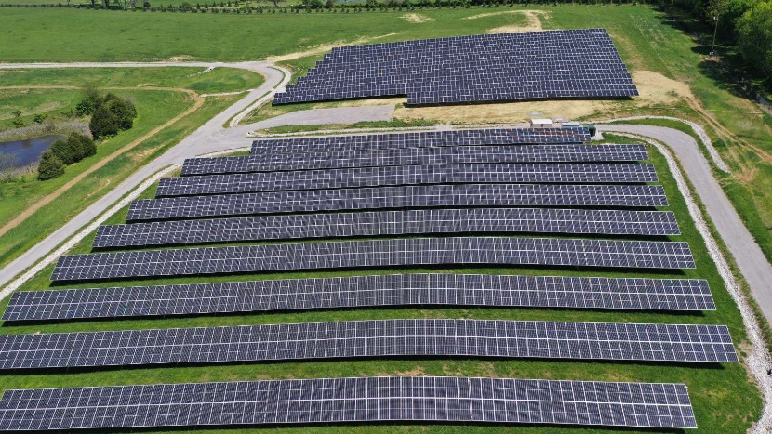
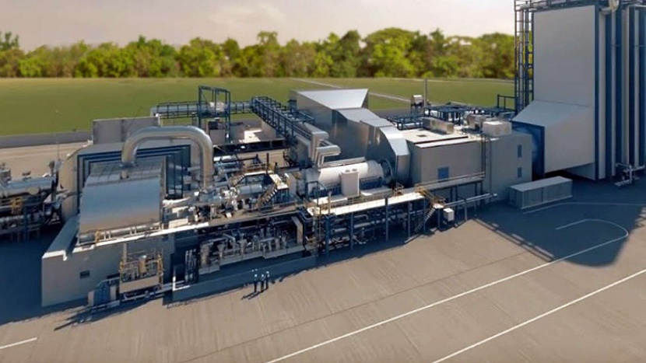
What are we doing to meet these demands?
Increasing our Transmission infrastructure for the increased demand
Self Build a ≈120MW solar facility in Mercer County
Single axis tracker rack system
Anticipated in-service date: 4Q26
Purchase a ≈120MW solar facility in Marion County (build and transfer)
All design and construction activities are the responsibility of the developer with input from the company
Anticipated in-service date: 2Q27
Construction of 645-megawatt natural gas combined-cycle units and more…
Mill Creek 5, under construction & available in 2028.
Regulatory Request, Certificate of Public Convenience and Necessity (CPCN)
Proposed in current CPCN settlement: —Brown 12, available in 2030. —Mill Creek 6, available in 2031. —Installation of a selective catalytic reduction facility to reduce nitrogen oxide (NOx) emissions for Ghent 2. —Extend the operation of Mill Creek 2
Notes:
This year we’re constructing a 120-megawatt solar facility in Mercer County and 125-megawatt battery storage unit at E.W. Brown to add to our generation fleet, and we’ve signed an agreement for the 120-megawatt solar facility to be built in Marion County.

Slide 11

Thank you! Q&A

