Slide 1

Building American data centers to meet consumer demand, create new tech jobs, and
beat China on AI
September 11, 2025
Bartlett Cleland, General Counsel

Slide 2
The Demand
Kentucky users, and all Americans, are driving ever-growing demand for data stored in “the cloud”
AI use requires even more data centers so we can increase our productivity and beat China

Slide 3

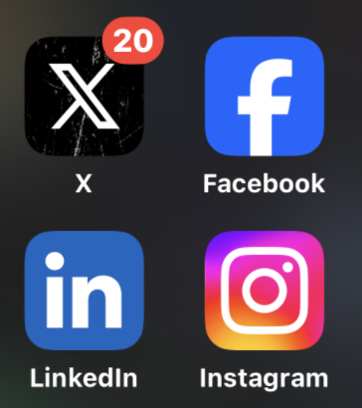
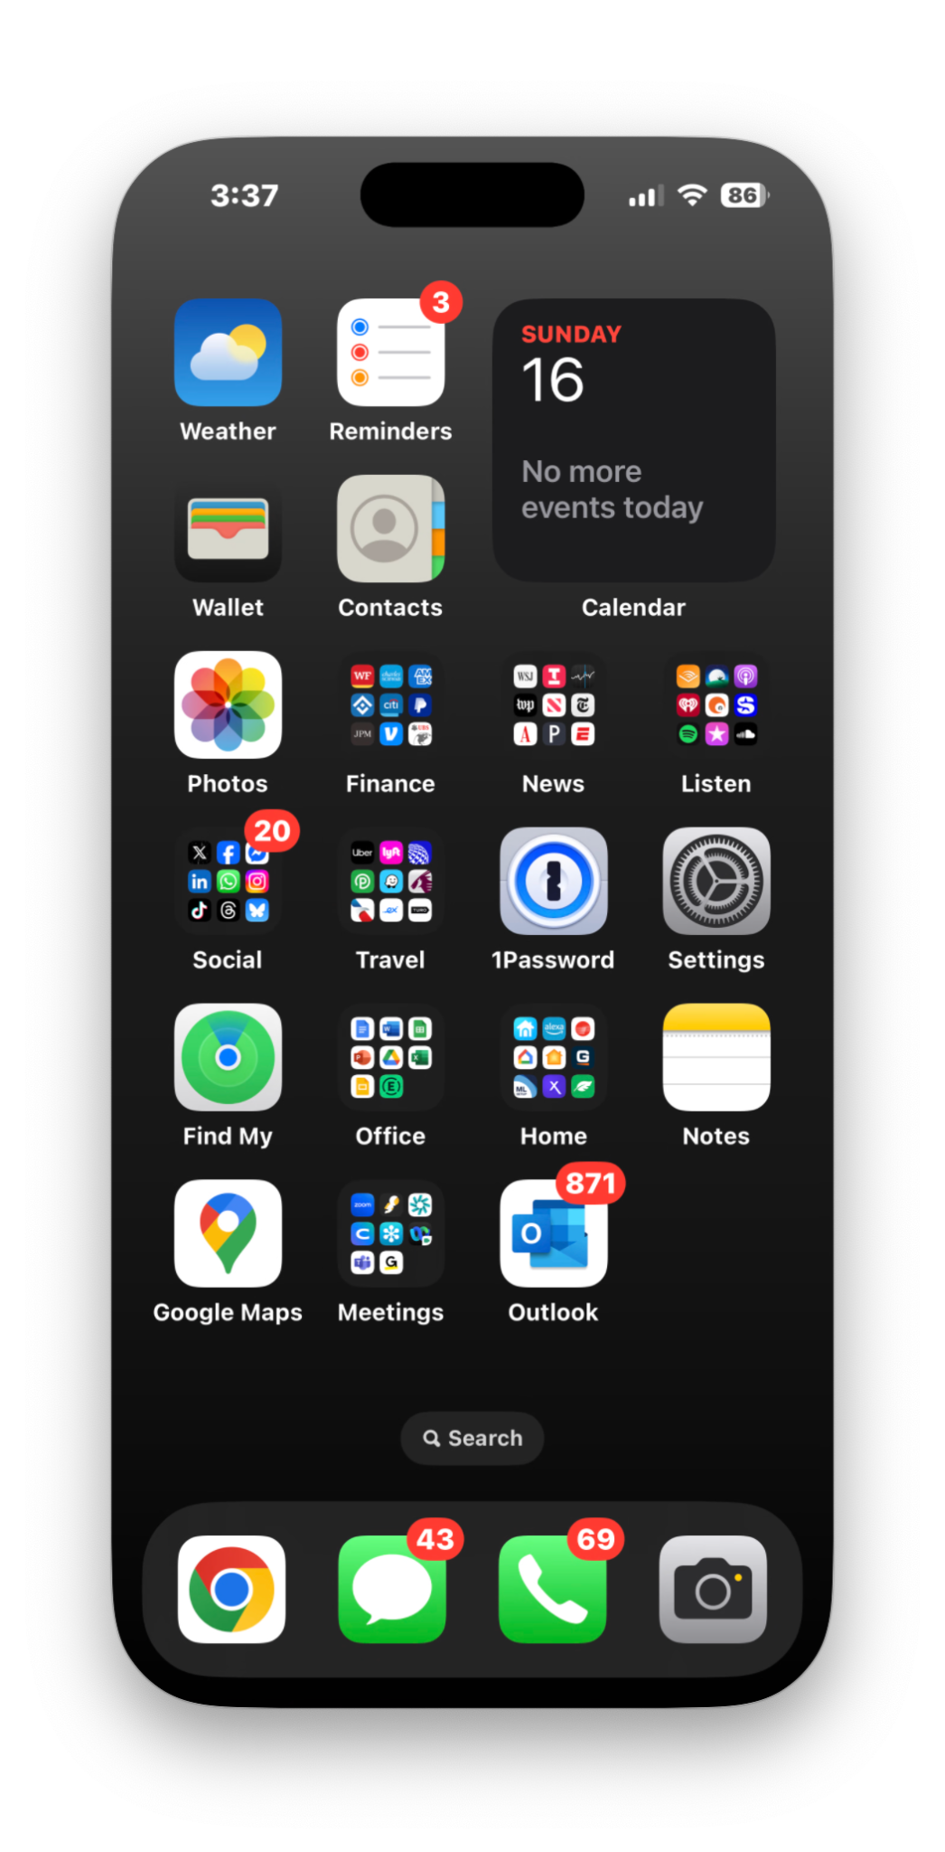
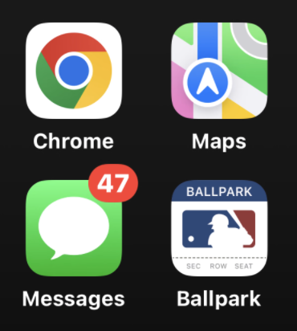







Listen
Watch
News
Finance

Slide 4
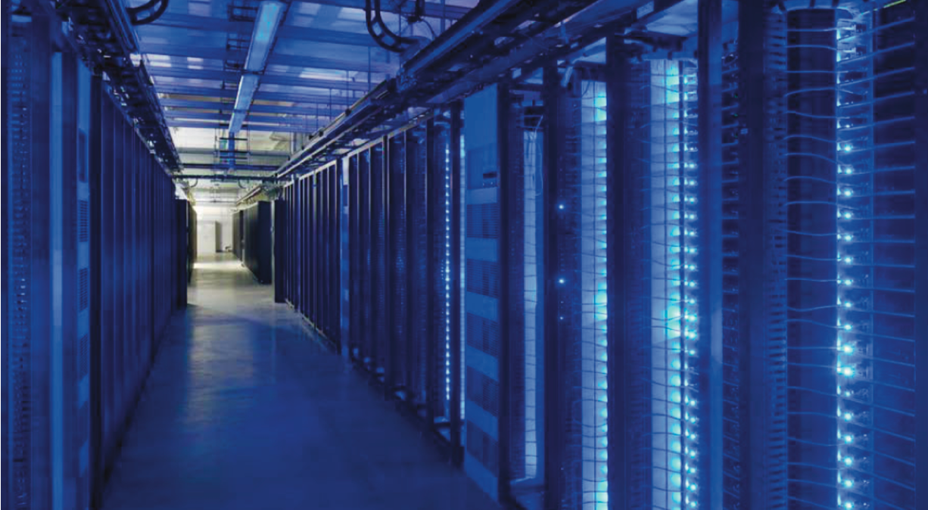

Slide 5
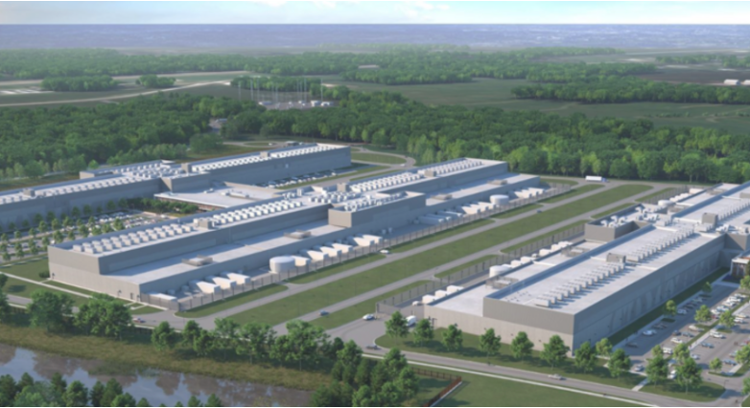

Slide 6
Kentucky as the next data center hot spot?
What do hyperscale data center builders/cloud computing providers look for given they could locate anywhere?
A warm welcome for new investment, tech jobs, and property taxes
No hyperscale data centers have located in a state that imposes sales tax on servers and equipment. Happily, Kentucky treats data center equipment like it does other business machinery
Available land
Strong community partners

Slide 7
What do Kentuckians get?
New economic activity
Data centers build out new electricity connections and substations
New jobs - 100 operations positions paying six-figures for high school or trade school grads
New tax revenue - in Loudon County, VA last year, property tax revenue from data centers was $900 million

Slide 8
If data centers come, economic activity comes with them.
Incremental economic benefits from data centers | Here | Not here
Income & spending by construction workers & contractors | + | 0
Income & spending by data center employees | + | 0
Revenue for local suppliers, contractors, lodging, and restaurants | + | 0
High-tech training and experience for workforce | + | 0
Make the state more attractive for tech business and any business needing low latency access | + | 0

Slide 9
If data centers come, new tax revenue comes, too.
Incremental tax revenue from data centers | Here | Not here
Personal income taxes paid by employees and contractors | + | 0
Corporate income taxes from data center operators & contractors | + | 0
Sales taxes on non-exempt equipment and supplies | + | 0
Sales taxes on services for tangible personal property | + | 0
Local real estate & personal property taxes | + | 0

Slide 10
What do Kentuckians NOT get?
Electricity bills for existing customers do not increase
Companies take great care in working with local utilities to ensure capacity is available and not at the expense of current customers
Large company contracts actually work to drive down rates
“Because of their large volume electricity use, these large load customers,including data centers, absorb a greater share of the fixed costs of operating grid infrastructure (power plants, poles and wires), thus lowering rates for all customers.” Energy, Kansas Testimony

Slide 11
What do Kentuckians NOT get?
Dominion CEO Bob Blue explained in an article that Virginia’s rates are lower than national and regional averages:
“On the affordability front, when we compare ourselves to national averages, we have been below the national average for residential customer rates for the last 18 years. Our residential rates have grown by a little bit, more than 1% a year, and our commercial rates by a little less than 1%, since 2010. The rate of inflation over that period has been about 2.6%. Relative to other things that our customers are paying for, our rates are declining.”
“This summer, we were 21% below the national average. We’re 36% below the East Coast regional average. That’s for residential customers, but the story is the same for our industrial customers. We’re 16.7% lower than the national average and we’re 38.7% lower than the East Coast rate. That’s important when we think about trying to attract businesses to Virginia.”
Last week in a Pennsylvania legislative hearing, Pennsylvania Power & Light Utilities testified that large-load data centers absorb more of the utility’s fixed costs, thereby reducing electricity bills for other customers.
One query uses the same electricity as 9 seconds of watching television

Slide 12
What do Kentuckians NOT get?
Water use questions
Data centers can use evaporative cooling or closed loop systems
80% of water intake is returned to the municipal system that provided the water. In evaporative cooling about 20% of the water evaporates
For example, Google’s data center in Montgomery County, Tennessee, consumed 288.6 million gallons of water in 2023 — as much as 1.9 golf courses
In a 2024 study of Virginia’s data center industry, the Joint Legislative Audit Review Commission (JLARC) concluded, “Most data centers use about the same amount of water or less as an average large office building, although a few require substantially more.”

Slide 13
President Trump is championing new data centers and AI –
and the new power generation we will need.
President Trump embraced data centers and AI to grow our economy and beat China.
“The release of DeepSeek AI from a Chinese company should be a wakeup call for our industries that we need to be laser-focused on competing to win”
President Trump declared a national emergency due to "inadequate" energy. His EO on “Unleashing American Energy” includes good news for the building trades:
Directing expedited permitting for energy projects
Reviewing all agency actions that might burden domestic energy development.
America’s tech industry is responding to the challenge:
$300 billion in capital spend this year from Amazon, Google, Meta and Microsoft
Utilities and data center operators are embracing nuclear power.

Slide 14
Building American data centers
to meet consumer demand, create new tech jobs and beat China on AI
Questions
September 11, 2025
Bartlett Cleland, General Counsel

