Slide 1
BR 94 PRESENTATION BY: Jesse Brewer
July 19, 2019

Slide 2
Background on Jesse Brewer
Member of Board of Directors of Greater Cincinnati/Northern Kentucky Apartment Association
Licensed real estate broker
Owns investment brokerage firm specializing in apartment management and sales
Personally owns more than 250 apartment units
Boone County Commissioner

Slide 3
The need
Some tenants of rental property have no respect whatsoever for the premises they rent from landlords or the wanton damage that they cause to these properties
Personally, I have experienced with my own properties as well as my clients’ properties a wide spectrum of damages to rental properties.

Slide 4
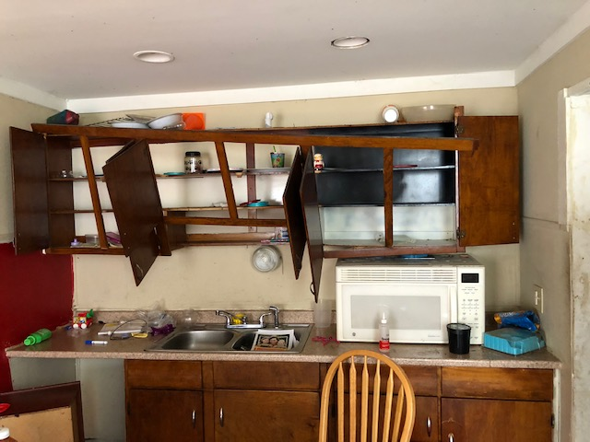
Examples of damages
Destroyed kitchen cabinets (cabinet doors were literally torn off the cabinets)

Slide 5
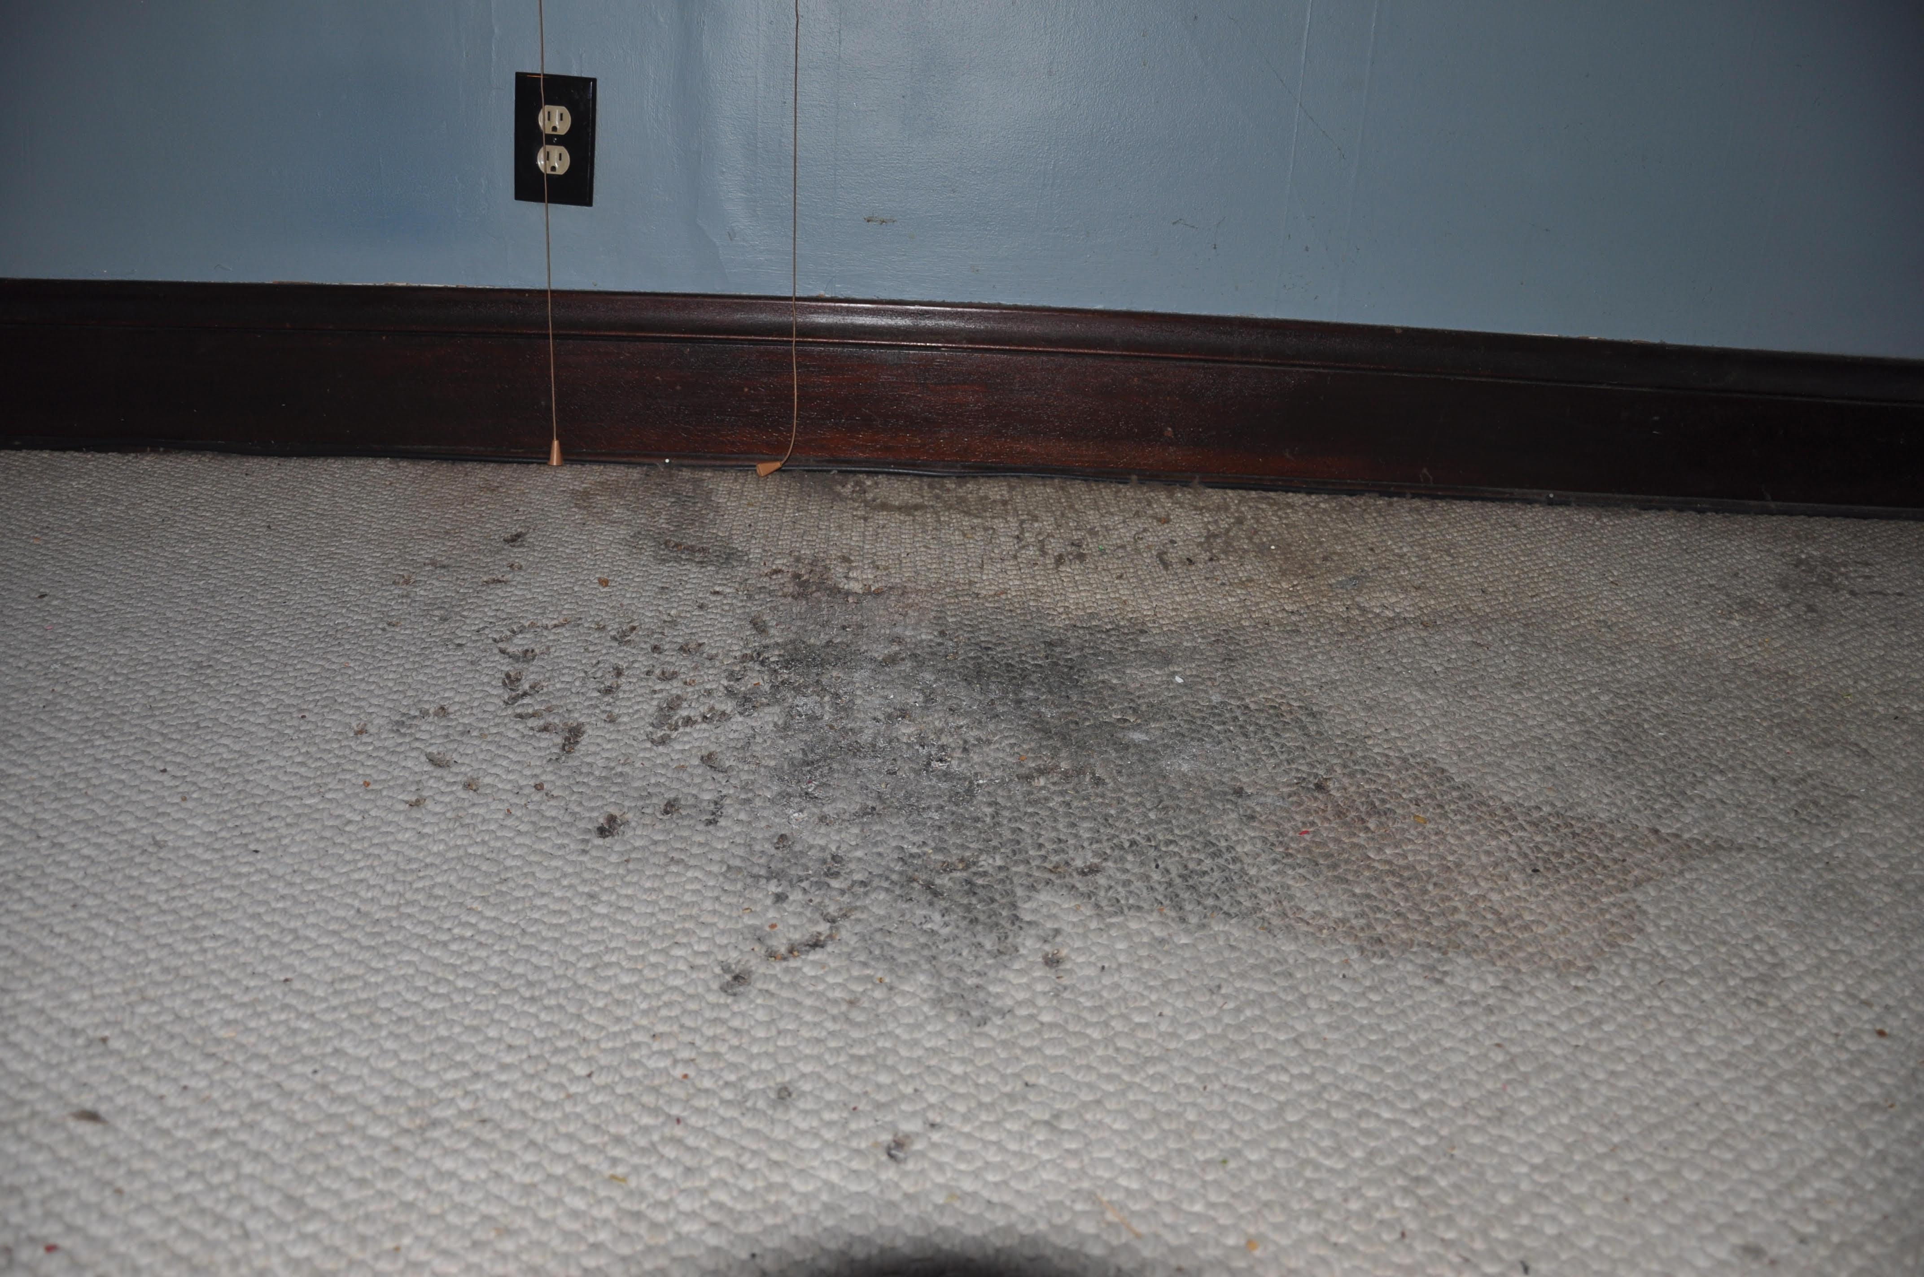
Damages continued
Cigarette burns intentionally left in carpets

Slide 6
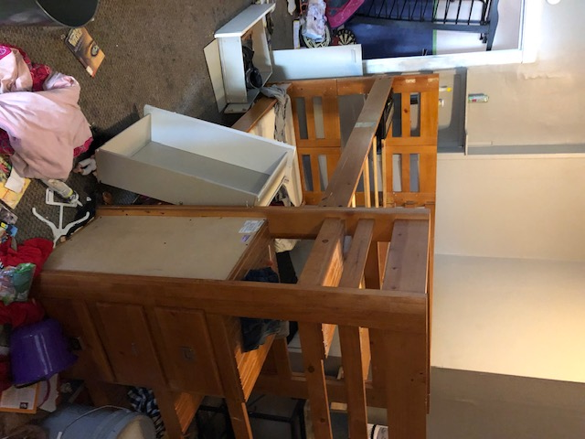
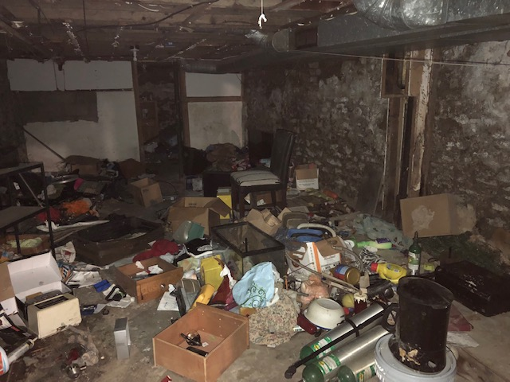
Damages continued
Leaving behind a “few” small items after they move out of the apartment

Slide 7
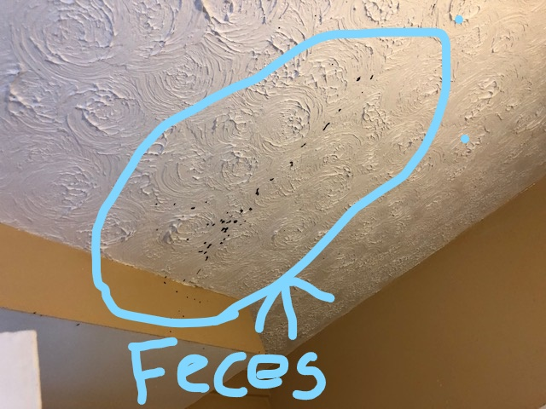
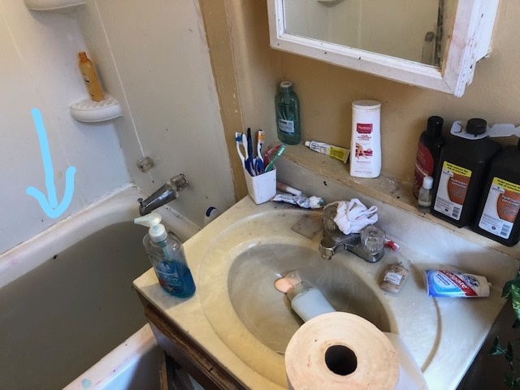
Damages continued
This was the condition a tenant left a bathroom in a recent rental unit

Slide 8
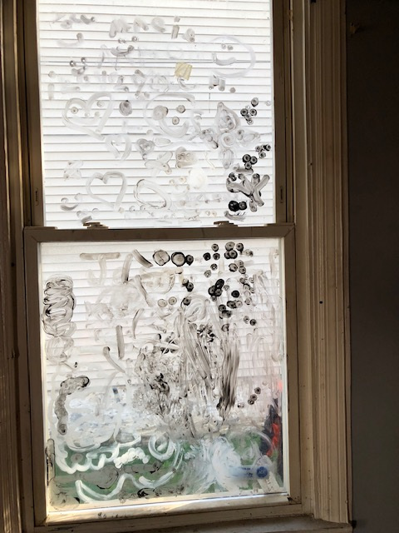
Damages continued

Slide 9
Damages to rental properties
Please reference the handout packet for more photos of damaged properties
This particular property resulted in
$7,000 worth of physical damages:
$4,000 in loss of rental revenue
Total loss of over $11,000

Slide 10
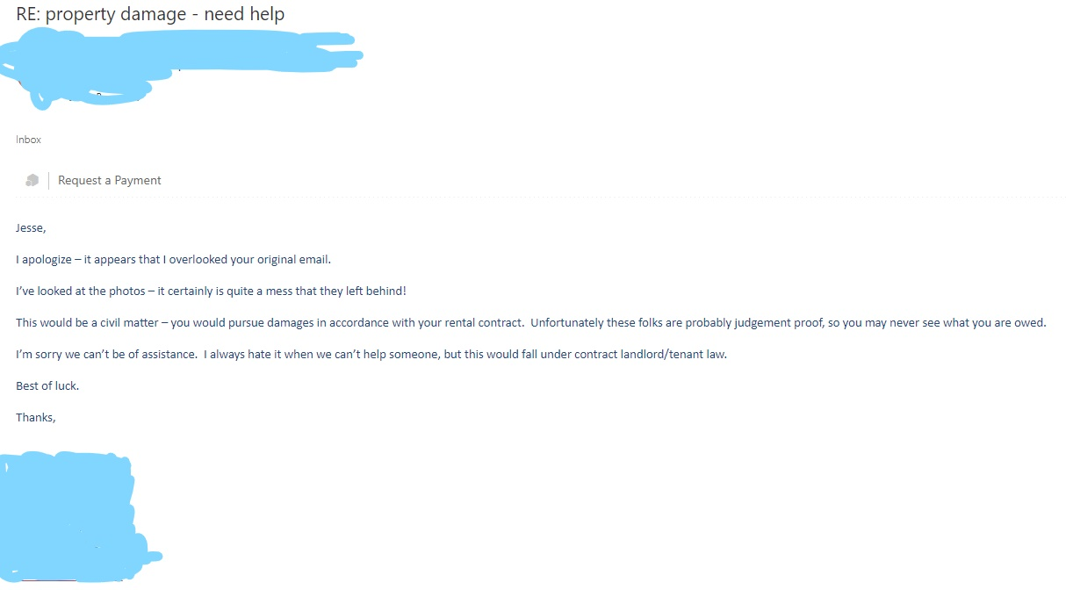
Email message from county attorney after repeated requests for assistance

Slide 11
Benefits of BR94
Gives county attorneys a new tool in their toolbelt
Help landlords screen future rental residents
Help landlords protect their property investments
Allows investors to put more capital into other projects
Reduces the cost of housing because fewer repairs will be needed
Results in better screening for the community and improved quality of life for nearby residents
Overall positive impact for Kentucky’s housing stock

Slide 12
QUESTIONS?
Jesse Brewer
jesse@cincyareaproperties.com
859-620-5061

