Slide 1
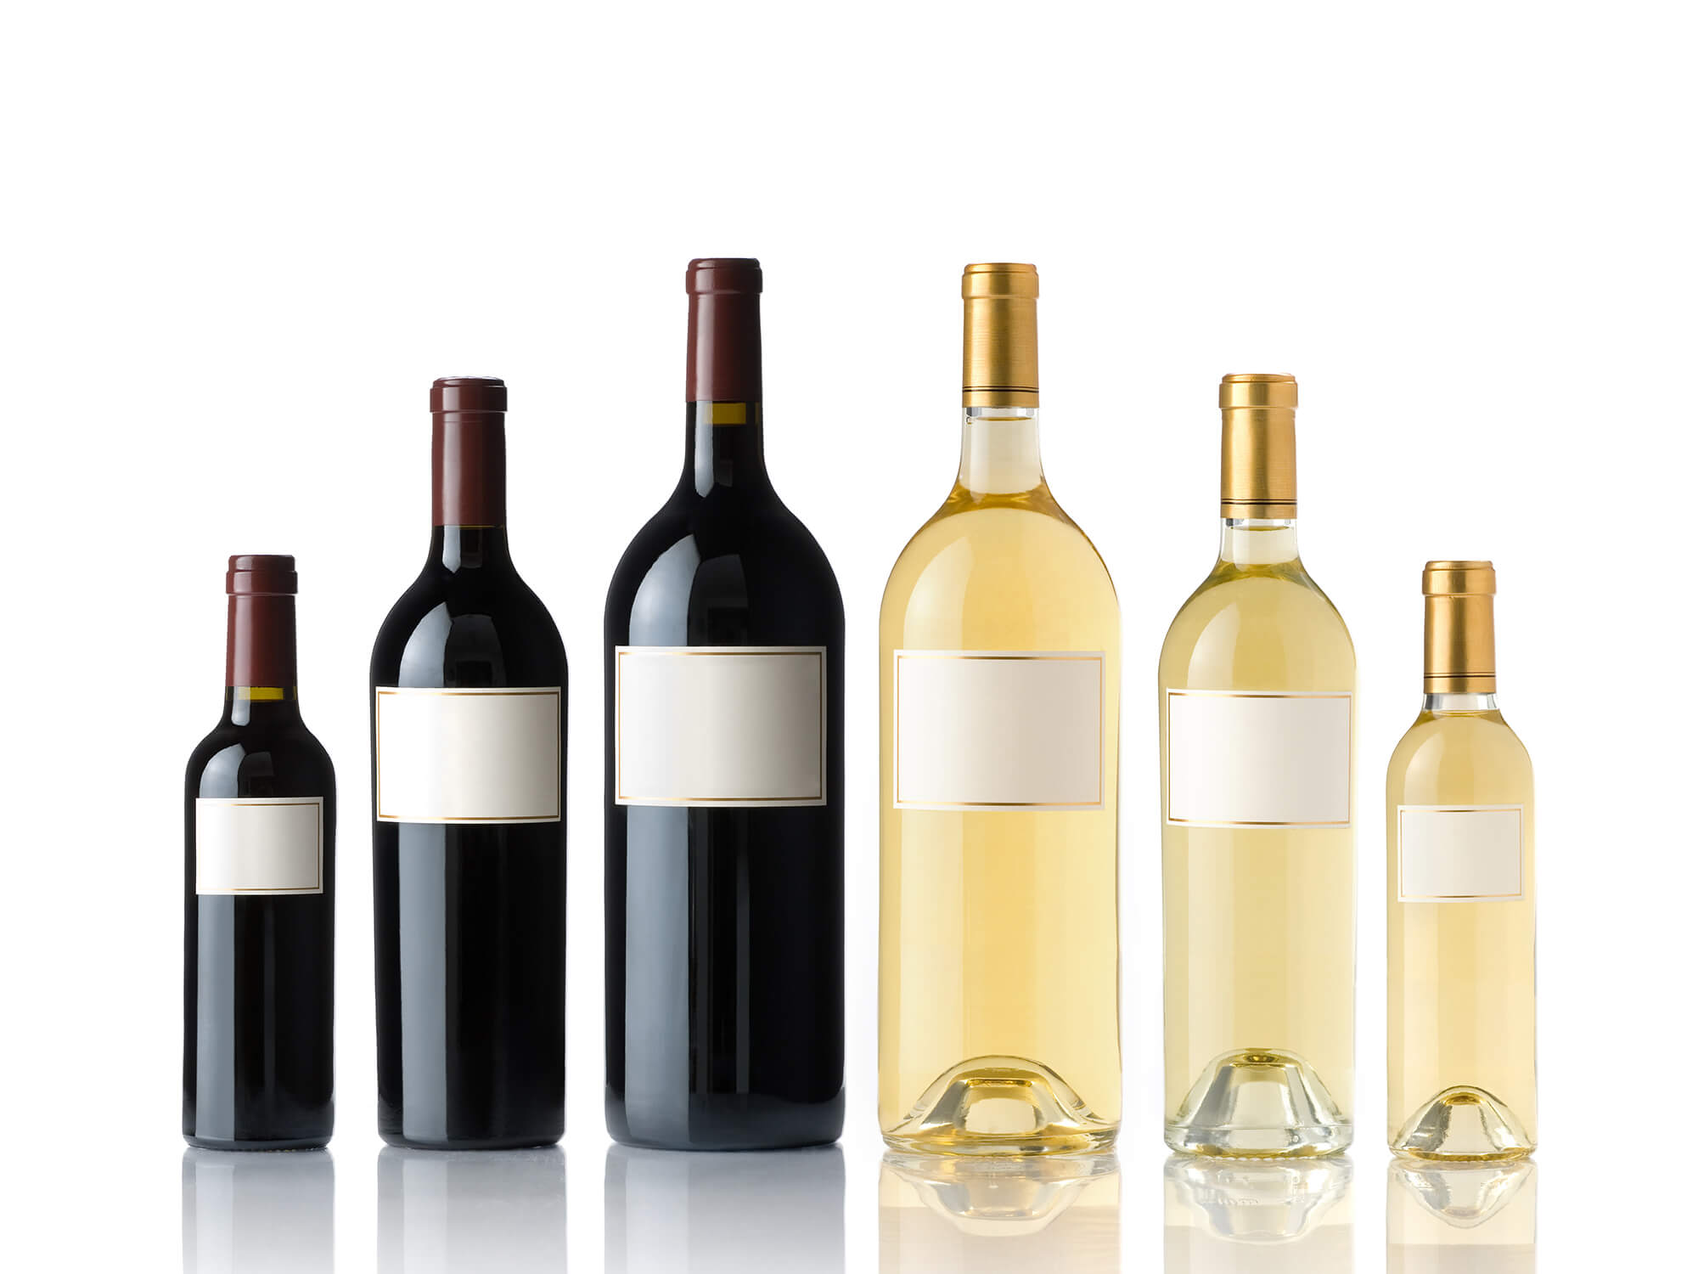
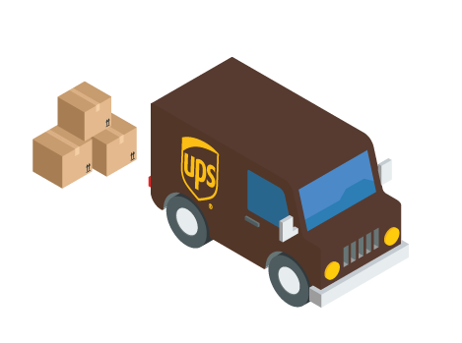
Alcohol Shipping L&O IJ Committee Meeting December 2019
Chairman Adam Koenig
Christy Trout Van Tatenhove

Slide 2
What does it do?
Allows in-state license holders to provide alcohol directly to Kentucky consumers and out-of-state consumers
Allows out-of-state license holders to ship alcohol directly to Kentucky consumers
Requires licensure and carrier reporting
Requires compliance with all Kentucky substantive and tax laws and regulations
Maintains the 3-Tier system in Kentucky

Slide 3
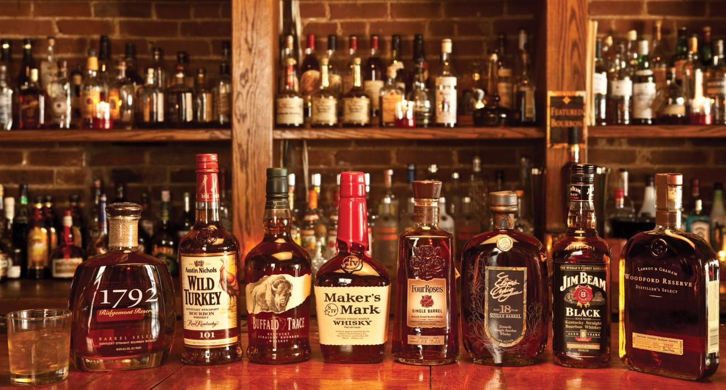
Why do it?
Parity
Consumer demand/modernization
Removes artificial barriers to competition
Makes Kentucky competitive nationally
Constitutionality

Slide 4
What does it say?
Allows any license holder to ship alcohol to a consumer in or out-of-state
Only ship to territories where alcohol is lawful
Package must be labeled “ALCOHOL” and “21 YEARS OLD” with SIGNATURE
Requires shipper to implement system to verify ID/payment
Requires all taxes and fees (state and local be collected and remitted to DOR)
Carrier reporting allows for proper regulatory enforcement and oversight
Maintains limits on the amount of alcohol shipped
Creates penalties for local jurisdictions which abuse the use of regulatory license fees
Allows retailers to purchase from other retailers on a limited basis

Slide 5
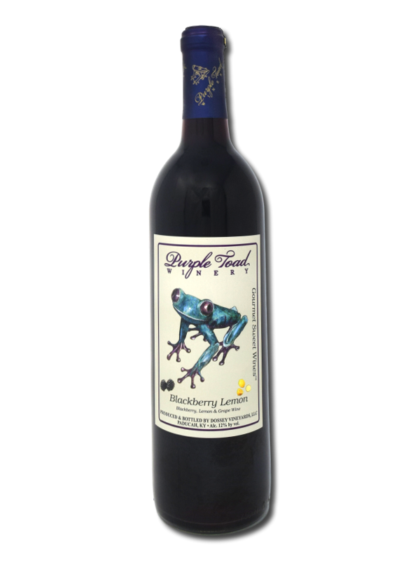
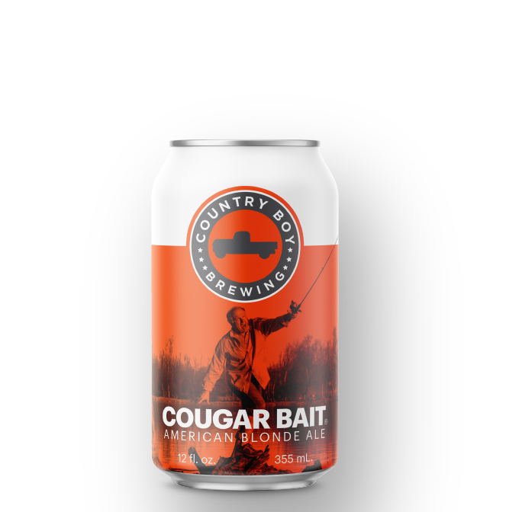
Parrot the Parity
Malt Beverages manufacturers from another state may ship to Kentucky consumers (already allowed for wine and distilled spirits)
Allows “dock sales” for malt beverages. Retailer may transport and purchase from the distributor’s premises (currently allowed for distilled spirits and wine)
Wholesaler must sell or offer reasonable service to authorized recipients during its normal business hours (matches existing rule for distributors of malt beverages)
Allows distillers and malt beverages to ship (currently allowed for small farm wineries)

