Slide 1

Kentucky Lottery Corporation
Presentation to the Interim Joint Committee on Licensing, Occupations, and
Administrative Regulations
Mary R. Harville
President and CEO
November 18, 2021
Presentation Title

Slide 2
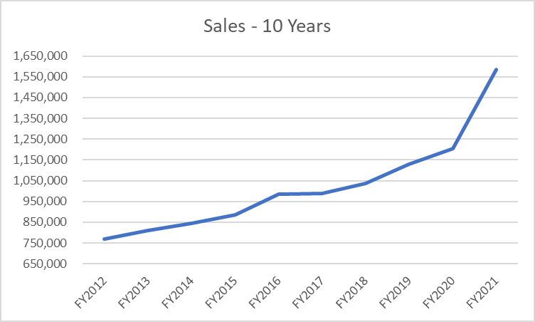
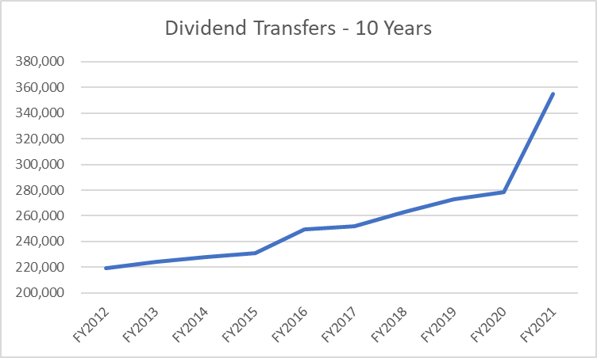
Sales & Dividend Transfers

Slide 3
Sales & Total Transfers
(in millions)

Slide 4
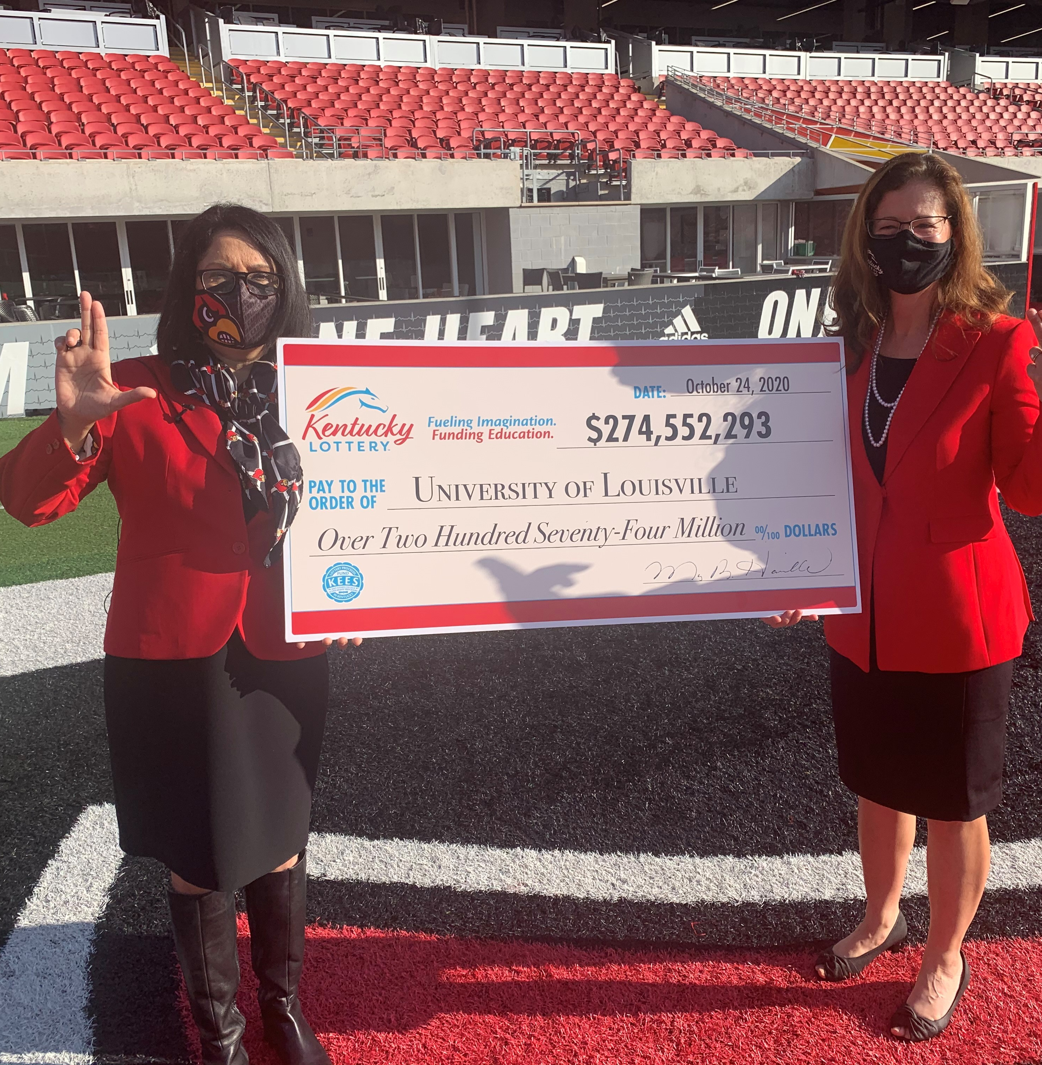
Lottery-Funded Scholarships and Grant Programs
Kentucky Educational Excellence Scholarship (KEES)
College Access Program (CAP)
KY Tuition Grants (KTG)
Work-Ready Kentucky Scholarship
Dual Credit Scholarship
National Guard Tuition Award

Slide 5
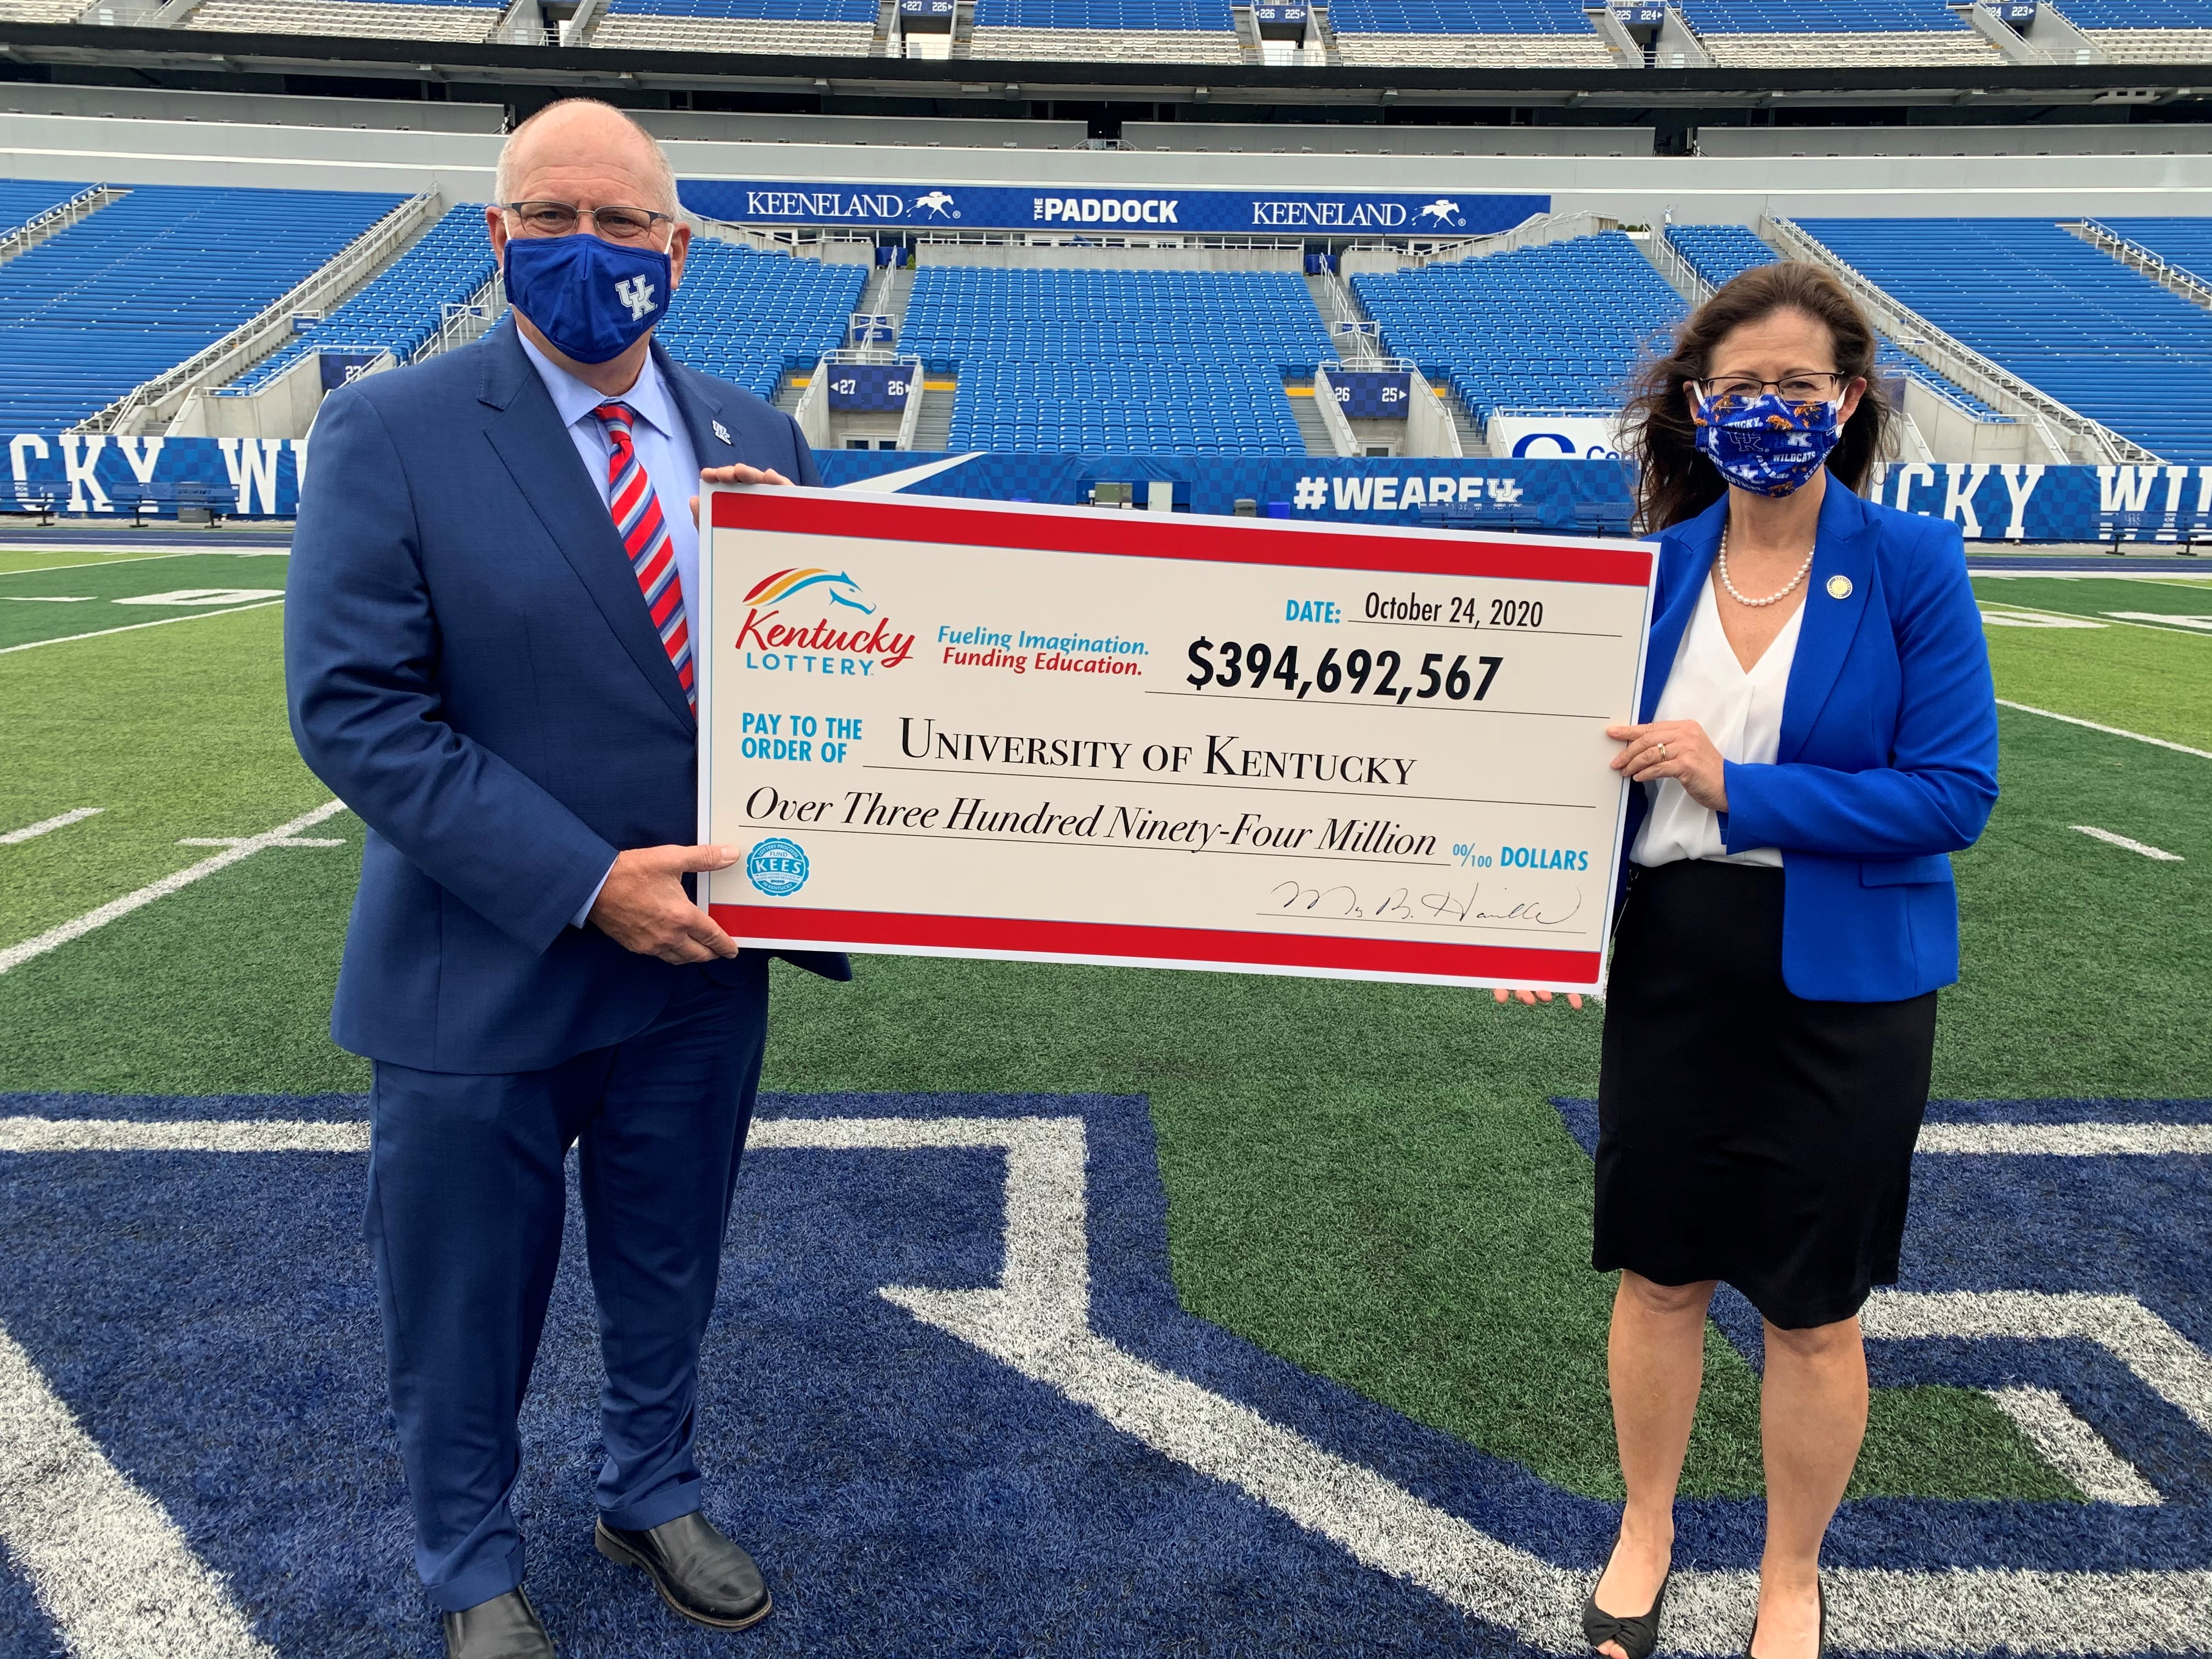
More than $4 billion in proceeds have provided over 2.43 million scholarships and grants since 1999.
98 cents of every $1 in student financial aid awarded by the Commonwealth comes straight from the sale of KY Lottery tickets.
In 2019, over 138,660 Kentucky students received a grant or scholarship paid for by Kentucky Lottery proceeds.

Slide 6
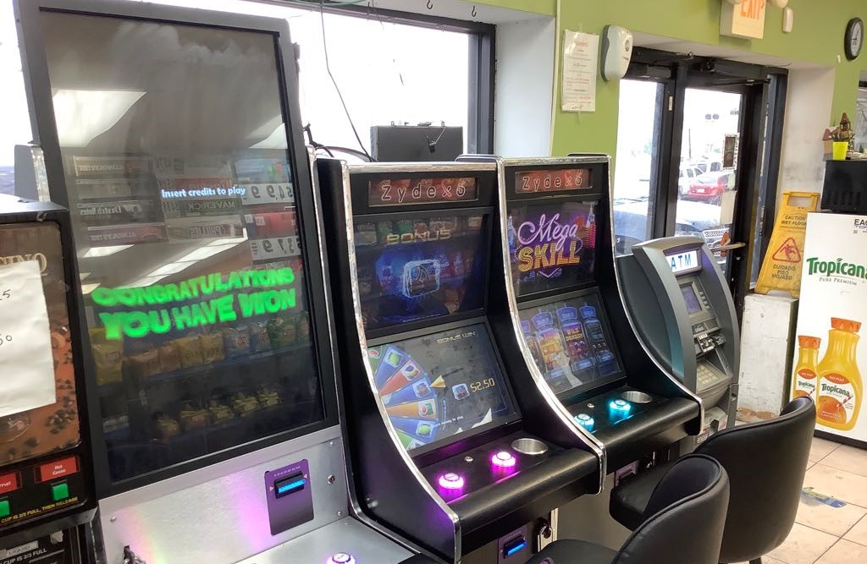
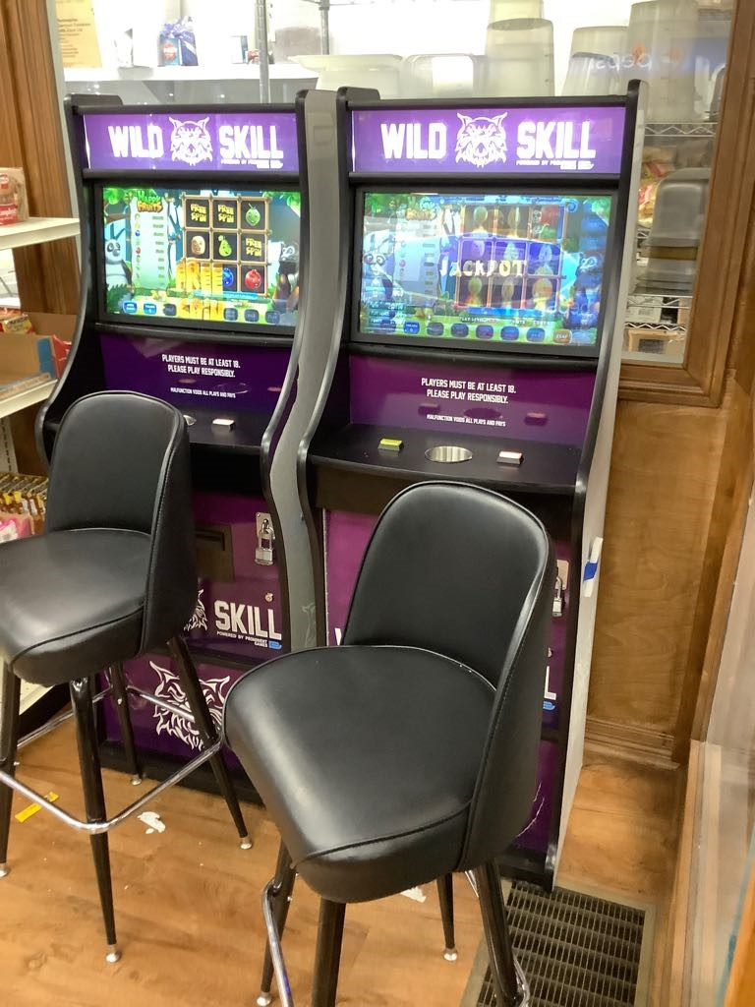
Unregulated Gaming Machines
“Skill” or gray machines

Slide 7
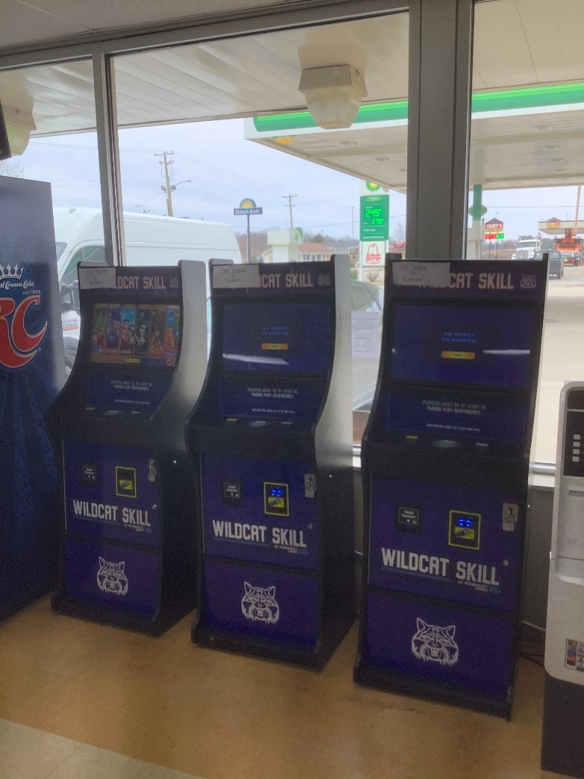
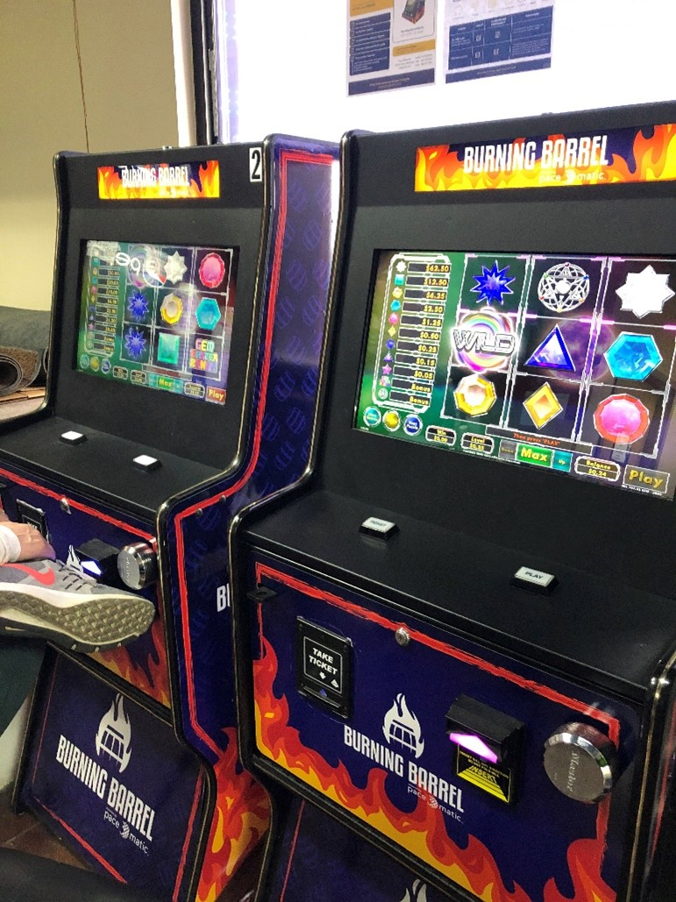
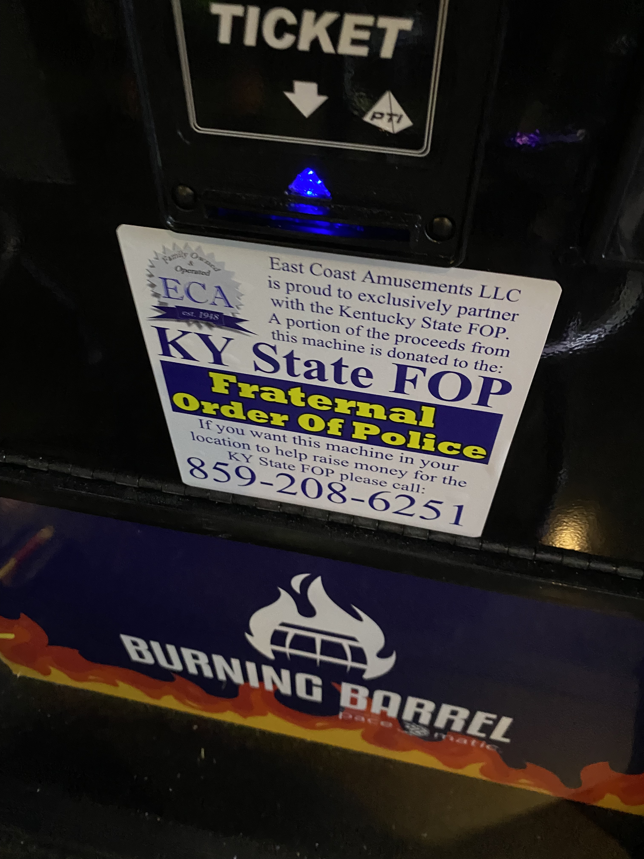
Unregulated Gaming Machines

Slide 8
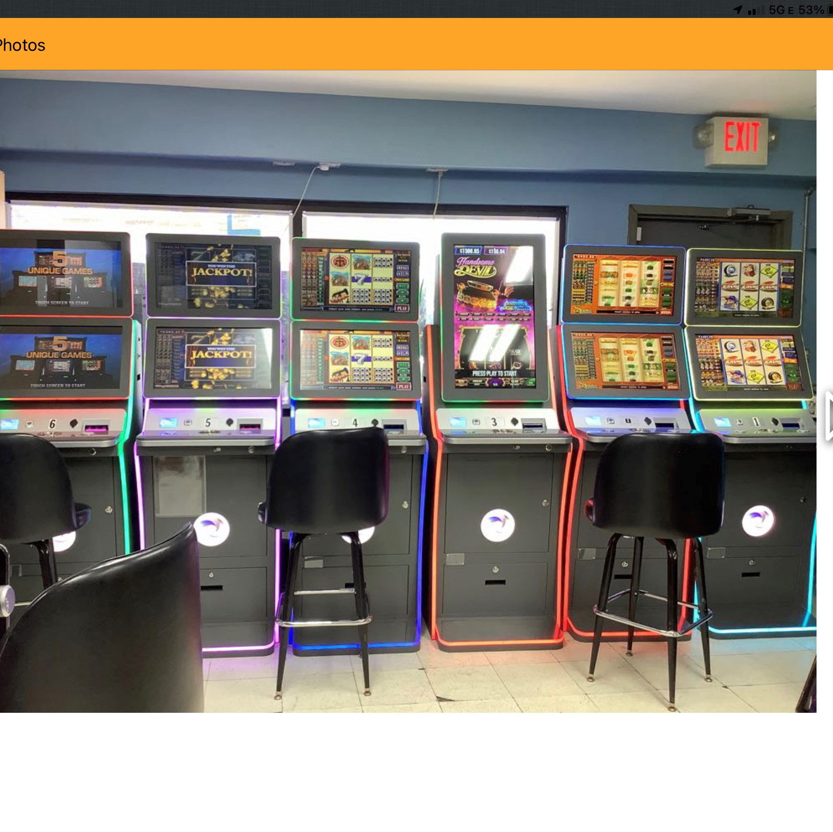
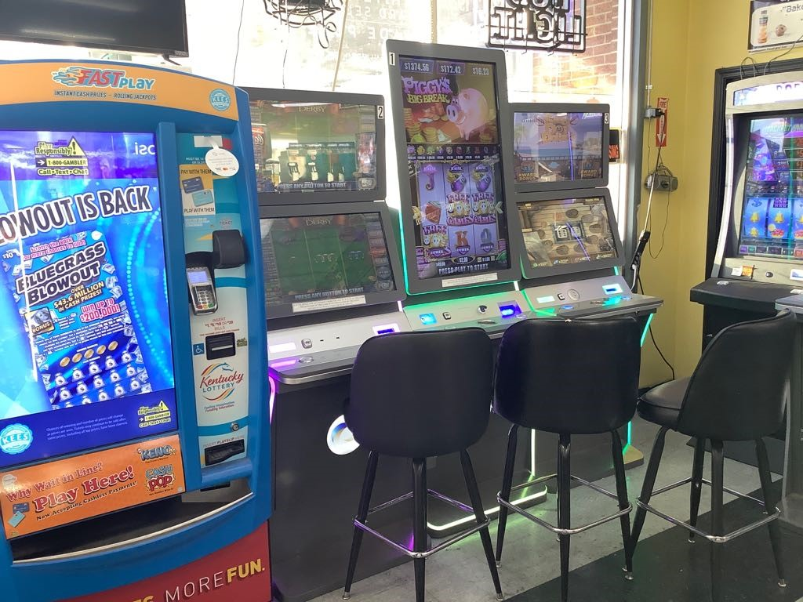
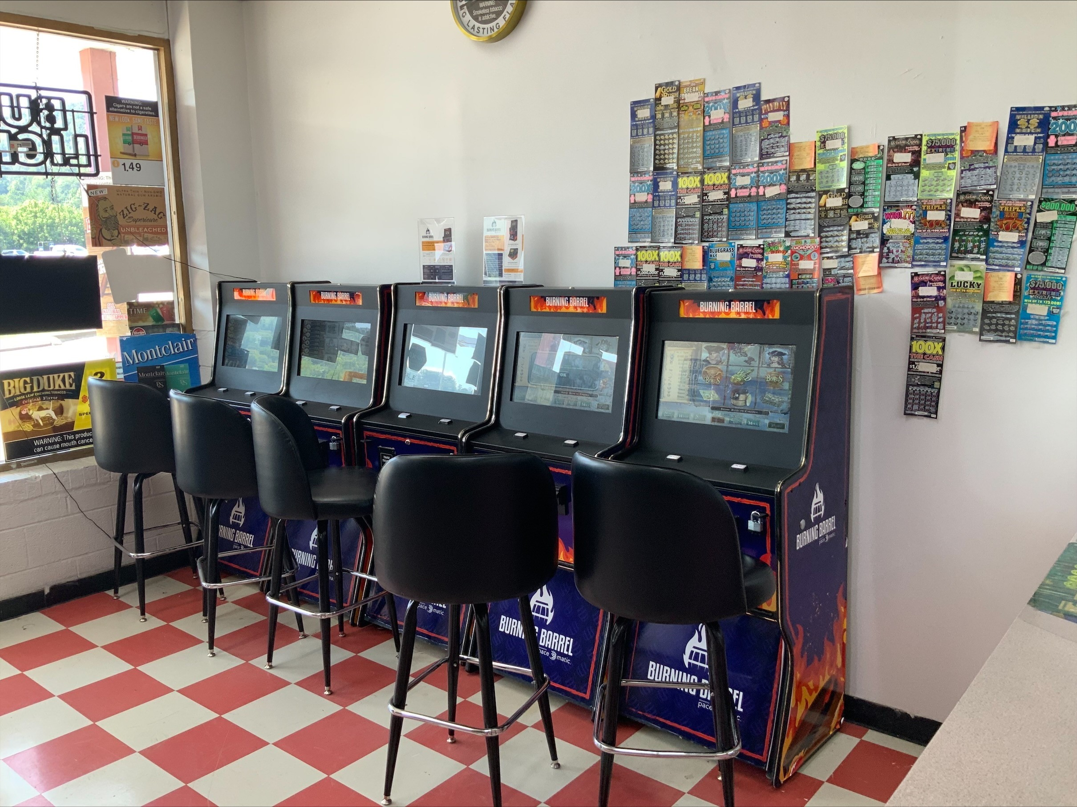
Unregulated Gaming Machines

Slide 9
Neighboring States and Impact of Machines:
VA: Estimated 10,000 Machines by fall 2019; Estimated $140 million in lost sales; Legislation made illegal July 1, 2021
PA: Estimated 10,000 Machines currently; Estimated over $500 million in lost sales over 4 years; Looking at legislation to address
MO: Estimated 14,000-20,000 Machines currently; Legal issues unresolved

