Slide 1
kybve.com
Vet@ky.gov
Veterinary Medicine Practice Act Modernization Initiative
Representative Matt Koch
Steven J. Wills, DVM, KBVE Chairman
John C. Park, DVM, KBVE Board Member
Michelle M. Shane, KBVE Executive Director
Learn more about the Kentucky Practice Act at www.kybve.com/practice-act.html

Slide 2
The Kentucky Practice Act
Practice Act Modernization
1942 – Creation of the Board, Meeting requirements, Vet License required, Penalties, Exemptions, Reporting requirements for County Clerks
1948 – Repeal of all statutes; passage of new statutory package for the Board, Meeting requirements, Funding Source, Vet License required, Penalties, Exemptions
1992, 1998 – Added statutes KBVE Power and Duties, Definitions, VCPR, Animal Control Agencies (ACAs) and Animal Euthanasia Specialists (AESs), Disciplinary Authority, Veterinary Technician licensure, Veterinary Assistants, Wellness Committee, and Mobile Facilities; as well as some minor edits to existing statutes; repealed multiple statutes, some requirements moved to regulation
1962, 2000, 2004, 2007, 2009, 2016, and 2017 – Minor edits, created Emergency Order for immediate suspension
2020 – added provisions for Animal Abuse Reporting
2021-22 – Complete Modernization Effort
In summary, more than 30 years since any substantial updates – a lot has changed in veterinary medicine in 30 years

Slide 3
Practice Act Modernization Overview
KBVE worked for more than one year on this initiative
Reviewed national Practice Act Models (PAMs)
American Association of Veterinary State Boards (AAVSB)
American Veterinary Medical Association (AVMA)
Reviewed state regulations and outreached to other state Boards on specific topics
VCPR
Veterinary Facility standards, registrations, and inspections
Veterinary technicians and assistants
Engaged veterinary medicine professional associations KVMA and KVTA Leadership for input on early drafts
Proposed Practice Act Modernization package
Preliminary development of veterinary facility registration requirements and minimum standards

Slide 4
Practice Act Modernization – Stakeholder Outreach
Outreach to Key Stakeholder Organizations
Kentucky Veterinary Medical Association (KVMA)
Kentucky Veterinary Technician Association (KVTA)
Kentucky Department of Agriculture (KDA)
Kentucky Office of the State Veterinarian (OSV)
Kentucky Cabinet for Health and Family Services (CHFS) Public Health Veterinarian
Kentucky Animal Control Advisory Board (ACAB)
Kentucky Animal Care & Control Association (KACCA)
Kentucky Humane Society of the United States (KHSUS)
American Veterinary Medical Association (AVMA)
Humane Society of the United States (HSUS)
Humane Society Veterinary Medical Association (HSVMA)
Kentucky Association of Counties (KAC)
Kentucky Cattleman’s Association (KCA)
Kentucky County Judge/Executive Association (KCJEA)
Kentucky Farm Bureau (KFB)
Kentucky League of Cities (KLC)
Kentucky Magistrates and Commissioners Association (KMCA)

Slide 5
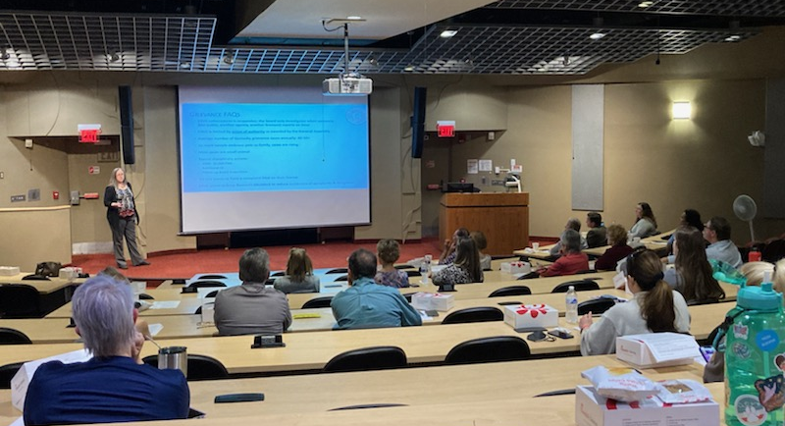
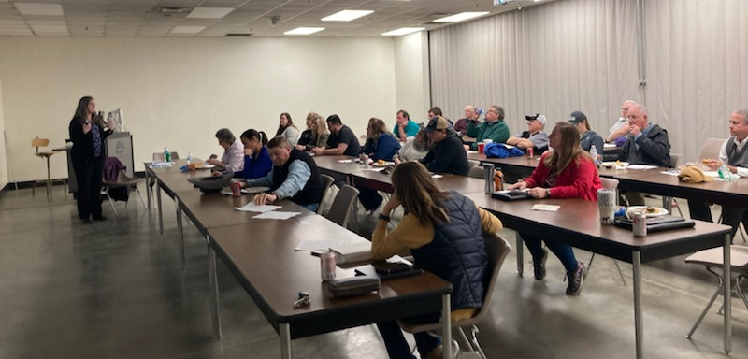
Practice Act Modernization – Stakeholder Outreach
Mailing to all Kentucky Licensees and neighboring state licensees
Outreach to Licensee Stakeholders – 10 regional meetings
Bowling Green, Burlington, Elizabethtown, Lexington (2), Louisville, Madisonville, Morehead, Paducah, and Zoom
Each meeting
Chairman Wills present at all but one meeting; each meeting had at least two (2) board members in attendance
20-45 public participants
45 min presentation
Demographics data
Preliminary regulations
45+ min dialog
Follow-up outreach
Renewal Responses

Slide 6
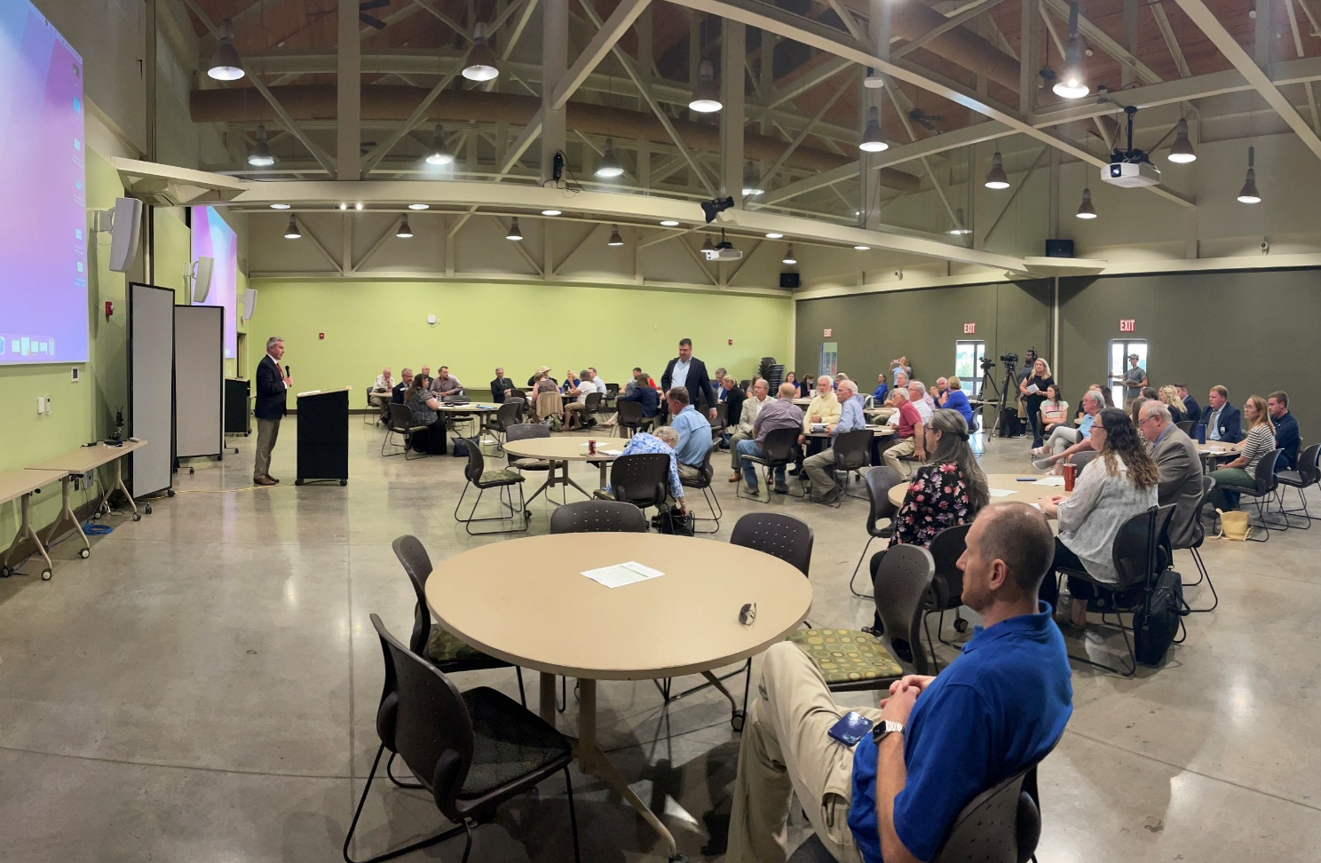
Practice Act Modernization – Stakeholder Outreach
Agricultural Leadership Dialogue on Veterinary Shortage
KDA Commissioner Ryan F. Quarles brought together agriculture and commodity group leadership with leaders from the veterinary community to dialogue about
Veterinary Shortage Issues
Practice Act Modernization
Possible shortage solutions
Common goals between industry and the profession
Future dialogue sessions planned
Watch the first Kentucky dialogue on veterinary shortages:
https://vimeo.com/723831966/84509d16bc

Slide 7
The Kentucky Practice Act
Credentialed professions assigned by the Kentucky General Assembly
Veterinarians
Special permits
Veterinary Technicians (LVTs)
Veterinary Assistants (unlicensed)
Animal Control Agencies
Shelters who seek DEA Registration for purchase and use of controlled substances without a veterinarian
Animal Euthanasia Specialists
Only allowed to conduct euthanasia, and only on shelter owned animals

Slide 8
Practice Act Modernization Highlights
Administrative Clean-up
Expanded Definitions – common ground for stakeholders
Additional Clarifying Statutes –
Renewal and Reinstatement Requirements – for all credentials
Clarifications for Animal Control Agencies (ACAs) and Animal Euthanasia Specialists (AESs) – related to Controlled Substance Management and Administration, and boundaries of work for AES
Medical Records – requirements for records, and who has rights to records
Criminal Background Checks – required by FBI for direct results
Clarifying the Roles of Veterinary Technicians and Veterinary Assistants – enabling veterinarians to better utilize their LVTs in times of shortages
Telehealth – emphasizes the current requirements for VCPR, and establishes telehealth terminology

Slide 9
Practice Act Modernization Highlights
Requests for Expansion of Scope
Educational Awards
Other state boards already doing this: Ohio, Oklahoma
Veterinary Facilities Registration and Inspection
Help elevate the practice of veterinary medicine in the Commonwealth
Better understand and work to lessen the veterinary shortages
Additional Requests for Expansion of Scope – in response to stakeholder feedback
Allied Professional Permits
Equine Dentists
Animal manipulation (e.g., chiropractic, therapy, etc.)
Animal massage
Increased board authority to enforce chapter, esp. for non-credential holders

Slide 10
Practice Act Modernization Takeaways
Stakeholder Feedback Summary on Major Issues
Veterinary-Client-Patient Relationship (VCPR) –
100% agreement from Kentucky veterinary community on moving forward with changes
Pushback will come mainly from out-of-state and corporate interests, including animal rights groups
Large online corporate companies and animal rights activists are seeking to lift the in-person VCPR requirement nationally
Online pharmaceutical companies are seeking to provide prescriptions without ever setting foot in Kentucky, and bypassing requirements for follow-up care
Lifting the in-person VCPR requirement opens doors to:
Opportunities for drug diversion and abuse
Failure to promptly identify, properly diagnose, and quickly contain high-consequence diseases
Lifting the in-person VCPR requirement discourages veterinarians from staying in food animal work

Slide 11
Practice Act Modernization Takeaways
Stakeholder Feedback Summary on Major Issues
Veterinary Facilities Standards, Registration, and Inspections
Estimates 70-80% support from licensees, much higher support from public
Hesitancy from some licensees about expanded government and additional fees
Fees would be minimal, estimated at $250-$350 every two (2) years – already in discussions with stakeholder leadership
Others strongly support minimum standards for veterinary facilities, to protect patients and clients
Veterinary Facility Standards, Registration, and Inspection will:
Allow the board to better understand and work to lessen the veterinary shortage in the Commonwealth
Help elevate the practice of veterinary medicine in the Commonwealth
Ensure that practitioners have access to transparent minimum standards
Offer protections for clients and producers by making standards transparent for everyone
Allow the board to conduct inspections to help licensees understand and comply with current regulations and basic standards
Define responsible parties in corporate or non-licensee owned practices
Address constituent complaints about basic standards of care in low-cost spay/neuter and health clinics
Reduce complaints to the board

Slide 12
Practice Act Modernization Takeaways
Stakeholder Feedback Summary on Major Issues
Educational Awards
Some stakeholders did not like the idea of using their licensing fees toward educational awards
Others were very supportive given the growing issues with veterinary shortages, particularly in rural communities and food or mixed animal practices. They feel this will help them hire and retain new employees
Contractual educational awards would be available to graduates and those advancing toward a degree in veterinary medicine or veterinary technology to focus on relieving shortages in the workforce, primarily in food animal medicine and rural communities
Unlike contract spaces, awardees would be required to come back to Kentucky to work in targeted areas for a period of time
Unlike the Federal Veterinary Medicine Loan Repayment Program (VMLRP), awards will be targeted to acute shortage areas focused solely in Kentucky
Ohio has legislation allowing issuance of similar awards since 2009, Oklahoma just passed legislation in 2021 to help alleviate rural shortages

Slide 13
Practice Act Modernization Takeaways
Stakeholder Feedback Summary on Major Issues
Allied Professional Permits
Added at the request of multiple stakeholder organizations and licensees
Equine Dental
Animal massage
Animal manipulation (e.g., chiropractic, physical therapy, etc.)
Others
This will enable the board to:
Provide protections for the public and patients related to allied professional services on animal patients
Allow clients an avenue for recourse when services result in harm or death to the patient
Ensure that allied professionals receive adequate and appropriate training for work on animals
Ensure continuing education requirements for these practitioners

Slide 14
Practice Act Modernization Takeaways
Stakeholder Feedback Summary on Major Issues
Stronger Enforcement Authority
Added at the request of a significant majority of stakeholders
This will enable the board to:
Take action against non-credential holders
“Registered Responsible Parties”, i.e., non-licensee and corporate owners
Allow for a Notice of Violation (NOV) and fine for violation of Practice Act
Swift resolution of violations
Non-response would still be adjudicated in Franklin Circuit Court

Slide 15
Practice Act Modernization Next Steps
KBVE to continue stakeholder outreach
Stakeholder Organizations – seeking feedback to address any concerns
Small group meetings with species-specific practitioners to better understand needs
Food animal
Equine
Small animal
Coordination with other professional boards re Allied Professional Permits
Board of Chiropractic Examiners
Board of Licensure for Massage Therapy
Others
KBVE to move forward with development of regulations
Working with KVMA
Veterinary Facility minimum standards, fees, inspections
Working with other professional boards

