Slide 1

Kentucky Lottery Corporation
Financial update
The Interim Joint Committee on Licensing, Occupations, and
Administrative Regulations
Mary R. Harville
President and CEO
October 27, 2022

Slide 2

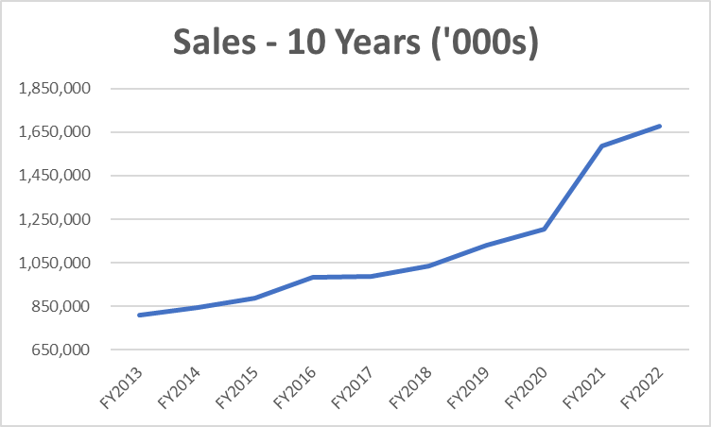
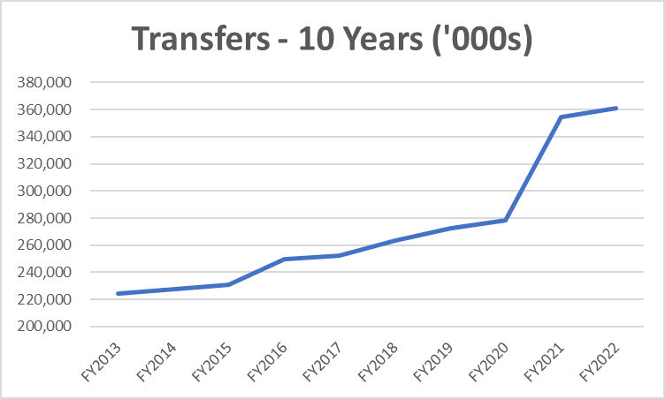
Lottery Business Update
Presentation Title

Slide 3
Lottery Business Update
Presentation Title
FY2022
Record sales of $1.677 billion
Record transfers of $360.8 million

Slide 4
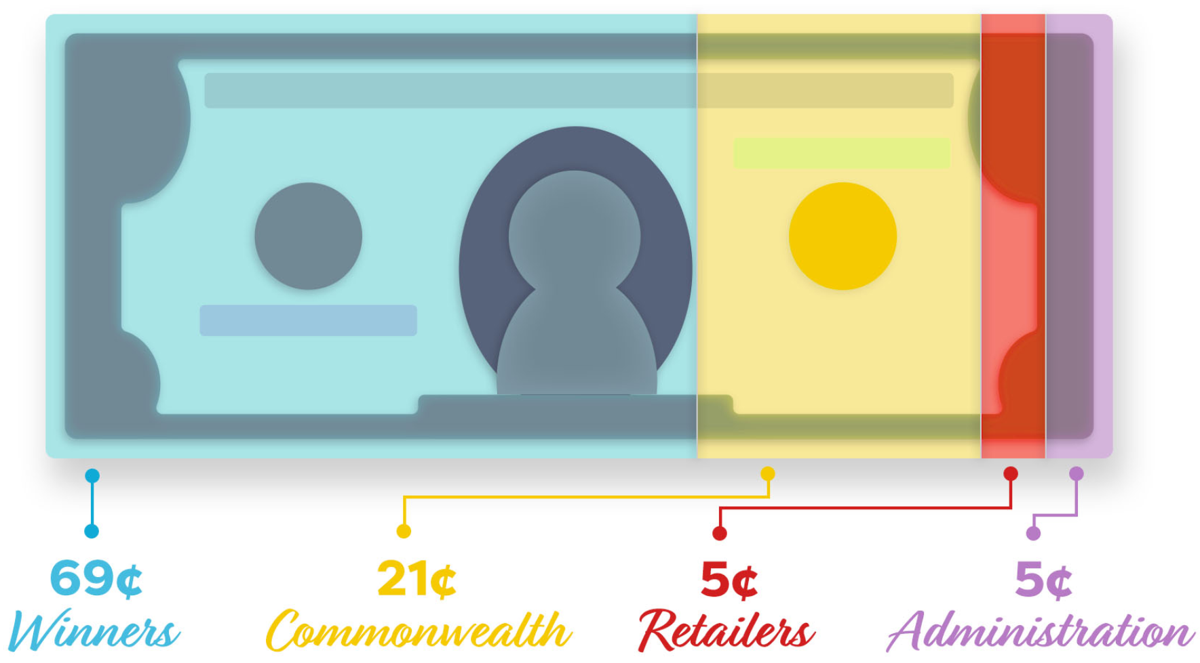
Kentucky Lottery Corporation
Where the Money Goes – FY2022
Sales $1,676,502,000

Slide 5
Lottery Business Update
FY2023 Q1 Results
Total sales of $425.2 million
Total net income of $91.2 million
(ahead of budget)
Presentation Title

Slide 6
Use of Lottery Funds
Since 1989, the Kentucky Lottery has turned over $6.4 billion to the Commonwealth.
Of that, since 1999, KLC has provided more than $4.4 billion for college scholarships, grants and education programs.
The specific allocations are set by legislation, KRS 154A.130 and biennial state budget (HB 1 for FY23-FY24).
Presentation Title

Slide 7
Lottery Funded Scholarships and Grant Programs Administered by KHEAA
Kentucky Educational Excellence Program (KEES)
College Access Program (CAP)
KY Tuition Grants (KTG)
Work-Ready Kentucky Scholarship
Dual Credit Scholarship
National Guard Tuition Award
Teacher Scholarship
Presentation Title

Slide 8
Lottery Funded Scholarships and Grant Programs
More than $4.4 billion in proceeds have provided over 2.43 million scholarships and grants since 1999.
98 cents of every $1 in student financial aid awarded by the Commonwealth comes straight from the sales of KY Lottery tickets.
820,000 Kentucky students have received a grant or scholarship paid for by Kentucky Lottery proceeds.
Presentation Title

