Slide 1
Licensing reform for non-citizen immigrants
Carl Sims, Deputy Program Director
The Council of State Governments

Slide 2
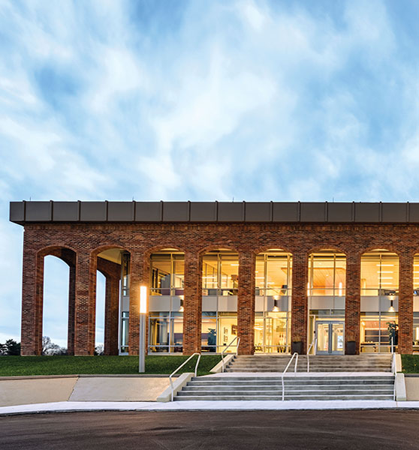
The Council of State Governments
CSG is a region-based membership organization that fosters the exchange of insights and ideas to help state officials shape public policy.
@CSGovts | csg.org

Slide 3
Prevalence of Workforce Shortages
Projected in-demand professions commonly requiring licensure:
Healthcare
Personal Care
Community and Social Services
Source: Kentucky Chamber of Commerce

Slide 4
Workforce Shortages – Contributing Factors
Workforce Participation Rates
Demographic Trends
Pathways to Employment/Licensure

Slide 5
Workforce Shortages in Health Care
In Kentucky, the hospital job vacancy rate is at 17.1%.
RN and LPN = 22.1% vacancy rate
An estimated 14% of the current nursing workforce in KY is nearing retirement age.
Source: Kentucky Hospital Association

Slide 6
Immigrant Workforce
The U.S. immigrant population currently makes up 13.75% of the total population and 17% of the national workforce.
In Kentucky, the immigrant population makes up 4% of the total population and 5% of the state's workforce.
Source: Migration Policy Institute

Slide 7
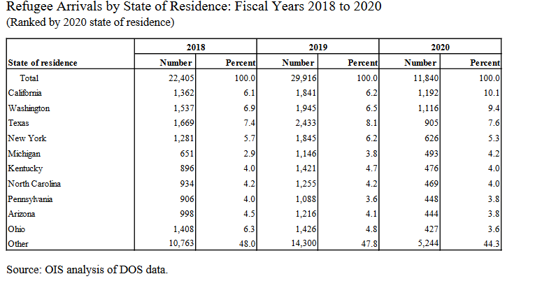
Immigrant Workforce
Source: U.S. Department of State

Slide 8
Economic and Social Costs of Licensure
May involve overly burdensome requirements
Creates additional costs for licensees
May contribute to workforce shortages
Reduces access to services
Inhibits ability of professionals to move/practice across state lines

Slide 9
Immigrant Specific Barriers to Licensure
Lack of recognition of foreign credentials
Lack of knowledge about licensing
Skill gaps and costs
English proficiency

Slide 10
State Policy Strategies

Slide 11
State Policy Strategies
Task Forces/Dedicated State Offices/Community Partnerships
Modifying Licensing Requirements
Addressing Skill Gaps and English Language Proficiency

Slide 12
Task Forces and Community Partnerships
Build partnerships, identify key areas for reform, craft individualized policy recommendations
State/community examples:
Colorado
Maryland
Louisville
Detroit/Michigan

Slide 13
Addressing Skill Gaps and English Language Proficiency
Improve communications with license applicants
State examples:
Texas
Pennsylvania
Washington
New York

Slide 14
Modifying Licensing Requirements
Reduce overly burdensome barriers to licensure
State examples:
Virginia
Colorado

Slide 15
Other Policy Considerations
Occupation Specific Strategies
Levels of Approach:
Legislation
Licensing Board/Department

Slide 16
Carl Sims
Deputy Program Director
The Council of State Governments
csims@csg.org

