Slide 1
James L. Gagliano
President and COO
The Jockey Club

Slide 3
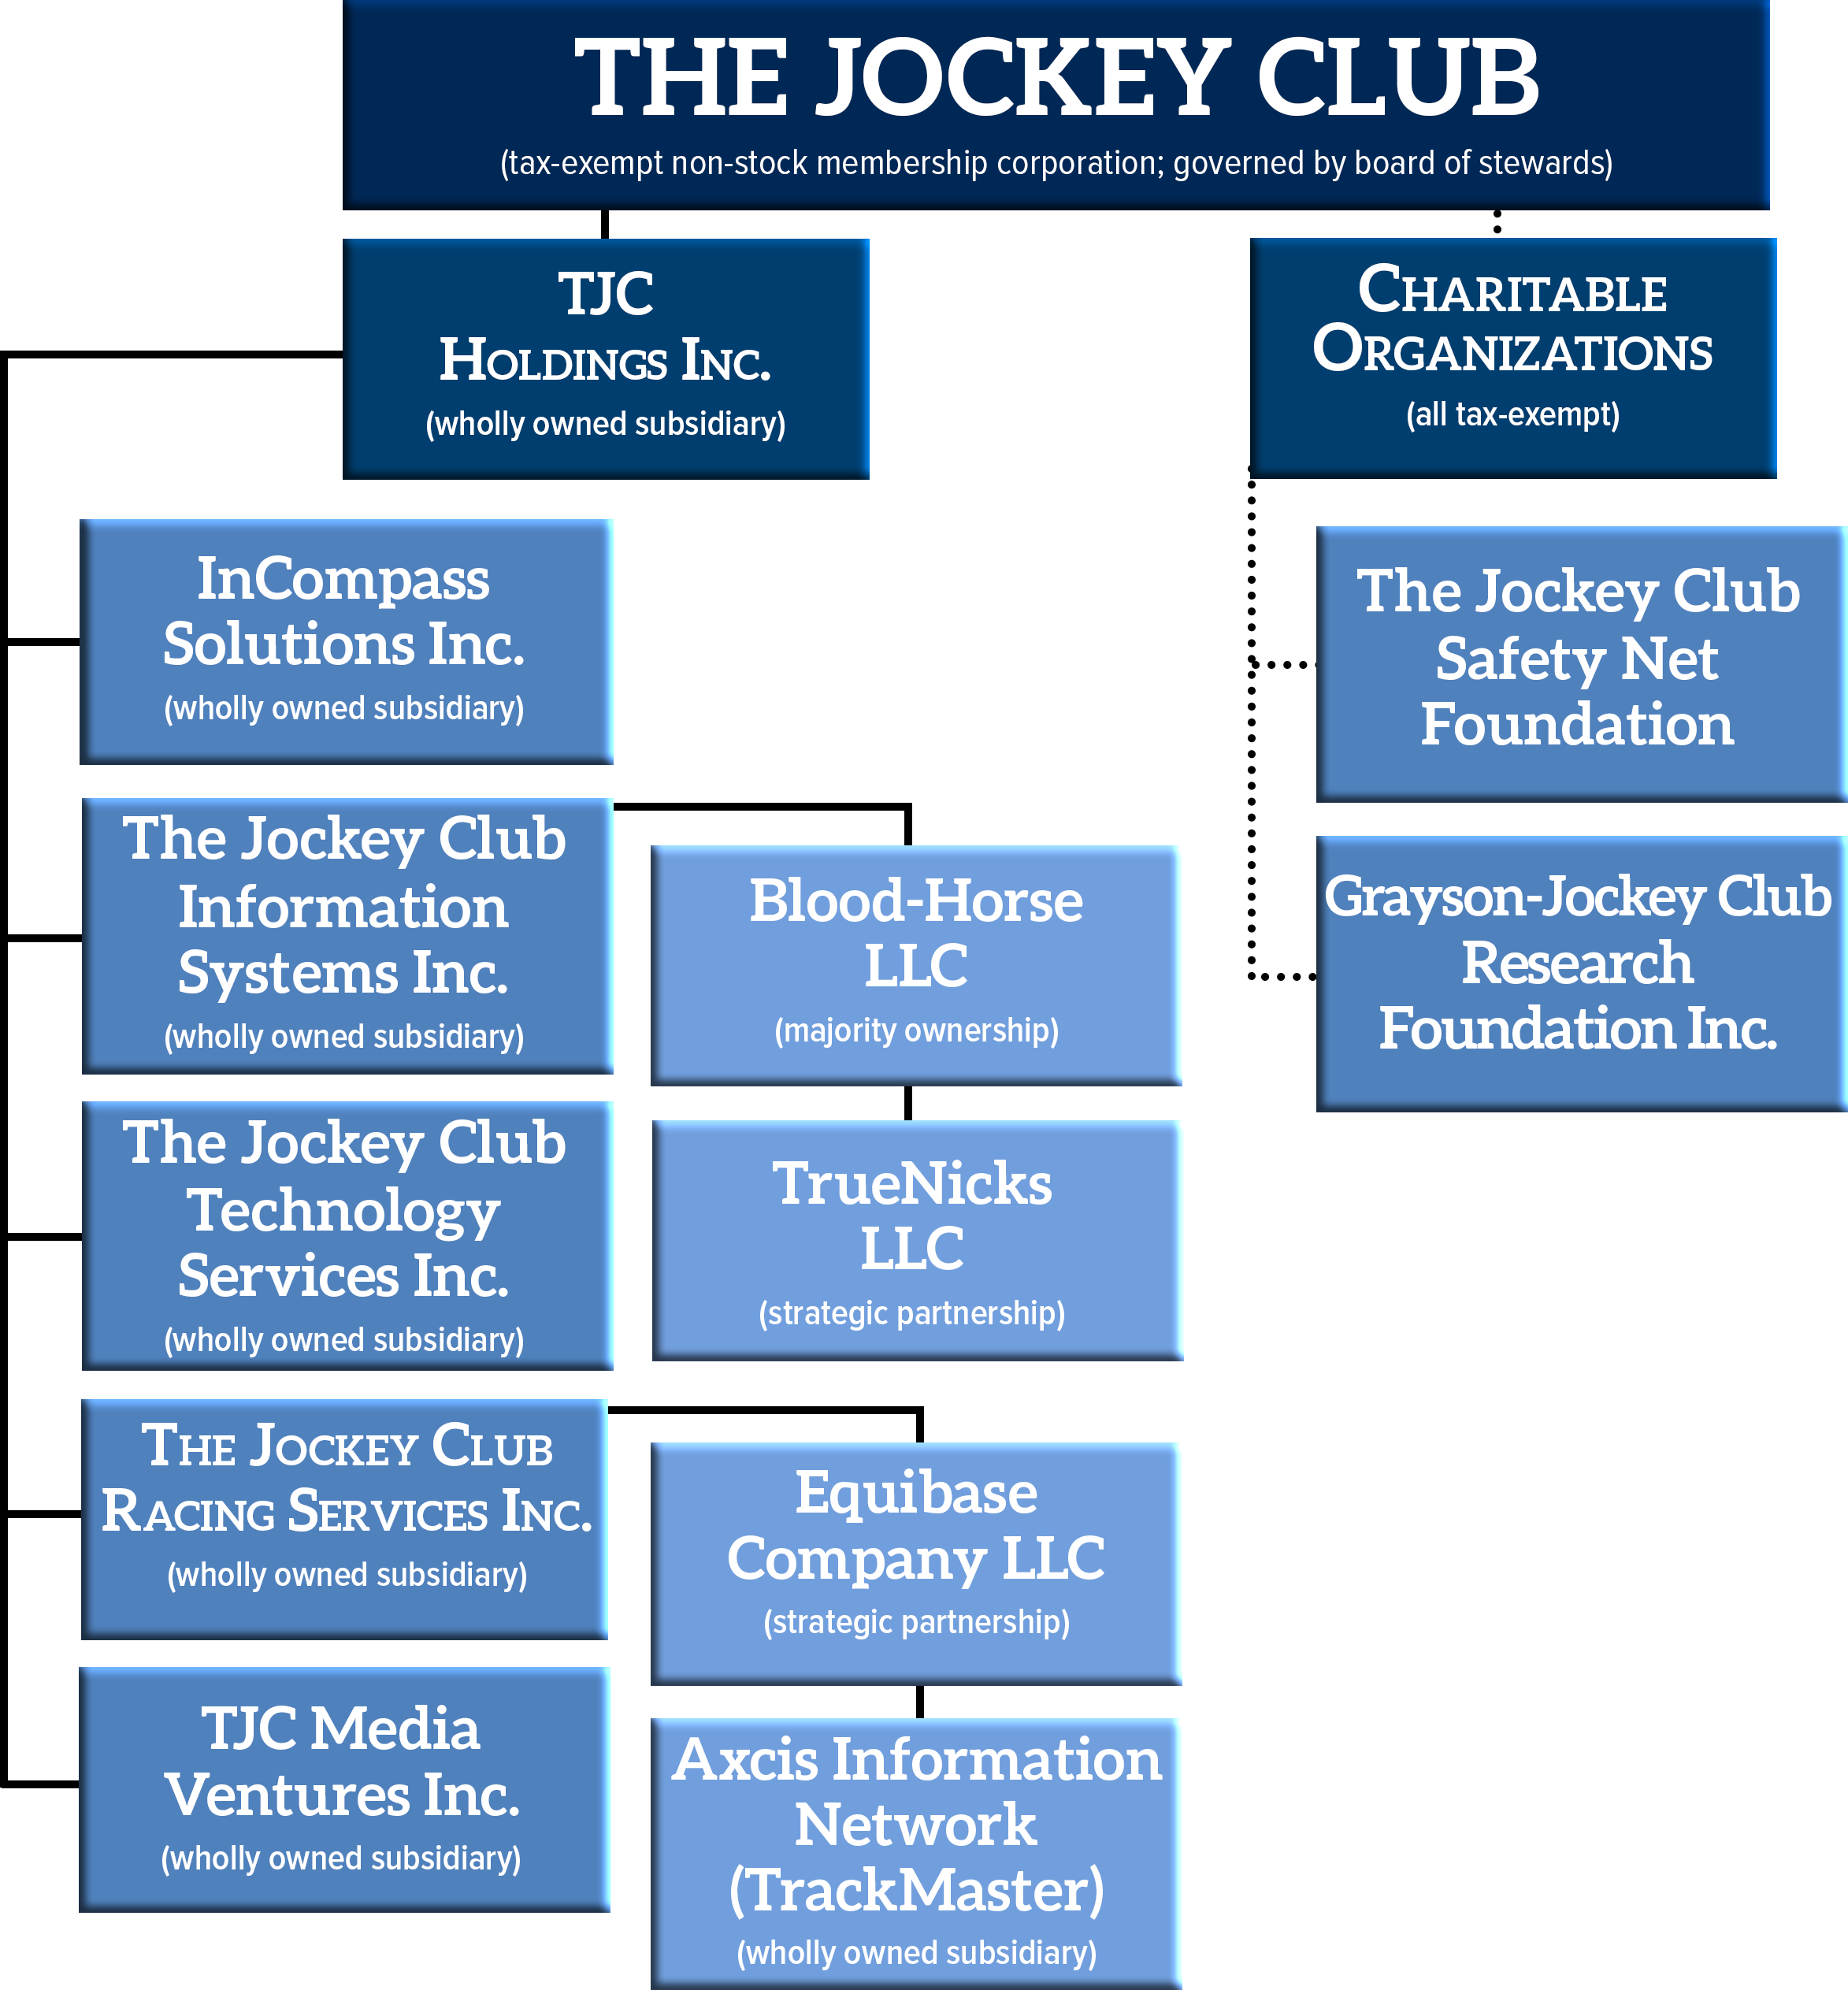

Slide 4
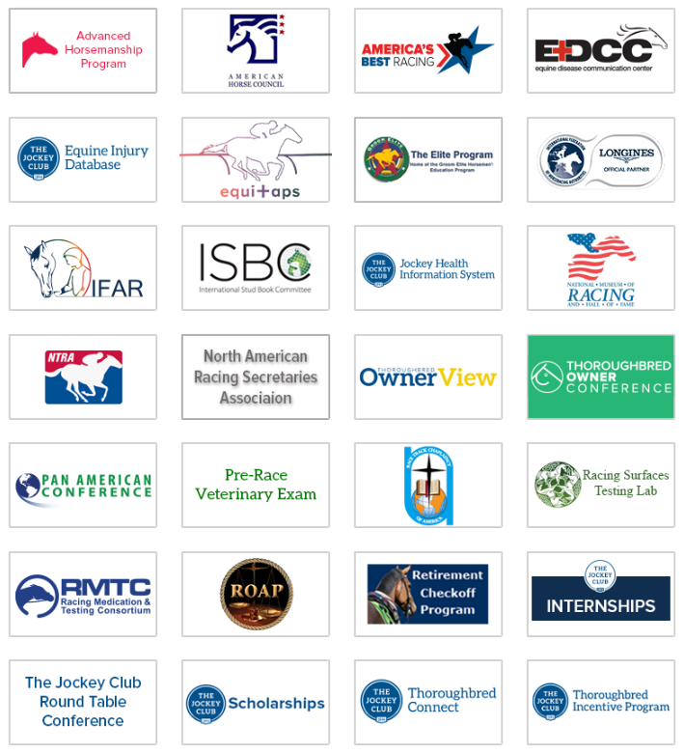
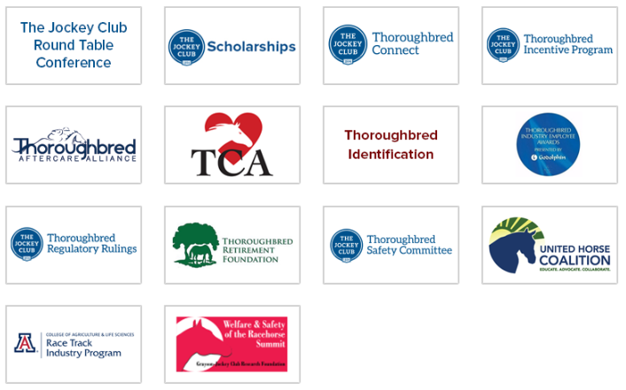
Supported Initiatives

Slide 5
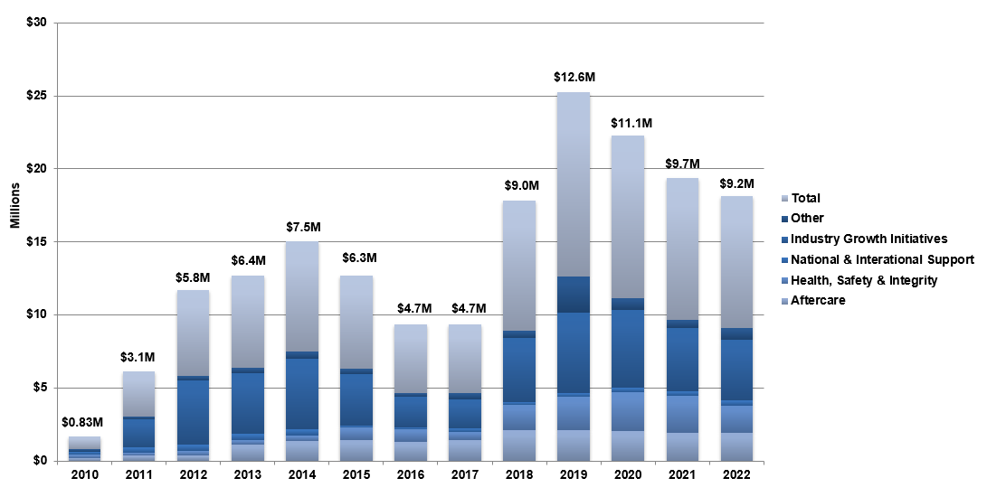
Industry Support

Slide 8
Equine Injury Database
Statistical Summary from 2009 to 2022
(Thoroughbred Flat Racing Only)
Calendar Year | 2009 | 2010 | 2011 | 2012 | 2013 | 2014 | 2015 | 2016 | 2017 | 2018 | 2019 | 2020 | 2021 | 2022
Rate | 2.00 | 1.88 | 1.88 | 1.92 | 1.90 | 1.89 | 1.62 | 1.54 | 1.61 | 1.68 | 1.53 | 1.41 | 1.39 | 1.25
Based on the 2022 data, 99.88% of flat racing starts at the racetracks participating in the EID were completed without fatality.
This is the fourth consecutive year that the rate has decreased.
It is the third consecutive year the rate has been below 1.5 fatalities per 1,000 starts.
It is the first time that the rate has been below 1.3 fatalities per 1,000 starts.

Slide 10
James L. Gagliano
President and COO
The Jockey Club

