Slide 1
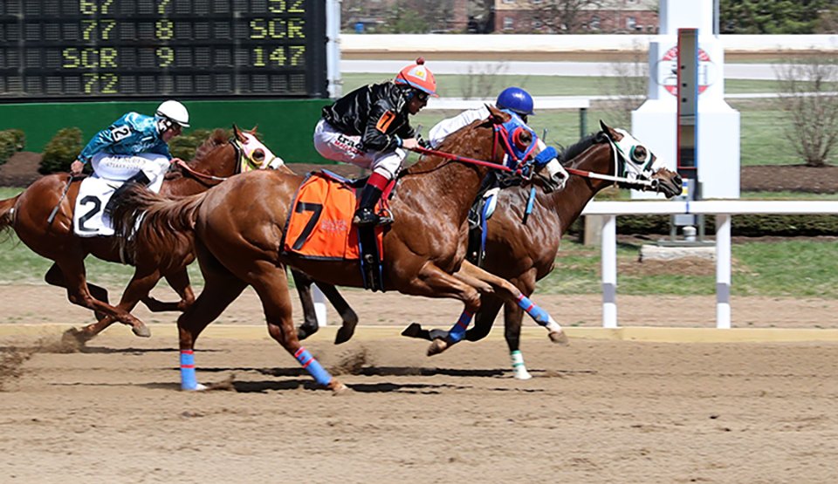
2023 Sandy Ridge at Red Mile

Slide 2
Sandy Ridge at Red Mile April 1-6, 2023
Racing
Race Days 6 Races 36 Horses Entered 318 Horses Programmed 240 Horses Started 193 Average Field Size 5.36 Fatalities 0

Slide 3
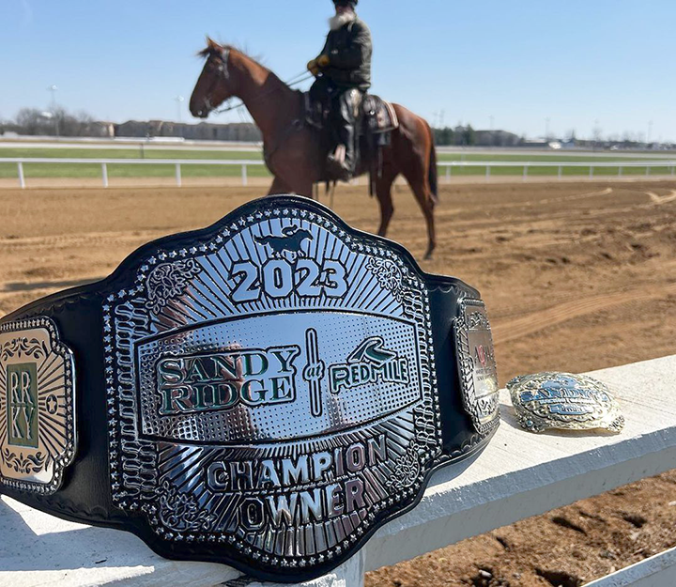
Sandy Ridge at Red Mile April 1-6, 2023
Financial impact
Total Purses Paid $1,006,145 On-Track Handle $81,975 (23.4%)
Export Handle $317,660 Total Handle $349,635
Avg. Handle/Race $9,712

Slide 4
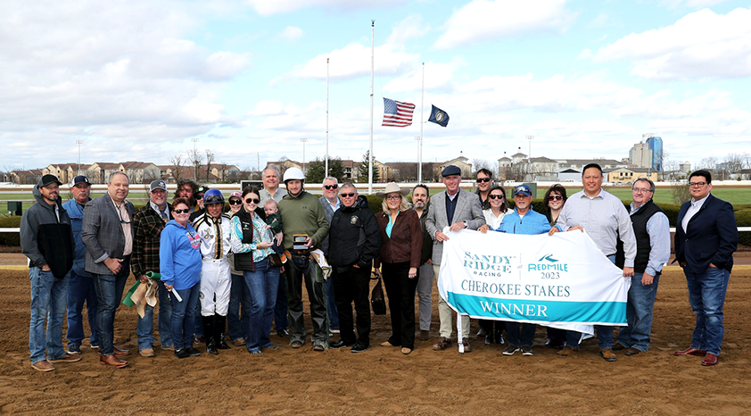
Sandy Ridge at Red Mile April 1-6, 2023
Leaders
Jockeys Trainers
Jorge Torres 1. Justin Powell
Gilbert Ortiz 2. Clint Crawford
Luiz Danie Martinez 3. Anthony Cunningham
Daniel Antonio Torres 4. Hector Sanchez
Note: Trainer Jason Driver banned for possessing controlled substance

Slide 5
Sandy Ridge at Red Mile April 1-6, 2023
Survey results
“Great, safe, clean, fun racing!”
We surveyed jockeys, trainers and owners after the race and received overwhelmingly positive feedback. On a 0-5 scale:
Overall Impression: 4.6
Stables/Services: 4.3
Purses: 4.9
Likely To Return: 5.0

