Slide 1
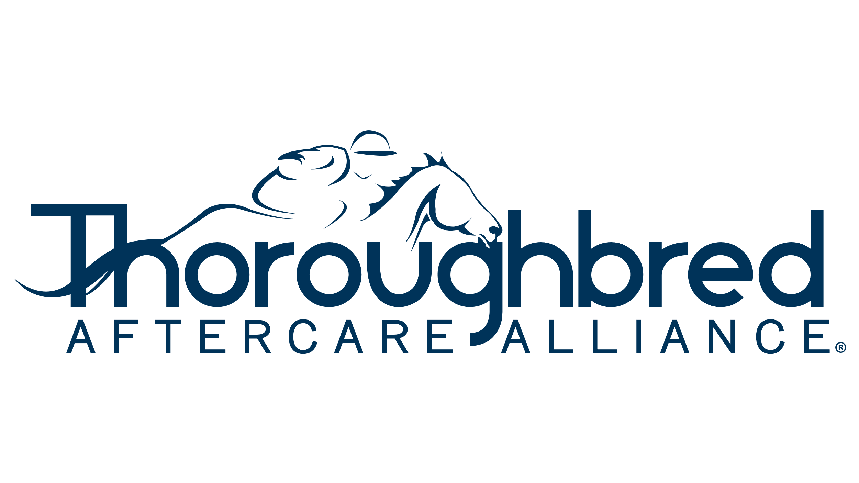
Thoroughbred Aftercare Alliance is an industry initiative started and based in Lexington, Kentucky in 2012. Thoroughbred Aftercare Alliance is a 501(c)(3) nonprofit that accredits, inspects, and awards grants to approved aftercare organizations to retrain, retire, and rehome Thoroughbreds.
Presentation by
Thoroughbred Aftercare Alliance
September 28, 2023

Slide 2
Thoroughbred Aftercare Alliance Foundation, INC.
Jeffrey Bloom, President, Thoroughbred Aftercare Alliance
Stacie Clark Rogers, Operations Consultant
Emily Dresen, Director, Funding & Events

Slide 3
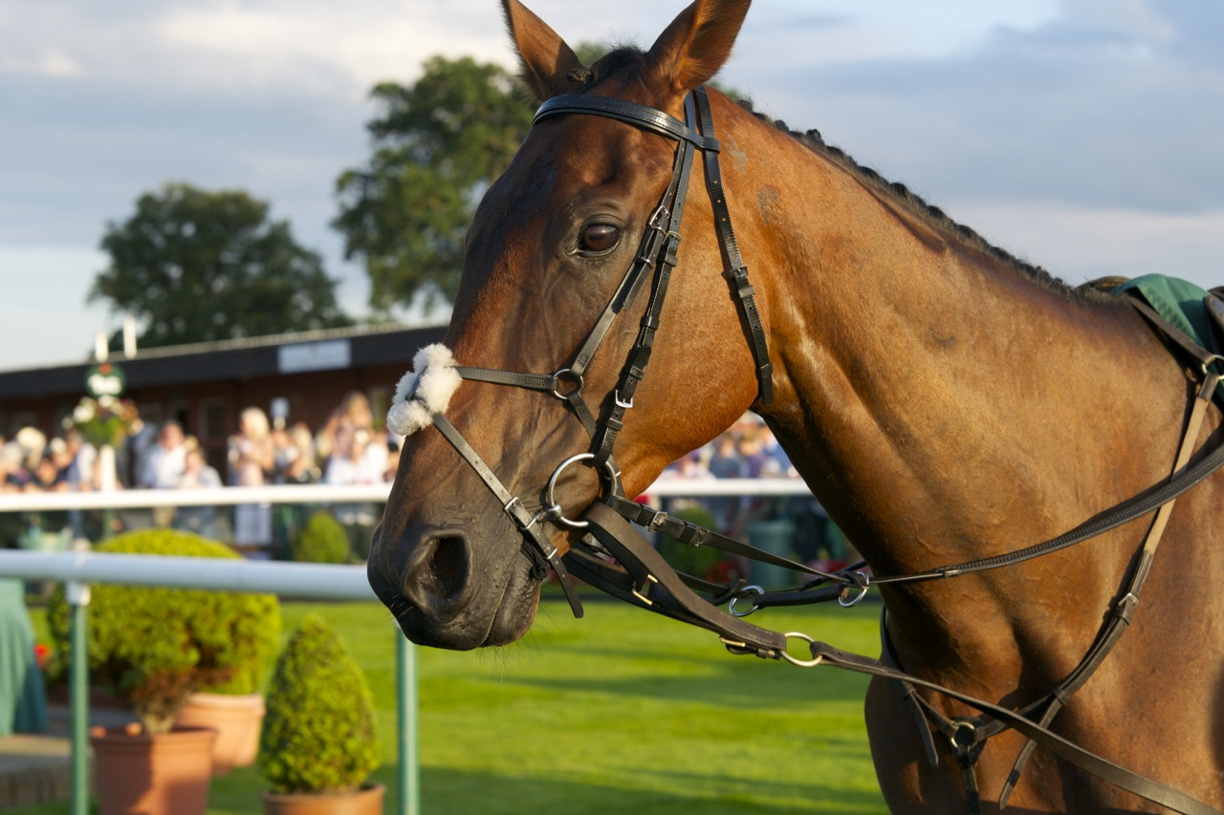
WHAT IS AFTERCARE
Anything that encompasses what a racehorse may do after they retire from racing (or even if they do not make it to the track but were bred and trained to be a racehorse). Some may be strictly retired, some may need rehabilitation, and some may move on to second careers.
Thoroughbred Aftercare Alliance was funded initially by seed money from Breeders’ Cup Ltd., The Jockey Club, and Keeneland Association Inc.
This Photo by Unknown author is licensed under CC BY.

Slide 4
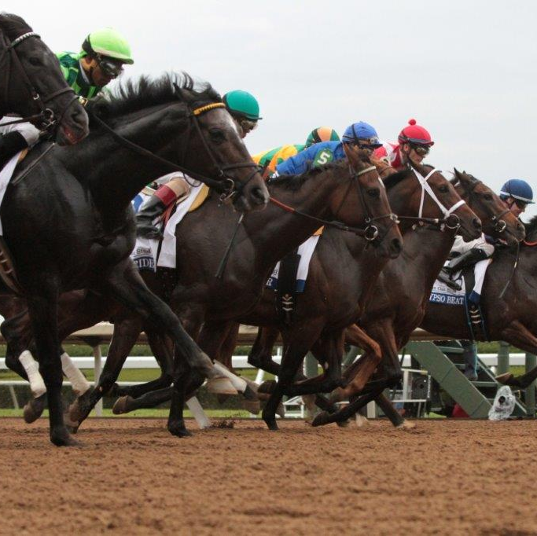
ECONOMIC IMPACT
The horse racing and breeding industry plays a substantial role in Kentucky's economy. It generates billions of dollars in economic activity, provides numerous jobs, and supports various ancillary industries. Demonstrating a strong commitment to Thoroughbred aftercare reflects positively on the industry's reputation, attracting investors, sponsors, and participants who value responsible horsemanship.

Slide 5
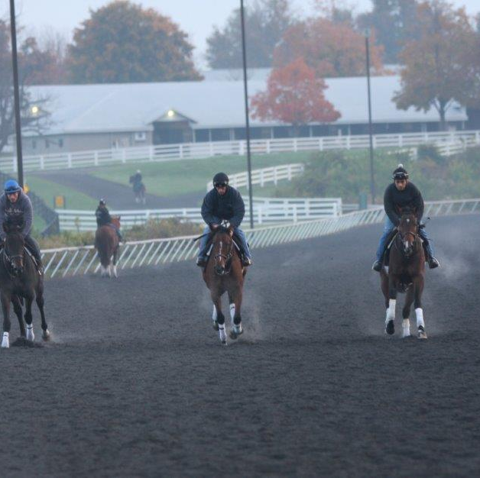
Kentucky is the largest seller of Thoroughbreds at public auction
Fasig-Tipton & Keeneland Sales generate over $750 million in annual sales.
236 Thoroughbred stallions stand in Kentucky. 227 of these stallions are registered with the Kentucky Thoroughbred Development Fund (KTDF).

Slide 6
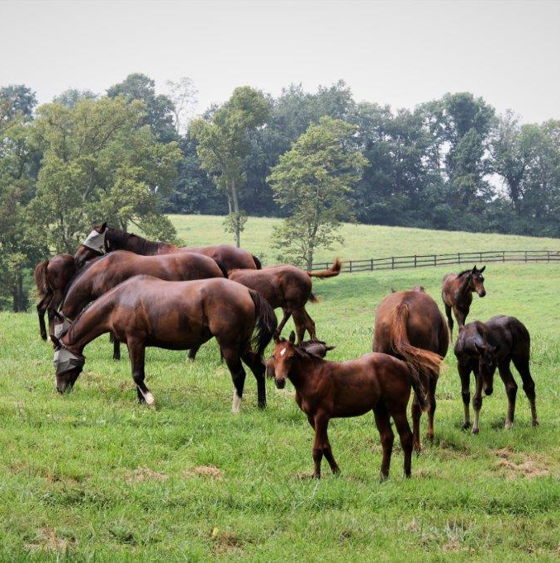
THOROUGHBRED IMPACT IN KENTUCKY
$115 million in tax revenues are generated for Kentucky through the Thoroughbred industry annually.
$33.6 million impact on employment through the Thoroughbred industry.
$24.4 million direct impact
$9.2 million indirect & induced impact
$1.003 billion impact on labor income through the Thoroughbred industry.
$2.7 billion impact on total value of industry production through the Thoroughbred industry.

Slide 7
THOROUGHBRED CAREERS IN KENTUCKY
$1.9 billion in labor income for people
More than 60 job categories are related to the Thoroughbred industry, including:
Veterinarians
General & Operations Managers
Farmers, Ranchers, and other Agricultural Managers
First-Line Supervisors of Farming, Fishing & Forestry Workers
Animal Scientists, Agricultural Engineers, Grounds Maintenance
Breeders, Sales, Racing
Farm & Home Management Advisors

Slide 8
THOROUGHBRED RACING IN KENTUCKY
Racing operations have a $517 million direct impact on Kentucky’s economy.
Racing sector:
24,402 direct jobs
$832 million in direct state value
$118 million in purses
Kentucky Oaks & Derby generate upward of $217 million.
The 2022 Breeders’ Cup at Keeneland brought in nearly $82 million.
This Photo by Unknown author is licensed under CC BY-ND.

Slide 9
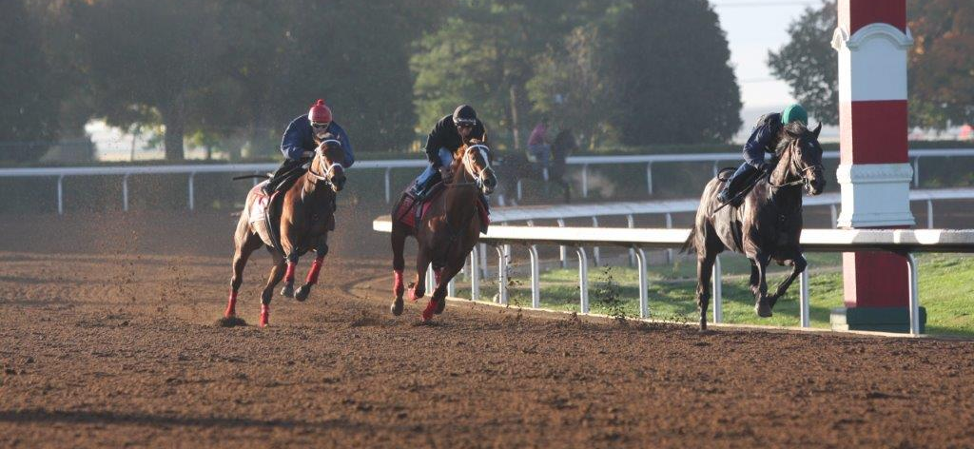
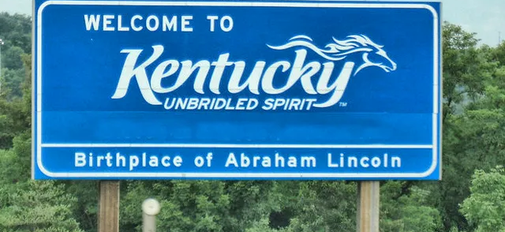
THOROUGHBRED INDUSTRY VITAL TO KENTUCKY ECONOMY
The equine industry combines to generate $6.5 billion in annual cumulative direct, indirect, and induced economic activity and a total of 60,494 jobs in Kentucky.
The horse industry contributes 1% of the total Kentucky Gross Domestic Product (GDP). In no other state is the horse industry more important to the economy than Kentucky.

Slide 10
What sets Thoroughbred Aftercare Alliance apart from other aftercare organizations?
ACCREDITATION
Thoroughbred Aftercare Alliance's leadership position makes it the most creditable leader in aftercare and a strong fundraiser to support Thoroughbred aftercare.
Thoroughbred Aftercare Alliance is the only accrediting body for Thoroughbred aftercare.
According to the Thoroughbred Aftercare Alliance's Code of Standards, accreditation status is determined after a complete review of five areas: operations; education; horse health care management; facility standards and services; adoption policies and protocols.

Slide 11
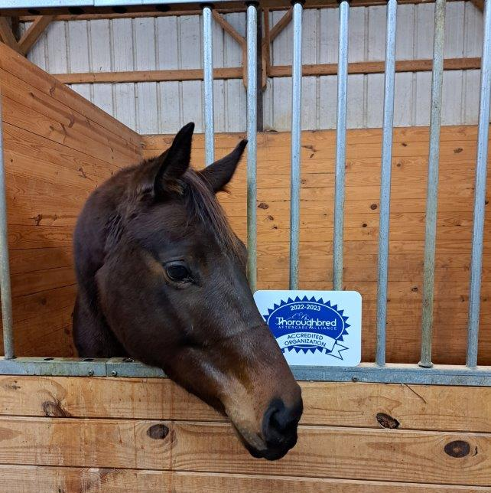
THOROUGHBRED AFTERCARE ALLIANCE IMPACT
Since 2012, more than 15,500 Thoroughbreds have found a new home or careers through Thoroughbred Aftercare Alliance accredited organizations. These organizations have transitioned former racehorses into eventers, champions show horses, partners in equine-assisted therapy programs, living tourism destinations, and more. Through the work of Thoroughbred Aftercare Alliance accredited organizations, new opportunities are arising for off-track Thoroughbreds.

Slide 12
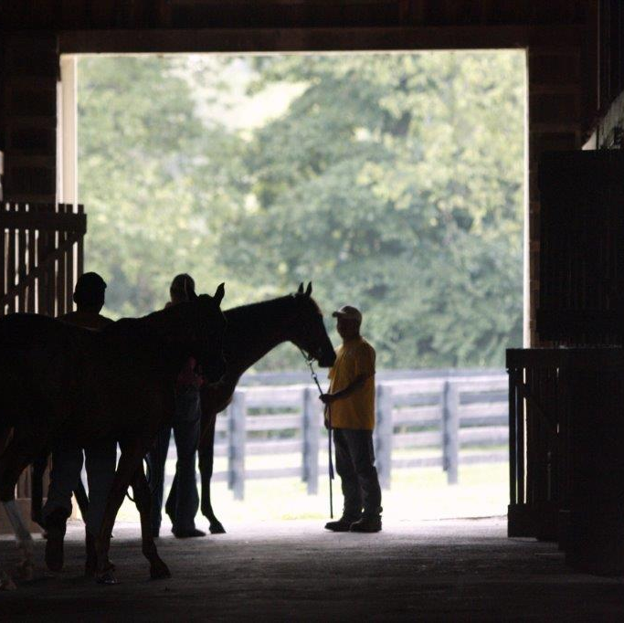
Why is accredited Thoroughbred aftercare important to Kentucky ?
ACCREDITED AFTERCARE
Thoroughbred aftercare is of great importance to Kentucky due to the state's deep-rooted connection to the horse racing industry and its commitment to the well-being of these magnificent animals. Several key factors highlight the significance of Thoroughbred aftercare in Kentucky.

Slide 13
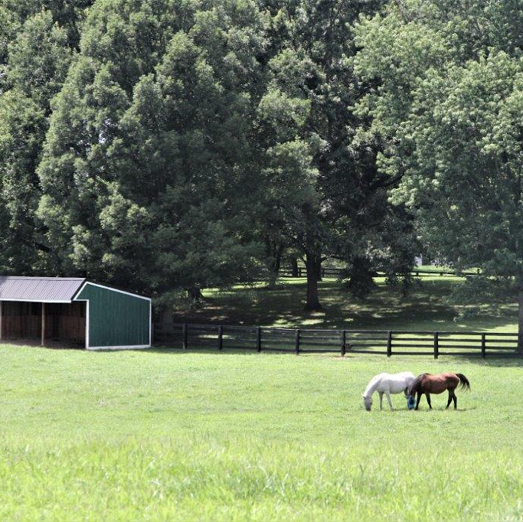
CULTURAL & HISTORICAL SIGNIFICANCE
Kentucky is widely recognized as the "Horse Capital of the World" and has a rich tradition of horse racing. Horses are an integral part of the state's culture, heritage, and identity. Given this historical significance, ensuring the proper care and support for Thoroughbreds throughout their entire lives is a responsibility that the state takes seriously.

Slide 14
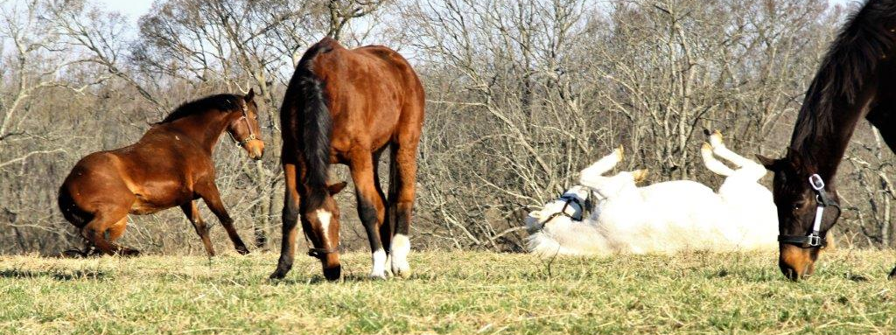
Kentucky recognizes its moral and ethical obligation to provide lifelong care for Thoroughbreds that have contributed to the state's racing legacy.
The state of Kentucky has already developed successful Breeders Incentives such as the KBIF and the KTDF.
Supporting the Thoroughbred Aftercare Alliance ensures their proper retirement, retraining, and rehoming while underscoring the state's dedication to animal welfare and sets a compassionate example for other racing jurisdictions.
ANIMAL WELFARE AND LONG-TERM SUSTAINABILITY

Slide 15
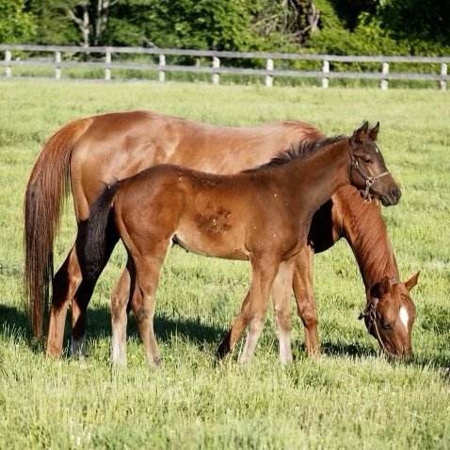
SUSTAINABILTY
Sustainable horsemanship practices are vital for the continued viability of the horse racing industry.
Demonstrating a commitment to Thoroughbred aftercare helps mitigate concerns about horse welfare and enhances the industry's longevity. It also aids in countering negative perceptions and challenges that may arise from instances of neglect or mistreatment.

Slide 16
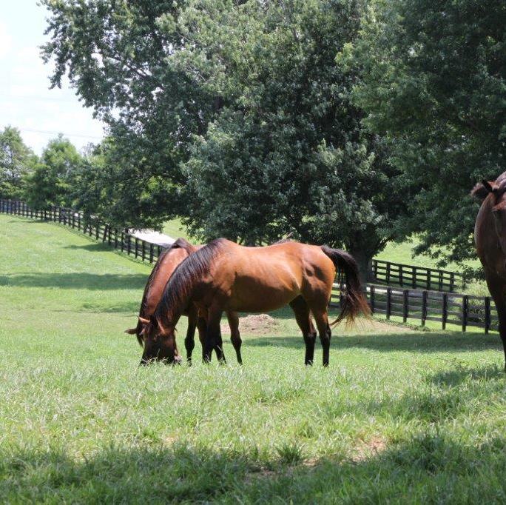
STAKEHOLDER ENGAGEMENT
Thoroughbred aftercare initiatives foster collaboration among various stakeholders in the horse racing industry. Racing associations, breeders, trainers, owners, and the broader community work together to create comprehensive aftercare programs.
These efforts build bridges between different segments of the industry and promote a unified approach to horse care.
While these collaborations are commendable it does not meet the funding needs of the accredited organizations.

Slide 17
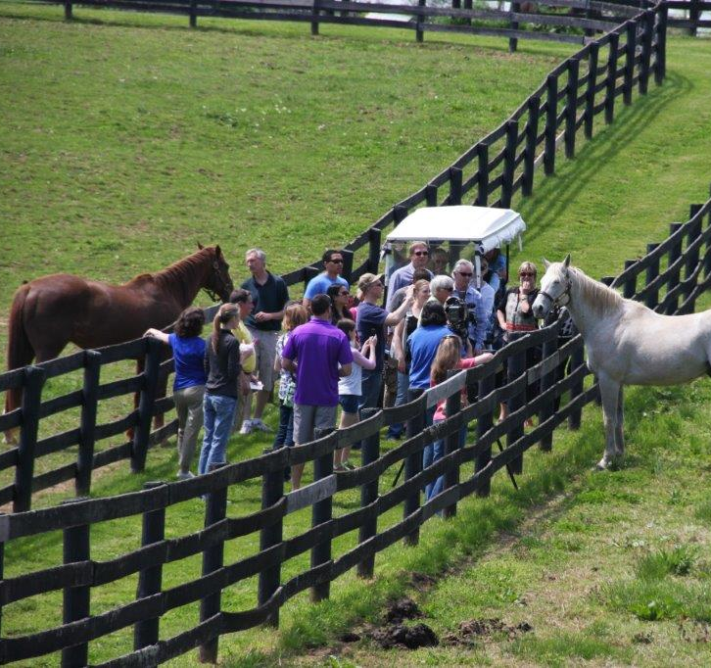
EDUCATION AND AWARENESS
Thoroughbred aftercare initiatives provide an opportunity to educate the public about the proper care of horses after their racing careers.
Thoroughbred Aftercare Alliance’s voice and leadership on aftercare are essential for public perception.
Awareness of Thoroughbred Aftercare Alliance can help dispel myths, clarify misconceptions, and emphasize the dedication of the Thoroughbred racing and breeding community.

Slide 18
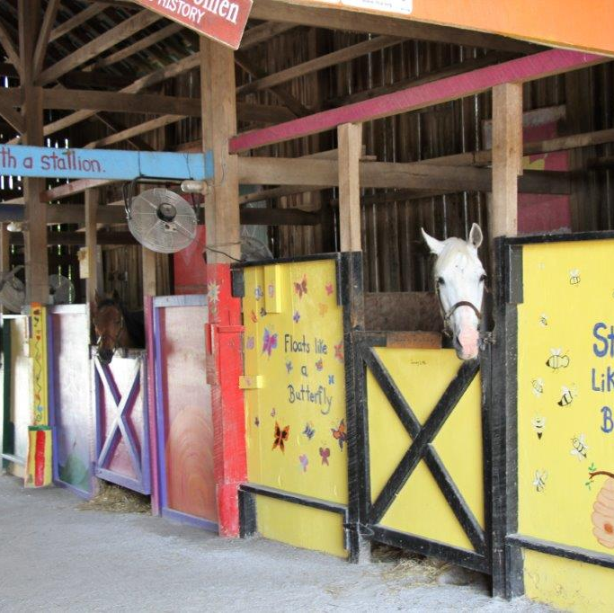
KENTUCKTY ORGANIZATIONS
Organizations
10 Thoroughbred Aftercare Alliance accredited organizations
20 facilities associated with Thoroughbred Aftercare Alliance accredited organizations
Horses
600 total Thoroughbreds in residence currently
461 Thoroughbreds in sanctuary residence
2674 adopted Thoroughbreds
Services
Services
5 organizations focused on Rehabilitation, Retraining, and Adoption
4 organizations focused on Sanctuary Retirement
2 organizations providing Equine-Assisted Therapy services for veterans
1 organization providing Therapeutic Riding services to special-needs individuals
1 facility operating a prison program

Slide 19
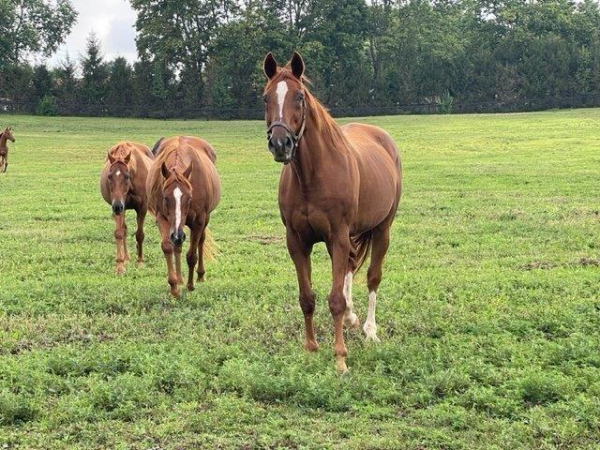
Budget of Kentucky Groups vs Thoroughbred Aftercare Alliance Grants
OPERATING BUDGETS
Total annual budget of Kentucky Thoroughbred Aftercare Alliance accredited organizations: $10,086,210
Total 2022 grants to Kentucky Thoroughbred Aftercare Alliance accredited organizations: $940,000
Percent of budget that Thoroughbred Aftercare Alliance is funding: 9.3%

Slide 20
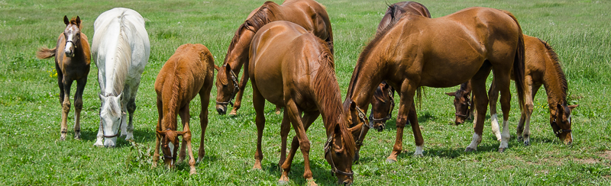
Kentucky-bred Thoroughbreds in all Thoroughbred Aftercare Alliance accredited organizations
KENTUCKY-BRED
This Photoby Unknown author is licensed under CC BY-NC-ND.

Slide 21
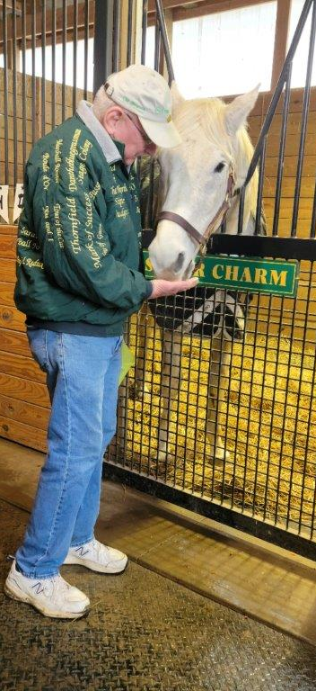
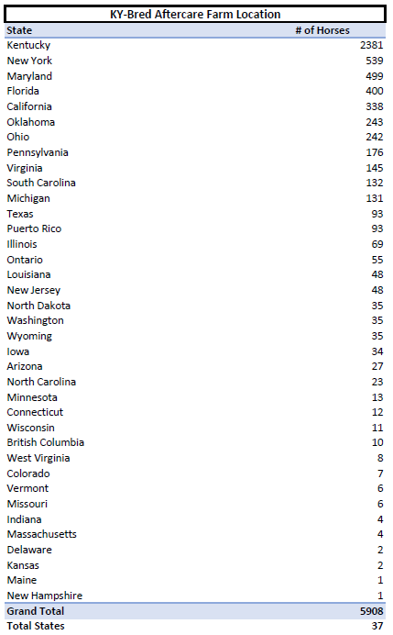
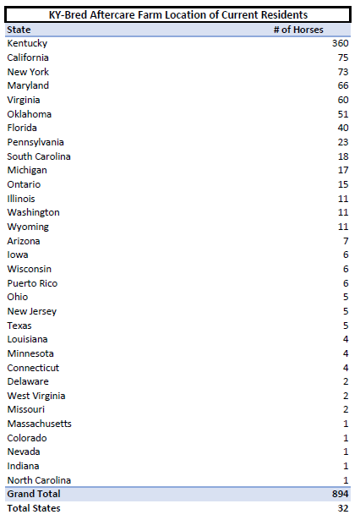

Slide 22
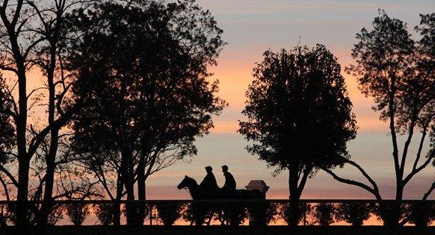
SUMMARY
Thoroughbred aftercare is important to the state of Kentucky because it aligns with the state's cultural, economic and ethical values. By prioritizing the welfare of retired racehorses, Kentucky can continue to be a leader in responsible horsemanship and set an example for the entire horse racing industry.
thoroughbredaftercare.org
(859) 224-2756

Slide 23
Sources
Yearling Sales History Stats
KTA Analysis via Keeneland
Stallions
Stallion Registry via BloodHorse
Thoroughbred Impact on Employment, Labor Income, & Total Value of Industry Production
American Horse Council Foundation. (2018). Economic Impact Results. Economic Impact of the Horse Industry in Kentucky,12.
Horses Put Kentuckians to Work
"2017 Economic Impact of the U.S. Horse Industry," prepared by American Horse Council and Innovation Group; University of Kentucky Community and Economic Development Initiative of Kentucky (DEDIK) Agricultural Cluster in Fayette & Woodford Counties.
Racing Impact
American Horse Council Foundation. (2018). The Recreation Sector. Economic Impact of the Horse Industry in Kentucky, 22., The Jockey Club State Facebook, Kentucky 2018, Louisville Tourism utilizing the Destinations International and Tourism Economics Event Impact Calculator, American Horse Council Foundation. (2018). The Recreation Sector. Economic Impact of the Horse Industry in Kentucky, 2.

