Slide 1
Freestanding Birth Centers
Presentation to the Interim Committee on Licensing, Occupations, & Administrative Regulations
October 16, 2023

Slide 2
HB129 and SB67
Require modernization of existing facility licensing requirements for Freestanding Birth Centers
Require Accreditation by the Commission for the Accreditation of Birth Centers (CABC), as recommended by the American College of Obstetricians and Gynecologists (ACOG)
Exempt Freestanding Birth Centers from the Certificate of Need requirement

Slide 3
Freestanding Birth Centers
A small home-like health care facility, separate from a hospital, for childbirth using a midwifery and wellness model.
Support for pregnancy and birth as a natural physiological process, “normal until proven otherwise.”
Staffed by licensed, qualified staff who care for healthy women with healthy pregnancies.
Equipped to provide routine care and initiate emergency procedures.
Integrated into the healthcare system, works with qualified obstetric/pediatric consultants, and has a relationship with a hospital that provides acute obstetric care.

Slide 4
HB 129 – RS 2023
January 5, filed by Rep. Jason Nemes
Co-sponsors: Bratcher, Chester-Burton, Fister, Grossberg, Heath, Hodgson, Kulkarni, Lockett, Massaroni, Palumbo, Rawlings, Webber, Willner
February 22- Passed in House Licensing, Occupations, & Administrative Regulations Committee
18 Yes, 0 No, 2 Pass votes

Slide 5
SB 67 – RS 2023
February 7, filed by Sen. Shelley Funke Frommeyer
Co-sponsors: Schickel, Adams, Armstrong, Deneen, Harper Angel, Neal, Southworth, Tichenor, Williams, Yates
February 21- Passed in Senate Licensing & Occupations Committee
9 Yes, 2 No votes
March 7- Passed in Senate Licensing & Occupations Committee with Senate Committee Substitute 1
7 Yes, 3 No, 1 Pass vote

Slide 6
SB67 - Committee Substitute
Maximum of 4 beds
Regulations to address malpractice insurance
Uniform language of “freestanding birth centers” throughout KRS
Reiterate responsibilities of freestanding birth centers regarding vital statistics and newborn testing

Slide 7
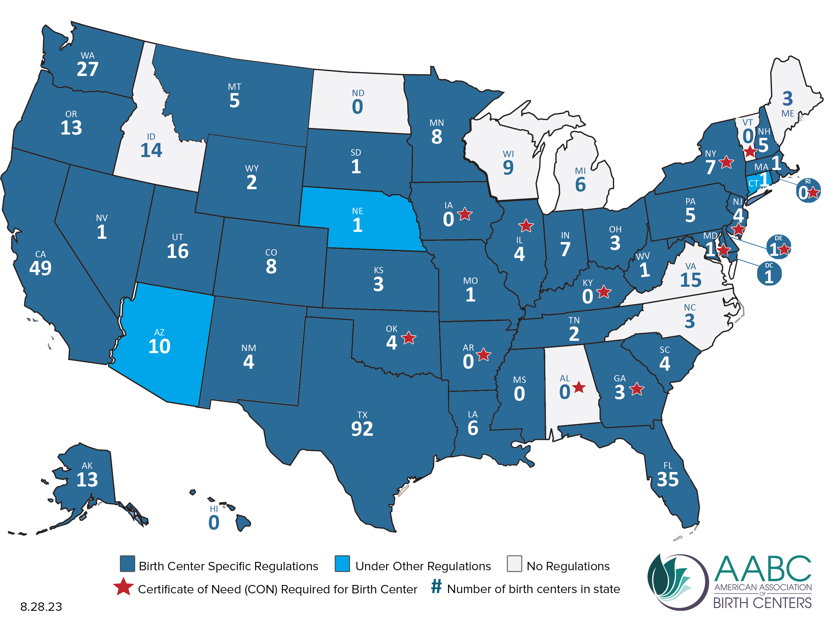
States with Certificate of Need for Birth Centers and Number of Birth Centers

Slide 8
