Slide 1
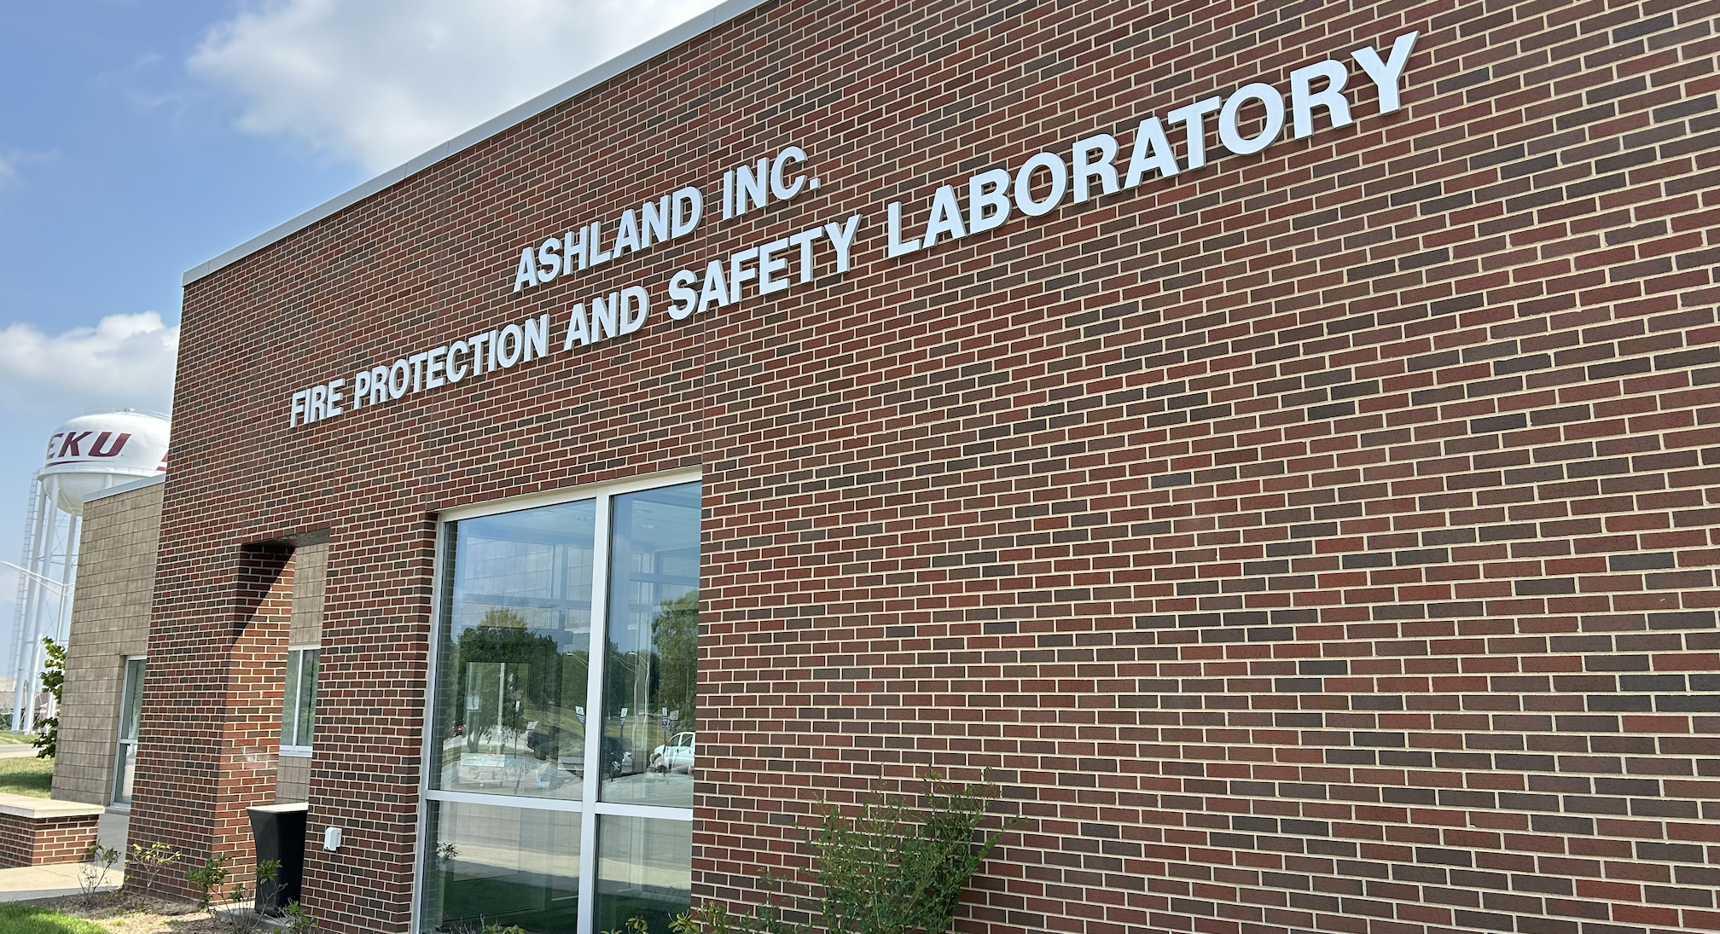
KENTUCKY IS LOSING OUR FUTURE
FIRE PROTECTION ENGINEERS

Slide 2

Pathways to Professional Licensure
Education
Examination (Fundamentals
of Engineering)
Professional Experience
Examination (Principles & Practice of Engineering)

Slide 3
FIRE PROTECTION ACCREDITATION
EKU is one of three ABET accredited programs in the U.S. to offer a BS in fire protection.
EKU’s fire protection degree is growing, and we recruit students from across the world.
Two kinds of ABET accreditation:
  Engineering Technology Accreditation Commission (ETAC) – EKU & OSU
  Engineering Accreditation Commission (EAC) – UM

Slide 4


FIRE PROTECTION ENGINEERS AGREE
Society of Fire Protection Engineers works with ABET to establish curriculum for and accredit both BS degrees in:
    Fire Protection Engineering
    Fire Protection Engineering Technology
In 2022, they stated, “Fire protection engineering technology graduates should be allowed to pursue professional engineering licensure.”

Slide 5
PROBLEM

Slide 6
FUTURE FIRE PROTECTION ENGINEERS
ARE LEAVING KENTUCKY
KRS 322.040 only recognizes EAC/ABET accredited programs for engineering licensure in Kentucky.
EKU fire protection graduates leave Kentucky and get licensed in other states.
  EKU graduates pass the Principles & Practice of Engineering (PE) at the same rate as the national average.
The job market is strong, and Kentucky has openings. Unfortunately, those jobs are filled by non-residents.

Slide 7
SOLUTION

Slide 8
Proposed change to KRS 322.040
A person shall qualify for licensure as a professional engineer by meeting the requirements set forth in paragraph (a) or (b) of this subsection
  (a) A person shall qualify if he or she has:
    1. Graduated from one of the following;
      a. An engineering program of four (4) years or more accredited by the Engineering Accreditation Commission of the Accreditation Board for Engineering and Technology or any engineering program deemed equivalent by the board;
      b. A fire protection engineering technology program of four (4) years or more accredited by the Engineering Technology Accreditation Commission of the Accreditation Board for Engineering and Technology

Slide 9

QUESTIONS?

