Slide 1
Intoxicating hemp-derived beverages
Jennifer Doering – chas Seligman Distributing
Joshua mulberry – Heidelberg distributing
Adam kline – heartland harvest / floral beverages

Slide 2
What are intoxicating hemp-derived beverages?
Intoxicating hemp-derived beverages are derived from hemp but contain compounds that can produce psychoactive effects.
Products may be labeled with different compounds – Delta-8 THC, Delta-9 THC, Delta-10 THC, THC-P, and HHC are the most common examples.
Delta-9 THC, or delta-9-tetrahydrocannabinol, is the primary psychoactive compound found in cannabis.
Hemp is legally defined as cannabis containing less than 0.3% Delta-9 THC
Other compounds, such as Delta-8 or Delta-10, have a similar molecular structure as Delta-9 but are found in much lower concentrations in the plant. Manufacturers with these products typically use a synthetic process to convert CBD into Delta-8 or Delta-10.
In addition to beverages, products can come in various forms, such as gummies and other edibles, vape pens, and smokable hemp flowers.

Slide 3
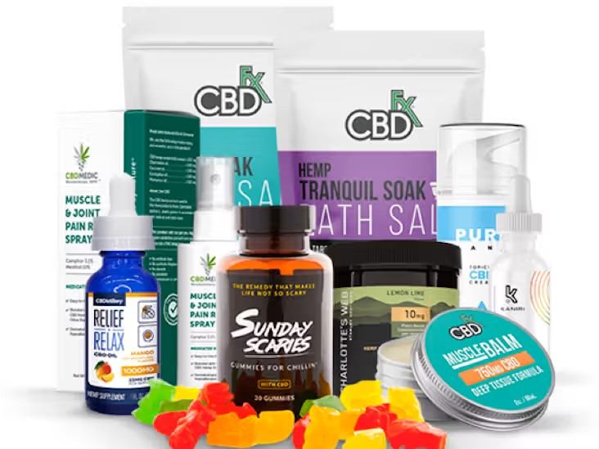
CBD products have NO intoxicating effect

Slide 4
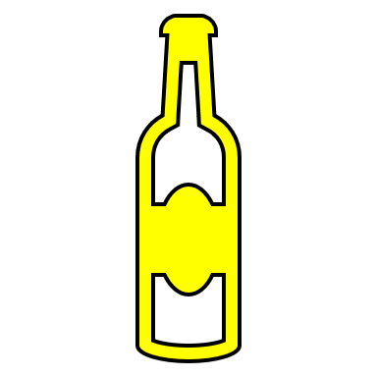
0.3% delta-9 THC on a dry-weight basis
0.3% ∆-9 THC by dry weight
20 mg ∆-9 THC
Psychoactive Ingredient
Pure ∆-9 THC Extract

Slide 5
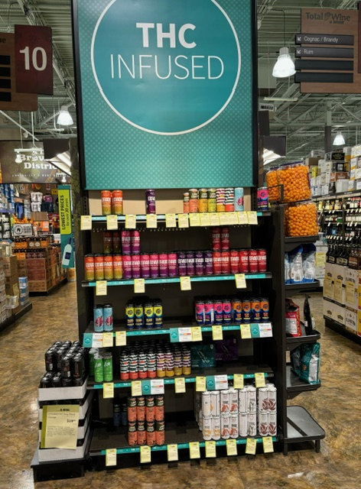
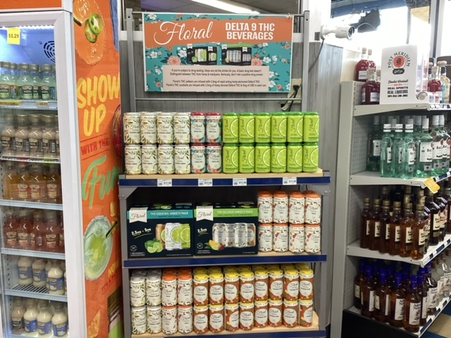

Slide 6
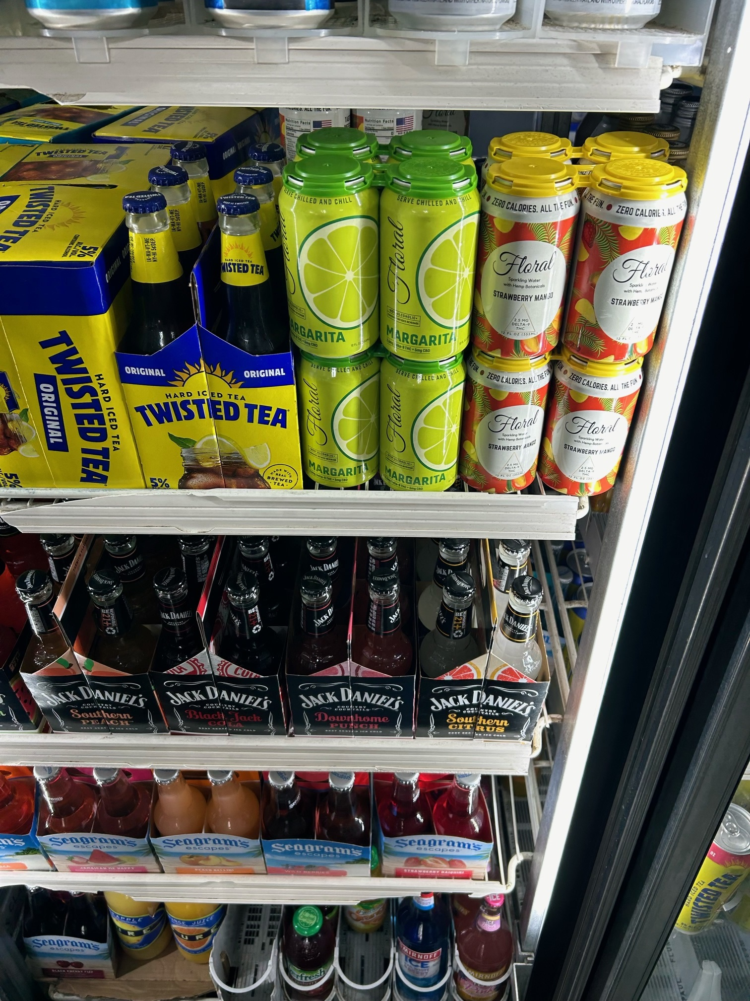
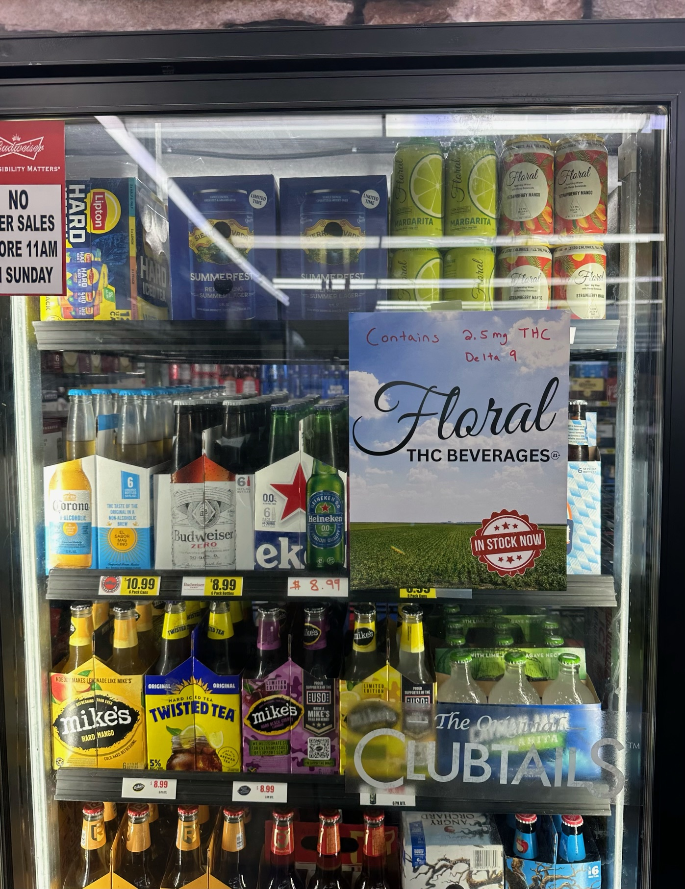

Slide 7
Legal status
Federally legal due to a provision in the 2018 Farm Bill that defined hemp as cannabis containing less than 0.3% Delta-9 THC on a dry weight basis.
Allows products with Delta-9 THC and other forms of THC, like Delta-8 and Delta-10 THC, to be legally sold if they meet the Delta-9 THC dry weight threshold.
Some states have enacted laws to regulate or ban the sale of intoxicating hemp-derived products, leading to a patchwork of regulations across the country.
State bans have been met with legal challenges, arguing federal preemption.

Slide 8
Kentucky law
HB 544 (2023) established minimum rules for intoxicating hemp-derived products – such as a 21+ age restriction and testing and labeling requirements – and broadly directed the Cabinet for Health and Family Services to promulgate regulations.
The Cabinet has since issued emergency regulations for retailers and distributors, product testing and registration requirements, processing and manufacturing procedures, and labeling and packaging requirements.
Oversight from Department for Public Health
Since HB 544 passed, many new intoxicating hemp-derived products have entered the market, including canned beverages which resemble alcoholic beverages.
315 retailers are registered in Kentucky, including businesses from 16 other states
California, Texas, Colorado, New York, Illinois, Nevada, North Carolina, Vermont, Delaware, Indiana, Massachusetts, Ohio, Pennsylvania, Wisconsin, Utah, Georgia
62 products are registered in Kentucky
54 are beverages; six are vapes; two are gummies
“Better Than Booze” ; “High without the hangover”

Slide 9
Hemp-Derived, Delta-9 Beverage Regulation Across the States
States Banning the Sale of Intoxicating Hemp Beverage
No Significant Legislation or Regulation in Place
State law or regulation bans ∆-9 hemp-derived beverages
Existing State law(s) echo federal permissions on the farming and sale of industrial hemp and go no further
50 STATES
Sales Routed to Cannabis Dispensary Market
State law or regulation allows for the sale of ∆-9 hemp-derived intoxicating beverage only via the recreational cannabis marketplace.
Legislation or Regulation Allowing for the Retail Sale of intoxicating Hemp
State law or regulation takes an affirmative step toward establishing a retail marketplace for ∆-9, intoxicating hemp beverage.
Last updated September 23, 2024

Slide 10
Parity with alcohol
Intoxicating hemp-derived beverages are intoxicating beverages just like alcohol.
Alcohol has been successfully regulated for over 90 years.
System of checks and balances to maintain level playing field
Trade practice rules
Taxation
Direct-to-consumer shipping laws
While the passage of HB 544 (2023) and subsequent regulations were an important first step to guard Kentuckians from unscrupulous practices and underage sales, these beverage products do not meet the stringent regulatory protections of alcohol beverage law.

