Slide 1
Kentucky Board of Emergency Medical Services
Report to Interim Joint Committee on Licensing, Occupations, and Administrative Regulations
8-22-2024

Slide 2
PROVIDER SHORTAGES

Slide 3
CURRENLTY LICENSED PROVIDERS = 15,192

Slide 4
MAJORITY OF SERVICES ARE ADVACED LIFE SUPPORT Traditionally requiring paramedic level certification
Basic Life Support (BLS):
Manage the airway at a basic level
Utilize automated defibrillator
Splinting and immobilization
A very limited range of medication administration
Advanced Life Support (ALS):
Provide basic and advanced life support
Advanced airway management
Cardiac Monitoring and intervention
A relative wide range of emergency medications

Slide 5
AFFILIATION AND RETENTION
6,911 Licensed Providers are affiliated with a service in the Kentucky EMS Information System (KEMSIS).

Slide 6
PROVIDER ATTRITION
21%
Of prehospital providers will not renew their license in Kentucky.
The number of newly certified paramedics is less than the number who leave the workforce.

Slide 7
PROVIDERS DECREASE WHILE NEEDS INCREASE
31,006
more requests for ambulance transport annually than five years previous.

Slide 8
CAUSES

Slide 9
NATIONALLY RECOGNIZED EMS WORKORCE CHALLENGES Sourced from National Conference of State Legislatures
Compensation is one of the top reasons EMS clinicians leave their jobs.
EMS has one of the highest rates of injuries and illnesses.
Ambulances are often not reimbursed for services unless a patient is transported to a hospital.
EMS clinicians experience high rates of behavioral and mental health conditions.

Slide 10
KENTUCKY RECOGNIZED EMS WORKORCE CHALLENGES Sourced from Kentucky Legislative Emergency Medical Services Task Force
There is a shortage and/or maldistribution of qualified trainers and training sites across the state, particularly for paramedics and advanced emergency medical technicians in Western and Eastern Kentucky.
Further expansion of the methods and amounts of reimbursement for EMS may improve the quality of services by increasing the ability of EMS providers to provide appropriate care.
The number of licensed emergency medical responders, emergency medical technicians, advanced emergency medical technicians, and paramedics has increased very little or has fallen since 2016.
There is a shortage and/or maldistribution of qualified trainers and training sites across the state, particularly for paramedics and advanced emergency medical technicians in Western and Eastern Kentucky.

Slide 11
BARRIERS TO PARAMEDIC TRAINING Sourced from Kentucky Office of Rural Health EMS Survey

Slide 12
ACCESS TO EDUCATION Sourced from Kentucky Office of Rural Health EMS Survey

Slide 13
REIMBURSMENT AND FUNDING
Wage deficits are appreciated but cannot be remedied due to limited operating margins.
Limited funds are being utilized to offset the increasing cost of equipment and operating costs.
Initial funding for additional education opportunities does not exist.
Limited reimbursement for services rendered creates a significant financial shortfall for EMS services.
EMS services often expend more capital per response than they are compensated for.

Slide 14
COST OF BUISNESS
Average Cost for Response $770 (2019 NEMSIS Data Set)
 | Medicaid | Medicare
Basic Life Support | $82.50 (-$687.00) | $365.67 (-$404.33)
Advanced Life Support | $110.00 (-$660.00) | $434.24 (-$335.76)

Slide 15
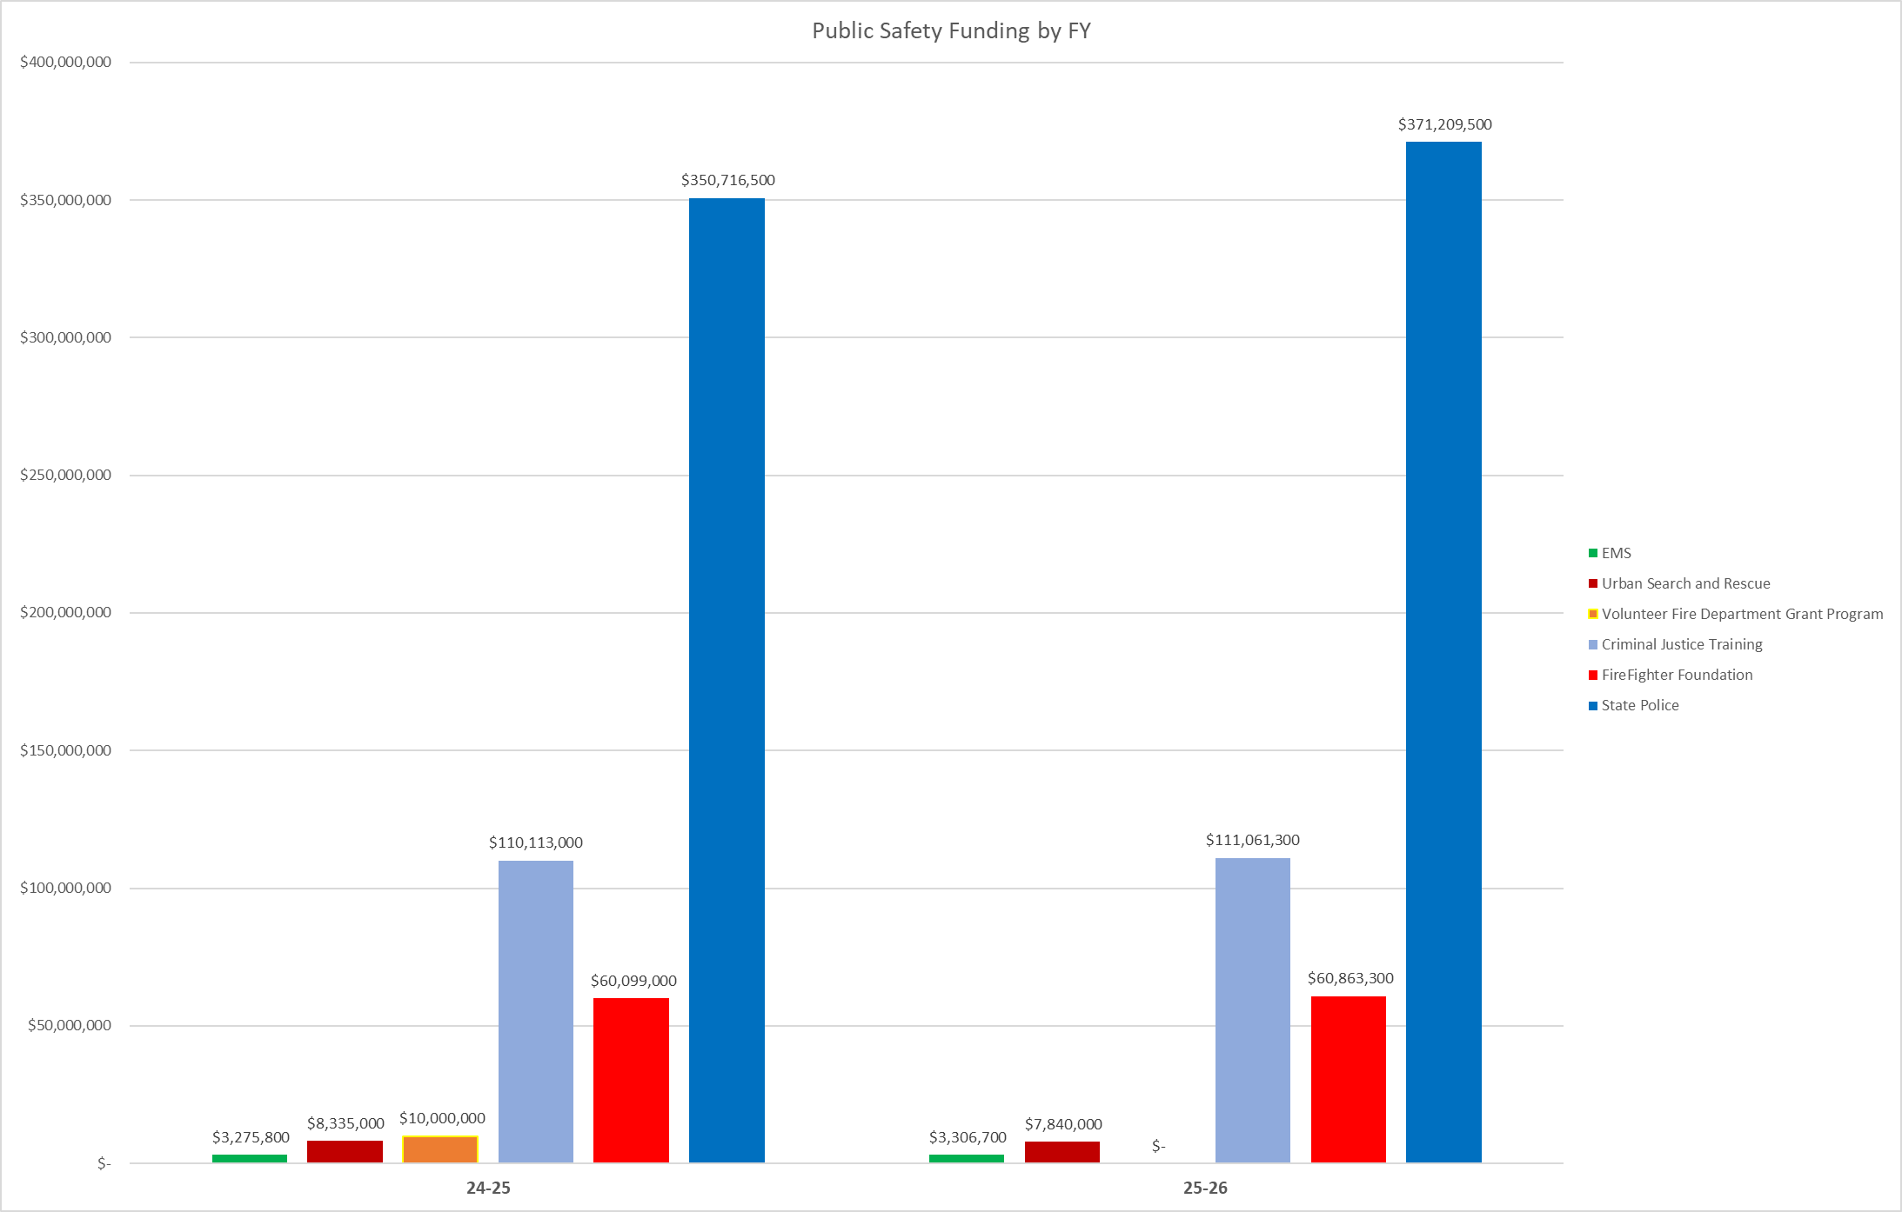
PUBLIC SAFETY FUNDING BY FISCAL YEAR

Slide 16
PREVIOUS IMPROVEMENT INITIATIVES
Decreased the initial requirements for EMS educators.
Removed licensing fees for newly certified providers.
Open reciprocity for providers moving from other states.
Decreased the number of advanced providers required to maintain ALS coverage.

Slide 17
GOALS FOR IMPROVEMENT
Increase reimbursement for services in order to increase wages, positively impact both recruitment and retention, as well as expand accessibility and decrease response/wait times.
Secure funding for addition training sites and student scholarships in order to expand educational opportunities, specifically in underserved rural areas.

Slide 18
QUESTIONS?
Kentucky Board of Emergency Medical Services
500 Mero Street, 5th Floor 5SE32,
Frankfort, KY 40601
Phone: 1-866-975-2367
https://kbems.ky.gov

