Slide 1
Kentucky Lottery Corporation The Interim Joint Committee on Licensing, Occupations, and Administrative Regulations Mary R. Harville President and CEO August 22, 2024

Slide 2
RECORD FY2024
RECORD Sales of $2.098 billion
RECORD Prizes paid to players of $1.5 billion
RECORD Low operating expenses as a % of sales (1.9%)
RECORD Cash transfers to the state of $404.4 million

Slide 3
Transfers to the Commonwealth of Kentucky

Slide 4
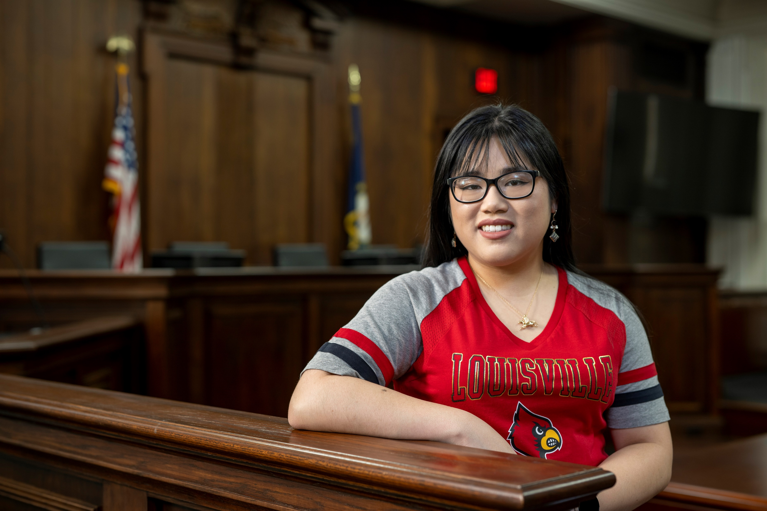
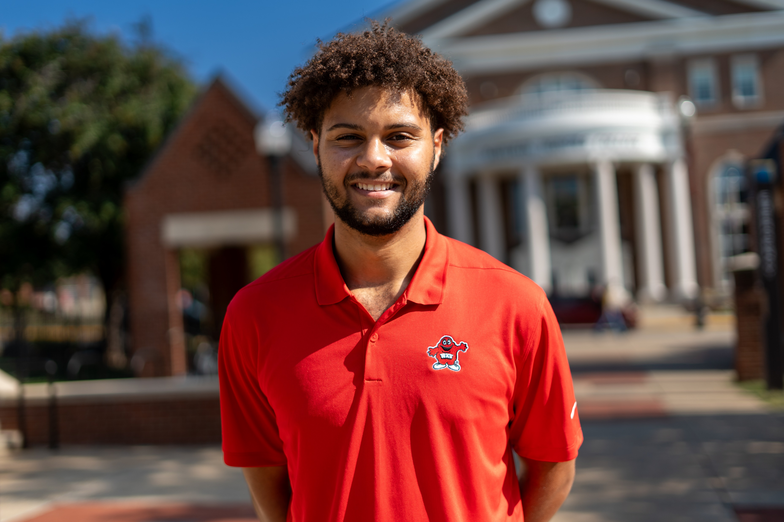
Lottery Funded Scholarship & Grant Programs
Lottery Funded Programs administered by the Kentucky Higher Education Assistance Authority (KHEAA):
Kentucky Educational Excellence Scholarship (KEES)
College Access Program (CAP)
KY Tuition Grants (KTG)
Work-Ready Kentucky Scholarship
Dual Credit Scholarship
National Guard Tuition Award
Teachers’ Scholarship Program

Slide 5
FY2025 Budget
Total Sales - $2,222,200,000
Total Transfers to the State:
$360,000,000 – General Fund (from operations)
$10,600,000 – KEES Reserve (estimated unclaimed prizes)

Slide 6
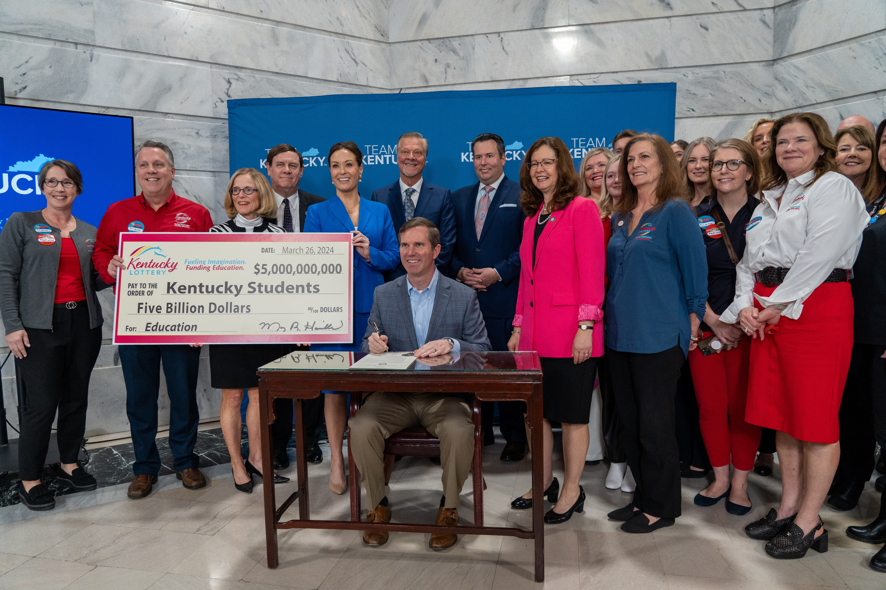
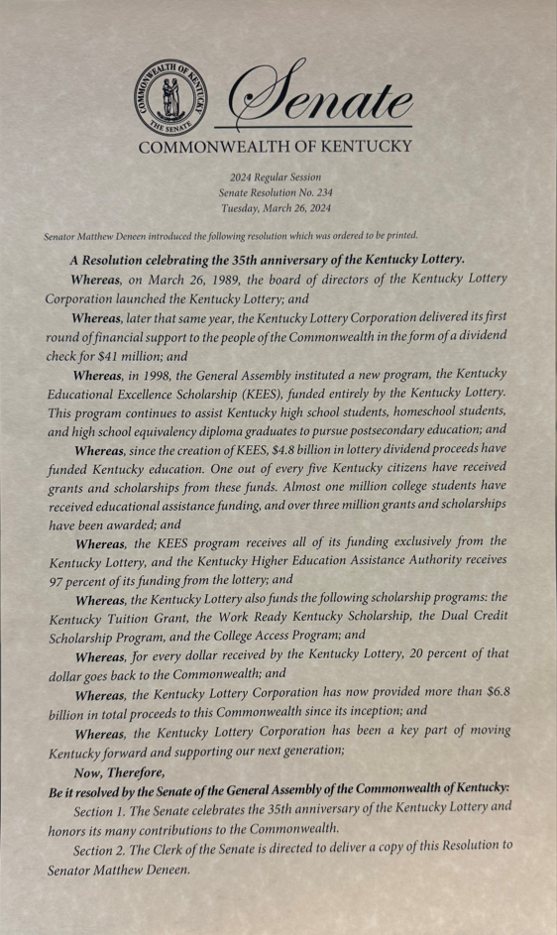
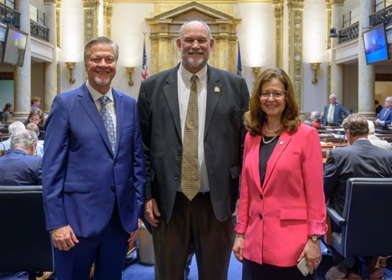
35th Anniversary Celebration

Slide 7
Work Ready Scholarship

Slide 8
Thank you!

