Slide 1

Interim Joint Committee
Licensing, Occupations, & Administrative Regulations
Thursday, September 25, 2025
Jamie Eads
President/CEO
jamie.eads@ky.gov

Slide 2
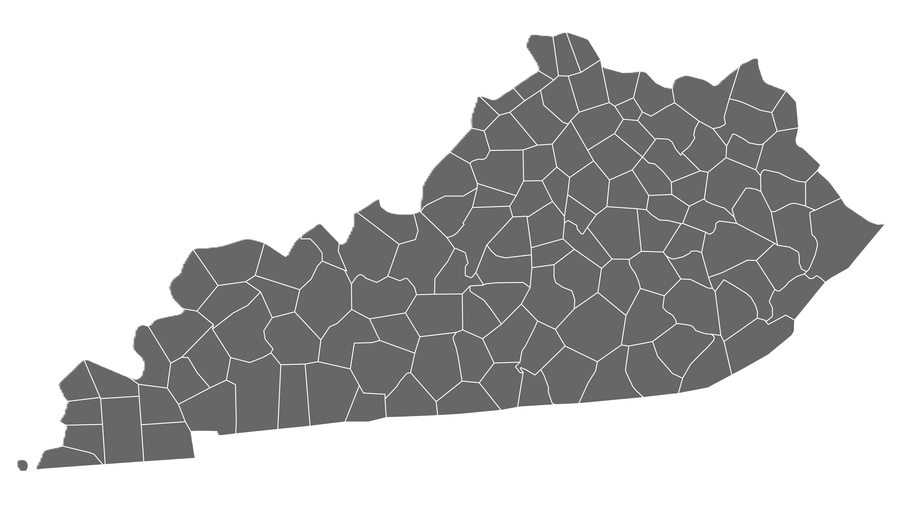




KHRG LICENSEES AND FACILITIES
Licensed Racing Associations – 9
448
Louisville &
Surrounding Counties
213
Northern KY
Racetrack Extensions - 6
Stand Alone Simulcast – 1
Race and Sportsbooks - 13
Charitable Gaming – 1,623
164
Central KY
148
Eastern KY
122
Out of State
338
Western KY
190
South Central KY

Slide 3





PARI-MUTUEL WAGERING 2025
ON TRACK
SIMULCAST
ADVANCED DEPOSIT WAGERING
HISTORICAL HORSE RACING
Total Wagered FY25
more than $11 Billion

Slide 4
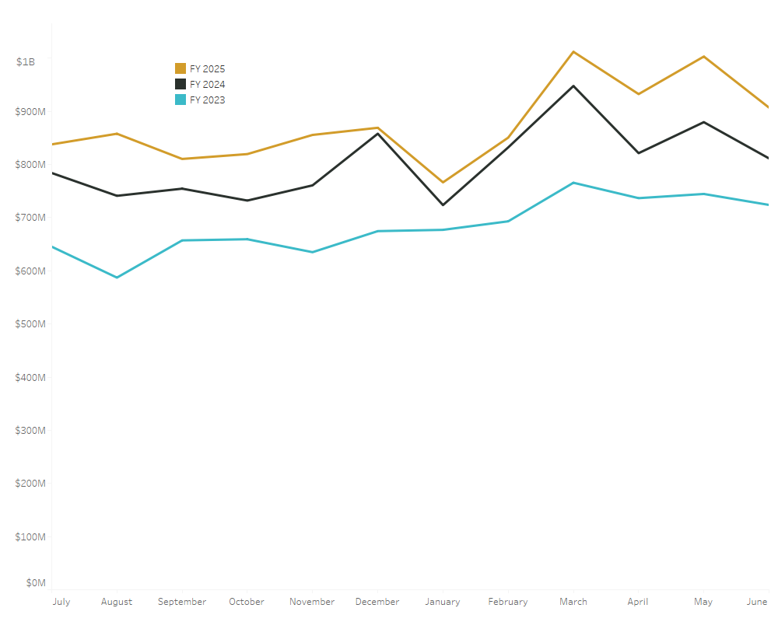


HISTORICAL HORSE RACING WAGERS
Total Wagers $10.52 B
Return to Player $9.54 B
9/25/25
4

Slide 5






PARI-MUTUEL WAGERING TAX REVENUE
Equine Drug Research
$450K
KTDF $59.6M
Higher Ed Equine Trust
$450K
KSDF $20.3M
Equine Industry Programs
$2.2M
KQHDF $3.9M

Slide 6




SPORTS WAGERING
$4.9 BILLION
$4.4 BILLION
$73 MILLION
$2 MILLION
Total Handle
(FY 24 and FY25)
Return to Player
(FY 24 and FY25)
Public Pension Fund Contributions
(FY 24 and FY25)
Problem Gambling Assistance Account Contributions
(FY 24 and FY25)
8 Operators
10 Service Providers
933 Occupational Licenses
13 retail facilities across 11 counties
92 additional events or sports added to the wagering catalog since launch
Sports wagering excise tax collections up 14% in July YoY

Slide 7
4047 Iron Works Parkway
Lexington, KY 40511
KHRC.KY.GOV

