Slide 1
Kentucky Quarter Horse Racing Association update
L&O Interim Meeting 9/25/25

Slide 2
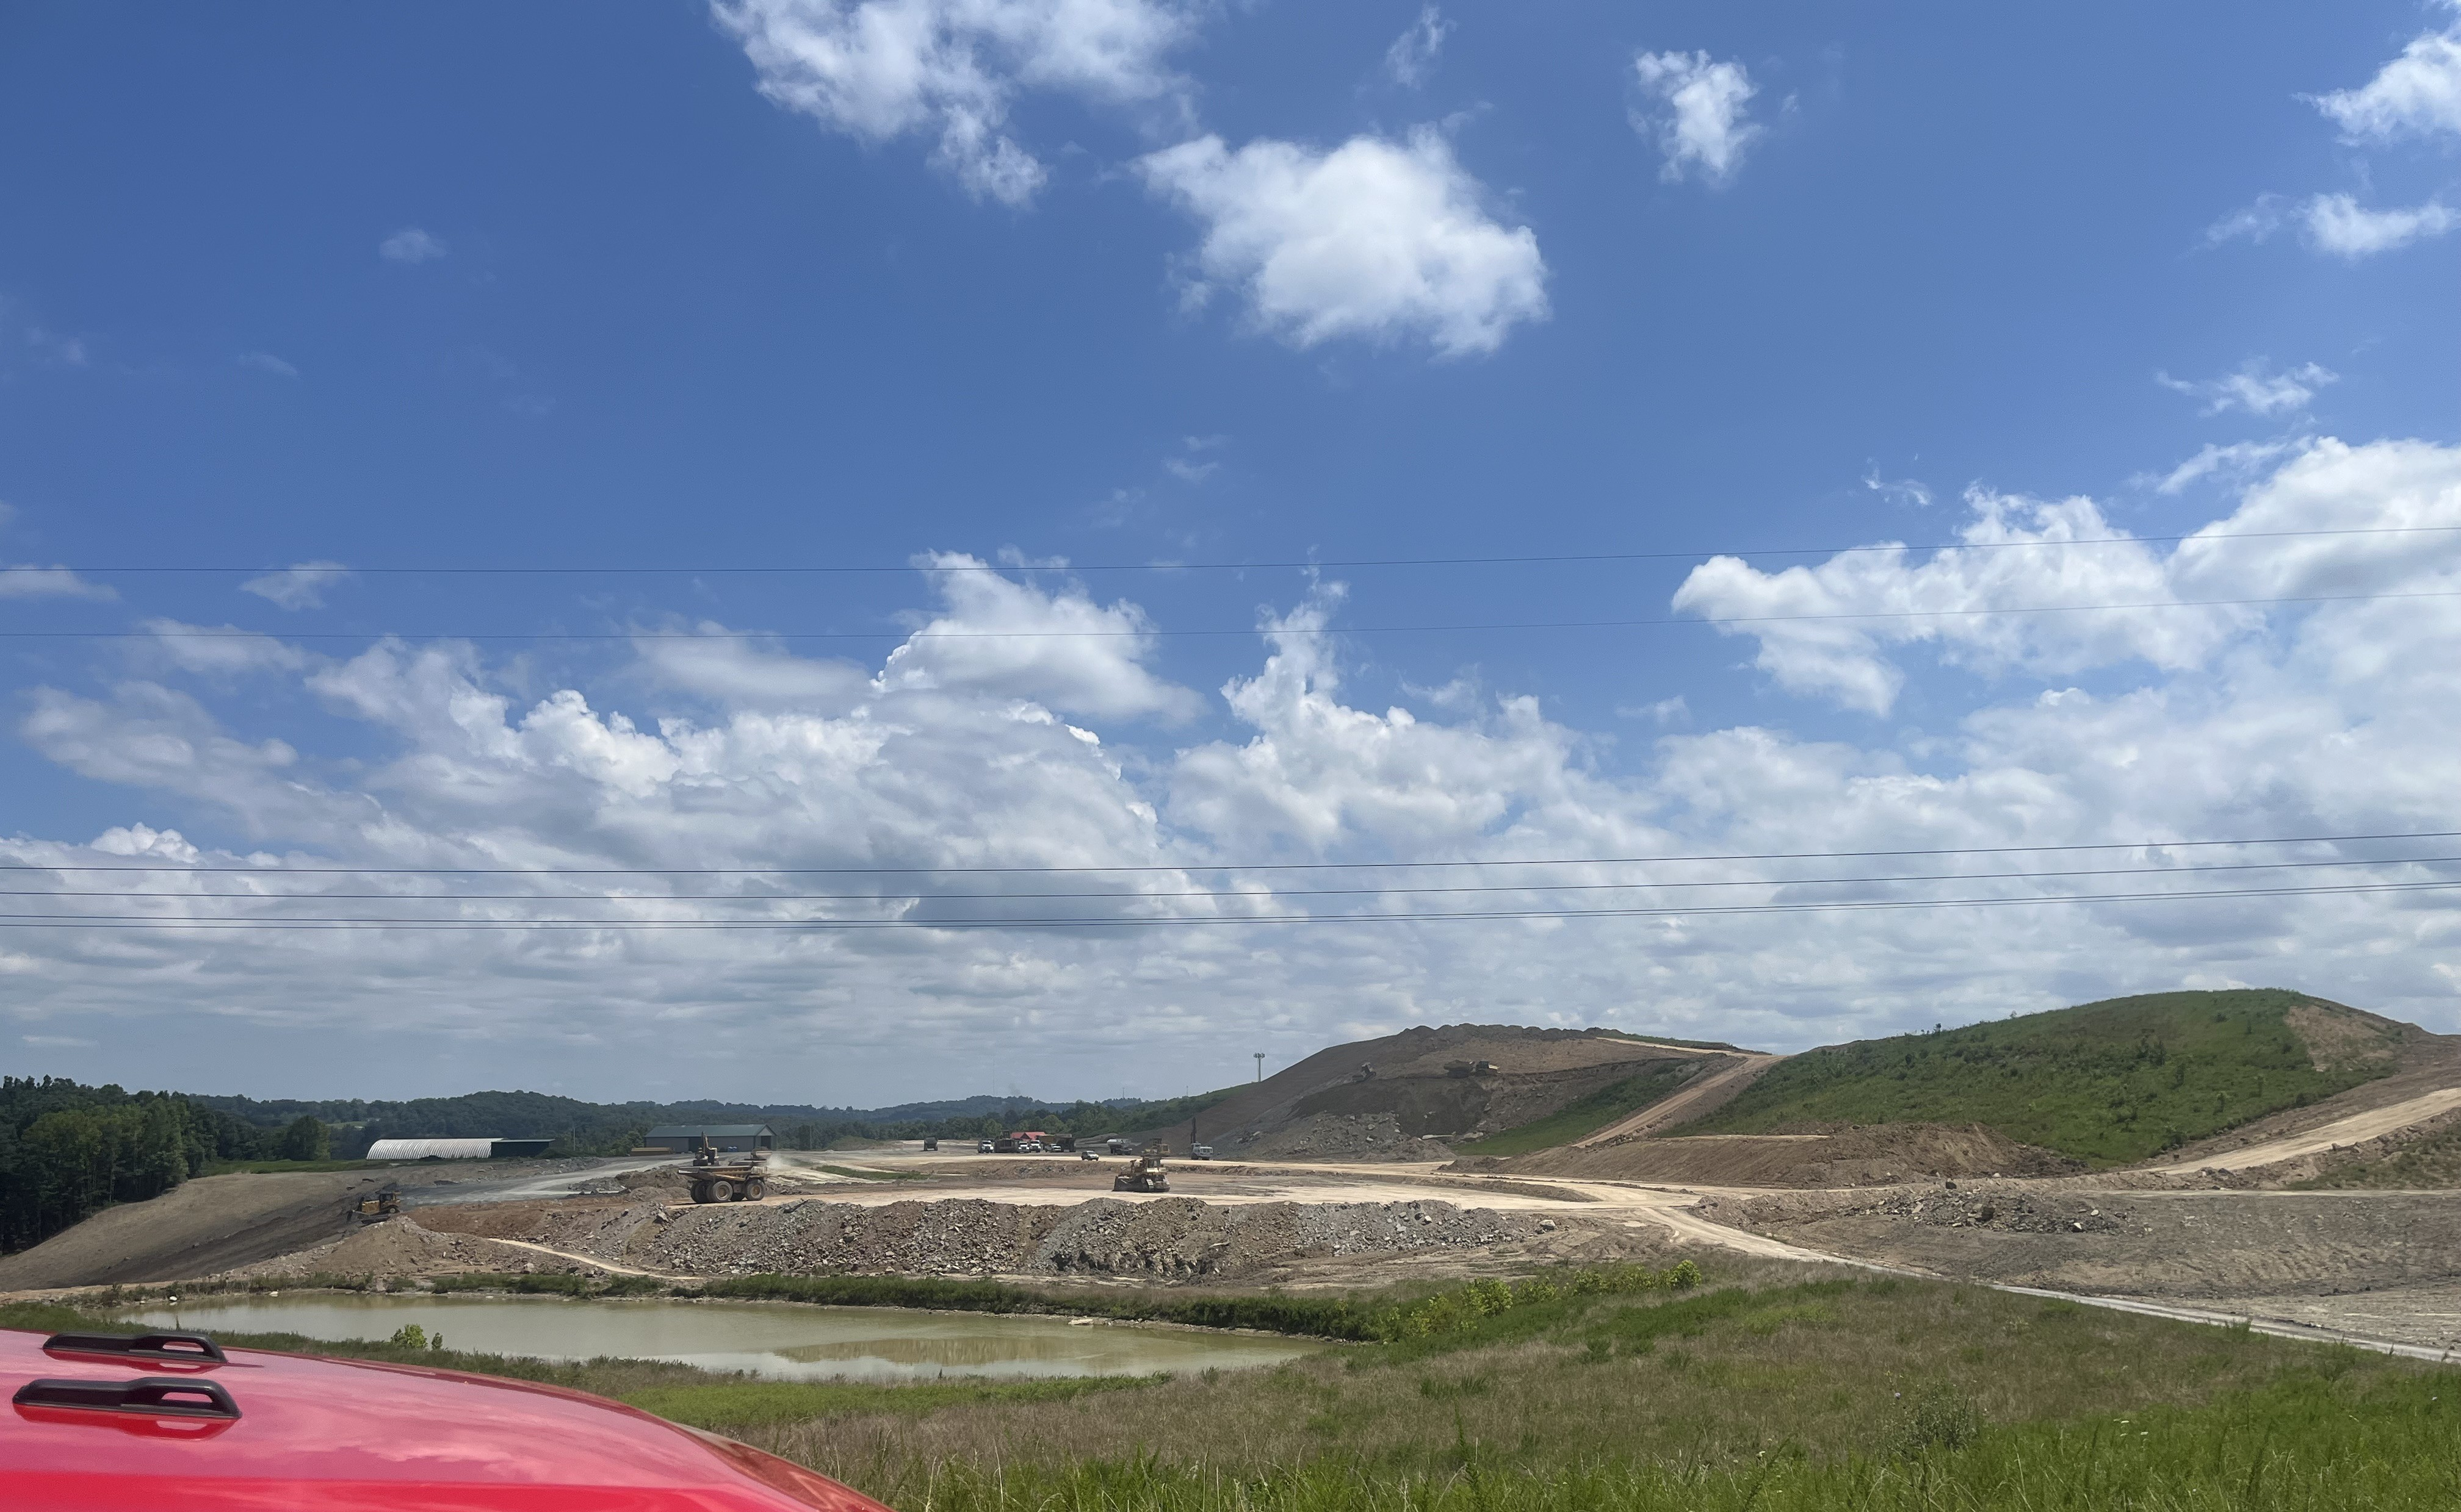
Track update

Slide 3
Track update
Sandy’s reports that the track construction is on time and will be ready to race in Ashland in 2026.
Both KyQHRA and KHRGC have completed site visits in the last couple months.
You can check on the progress yourself at sandyridge.com

Slide 4
2025 HB 566
Regulations addressing the changes made in HB 566 regarding Quarter Horse racing passed the KHRG corporation on June 24th.
The KyQHRA is working on a database system that will streamline the registration process for Kentucky Breds.
We have been promoting the state bred program through advertising in industry publications and at the Heritage Sale in Oklahoma.
Discussions are on-going about race days for 2026, but most likely will be in August.

