Slide 1

Presentation for the
Interim Joint Committee on Licensing, Occupations, and Administrative Regulations
Maggie Garrison, President & CEO
Jennifer Luhrs, EVP & Chief Administrative and Legal Officer
Ryan Mudd, VP & CFO
August 27, 2026

Slide 2

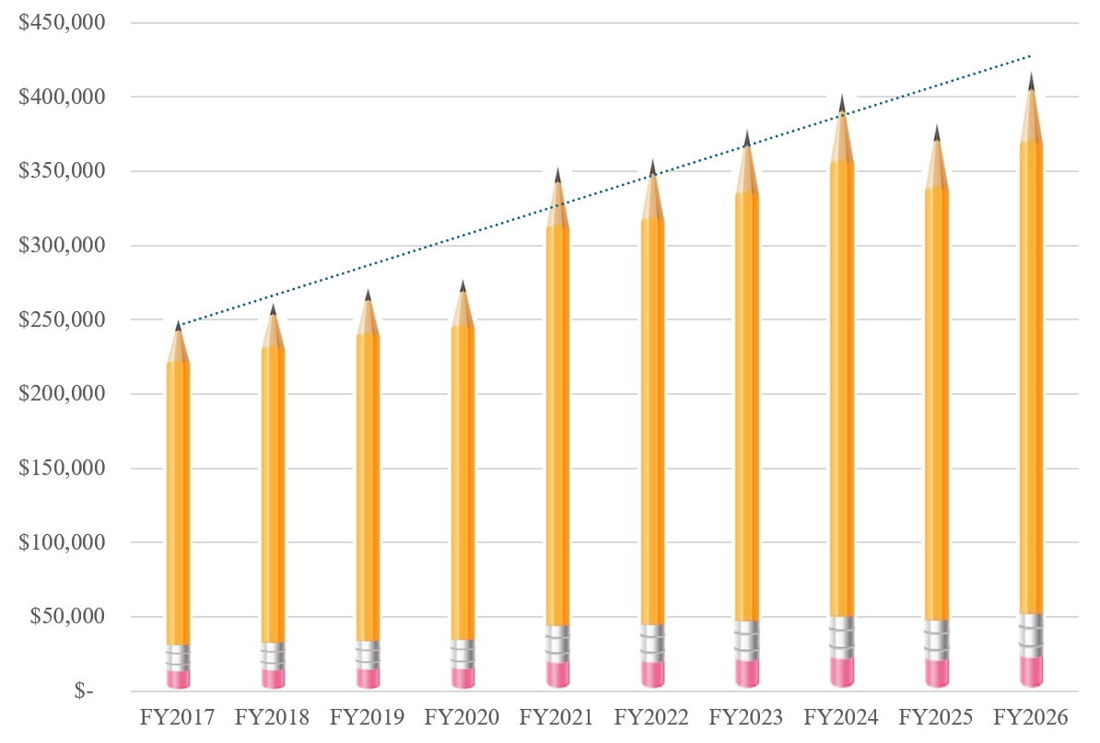
FY2026 Mission Milestones
In FY2026, the Lottery transferred a RECORD $419.2 million to the Commonwealth to support scholarships and grants programs.
Since inception, the Lottery has earned more than $8.0 billion in proceeds for the state.
Amounts in 000’s

Slide 3
FY2026 Highlights
Meaningful growth
  Two historic Powerball jackpots exceeding $1.7 billion fueled sales growth of 74.4% in game sales year over year.
  Mature iLottery platform reaching 10 years in April 2026, with continued iLottery growth supported by new player acquisition efforts. Growth of iLottery instant play sales were 28.5% more than prior year.
Operational improvement
  FY2026 operating expenses accounted for just 1.8% of total sales.
Strategic investment
  Through our vendor partner, we completed a multi-million-dollar investment at our 3,500 retailers statewide.
  Implementation of Connected Play, offering player convenience and bridging retail and online channels.

Slide 4
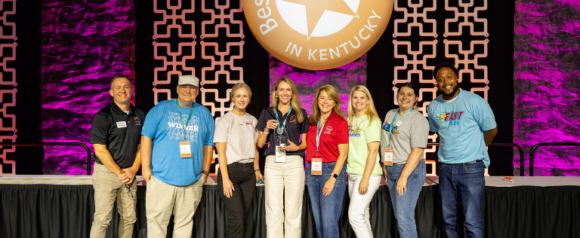
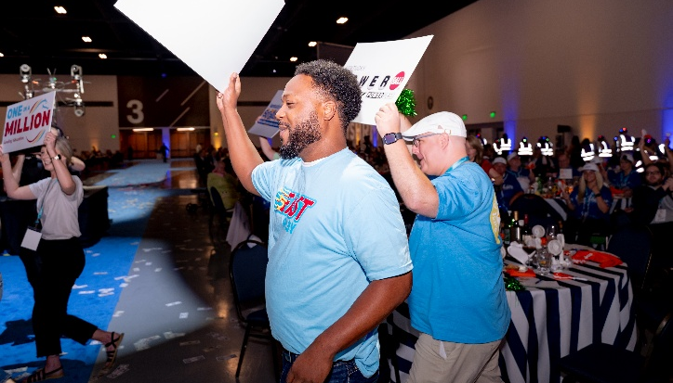
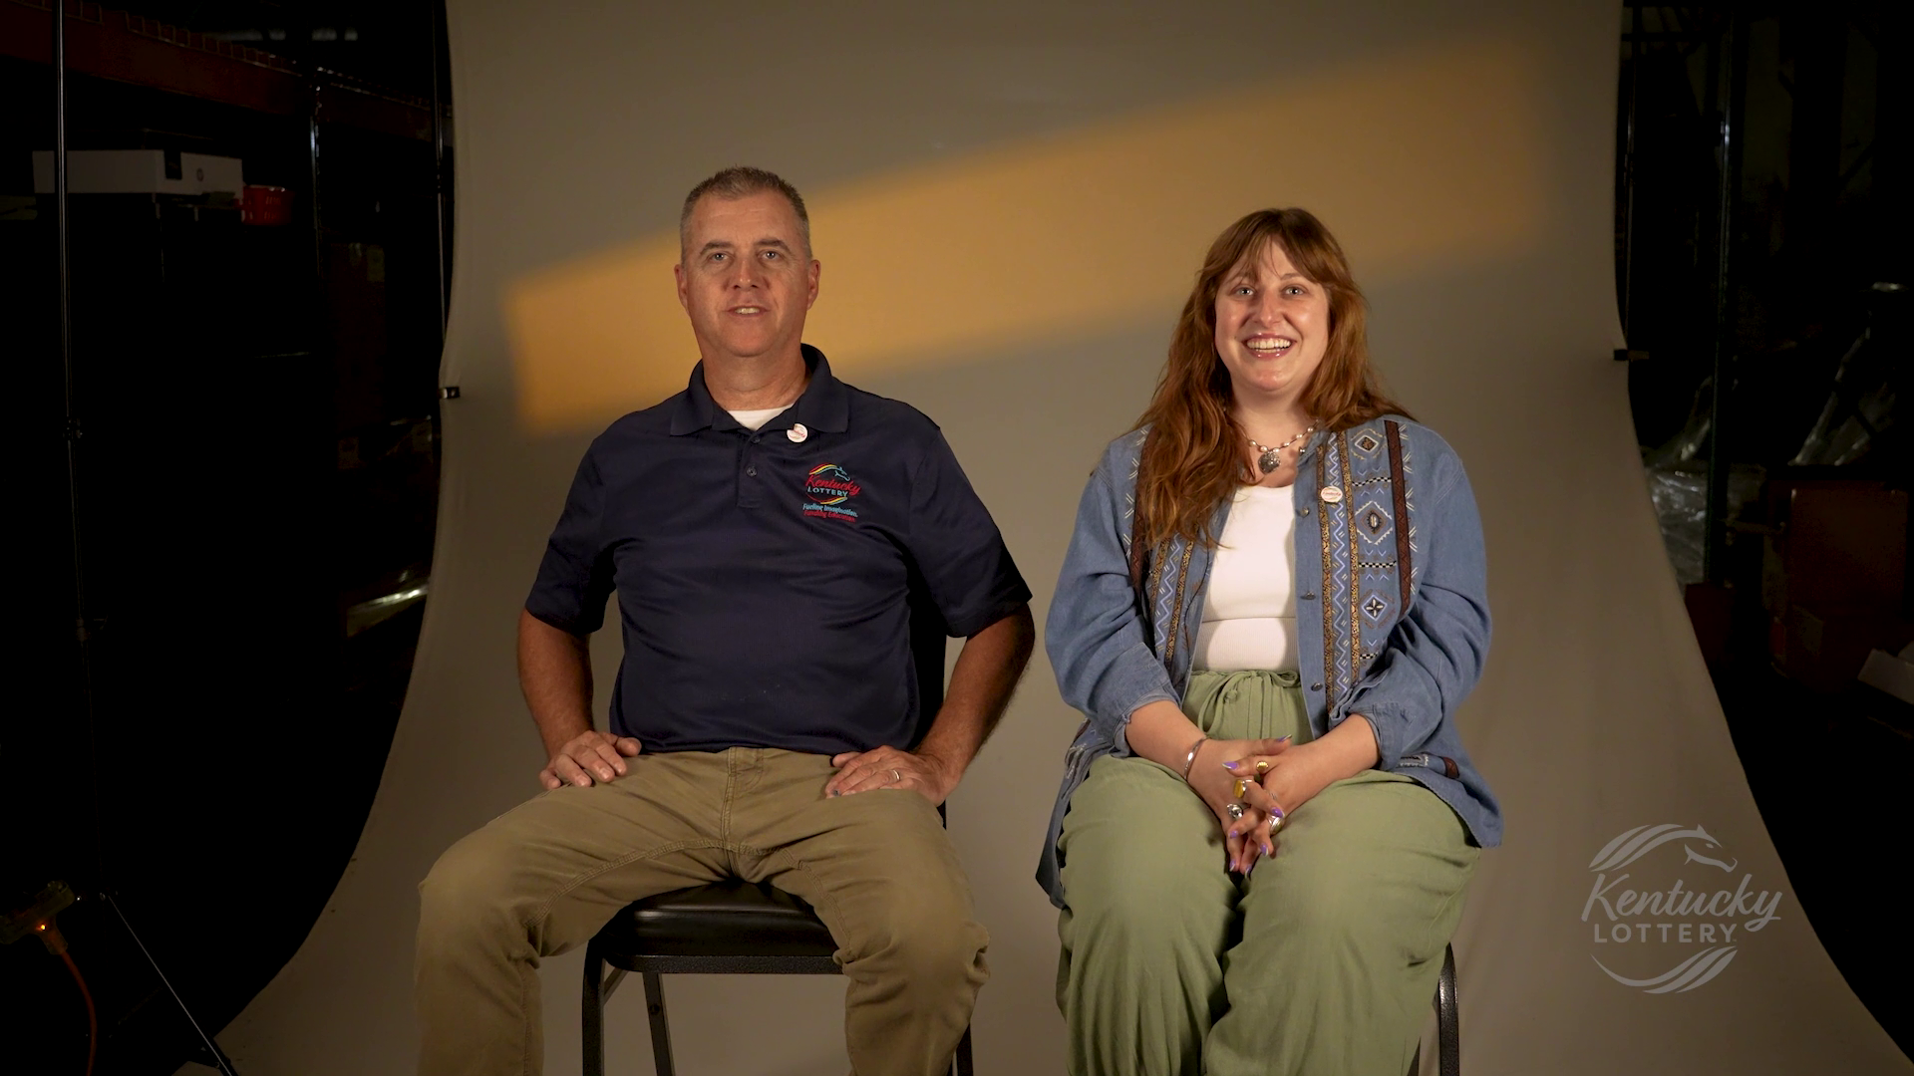
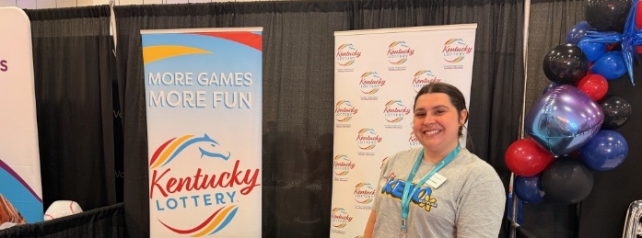
Kentucky Chamber of Commerce Best Places to Work in Kentucky 4th place!

Slide 5
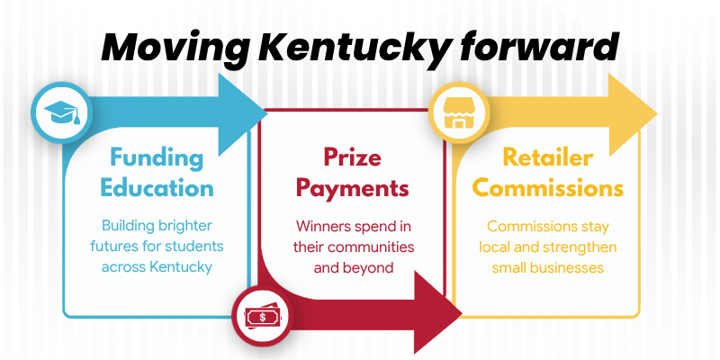

Slide 6
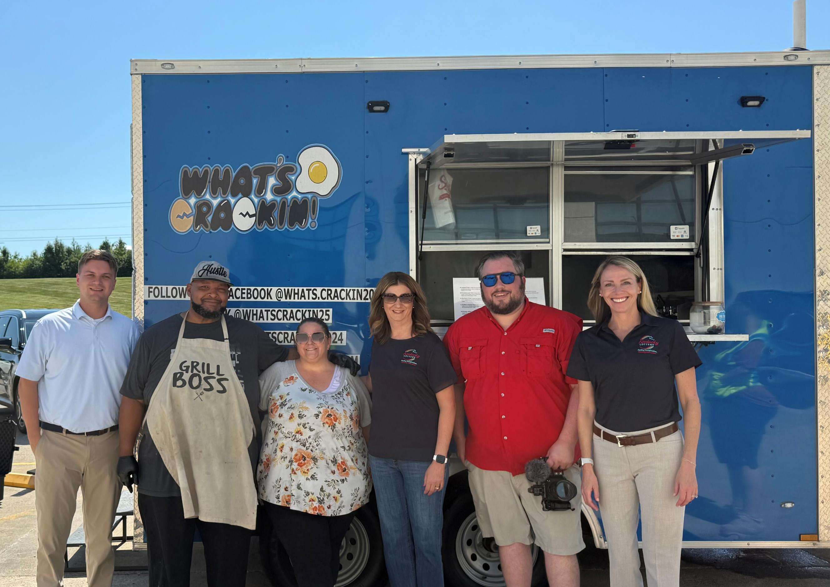
Players
Prize payments totaled $1.783 Billion in Fiscal Year 2026.
Previous lottery winners, Tony and Amber Snead, used lottery winnings to start a food truck business in Lexington. Named Best Food Truck in 2026!

Slide 7
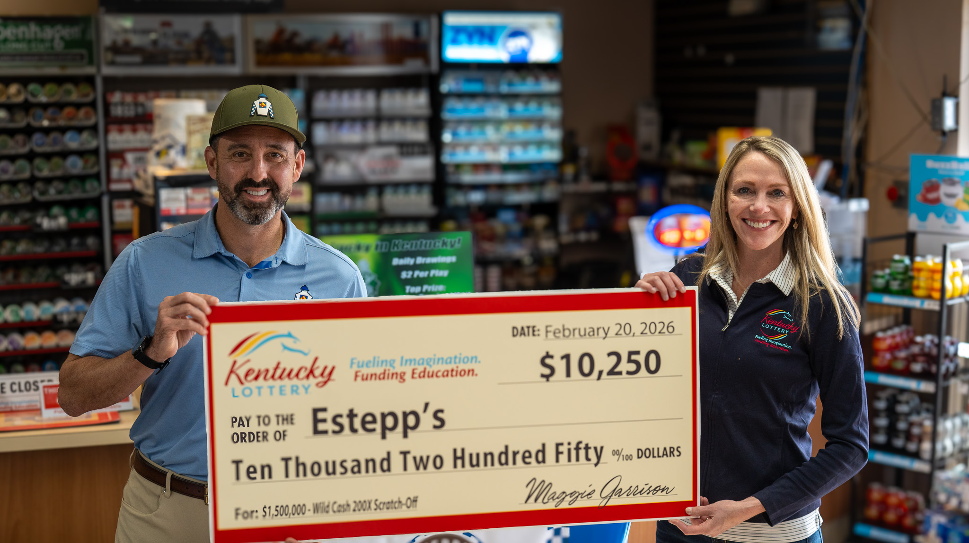
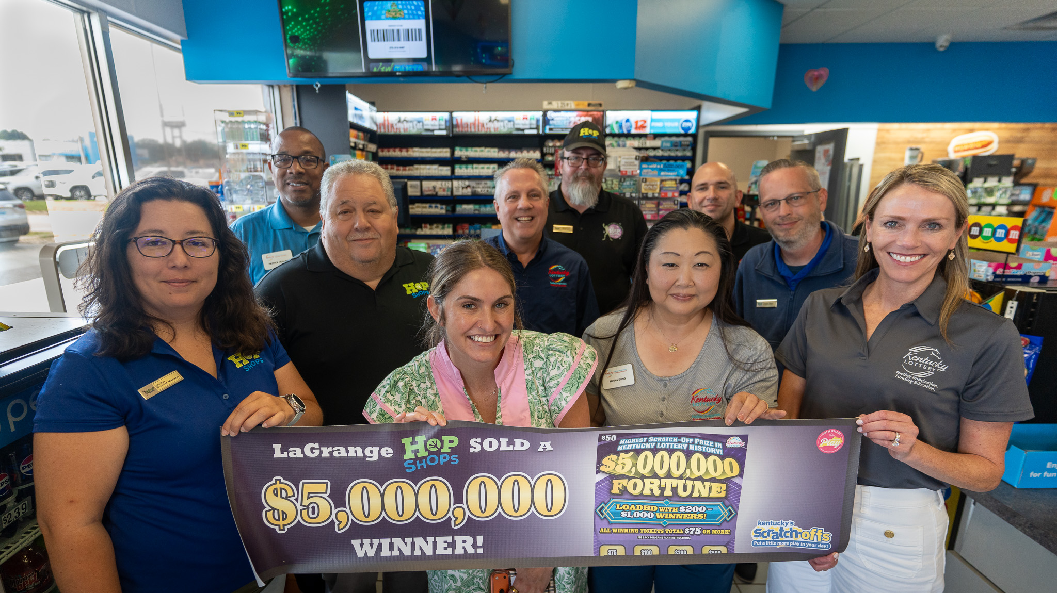
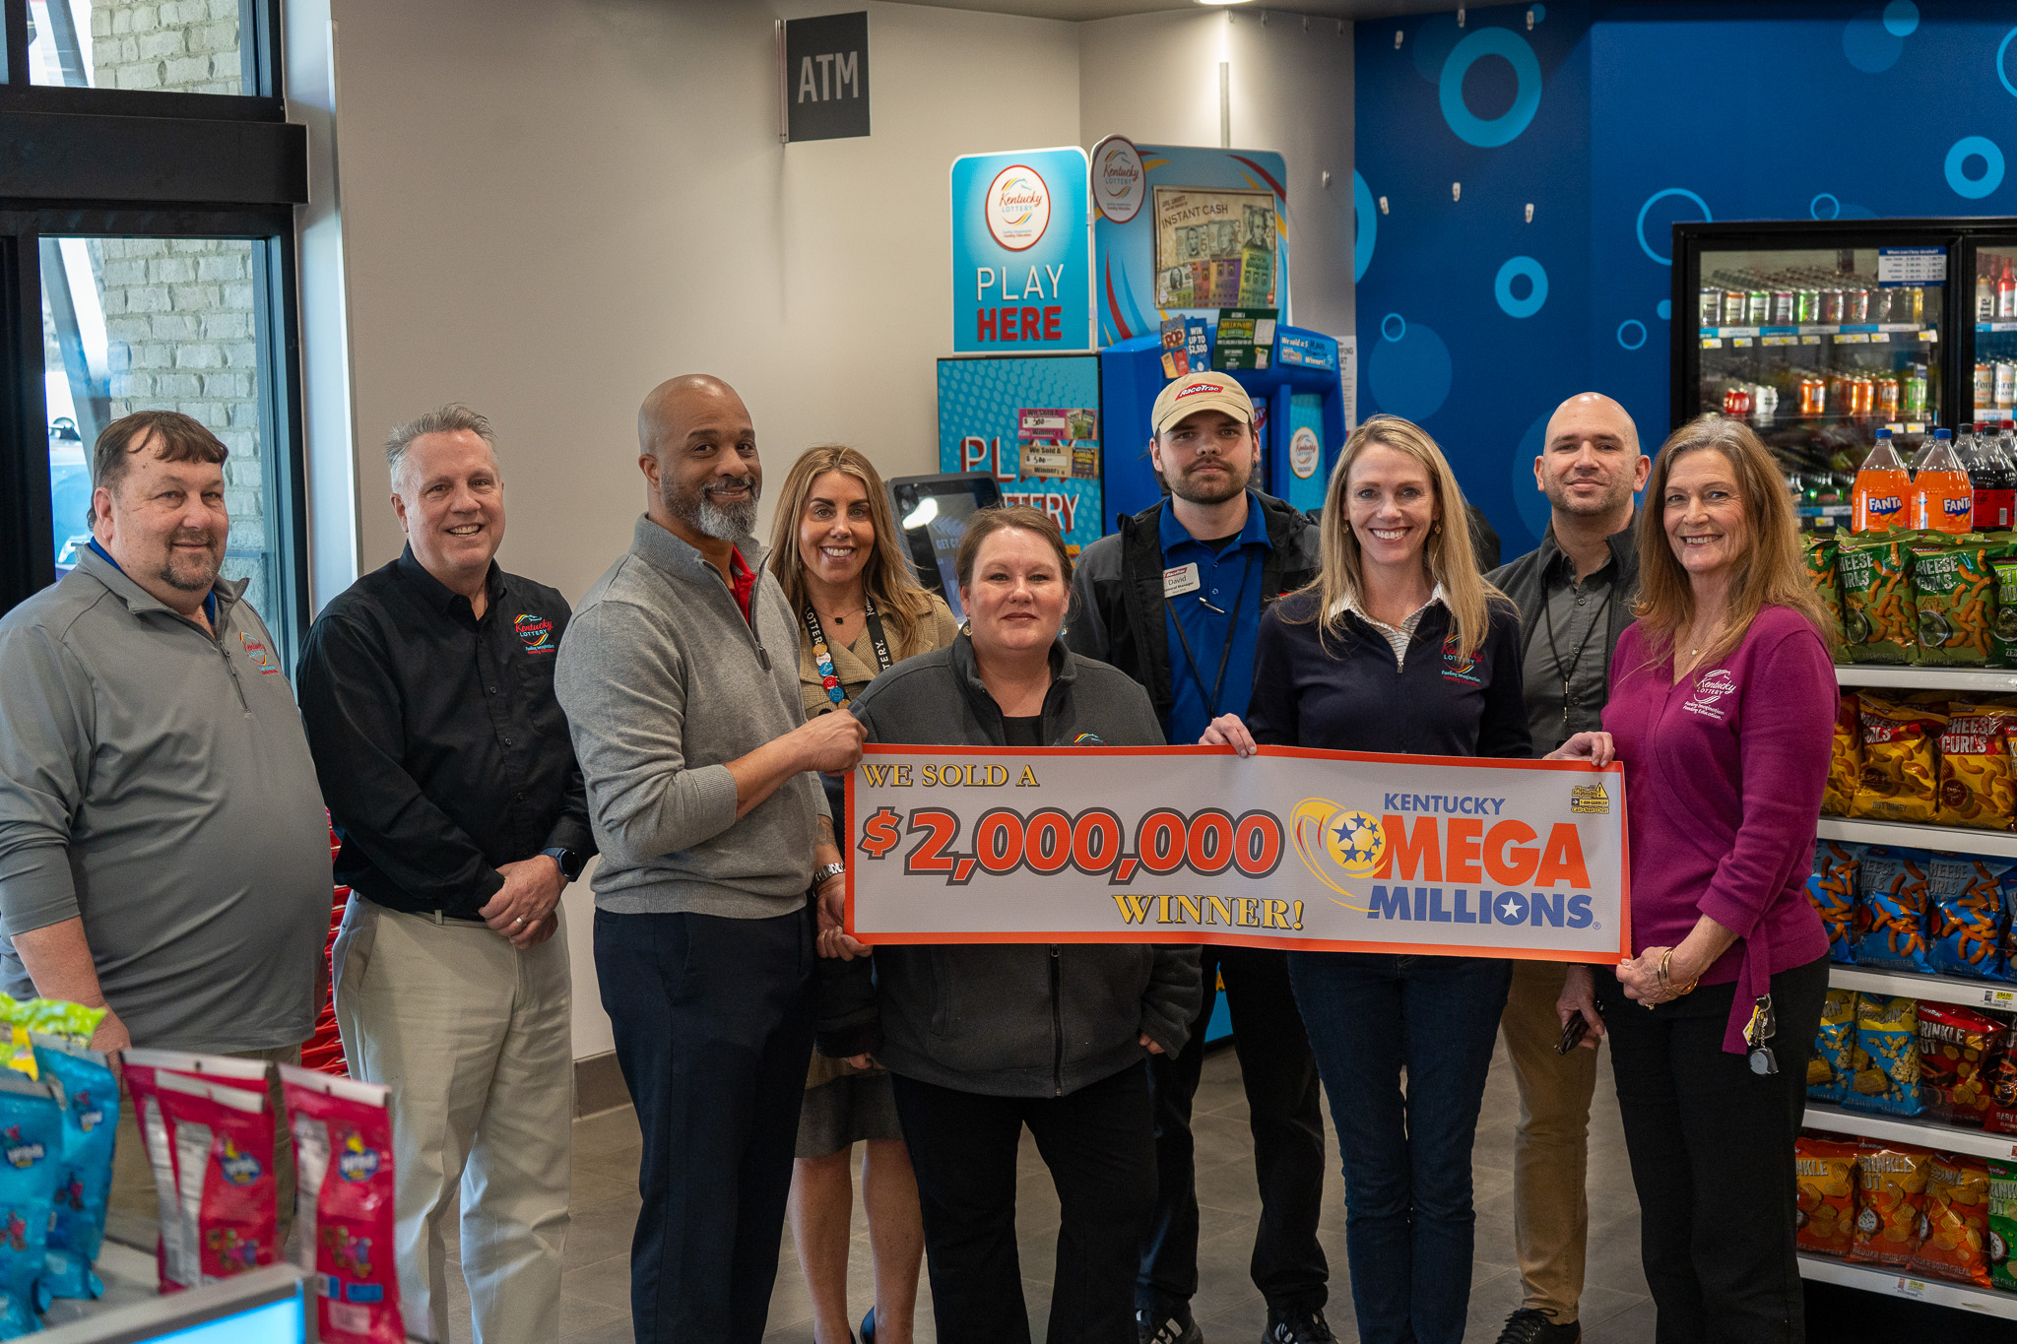
Retail Partners
Payments to retailers totaled $80.7 million in FY2026.
Since inception, retailers have earned over $1.86 Billion in lottery commissions, incentives, and bonuses.

Slide 8


