Slide 1
Read To Succeed Act Senate Bill 9
Kentucky General Assembly
Senate Education Committee
January 13, 2022

Slide 2
Why Early Literacy?
Kentucky Performance Rating for Educational Progress (K-PREP) Results
Year | Percent Proficient and Distinguished
2015 | 54.3%
2016 | 53.7%
2017 | 55.8%
2018 | 52.3%
2019 | 52.7%
Over the past five years, approximately 118,000 Kentucky students in grade 3 were not proficient readers.
Research indicates that students not reading proficiently by the end of 3rd grade are four times more likely to not finish high school.
Kentucky Department of Education. (2019). Kentucky School Report Card. Retrieved from: https://www.kyschoolreportcard.com/organization/20/academic_performance/assessment_performance/state_assessments_accountability?year=2019
Notes:
Hernandez, D. (2012). Double jeopardy: How third-grade reading skills and poverty influence high school graduation. Baltimore, MD: The Annie E. Casey Foundation.

Slide 3
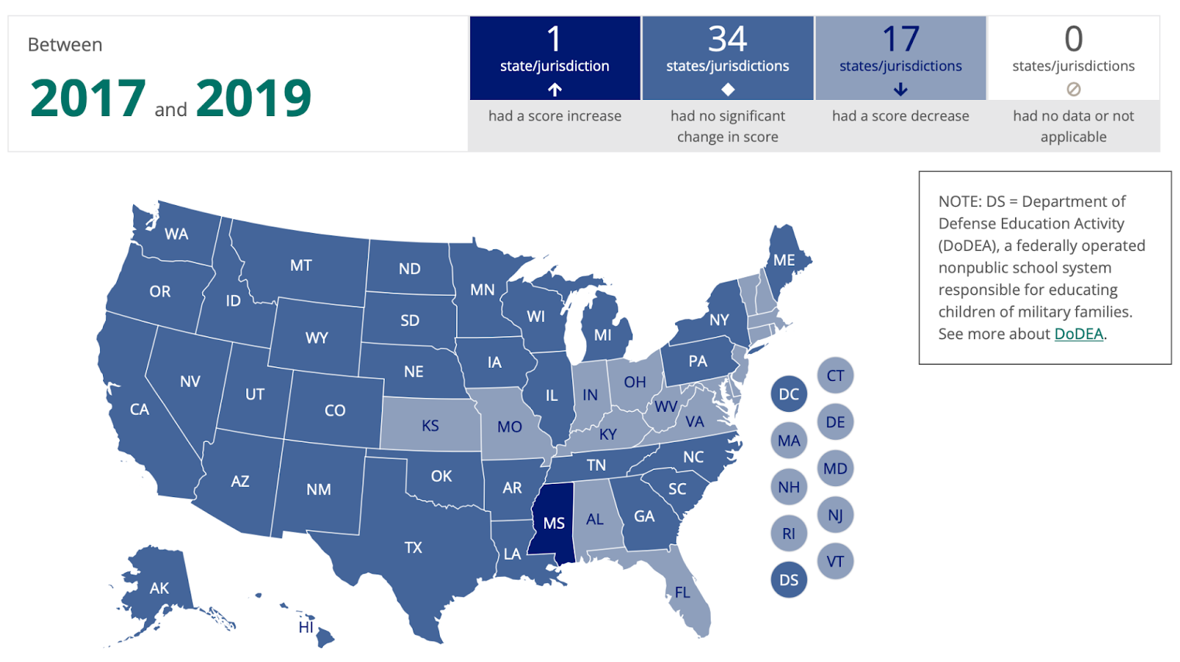
Change in average NAEP scores between
2017 and 2019 in grade four reading
The National Assessment of Educational Progress (NAEP) state data for the Kentucky School Report Card also revealed a downward trend continuing into grade 4.
Based on 2018-2019 data, Kentucky ranked 23rd in the nation.
A third of students scored below basic on the grade 4 reading assessment.
The Nation’s Report Card. (2019). NAEP Data Explorer. Retrieved from: https://www.nationsreportcard.gov/reading/states/scores/?grade=4

Slide 4
Read to Succeed Act 2022 Regular Session: SB 9
Comprehensive actions to improve early literacy outcomes:
Fully funded Read to Achieve (RTA) grant
State Professional Learning Support Strategies
Early Intervention and Instruction
Reading Improvement Plan
Family and Community Engagement
Teacher Certification
Notes:
The Read to Succeed Act includes specific policy changes that can be made now as first steps in a long-term effort to improve learning outcomes for all students.

Slide 5
Section 1: Amends KRS 158.791
Clarifies the intent for all elementary schools:
Multi-tiered system of supports
Instruction provided by qualified individuals
Evidence-based reading instruction that emphasizes phonemic awareness, phonics, fluency, vocabulary and comprehension
Collaboration with the Governor’s Office of Early Childhood, Kentucky Educational Television (KET) and Kentucky Department for Libraries and Archives

Slide 6
Section 2: Amends KRS 158.305
Clarifies the process for developing an improvement plan to help accelerate learning for students
Establishes selection of and training on the administration and use of universal screeners and diagnostic assessments
Engages parents in the decision process and provides information to families to promote literacy in the home

Slide 7
Section 3: New Section of Chapter of KRS 164
Requires educator preparation programs for interdisciplinary early childhood education or elementary education to include evidence-based reading instructional programming and assessment processes and programs
EPSB maintains a list of approved reading teacher preparation tests to evaluate reading instruction knowledge and skills; teacher candidates must successfully pass approved reading instruction test

Slide 8
Section 4: Amends KRS 158.840
Requires the Council on Postsecondary Education (CPE) to submit a report summarizing teacher preparation program alignment to the instructional requirements of Section 3
Requires CPE report program data to an external evaluator for analysis of progress

Slide 9
Section 5: Amends KRS 158.792
Read to Achieve (RTA) Grant program is fully funded and targets student supports for Tier 2 and Tier 3 interventions
Includes school selection process with a focus on those with the most need
Requires the Kentucky Department of Education (KDE) to report data to an external evaluator for analysis of program success

Slide 10
Section 6: Amends KRS 158.794
Updates roles of the Read to Succeed Council to include more elementary school educator representation
Council advises the KDE on universal screeners, reading diagnostic assessments and a statewide professional development program for K-3 literacy instruction

Slide 11
Section 7: Amends KRS 164.0207
The Collaborative Center for Literacy Development (CCLD) advises the Kentucky Board of Education regarding evidence-based comprehensive reading instruction
CCLD collaborates with the KDE to develop and implement a comprehensive research agenda evaluating comprehensive reading programs and reading intervention programs

Slide 12
Sections 8-9: New Section of Chapter 158
Establishes Read to Succeed Fund and Act
Fund created to train and support educators to improve the reading skills of K-3 students
Provides statewide professional learning academies in reading, if funding is appropriated
Creates a literacy coaching program to provide job-embedded support, if funding is appropriated

Slide 13
Questions or Comments
Micki Ray
Chief Academic Officer, Office of Teaching and Learning
Kentucky Department of Education
Micki.Ray@education.ky.gov

