Slide 1
Funding Sources for the Department for Medicaid Services
Prepared for the Senate Standing Committee on Appropriations and Revenue
John Hicks, State Budget Director
Eric Friedlander, CHFS Cabinet Secretary
Steve Bechtel, DMS Chief Financial Officer
February 14, 2024

Slide 2
Department for Medicaid Services Budget
The benefits budget for the Department for Medicaid Services (DMS) consists of:
Fee for Service (FFS) payments
Managed Care Capitation Payments
Managed Care Organizations (MCO)
Non-Emergency Medical Transportation (NEMT)
“Below the Line” items
Medicare Part A and Part B premiums
Part D Medicare Clawback
Drug Rebates
Any potential additional funding for additional projects that occur outside of the baseline submitted via Additional Budget Requests (ABRs)

Slide 3
Medicaid Sources of Funding
Medicaid is a joint federal-state program and is funded with:
State Funds (historically 20-23%):
General Fund Appropriations – provided by the general assembly
Restricted Fund Appropriations – supported with agency cash
Federal Funds (historically 77-80%): The state funds are matched by federal funds
 | Blended Federal Match |  |  |  | Blended State Match
 | FY 2024 | FY 2025 | FY 2026 |  | FY 2024 | FY 2025 | FY 2026
Traditional Medicaid* | 72.88% | 71.57% | 71.50% |  | 27.12% | 28.43% | 28.50%
CHIP | 81.01% | 80.10% | 80.05% |  | 18.99% | 19.90% | 19.95%
Expansion | 90.00% | 90.00% | 90.00% |  | 10.00% | 10.00% | 10.00%
*Enhanced FMAP during the Public Health Emergency phased out by December 31, 2023.
During FY 2023, the traditional FMAP was 78.95%

Slide 4
Benefits Budget Forecasting Process
The projected benefit expenditures are developed via a consensus forecasting group:
Department budget staff (DMS Chief Finance Officer and Fiscal Management Staff)
Cabinet for Health and Family Services Budget Staff (CHFS Budget Director and Office of Finance and Budget)
Office of State Budget Director (Economist, Analysts, Deputy State Budget Director)
By using historical data and various forecasting models, this group collectively projects and estimates Medicaid MCO enrollment (by MCO rate cell) and FFS expenditures (by category of service). The following time-series methods are utilized in the process:
Univariate time series models are created utilizing numerous statistical methods to analyze each data series
ARIMA models
Trend and Seasonal Decomposition models
Multivariate time series models are created utilizing numerous statistical methods to analyze each data series and the relationship of the series to exogenous variables (i.e. economic variables, policy changes, etc.) chosen based on empirical evidence or by economic theory
Vector Autoregression models
Vector Autoregression Moving-Average with Exogenous Regressors (VARMAX)
Structural Models with Autoregressive Error Correction
The enrollment projections are placed into a cash model to estimate the MCO spend.
The final product from this exercise is the “Consensus Forecast” that makes up the Medicaid Benefits budget projections.

Slide 5
Benefits Budget
For consensus forecasting, current and recent state fiscal year expenditures are considered including largest cost drivers of the budget:

Slide 6
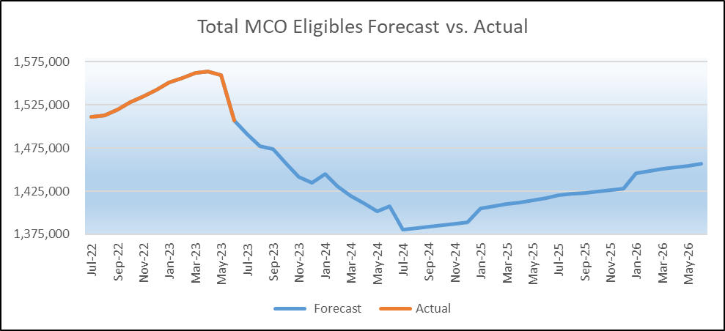
Benefits Budget
For consensus forecasting, enrollment trends are projected based on a variety of factors, including the restart of redeterminations following the end of the public health emergency. The Governor’s recommended budget assumed the following eligibility forecast:
 | Managed Care (MCO) | Fee For Service (FFS) | Grand Total
FY 2024 | 1,441,453 | 142,864 | 1,584,317
FY 2025 | 1,398,450 | 145,026 | 1,543,476
FY 2026 | 1,438,392 | 148,083 | 1,586,475

Slide 7
Medicaid Sources of Funding
Medicaid’s agency cash accounts are funded through various provider taxes and intergovernmental transfers (IGTs):
Source of Funds | FY 2024 | FY 2025 | FY 2026
Beginning cash balance: | $695,825,700 | $487,275,400 | $116,236,000
Provider Taxes | $318,098,100 | $323,660,100 | $337,591,200
Hospital Rate Improvement Program (HRIP) Assessment | $567,000,000 | $567,000,000 | $567,000,000
University Directed Payments | $267,652,300 | $267,652,300 | $267,652,300
1% Assessment (KY Access funds and managed care) | $138,971,500 | $135,033,500 | $138,231,000
Other IGTs with state agencies and public universities | $68,770,800 | $164,611,600 | $164,542,800
Projected receipts: | $1,360,492,700 | $1,457,957,500 | $1,475,017,300
Total projected available cash: | $2,056,318,400 | $1,945,232,900 | $1,591,253,300
Total Projected Restricted Fund Expenditures: | ($1,569,043,000) | ($1,828,996,900) | ($1,591,253,300)
Ending Balance: | $487,275,400 | $116,236,000 | $0

Slide 8
Funding Concerns in House Bill 6 Medicaid Current Services
Medicaid Current Services FY 2025 | State Funds | Federal Funds | Total
Medicaid Base Reductions (General Funds) | $71,915,000 | $211,472,700 | $283,387,700
Medicaid Base Reductions (Restricted Funds) | $43,833,400 | $128,896,200 | $172,729,600
Total Medicaid Base Reductions: | $115,748,400 | $340,368,900 | $456,117,300
*The Governor’s Recommended budget in FY 2025 included $61.7M Restricted Funds and $541M federal funds that were available but omitted in House Bill 6.

Slide 9
Funding Concerns in House Bill 6 Continued
Initiative | FY 2025 | FY 2026
Nursing Facility Reimbursement (Funds switched from General to Restricted) | $43,833,400 | -
Nursing Facility Reimbursement (Reduction of General Fund) | $4,500,000 | -
Serious Mental Illness Waiver (Funds switched from General to Restricted) | $4,307,100 | $4,626,300
Mobile Crisis (Funding was removed from HB6) | $2,745,200 | $2,819,300
Total Medicaid Benefits | $55,385,700 | $7,445,600

Slide 10
Benefits Budget
In summary, our concerns with HB6 are:
reduces baseline by $115.7M in state fund appropriations in FY 2025
eliminates all funding for Mobile Crisis in both FY 2025 and FY 2026
reduces state funding for rebasing of nursing facility rates by $4.5M and replaces $43.8M of general funds with restricted fund appropriations in FY 2025
replaces $4.3M of general funds for Serious Mental Illness Waiver with restricted fund appropriations in FY 2025
reduces continued services by $61.7M in state fund appropriations

Slide 11
Department Concerns
HB6 does not fully fund the Medicaid program based on current funding and projected enrollment.
HB6 does not appropriately and fully fund rebasing for nursing facilities putting services to long-term care members at risk.
Important to consider - any legislation that adds services, expands services, or increases provider reimbursements, must be accompanied by a General Fund appropriations to be implemented.
11

Slide 12
QUESTIONS and/or Comments?

