Slide 1
Cincinnati Children’s Hospital
Budget Request Presentation
Senate Appropriations and Revenue Committee
Lisa Cooper, Senior Government Relations Analyst – Kentucky
Laura Lewin, Senior Business Director, Heart Institute
February 14, 2024

Slide 2
Cincinnati Children’s Serves Kentucky
Kentucky Patients (2022)
Inpatient/Outpatient: 63,000+
Covered by Medicaid: 54%
Kentucky Employment Tax Data (2022)
Number of KY Employees: 3,151
KY Employee Wages: $173 million
KY Income Taxes Paid: $8.3 million
Local Taxes Paid: $183,763

Slide 3
Cincinnati Children’s –
UK Radiology Collaboration
UK imaging now integrated with CCHMC allowing the same service level as CCHMC’s internal patients
Currently covering all radiographs and ultrasounds from UK’s 95-bed NICU, as well as select other cases
  Interpreting over 1,000 studies per month for Kentucky Children’s Hospital’s smallest and sickest patients
Soon to expand to PICU and CICU coverage, followed by other inpatient work
Discussions about longer-term partnerships for recruitment, education and training, protocol sharing, and subspecialty expertise

Slide 4
Current Medicaid Reimbursement
907 KAR 10:830. Acute care inpatient hospital reimbursement
The department shall reimburse for inpatient acute care provided by an out-of-state children's hospital located in a Metropolitan Statistical Area as defined by the United States Office of Management and Budget and whose boundaries overlap Kentucky and a bordering state, and except for Vanderbilt Medical Center, the average operating rate and average capital rate paid to in-state children's hospitals.
The out-of-state hospitals referenced in subsections (4) and (5) of this section shall not be eligible to receive indirect medical education reimbursement, organ acquisition cost settlements, or disproportionate share hospital payments.
907 KAR 10:015. Payments for outpatient hospital services
Excluding services provided in a critical access hospital and laboratory services, reimbursement for an outpatient hospital service provided by an out-of-state hospital shall be ninety-five (95) percent of the average in-state outpatient hospital cost-to-charge ratio.

Slide 5
CCHMC KY Medicaid Cost/Payment Overview
KY Medicaid:
Total Costs: $222,083m,130
Total Payments: $123,565,664
Total Loss: $98,527,465

Slide 6
Reimbursement Comparisons
Cincinnati Children’s Payment Ohio Medicaid | Cincinnati Children’s Payment Kentucky Medicaid | Kentucky Hospital Payment
INCLUDING DSH, Supplemental payments, GME add on, 74% of cost paid | EXCLUDING DSH, supplemental payments, GME add on because not eligible in Kentucky. 55% of cost paid | KY Admin Regs: the department shall reimburse an in-state acute care hospital for an inpatient acute care service, except for a service not covered pursuant to 907 KAR 10:012, on a fully prospective per discharge basis. The department's reimbursement pursuant to this administrative regulation shall approximate ninety-five (95) percent of a hospital's Medicare reimbursement KY Budget language: Intergovernmental Transfers (IGTs): Any funds received through an Intergovernmental Transfer (IGT) agreement between the Department for Medicaid Services and other governmental entities, in accordance with a federally approved State Plan amendment, shall be used to provide for the health and welfare of the citizens of the Commonwealth through the provision of Medicaid Benefits. Revenues from IGTs are contingent upon agreement by the parties, including but not limited to the Cabinet for Health and Family Services, Department for Medicaid Services, and the appropriate providers. The Secretary of the Cabinet for Health and Family Services shall make the appropriate interim appropriations increase requests pursuant to KRS 48.630.
Child presents for: TONSIL AND ADENOID PROCEDURES, complications present post surgery and require inpatient admission. | Child presents for: TONSIL AND ADENOID PROCEDURES, complications present post surgery and require inpatient admission.
APRDRG 97 Severity 3 - TONSIL AND ADENOID PROCEDURES - OH Medicaid base rate reimbursement $30,377.56. | DRG [143] OTHER EAR, NOSE, MOUTH AND THROAT O.R. PROCEDURES WITH MCC - KY Medicaid base rate reimbursement $20,250.17 | While we do not know what other KY Hospital Medicare Base Rates are, using Medicare rates for a Children's Hospital is not comparable due to most Children's Hospitals seeing very few children covered by Medicare. *
*Data from the (CMS) Centers for Medicare & Medicaid Services indicates that Medicare normally covers about 80% of costs. In turn, Medicare reimbursement rates are typically more than 30 % higher than Medicaid rates. With KY Hospitals receiving 95% of the Medicare reimbursement rate, this would equate to a rate well above the 120% Cincinnati Children's requested. In addition, CCHMC is not eligible for graduate medical education (GME) which pays on average $1,400 per patient discharge. This amounts to an additional discrepancy of approximately $2.5 million per year that, unlike KY hospitals, we do not receive..

Slide 7
Cincinnati Children’s Budget Request
CCHMC requests that our Medicaid reimbursement rate be increased to 120% of the Kentucky Medicaid rates for inpatient and outpatient services. We estimate this would equate to approximately $6 million annually from the Kentucky budget, based on the details provided below. As noted above, we are not requesting eligibility for the supplemental funds in-state hospitals receive. This would be in lieu of those funds.
Based on FY22 patient volumes, CCHMC received $109 million for hospital services from Kentucky Medicaid, including Medicaid HMOs (Wellcare, Aetna Better Health, Anthem, Passport Health Plan by Molina Healthcare, United, and Humana).
Breakdown of the 20% increase based on FY22 patient volumes:
Federal Medicaid portion $15 million annual
Kentucky Medicaid match $6 million annual
Additional estimated reimbursement: $21 million annual
Please note, this is not a direct allocation request. These additional funds would only be realized if and when Kentucky Medicaid patients received inpatient and outpatient medical services from CCHMC.

Slide 8
Precedent for rate variation
KY – Vanderbilt Medical Center
907 KAR 10:830. Acute care inpatient hospital reimbursement.
The department shall reimburse for inpatient care provided by Vanderbilt Medical Center using the hospital-specific Medicare base rate extracted from the CMS IPPS Pricer Program in effect at the time that the care was provided multiplied by eighty-five (85) percent.
Indiana Out of State Rate
The state of Indiana recently enacted similar legislation, by increasing their out of state children’s hospital reimbursement rate to 130% of their Medicaid reimbursement rate, as many of their children receive pediatric services at hospitals in bordering states.

Slide 9


The Joint Pediatric and Congenital Heart Program offers a full spectrum of pediatric and adult congenital heart care from the world-class cardiology experts and heart surgeons at Cincinnati Children’s and Kentucky Children’s Hospital.
It’s an innovative collaboration dedicated to providing high-level heart care closer to home.

Slide 10



Successful Heart Partnership
One Program, Two Sites Model
Development of a Comprehensive Cardiac Surgery Program
Joint recruitments
Training and CME
Shared protocols
Combined discussion and triage
Joint reporting
(STS, USNews)

Slide 11
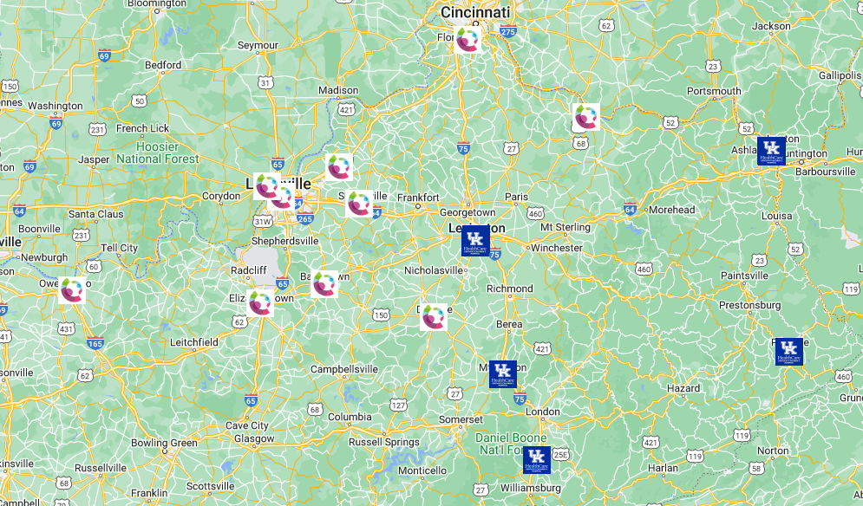
Kentucky Clinic Locations
Serving multiple service areas through clinic development and partnership to increase access to care.
CCHMC
Bardstown
Crestview Hills
Danville
Maysville
LaGrange
Louisville
Elizabethtown
Shelbyville
Owensboro
Joint Clinics with UK
Ashland
Owensboro

