Slide 1
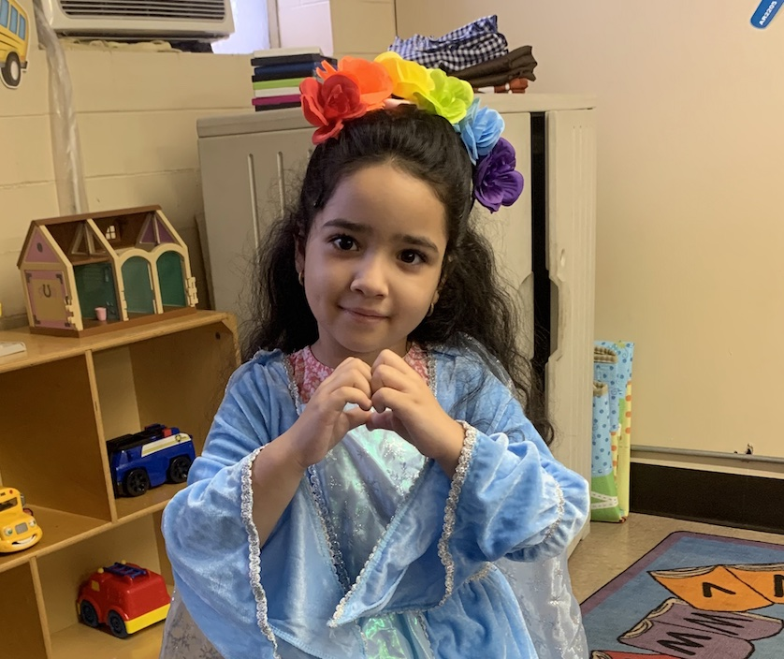
THE CUBAN COMMUNITY OF CENTRAL KENTUCKY
Moving From “Welcoming” To Self-Sufficiency
Colin Triplett
Director of Intercultural Services
Catholic Charities of Louisville
ctriplett@archlou.org

Slide 2
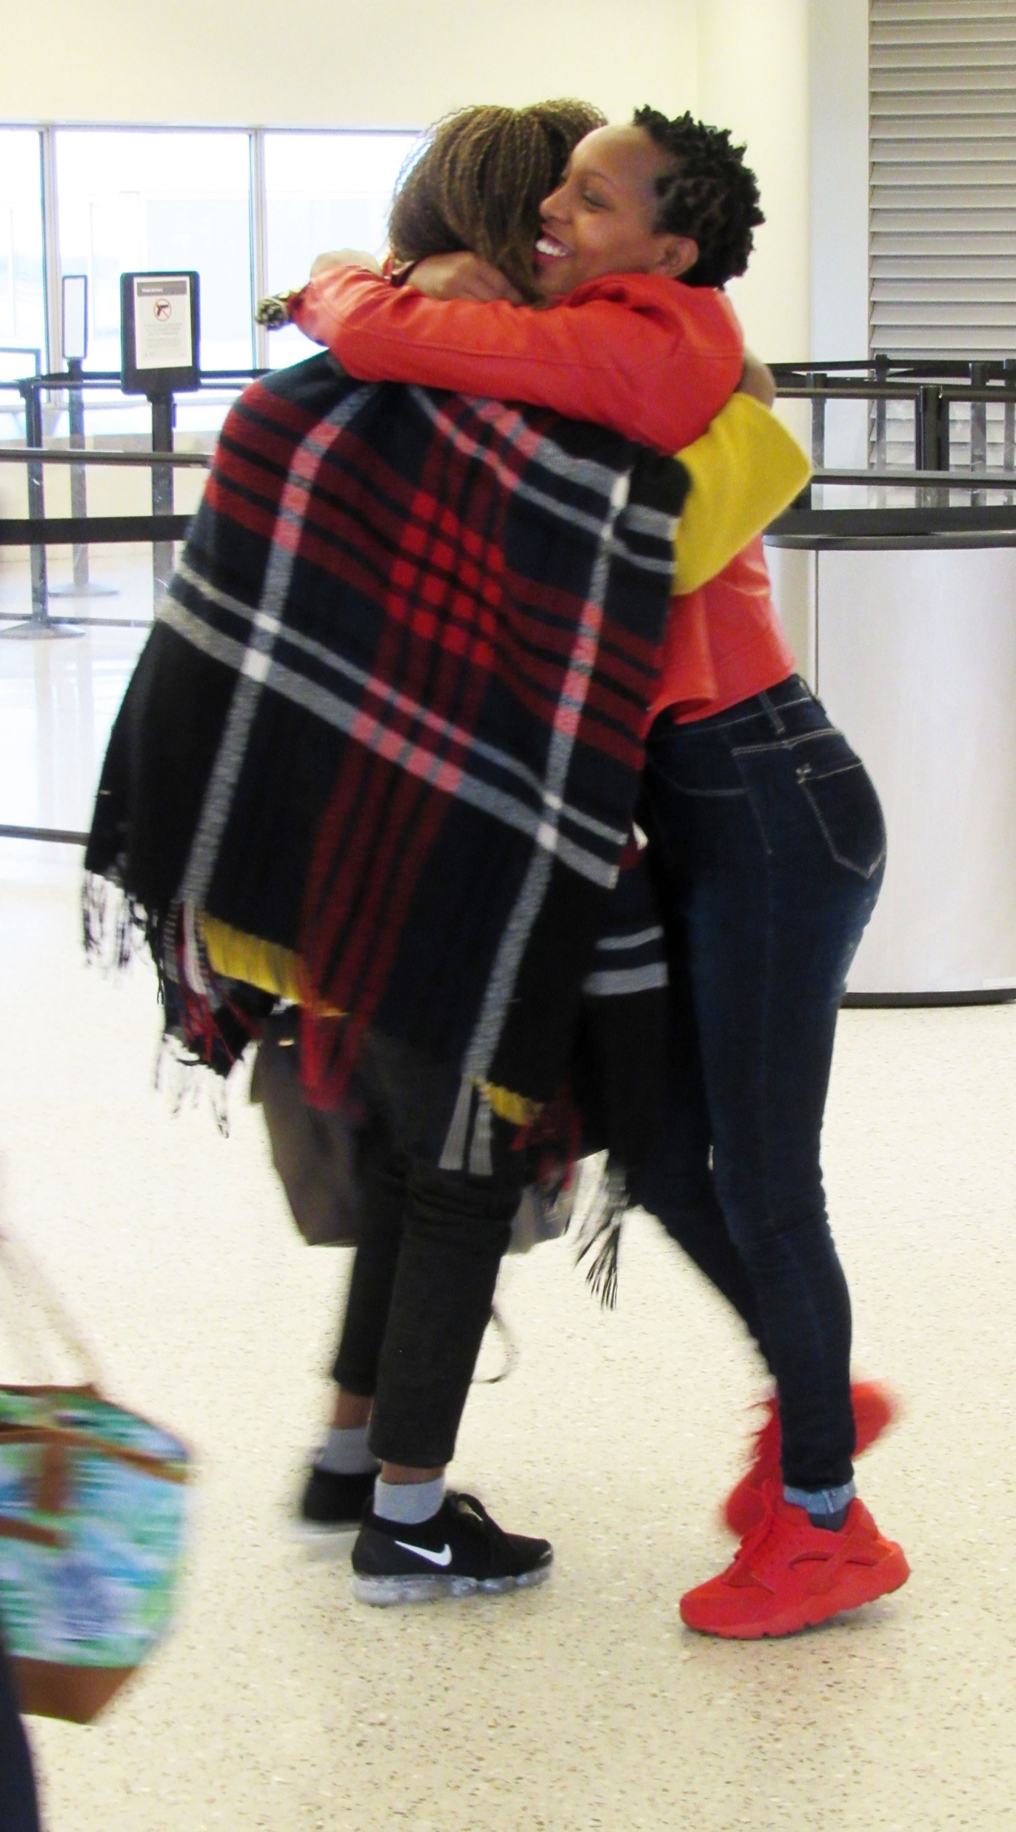
ARRIVAL TRENDS BY YEAR

Slide 3
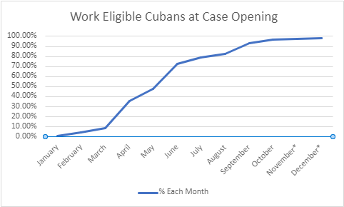
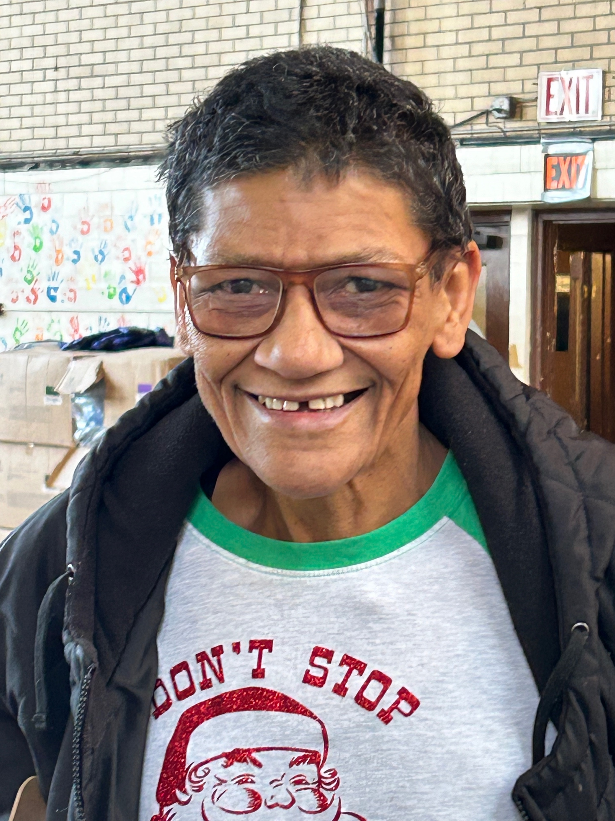
WORK-ELIGIBLE ARRIVALS, 2023

Slide 4
Legal Representation
Time Frame | Percent of Legal Immigrants WITHOUT Legal Representation
End of FY 2019 | 35%
End of Dec 2023 | 70%
*TRAC Immigration, Too Few Immigration Attorneys: Average Representation Rates Fall from 65% To 30%, https://trac.syr.edu/reports/736/

