Slide 1


Eric Gibson, Director
Kentucky Emergency Management
100 Minuteman Parkway
Frankfort, KY 40601
March 3, 2025
KENTUCKY EMERGENCY MANAGEMENT

Slide 2
DR-4860 Statewide Flooding
February 14, 2025
23 Deaths
Maximum Power Outages – 41,578 February 16, 2025
Maximum Water Outages – 18,022
Maximum Sheltered – Greater than 500
USAR Teams
  33 State
  3 Federal
  3 out-of-state
Approximately
  150 Kentucky first responders
  170 Federal responders
50 out-of-state responders

Slide 3
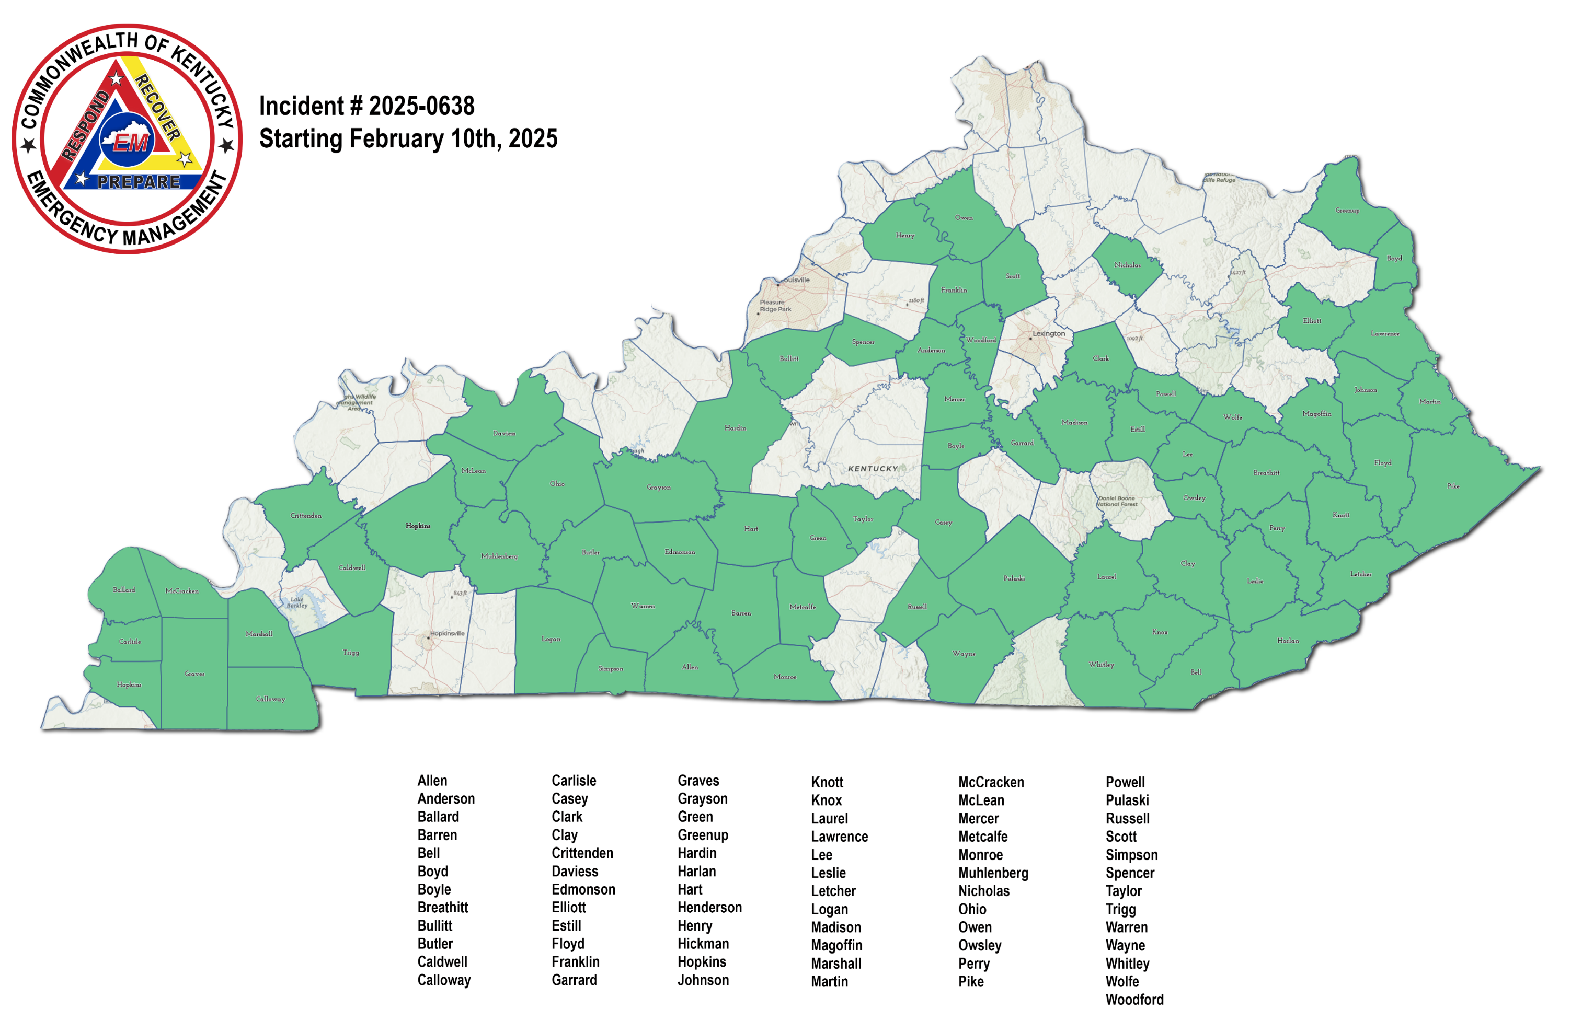
DR-4860 Statewide Flooding
February 14, 2025
23 Deaths
Requested Declarations
72 Counties

Slide 4
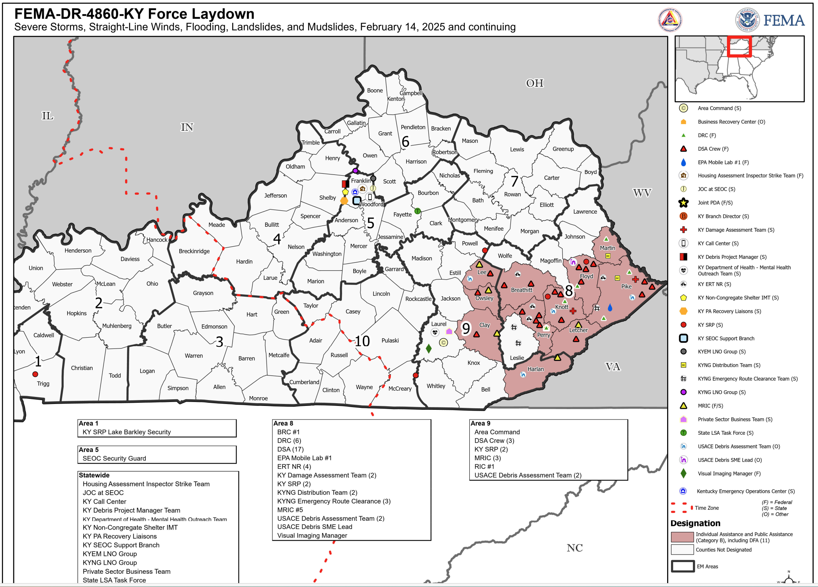
DR-4860 Statewide Flooding
February 14, 2025
23 Deaths
Estimated:
Public Assistance
70 Counties
$300 Million
Individual Assistance
15 Counties
$16 Million
Hazard Mitigation
$12 Million
KENTUCKY EMERGENCY MANAGEMENT

Slide 5
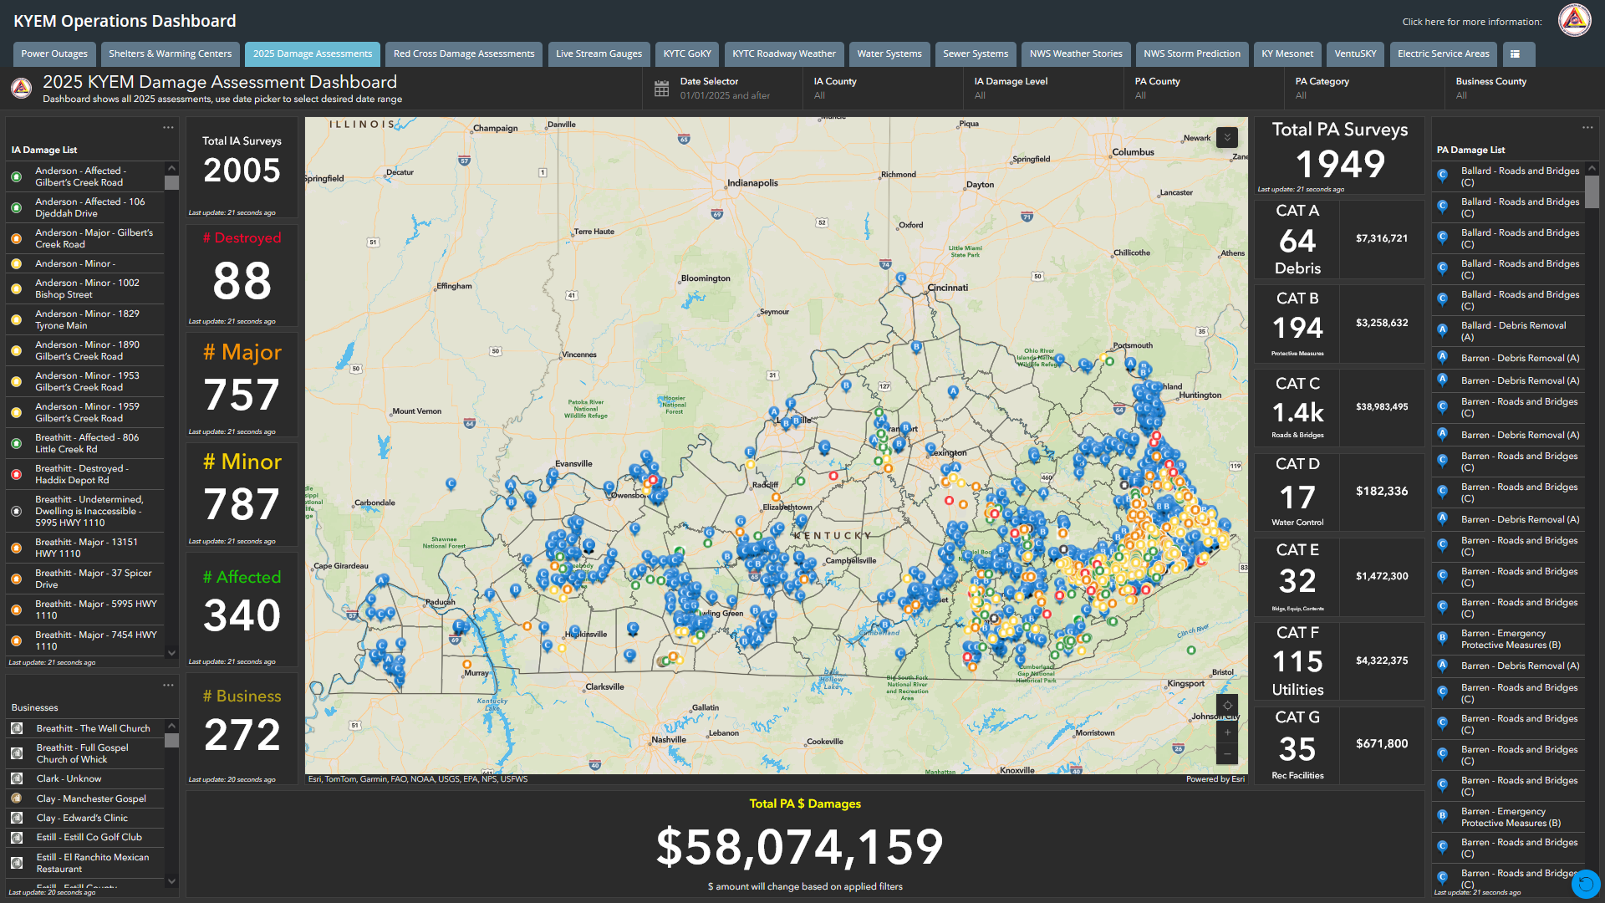
DR-4860 Statewide Flooding
February 14, 2025
Damage Assessments
Public Assistance
Blue Dots indicate Public Assistance
Letter within Dot indicate the Category of the Assessment
The Total Excludes the Cost of Utilities and State Roads

Slide 6
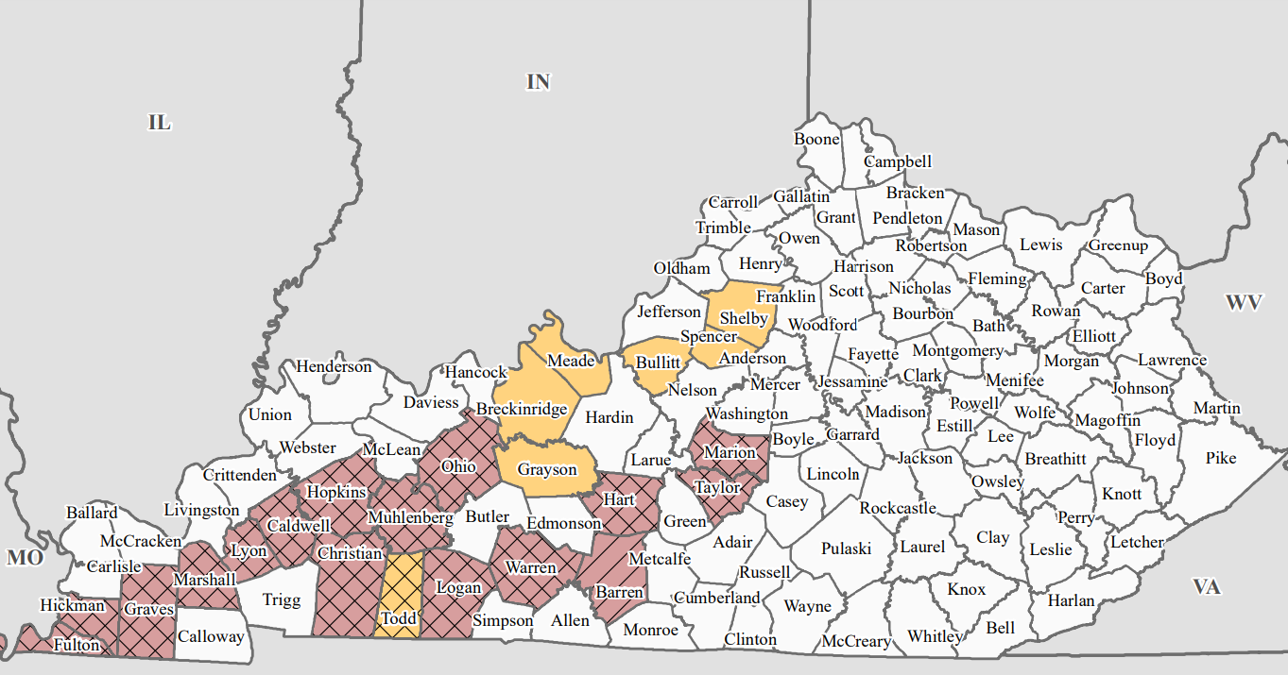
DR-4630
Mayfield Tornadoes
December 10, 2021
80 Deaths
Public Assistance
23 Counties
$350 Million
Individual Assistance
15 Counties
$16 Million
Hazard Mitigation
$12 Million
Red Counties Declared Public Assistance
Yellow Counties Declared Individual Assistance
KENTUCKY EMERGENCY MANAGEMENT

Slide 7
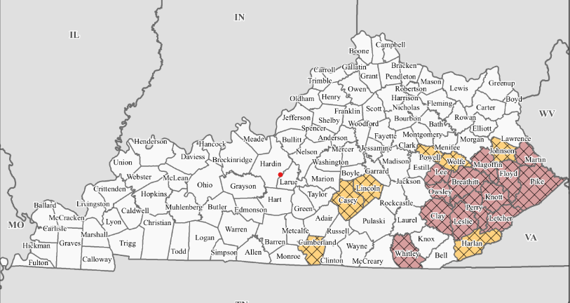
DR-4663 E KY Flooding
July 27, 2021
45 Deaths
Public Assistance
20 Counties
$630 Million
Individual Assistance
13 Counties
$110 Million
Hazard Mitigation
$126 Million
Red Counties Declared Public Assistance
Yellow Counties Declared Individual Assistance
KENTUCKY EMERGENCY MANAGEMENT

