Slide 1
Temporary Assistance for Needy Families (TANF) Funding and Uses
This supplemental document is being provided to the House Standing Committee on Health and Family Services and the Senate Standing Committee on Health and Welfare
January 7, 2021

Slide 2
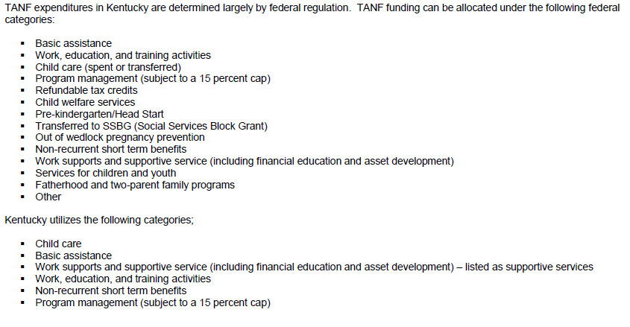
Use of TANF Funding in Kentucky

Slide 3
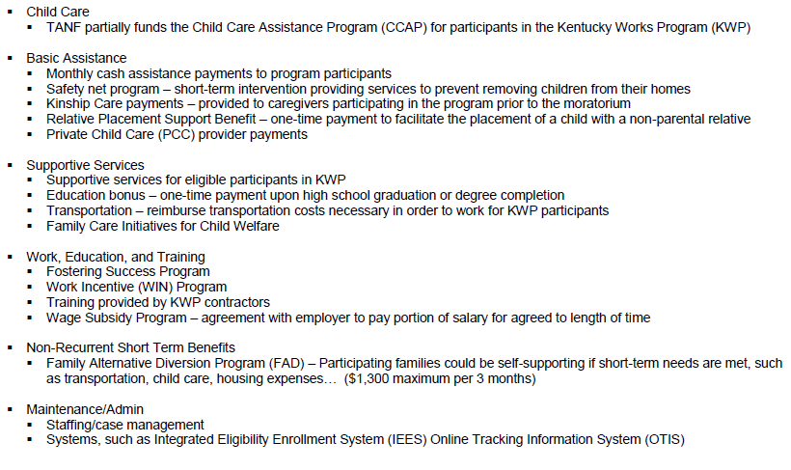
Services, Supports, and Programs

Slide 4
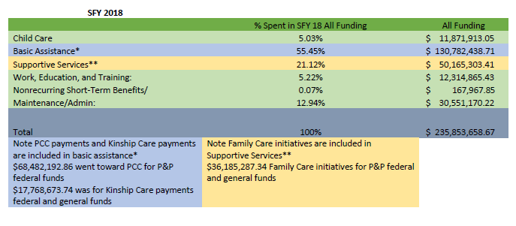
TANF Expenditures for SFY 18
Data included in this table are for the TANF expenditure categories on slide 3, including expenditures for protection and permanency (P&P) child welfare programs for private child care (PCC) and kinship care.

Slide 5
TANF Expenditures for SFY 19
Data included in this table are for the TANF expenditure categories on slide 3, including expenditures for protection and permanency (P&P) child welfare programs for private child care (PCC) and kinship care.

Slide 6
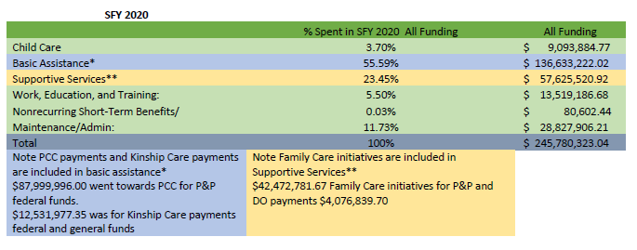
TANF Expenditures for SFY 20
Data included in this table are for the TANF expenditure categories on slide 3, including expenditures for protection and permanency (P&P) child welfare programs for private child care (PCC) and kinship care.

