Slide 1
HB 607 Pari-mutual modernization
What does it do?

Slide 2
HB 607 is a result of the Pari-mutuel wagering task force that met in the 2021 interim after the passage of SB 120. This bill does the following:
Taxes EVERY pari-mutuel wager at 1.5%.
Changes the distribution of live and HHR taxes to direct more toward the general fund.
Directs funds to the University of Kentucky and BCTCS equine industry programs.
Eliminates the admission tax.
Includes language to require the KHRC to be self funding
Requires the operators to maintain a self-exclusion list and share that list with KHRC for other operators to use.
Eliminates breakage
Allows KTDF funds to be used for claiming races.

Slide 3
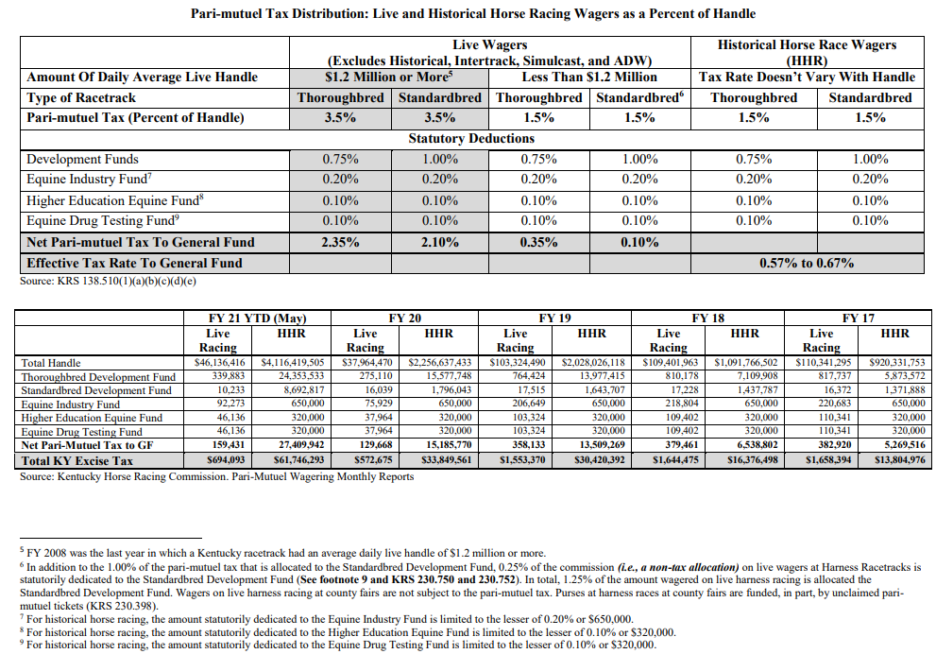
How do we generate more money for the general fund in HB 607?

Slide 4
How do we generate more money for the general fund in HB 607?
HB 607 puts a cap on monies that go into the KTDF ($40mil) and SBDF ($20mil). When that cap is met for each fund, the amount that goes into each fund drops from .75% to .35%, with the reminder going to the general fund.
In 2-3 years, it is estimated that this change will net the general fund at least $20+mil a year.
The increase in the ADW tax from .5% to 1.5% will be an immediate increase of $4mil a year, which will steadily increase.
Requiring the KHRC to be self sustaining will save the state budget $3mil a year.

Slide 5
How do we generate more money for the general fund in HB 607?
This revenue would on top of an already growing amount of money going into the general fund from pari-mutual wagers:
2016: $4mil
2017: $6mil
2018: $9mil
2019: $18mil
2020: $18mil
2021: $41mil
2022: estimated $62mil

Slide 6
What is breakage?
Ever wonder why all these payouts are in increments of 20 cents? That is breakage.
On pages 26, 27 and 37, we change the word dime to penny, so the bettor gets their money.
For instance, if you bet on Justify to win, you may have received $7.92 instead of $7.80.
This will put more money in bettors pockets.

