Slide 1
Organized Retail Crime
Kentucky Retail Federation
Shannon Stiglitz
Senior Vice President of Government Affairs
August 18, 2022
Presentation to the Interim Joint Committee on Judiciary

Slide 2
Retail Industry Impact on Ky Economy

Slide 3
Organized Retail Crime
What is Organized Retail Crime (ORC)?
According to David Johnson, Section Chief, Criminal Investigative Division at the Federal Bureau of Investigation in testimony before Congress, What is called Organized Retail Theft or ORT by retail loss professionals, can generally be described as professional burglars, boosters, cons, thieves, fences and resellers conspiring to steal and sell retail merchandise obtained from retail establishments by theft or deception.

Slide 4
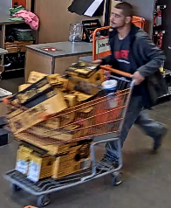
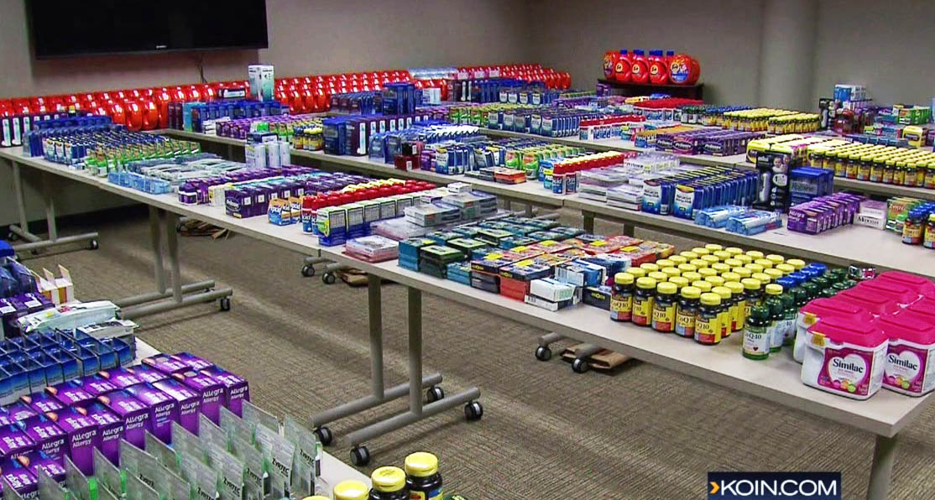
5 charged in Bellevue organized retail theft ring, totaling more than $100,000
By FOX 13 News Staff
Published August 11, 2022 1:40PM
Bellevue
FOX 13 Seattle
JUNE 1, 2022WASHINGTON, DCFINANCIAL CRIMES
HSI, ACAMS take aim at organized retail crime
New investigative guide outlines red flags associated with schemes generating nearly $70 billion annually
Breaking News
ORC Ring Busted; 70-Year-old Woman ‘Ringleader’ Arrested

Slide 5
ORC—Why is it on the rise?
ORC is on the rise for two reasons:
Multiple sources report generally two reasons for the increase in organized retail crime.
First, the ease and anonymity of selling stolen goods online through third-party marketplaces, make it easy for these criminals to monetize theft.
Second, due to overcrowding in jails, many states have increased felony theft thresholds. This gives organized retail criminal organizations the ability to fund their organizations with lower level of risk.
(Source: https://www.acams.org/en/media/document/29436
ACAMS Detecting and Reporting the Illicit Financial Flows Tied to Organized Theft Groups (OTG) and Organized Retail Crime (ORC).

Slide 6
ORC—its on the rise
Kentucky:
Value theft: $727,444,260
Percent of total:1.06%
Total Sales Analyzed: $61,094,436,576
Percent of Total Sales: 1.30%
Percent of Sales Stolen: 1.19%
Theft per capita: $ 164.42

Slide 7
Misconceptions about ORC
ORC is not just shoplifting
A common misconception is that the billion-dollar criminal activity is simply perpetrated by one-time shoplifters that retailers should manage on their own.
This not an issue of one-time shoplifters or shoplifters stealing items they cannot afford
ORC involves sophisticated, professional organized theft groups or criminal networks working together to steal for a profit that funds other criminal activity, such as drug and human trafficking.
Additionally, ORC can negatively impact consumer health and safety, especially when an unsuspecting consumer faces risks from legitimate products, such as stolen infant formula, pharmaceuticals, and other consumable products which may have been mishandled or manipulated (e.g. expiration dates) by the OTG who stole them for resale to consumers.
ORC is viewed as property crime, which tends to be at the bottom of cases investigated and prosecuted.

Slide 8
ORC-Misconceptions
Organized Retail Theft is a victimless crime—
WRONG--These are not victimless crimes; they jeopardize employee and customer safety and disrupt store operations. They’re also not non-violent — customers, employees and community members are traumatized by these incidents. News headlines around “smash and grab” thefts at national retailers in major cities show that organized retail crime continues to be a serious problem. ORC continues to be a “gateway crime” to more serious crimes and often has ties to transnational crime rings.

Slide 9
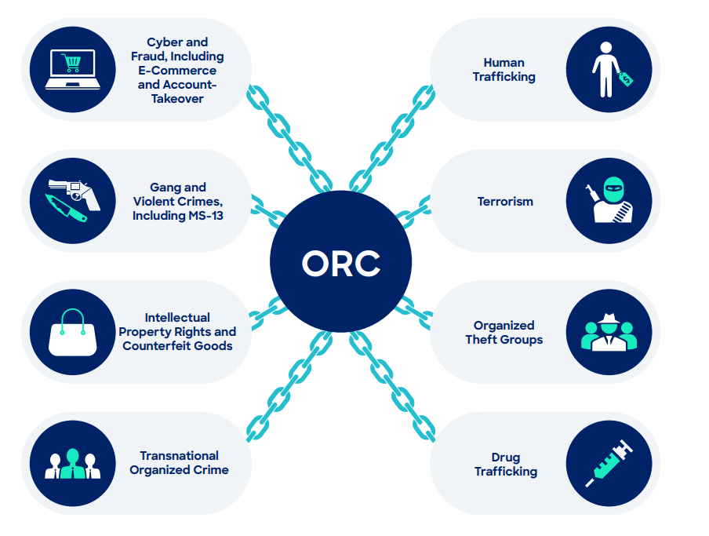
Organized Retail Crime
Who are organized retail criminals?

Slide 10
Organized Retail Crime
How does it work?

Slide 11
Retailers Targeted

Slide 12
The Impact of ORC
In 2019, as much as $68.9 billion worth of products were stolen from retailers, which represents about 1.5% of total retail sales.
Retailers face increased costs for lost product, security, and labor, which leads to higher consumer prices.
ORC can negatively impact consumers by way of receiving counterfeit or tainted products such as baby formula, over the counter medication or other consumer health products. Some of which are the most likely items to be stolen.

Slide 13
Organized Retail Crime
Who does it impact?
Consumers:
Consumers are impacted as threat of violence grows in stores;
Mishandled stolen goods represent a potential health and safety threat;
Pay increased prices due to theft.
Retail employees: A survey of asset protection managers reported that employees are experiencing increased verbal and physical threats.
EXAMPLE: In Florida, a retail theft ring targeted ULTA Beauty stores, and would pepper spray retail employees to gain access.
Federal, State, and Local government tax revenues: It is estimated that retail theft costs federal and state governments nearly $15 billion in personal and business tax revenues, not including lost sales taxes.

Slide 14
Estimated Impact of Retail Theft on Ky Economy

Slide 15
ORC Activity by Severity

Slide 16
Solution—The INFORM Act
11 states have enacted the Integrity, Notification, and Fairness in Online Retail Marketplaces for Consumers Act (INFORM Act):
Requires an online marketplace to require “high-volume third-party sellers” to provide information to the marketplaces and consumers and requires marketplaces to verify this information.
This information includes sellers’ government ID, tax ID, bank account information, and contact information.
The online marketplace must verify this information.
High-volume sellers are those that meet a certain threshold of sales, such as 200 transactions in 12 months and which results in $5,000 or more in aggregate revenue.

Slide 17
INFORM Act
Protects consumers against counterfeit and stolen merchandize that can be tainted or mishandled.
Provides law enforcement with the ability to better track stolen goods and organized retail theft groups.
Removes the anonymity of sellers, making it less attractive for criminal to use these platforms.
Provide consumers with the enough information about the seller to make informed decisions about the reputation of the seller or the legitimacy of the products.
By verifying that the information is correct it makes it more difficult for sellers to create fake accounts or storefronts.

Slide 18
States with the INFORM Act

Slide 19
KRS 226.040

Slide 20
Ky Organized Retail Crime Law
KRS 506.120:

Slide 21
Thank you for the opportunity
Questions?
Contact Information
Shannon Stiglitz
sstiglitz@kyretail.com

