Slide 2
Snapshot of DPA Personnel
570 Employees total
331 Attorney Positions (286 Trial Division, 45 Post-Trial Division)
91 Administrative Staff Members
47 Alternative Sentencing Workers / Mitigation Specialists
45 Public Advocate Investigators
23 Employees – Law Operations (Fiscal, HR, IT) / Conflicts Divisions
8 Employees – Education and Training Branch
6 Employees – Office of Public Advocate
19 Employees – Protection and Advocacy Division

Slide 3
DPA Staff Attorney Positions
Staff Attorney I – No experience required
Staff Attorney II – At least one year of experience
Staff Attorney III – Four years of experience
Staff Attorney Supervisor Leads DPA Office, at least four years of experience (also carries substantial caseload)
Staff Attorney Manager Oversees Multiple DPA Offices and supervises supervisors, at least five years of experience (also carries substantial caseload)

Slide 4
Public Defender Salary Increases
Expenditures so far? Very Limited, Effective date delayed until August 15, first increased paycheck September 15
Annualized total salary increase once implemented? $3,545,969
Annualized total cost (including fringe benefits)? $7,269,236

Slide 5
Public Defender Salary Increases
FY23 DPA Attorney Pay Schedule
Creates a defined pay structure based on:
Position (Staff Attorney I, II, III, Supervisor, Manager)
and
Experience (Baseline, 3 years, 6 years, 10 years, 15 years, 20 years)

Slide 6
Public Defender Salary Increases
Salary increases aimed at improving retention and recruiting
Raises range from 8% to 44%
291 Attorneys received a raise higher than 8%
Average Raise – 22%

Slide 7
Public Defender Salary Increases
Starting Salary - $52,000 (up from $45,000)
Staff Attorney II - $59,000 to $73,000
Staff Attorney III - $64,000 to $78,000
Supervisors - $72,000 to $82,000

Slide 8
Public Defender Salary Increases
Challenges
Midpoints (i.e. “Maximum” salary)
Staff Attorney I - $62,033.52
Staff Attorney II - $68,234.40
Staff Attorney III - $75,051.60
Staff Attorney Supervisor - $82,563.12
Staff Attorney Manager - $90,811.68
Non-Merit Attorney Leaders
Salaries set by the Governor
Not included on Pay Schedule

Slide 12
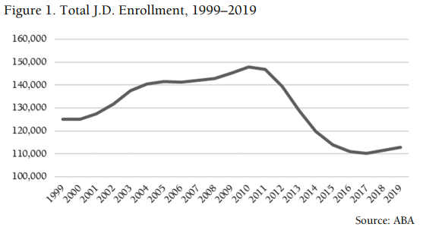
Ongoing Challenges
Hiring
Turnover has exhausted the applicant pool.
Caseloads, Stress, and Work Conditions
Fewer Law School Graduates

Slide 13
Ongoing Challenges
Hiring
State Government Processes
Delays
Create Position
Post on Website for mandatory period
Compulsory interviews and process
Personnel Cabinet Approval of Appointment
Acquisition of Necessary Equipment (i.e. COT))
Classifications and Pay Ranges, including midpoints
Pay Equity restrictions
Lack of flexibility (i.e. incentives, bonuses)

Slide 14
Ongoing Challenges
Continued Turnover
Since April 1, 2022 (when budget was final and raises were assured)
47 more resignations, including 24 attorneys
Work conditions, including stress, health, and work at home options

Slide 15
Ongoing Challenges
Public Defender vs Defender Contractor vicious cycle
Contracts
Recruiting
Turnover
Contracts
We can’t cancel the contracts until we fill vacancies, but our ability to fill the vacancies is impeded by the attractiveness of the contracts.

Slide 16
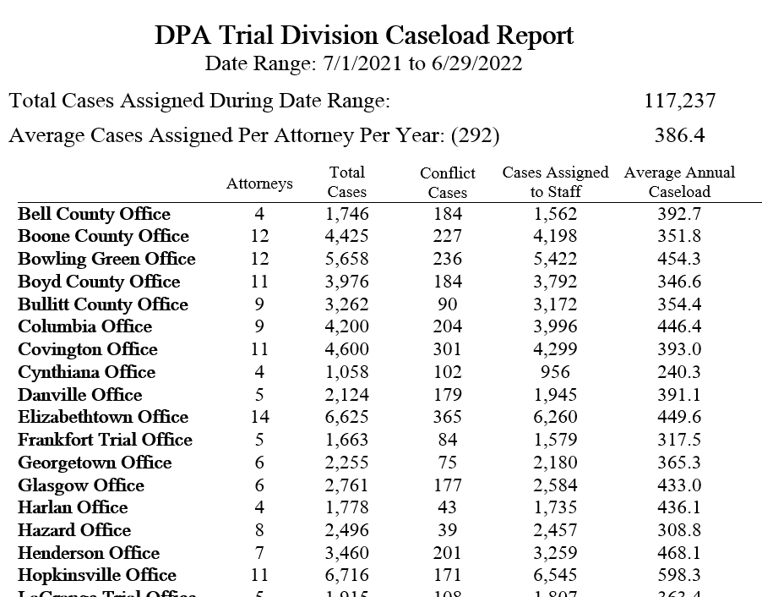

Slide 17
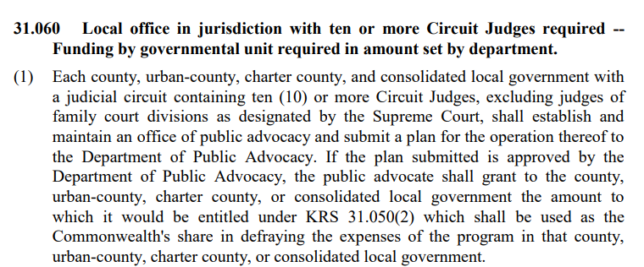
Louisville

Slide 18
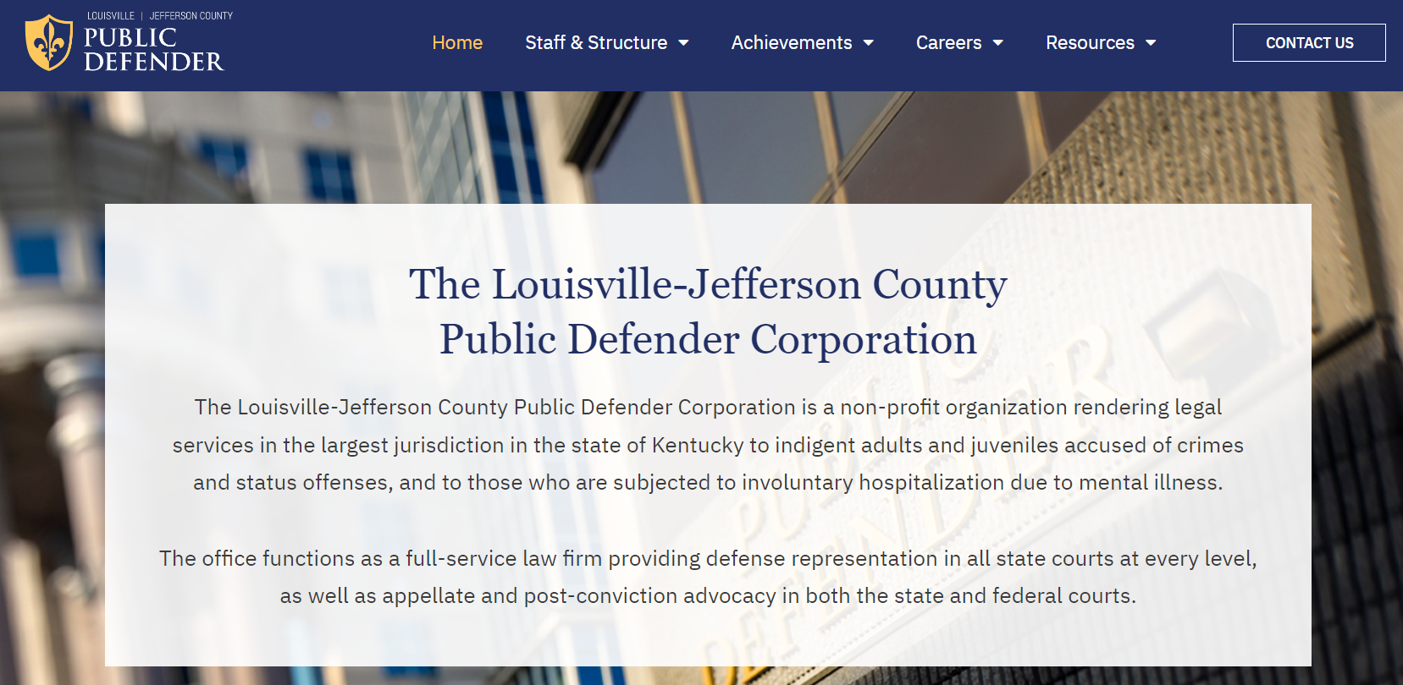
Louisville

Slide 19
Louisville Metro PD Funding – FY23
DPA - $6,067,902 (57%)
Louisville Metro Government - $4,519,800 (43%)
Within DPA’s funding for FY23 was additional funding so Louisville could give defender salaries increases comparable to DPA increases

Slide 20
Priorities
Independence – DPA must remain independent from judicial or prosecutorial involvement or from political pressures.
Client services – All organizational improvements must be focused on maintaining or enhancing services to clients.
Maintaining Strengths – DPA has a national reputation as an effective client-centered organization with excellent training and leadership development. We should build on these strengths.

Slide 21
Possible Structural Improvements
Clear Statutory Independence (within or outside of Justice Cabinet)
Requirement of at least one DPA office in every Judicial Circuit (currently DPA has an office in 36 of 57 circuits)
Increased presence in rural counties (designated County Defenders)
Caseload standards, permitting additional personnel when caseloads or court obligations require

Slide 22
Possible Statutory Improvements
Removal from KRS Chapter 18A merit employment system while maintaining some protection from political or unjust dismissals
Authorization for Public Advocate to set salaries for all DPA employees without Personnel Cabinet or Governor’s Office approval
Eliminate outdated portions relating to other county systems
Provide Alternative (Non-DPA) Counsel in non-criminal matters such as Involuntary Commitment and Tim’s Law (KRS Chapter 202A)

Slide 23
Additional Funding Needs
Resources to Improve Recruiting and Retention
Loan Forgiveness
“Signing Bonus” (i.e. cover moving expenses, cost of Bar Exam, etc.)
Establish Pay Schedule for non-attorney positions
Administrative Staff
Alternative Sentencing Workers (who did not get a matching raise when CHFS Social Workers got a raise)
Investigators

