Slide 1
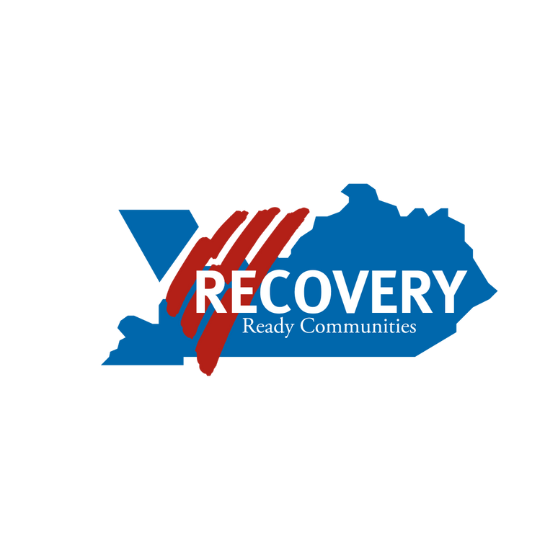
Volunteers of America Mid-States Presents:
Recovery Ready Communities

Slide 2
Proposed Strategic Goals:
Reduce Stigma
Increase Recovery Capital
Strengthen/Develop Recovery Oriented Systems of Care (ROSC)
Leading to:
Decreased overdose deaths
Increased workforce participation
Healthier and safer communities for all

Slide 3
Stakeholder Engagement:
PROVIDERS
18
29
MEETINGS
GOVERNMENT
13
140
STAKEHOLDERS
PUBLIC HEALTH
60
120
KENTUCKY COUNTIES
COMMUNITY MEMBERS
49

Slide 4
Certification Process
Community education and recruitment
Identify single point of contact for community
Community applies
VOA Team site visit
VOA Team assessment
VOA Recommendation to Advisory Council
Advisory Council decision
Share outcome with community
Provide follow-up technical assistance for re-application purposes

Slide 5
Criteria Scoring Categories:
Prevention
Treatment
Recovery Support

Slide 6
Advisory Council Feedback:
We want to hear from you!
RRCKY@VOAMID.ORG

