Slide 1
Clean Slate Initiative
The Benefits of Record Sealing for Kentuckians

Slide 2
What is “Clean Slate” legislation?
The Clean Slate Initiative works to expand and automate the sealing of arrest and conviction records after people have completed their sentence and remained crime-free for a period of time.
We believe everyone should have a shot at redemption.
CSI is a national, bipartisan non-profit organization that builds advocacy campaigns where local, state, and national partners operate with the shared goal of passing Clean Slate laws in states and in Congress.

Slide 3
Primary Objectives
Automate the record clearance process for records that are eligible for petition-based clearance;
Update eligibility for record clearance via the petition-based process with the goal of automating clearance of as many offenses as possible;
Decrease the period an individual must wait to benefit from record clearance based on public safety research.

Slide 4
How does research impact waiting periods?
A waiting period is the amount of time a person must remain crime free before becoming eligible for automatic record clearance.
Once individuals have been crime free for a few years, they have reached what researchers call the “point of redemption” meaning they are no more likely than anyone in the general population to commit a crime.

Slide 5
What is the recommended Clean Slate automation process?
Due to state-by-state variations in record sealing laws, processes, data systems, and flow of information among agencies, there is no “one” recommended way to automate the record clearance process.
Our coalitions aim to work with state agencies to ensure the most successful implementation process for each state.

Slide 6
Government’s Role in an Automatic Process
Determine
Inform
Update
Determine
eligible cases
under the law
Inform relevant agencies about eligible charges
Update records in relevant agency systems
Notes:
At a high level, record clearance comes down to three main steps:
The initiating agency determines which charges are eligible, based on the way the law is written
The agency will notify or inform the other relevant agencies in the state
Records will be updated in the relevant systems
It’s important to note that an automatic process is does not mean you can push one button to do all of these things. At each step in the process, there are different levels of ‘automation’ that can occur

Slide 7
ESTIMATED POPULATION WITH A CONVICTION OR NON-CONVICTION RECORD IN 2019, BY TYPE OF RECORD

Slide 8
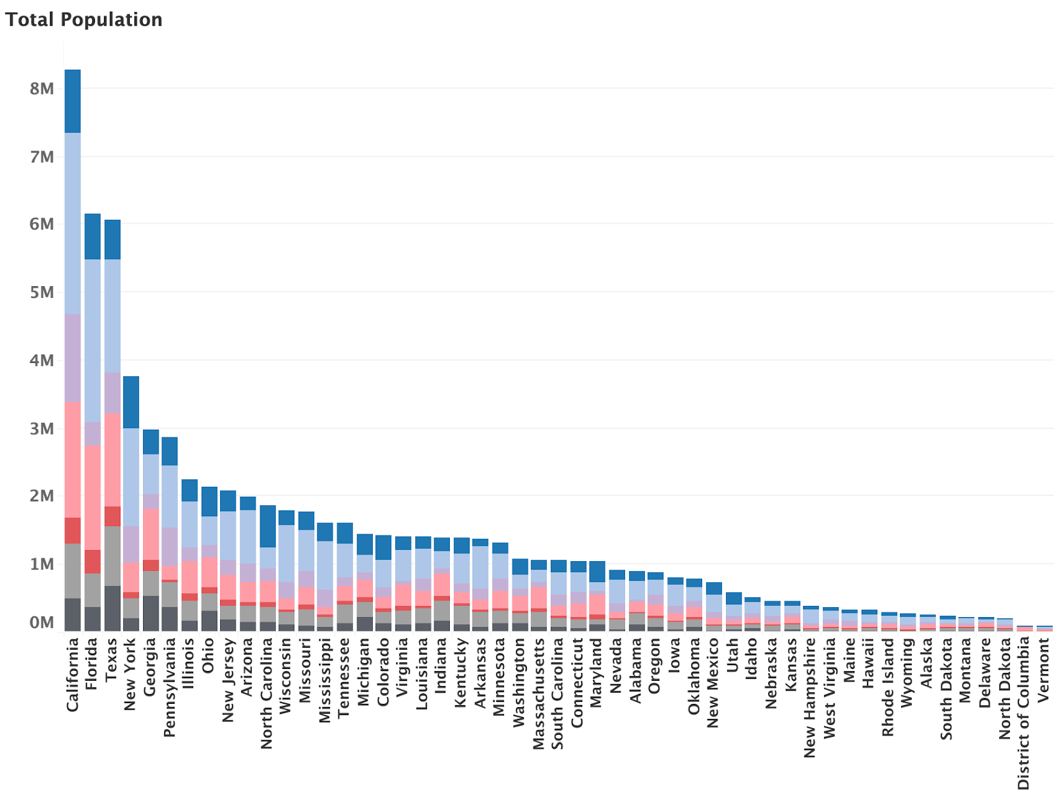
ESTIMATED POPULATION WITH A CONVICTION OR NON-CONVICTION RECORD, BY STATE AND TYPE OF RECORD

Slide 10
Expungement of Criminal Convictions:
An Empirical Study
J.J. Prescott, University of Michigan Law School & Sonja B. Starr, University of Michigan Law School
Among those legally eligible for expungement, just 6.5% obtain it within five years of eligibility.
Those who do obtain expungement have extremely low subsequent crime rates, comparing favorably to the general population — a finding that defuses a common public-safety objection to expungement laws.
People who obtain expungement experience a sharp upturn in their wage and employment trajectories; on average, within one year, wages go up by over 22% versus the pre-expungement trajectory, an effect mostly driven by unemployed people finding jobs and minimally employed people finding steadier or higher-paying work.

Slide 11
Economic Challenges
Brennan Center research shows that any time in prison can reduce a person’s annual earnings by roughly half.
Combined with the effects of other types of criminal justice involvement, incarceration costs our communities, and the economy, hundreds of billions of dollars each year.
One solution to this problem is to limit who can access a criminal record, and when. This process, called “sealing” or “expunging” a criminal record, has been adopted in several states, with promising results.

Slide 12
Beyond Second Chance Hiring
Many employers engage in second chance hiring. Record sealing and relief policies push beyond hiring practices.
Unfortunately, with the rise of technology and background checks, criminal records often prevent individuals from securing employment.
As many as 9 out of 10 employers run a background check before offering someone a job, and research suggests a felony record can reduce the call-back rate for jobs by 50 percent.
Even a simple arrest record can harm someone’s reputation and ability to find work.

Slide 13
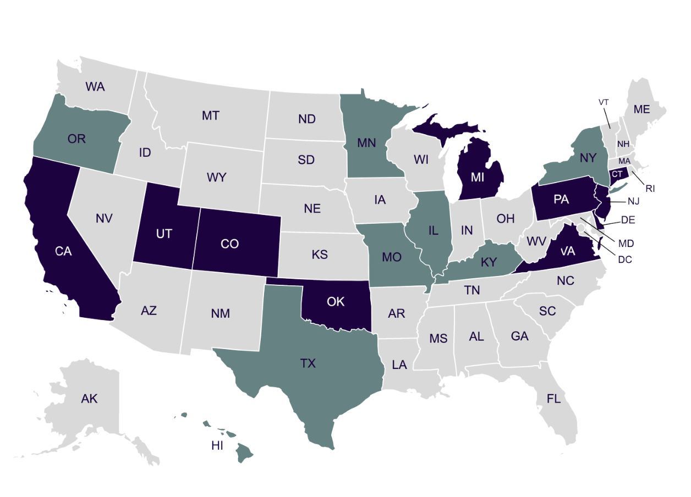
State-by-State Legislative Outlook
cleanslateinitiative.org/states

Slide 14
Question & Comments

