Slide 2
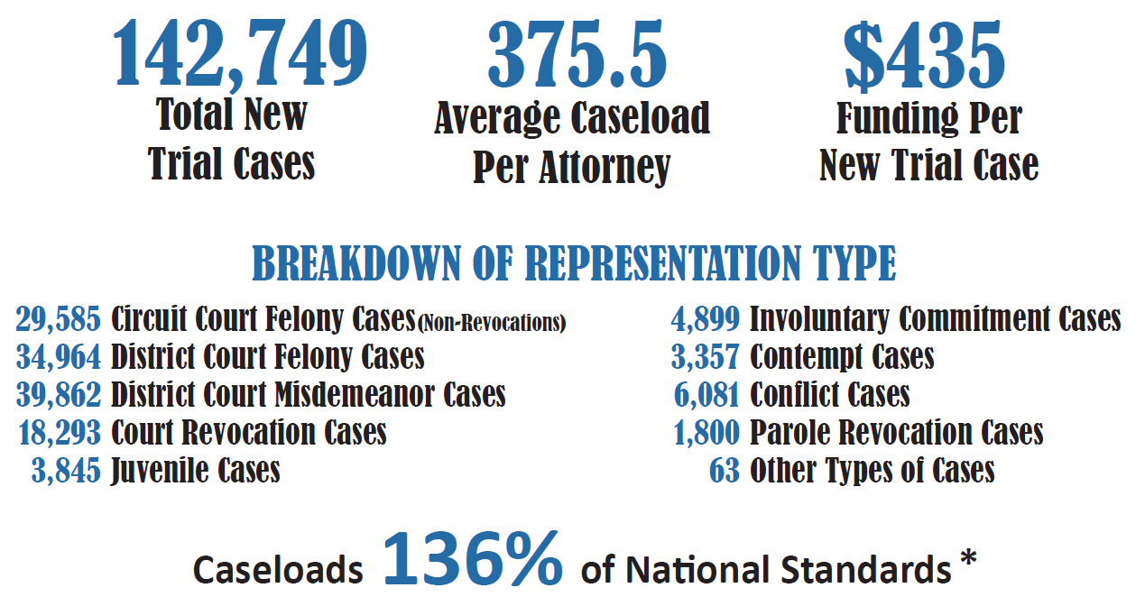

Slide 3
2022/23 Raises – THANK YOU!
Thanks to Legislature for funding and authority
Thanks to Personnel Cabinet for assistance in implementation
Starting Attorney Salary Raised from $48,000 to $52,000
Salary Schedule created recognizing experience and position
Average raise – 22%

Slide 4
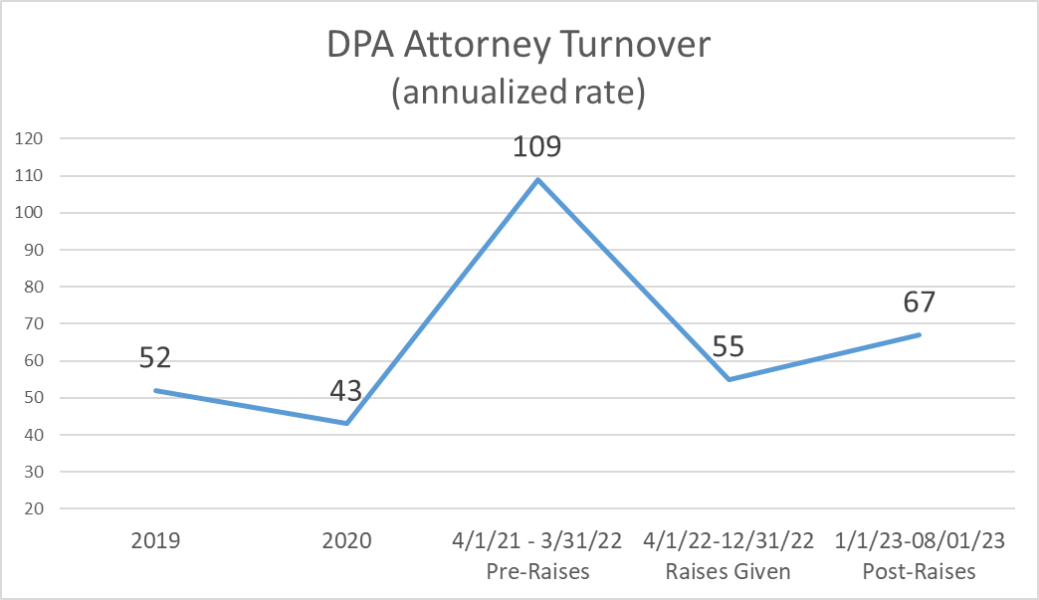

Slide 5
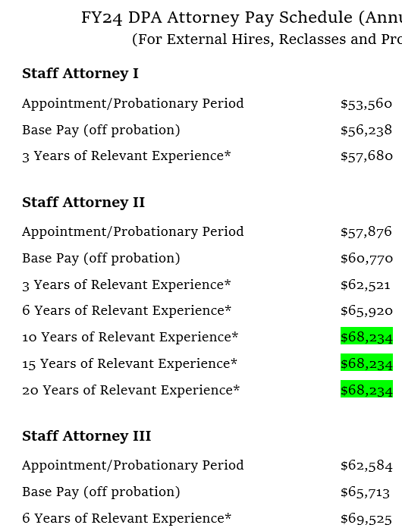
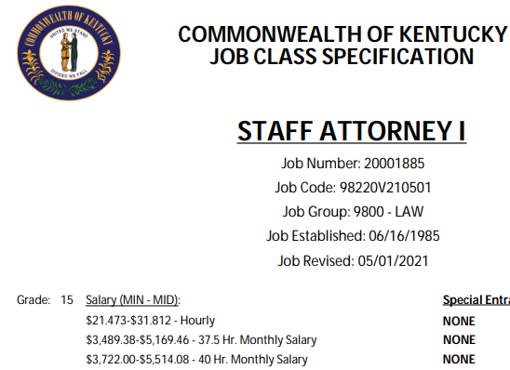

Slide 6
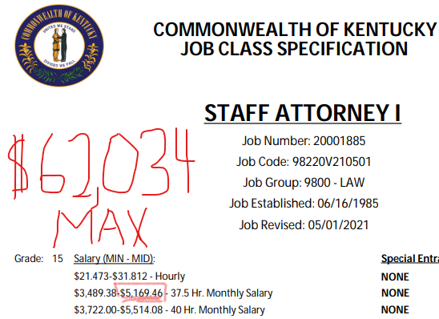

Slide 7
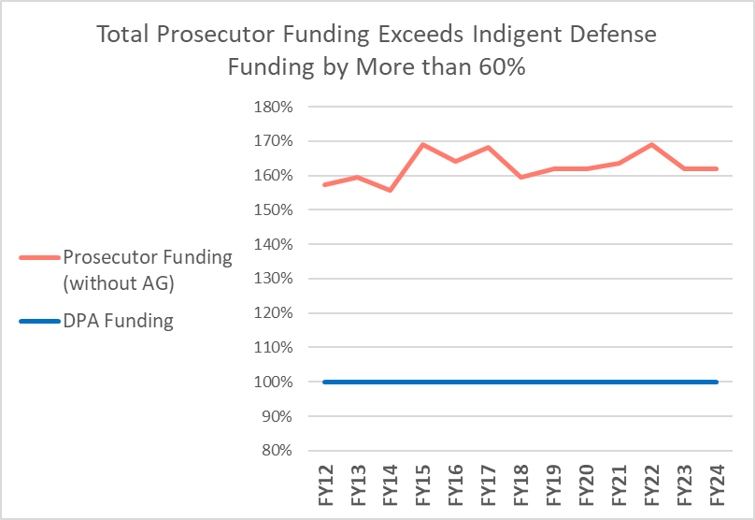
About 1 in 4 departing DPA attorneys leave for prosecutor positions at higher salaries

Slide 8
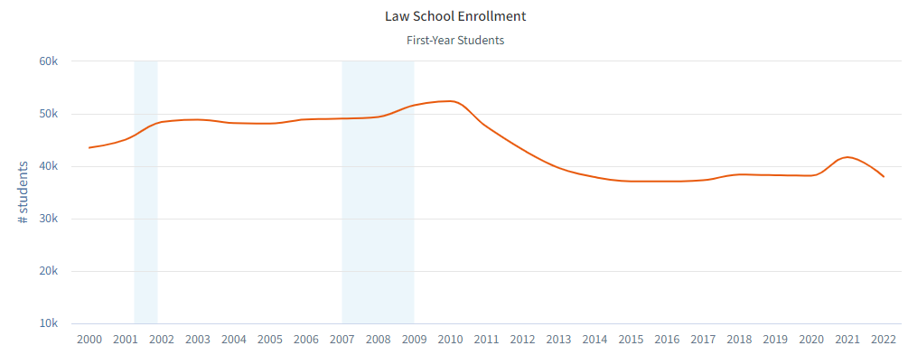
Challenge – Less Lawyers, Less Applicants
Law School Enrollment Down 25% in the last 12 years
Turnover Created Vacancies, We Can’t Catch Up in Current Legal Market

Slide 9
Public Defender vs Defender Contractor vicious cycle
Turnover
Contracts
Recruiting
Contracts
We can’t cancel the contracts until we fill vacancies, but our ability to fill the vacancies is impeded by the attractiveness of the contracts.

Slide 10
The Need? Round Two of Raises
Being “competitive” is no longer enough.
Public defense is a state constitutional obligation.
State should incentivize being and staying a public defender
Need to standardize Defender and Prosecutor salaries:
Starting Salary - $70,000

Slide 11
Recruiting – Flexibility and Authority Needed
Every year, DPA loses recruits because public-service minded law graduates can’t afford to move to and start for DPA.
After Graduation in May
Bar Prep in June - $
Bar Exam in July - $
Moving in August - $
Up-Front Housing Costs - $
Delayed First Paycheck - $
Public Defender Salary – ¢
Authority for Recruiting or Retention Expenditures - Notwithstanding any other provision of law, the Public Advocate is authorized to spend up to $500,000 of the funds appropriated to the Department of Public Advocacy for a Recruiting and Retention Program that may include one-time payments to incoming or current employees of the Department for the purpose of improving recruiting and retention of public defenders.

Slide 12
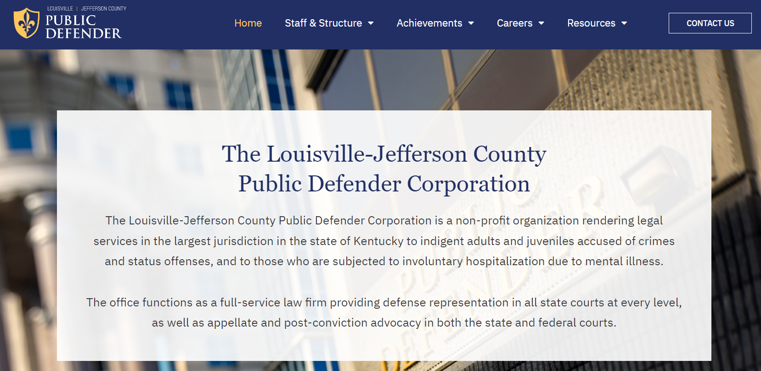
Louisville

Slide 13
Louisville Metro Public Defenders – FY24
DPA - $6,067,902 (56%) ($5,531,379 in cash, $536,523 in non-cash)
Louisville Metro Government - $4,843,800 (44%)
Full Staffing – 129 Employees, 78 Attorneys
Actual Staffing – 90-100 Employees, 50ish Attorneys
Temporary Workload Reduction Program – Private Attorney Contracts
FY22 Case Assignments – 21,542 new cases

Slide 14
Priorities
#1 – Funding
Estimated Funding Request: $10,854,440
Assumptions:
Full Staffing (129 Employees)
All Employees in State Retirement System
No moving, Increase in rent no more than 20%

Slide 15
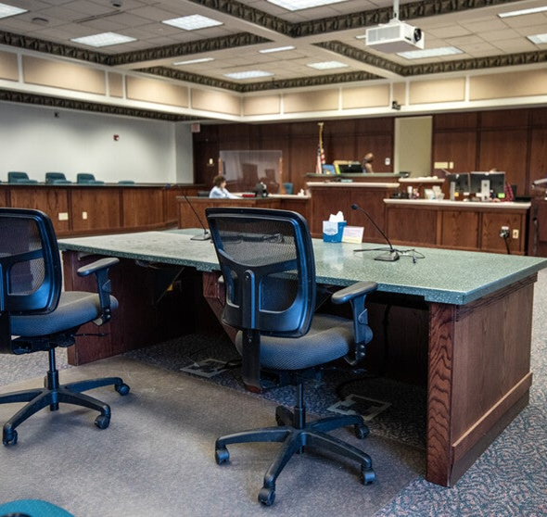
Priorities
#2 – Employee Retention
Doomsday Scenario
20,000 clients have no attorney on July 1, 2024
We must retain the dedicated qualified staff of the Louisville Metro Public Defender’s Office.

Slide 16
A “Smooth Transition Statute” is Needed
Section 1: A new section of KRS Chapter 31
(1) Personnel employed by the Louisville & Jefferson County Public Defender Corporation shall be transferred with status into the Department of Public Advocacy and be subject to all the provisions of the KRS Chapter 18A personnel system.
(2) With approval of the Public Advocate, employees transferred to the Department of Public Advocacy shall retain their salaries and leave time balances accumulated as of the transfer date. Leave time accumulated in leave types different from that in KRS Chapter 18A shall be transferred into a comparable KRS Chapter 18A leave type as determined by the Personnel Cabinet.

Slide 17
Challenge –Representation of Children
Currently, the most vulnerable clients we represent are the most unlikely to see their attorney in advance of court.
Juvenile clients are no longer housed at the closest juvenile facility.
To see clients in person, attorneys must spend entire days on the road for one or two clients.
…Or the juvenile clients just don’t get to see an attorney.

Slide 18
Challenge – Virtual Court
In many courts, incarcerated defendants are required to attend court virtually.
Effects:
DPW work is doubled due to pre-court and post-court jail visits
Jail costs increased as cases are continued and releases decline
Defendants cannot meaningfully participate in court hearings

Slide 19
Challenge – Senate Bill 90 – Barrier Relief Program
BHDID proposes that DPA hire Barrier Relief Administrators, who would work with our existing Alternative Sentencing Workers to assist Behavioral Health Conditional Dismissal Program participants.
Funding would be provided through a grant from BHDID, but hiring 11 additional social workers may raise collateral costs (i.e. office space).
DPA is willing to play this role but would need legislative authorization and all necessary funding.

Slide 20
Legislative Priorities

Slide 21
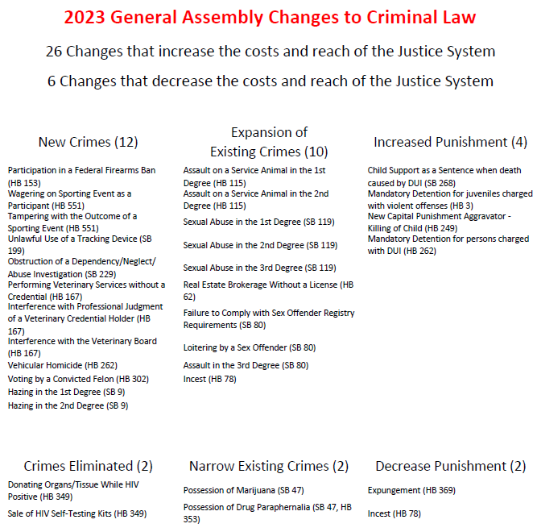
2023 Scorecard:
2023 Scorecard: 26 to 6

Slide 22
Legislative Priorities
Targeted PFO Improvements
Pretrial Release Reform
Comprehensive Sentencing Perspective

Slide 23
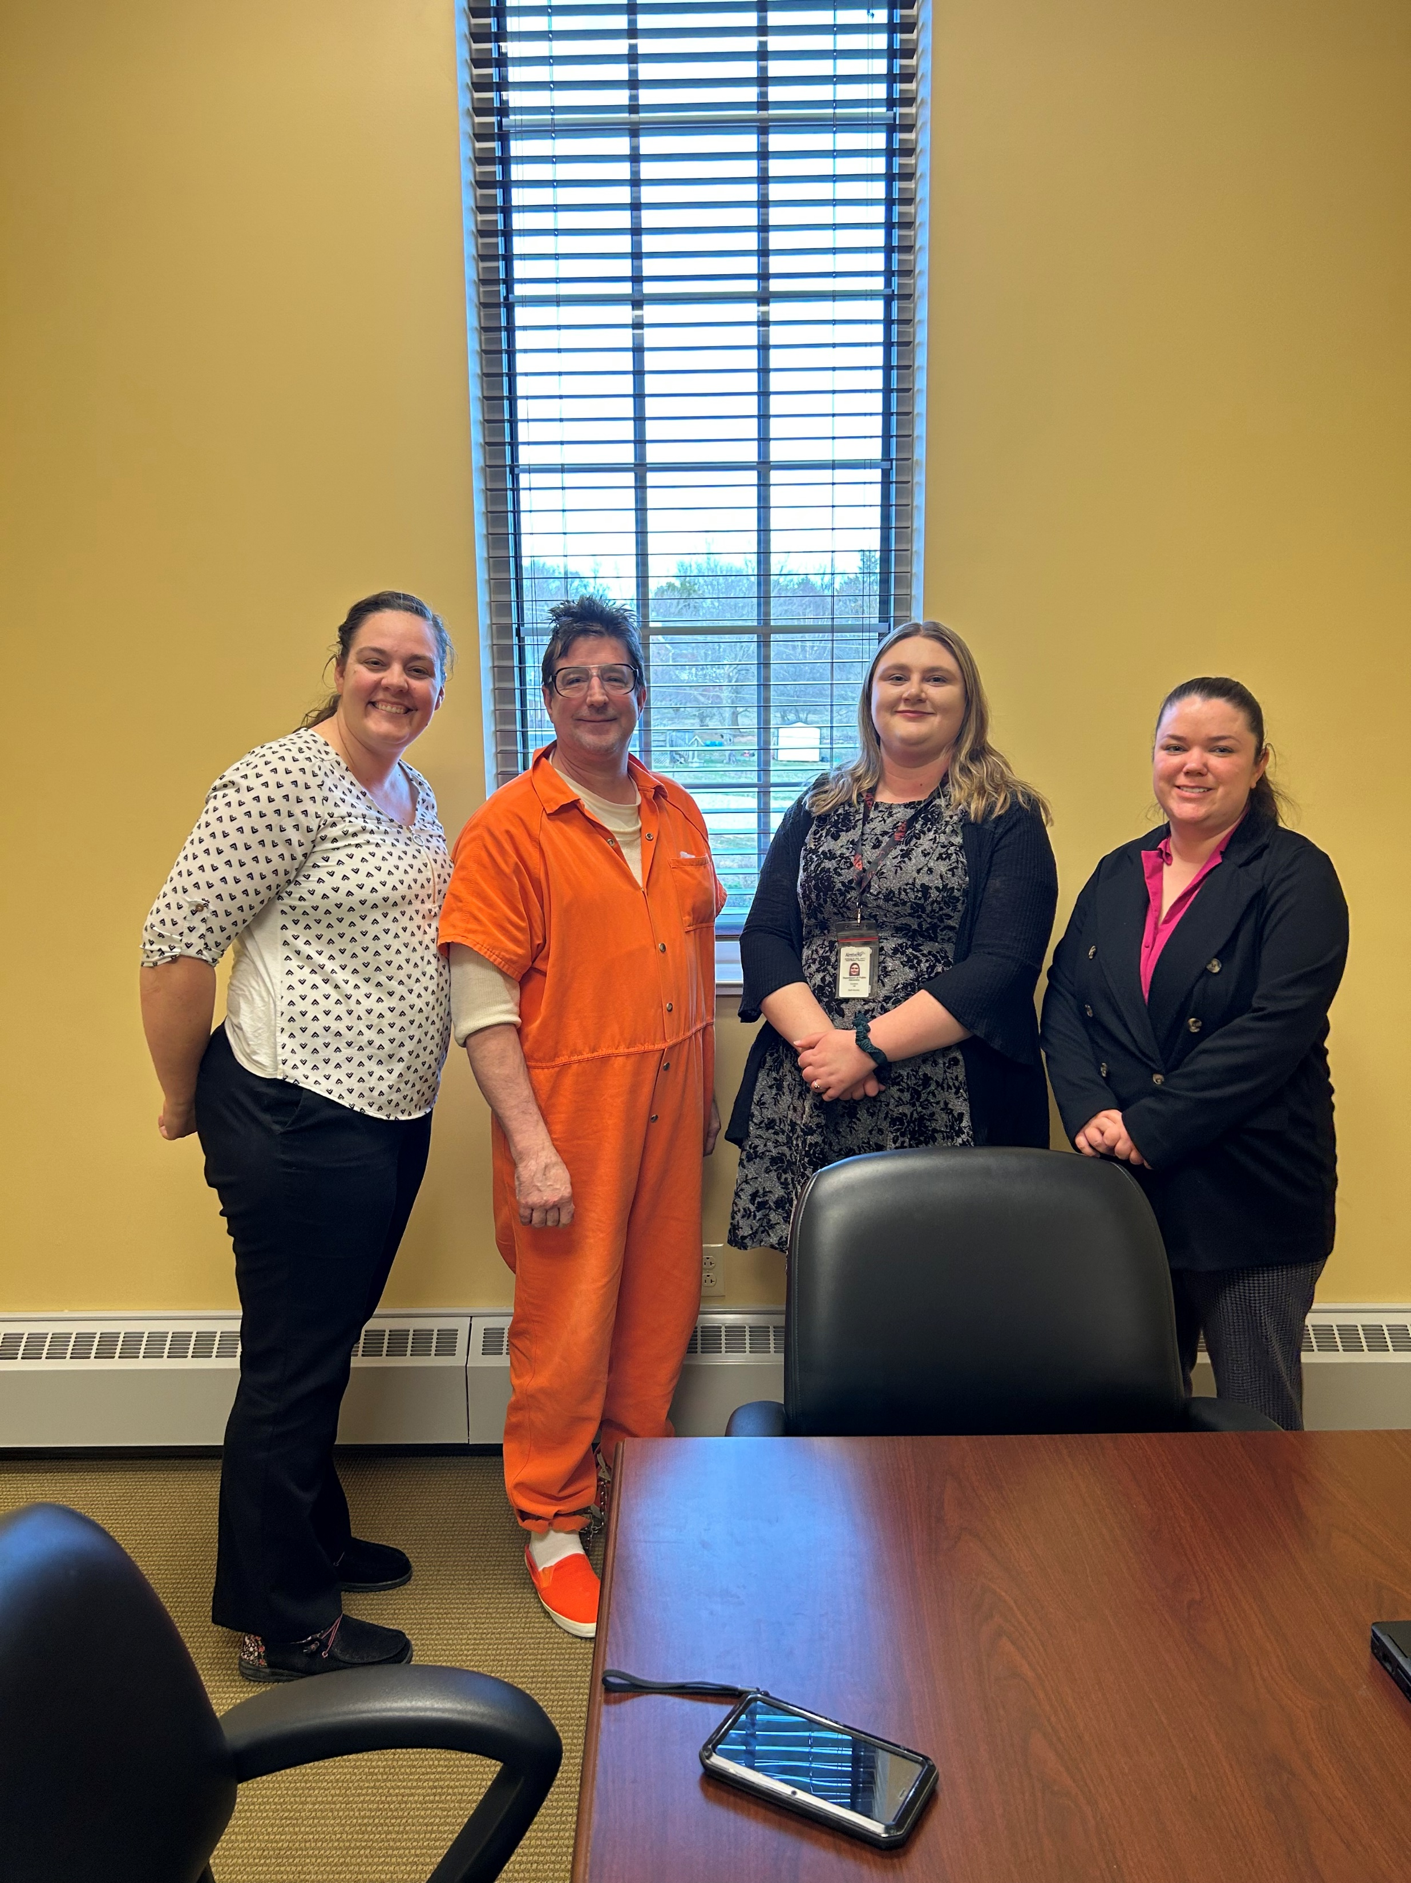
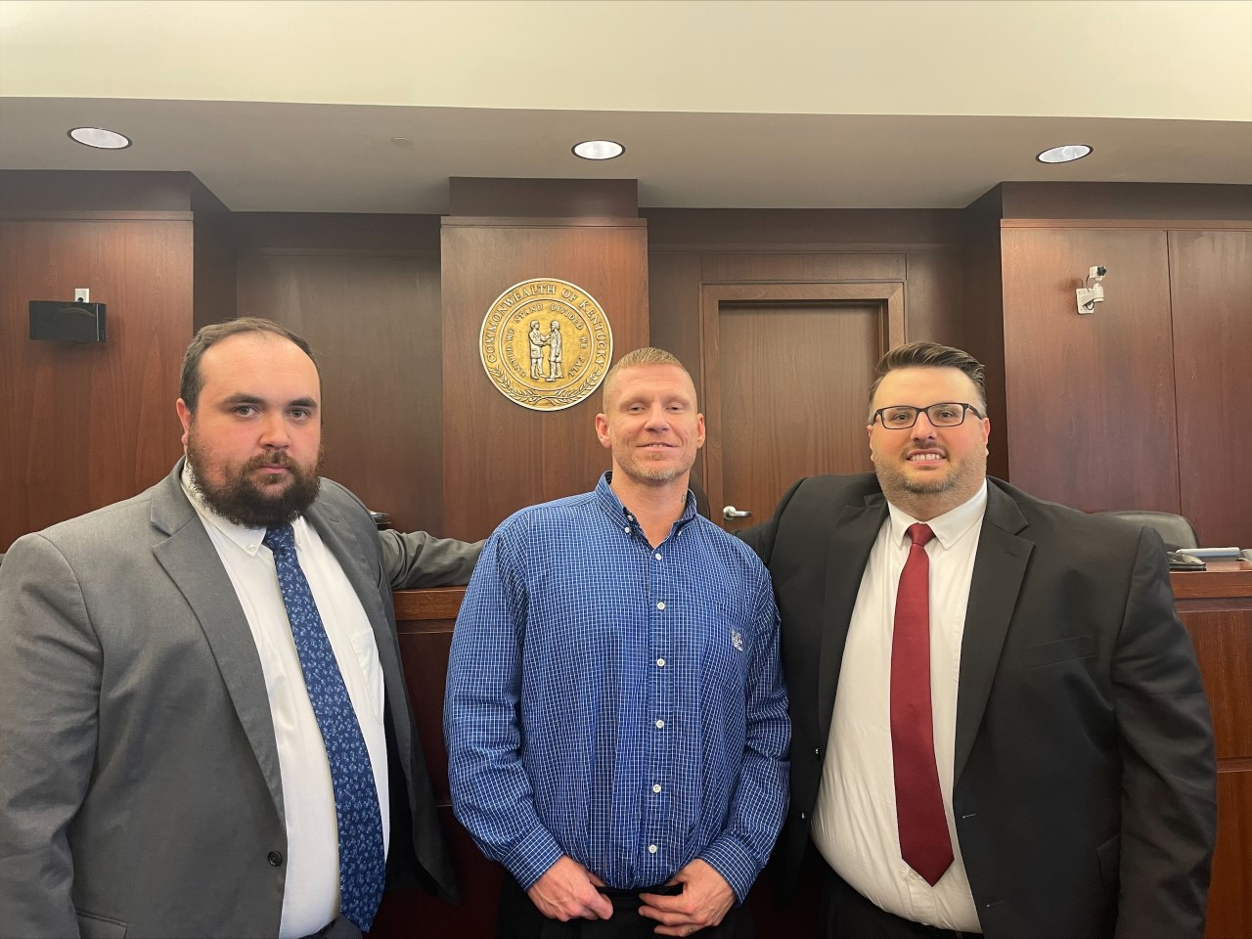
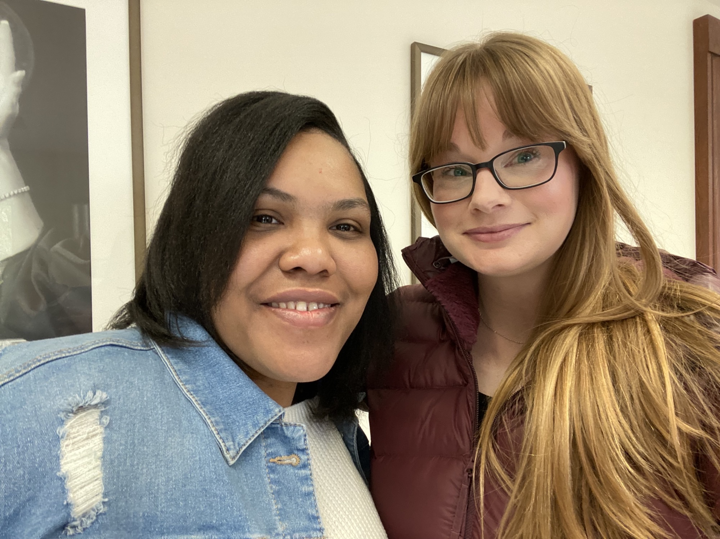
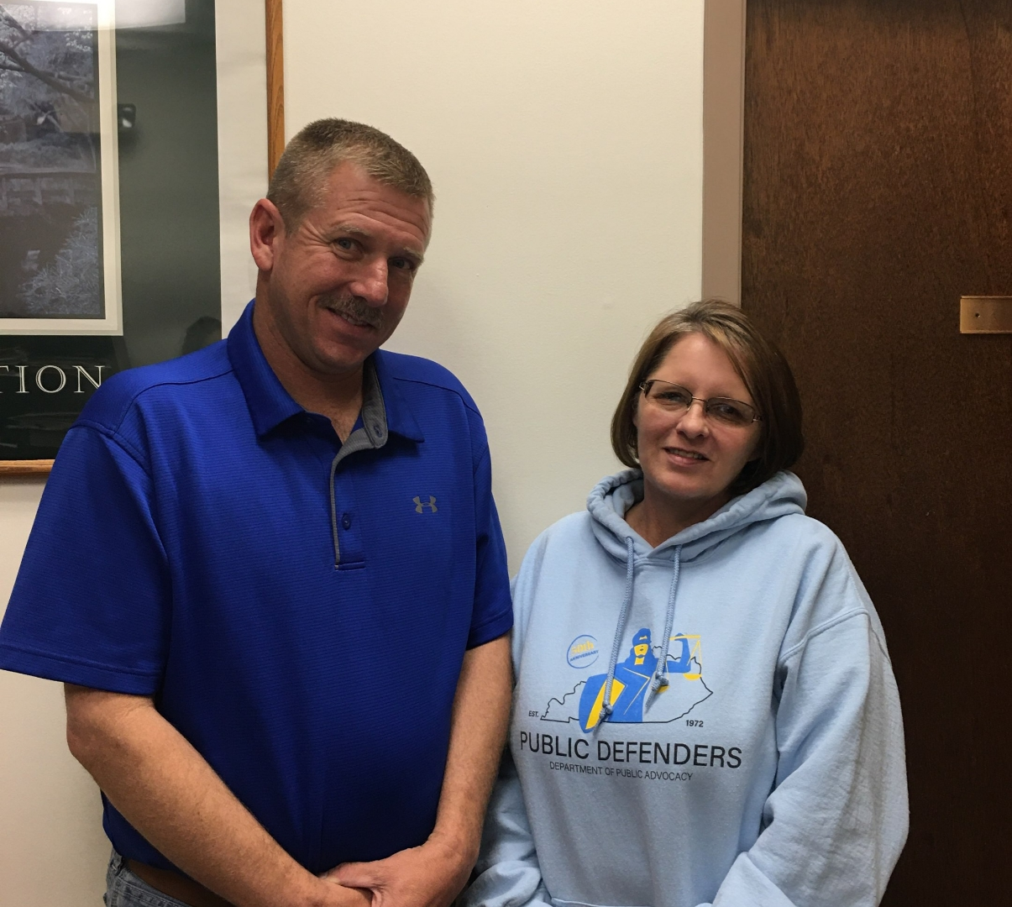
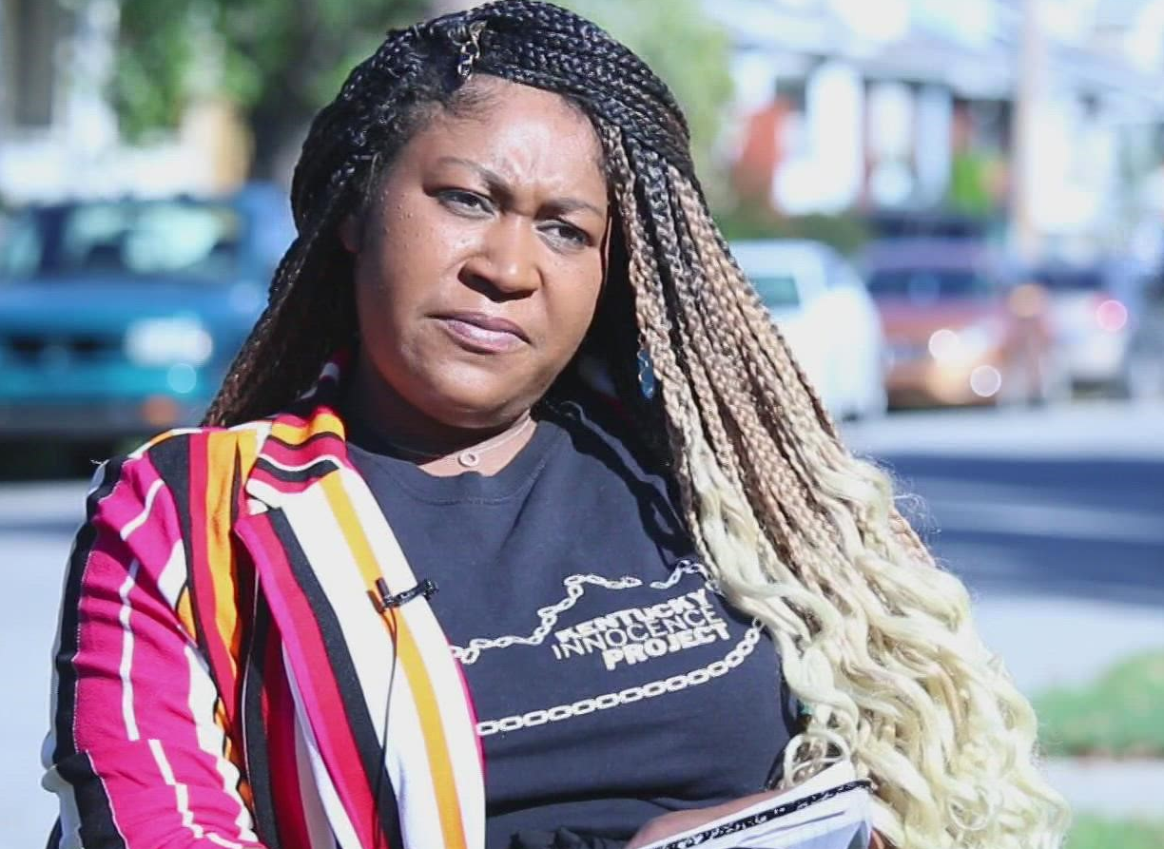
Making a Difference

