Slide 1

2026 HB 557:
Reshaping the Shared Responsibility
of County Jails in Kentucky

Slide 2

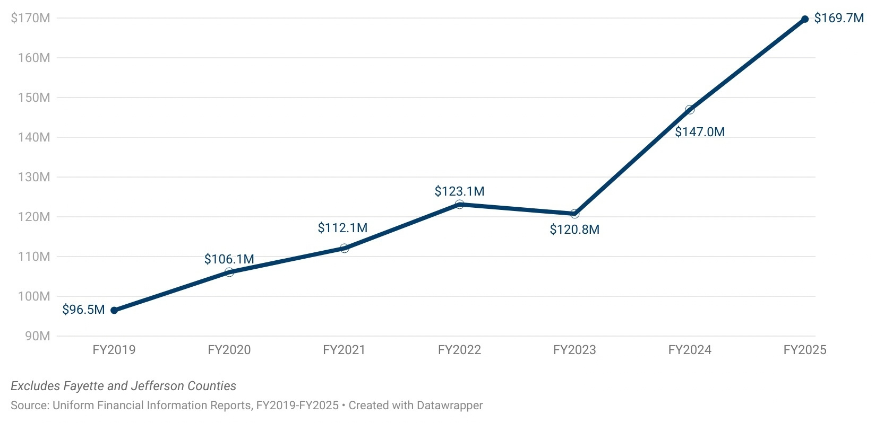
County jails at a crisis point
¬Ò
County general fund support for jails FY2019 - FY2025
+76%
Source: KACo analysis of Uniform Financial Information Reports, FY2019-25 (excludes Fayette and Jefferson)

Slide 3
HB 557 – 2026 session
¬Ò
Comprehensive approach:
  Incentivizing regional jails
  Clarifying responsibility for pre-trial felony detainees
  Redefining the state inmate housing model
  Total fiscal impact: Approximately $200 million excluding one-time funding incentives and construction.
+76%

Slide 4


Incentivize
Regional Jails

Slide 5
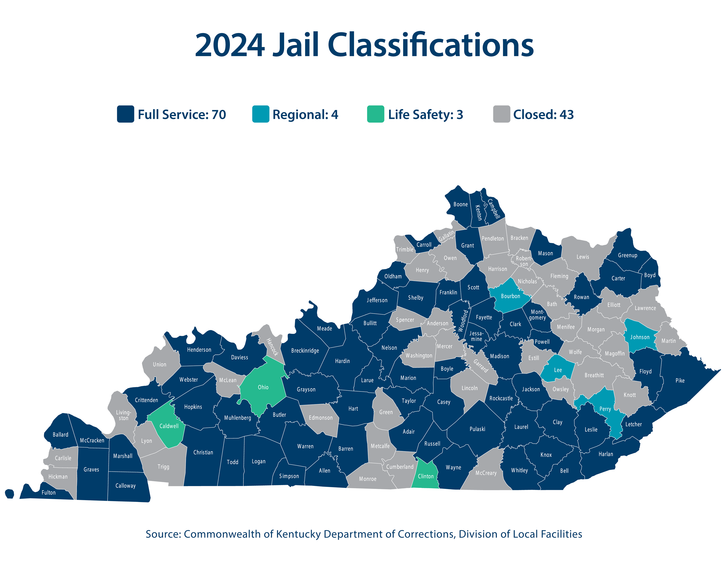
County jail classifications
¬Ò
Full Service - 70
Closed - 43
Regional - 4
Life Safety - 3

Slide 6
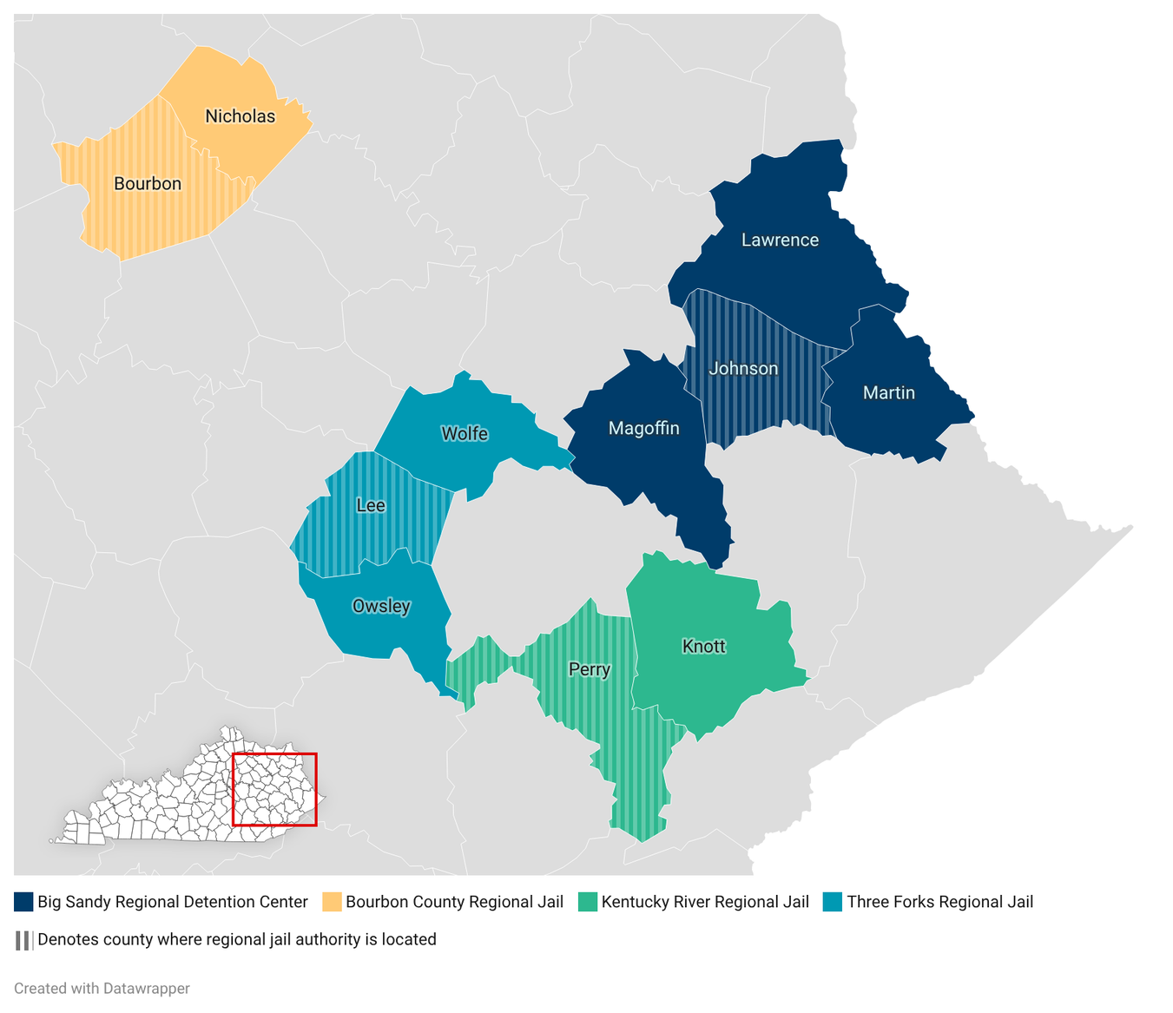
Regional jail authorities
¬Ò
RJAs are created
by ordinance of participating counties and governed by a multi-county board rather than a single fiscal court.
KRS 410.800-820

Slide 7
HB 557 –2026 session
¬Ò
Incentivize regional jails
  Establish a process for RJAs to apply for funding from the state for construction of new facilities or expansions and improvements of existing facilities.
  Provide a $1 million incentive grant to any fiscal court that establishes a new RJA or joins an existing RJA; provide a $500,000 incentive grant to each county already in an RJA that agrees to accept a new county into the authority.
  Allow 96-hour holdover facilities.
  Allow the jailer of each county participating in a RJA to automatically
be a member of the RJA board.
+76%

Slide 8
Clarify Responsibility for
Pre-Trial Felony Detainees

Slide 9







Who’s responsibile: Felony charges
County Bears All Costs
State Per Diem
Grand Jury
Indictment
Plea Agreement
Sentencing
Arrest
Release
Arraignment
Trial
Verdict

Slide 10

Credit for time served
County Bears All Costs
State Per Diem
Grand Jury
Indictment
Plea Agreement
Sentencing
Arrest
Release
Arraignment
Trial
Verdict
State Responsibility
Sentencing
Credit

Slide 11
HB 557 – 2026 session
¬Ò
Clarify Responsibility for Pre-trial Felony Detainees:
  Credit for time served: reimburse counties for the credit for time served an inmate receives when sentenced on a felony charge.
  Fiscal impact:
    $35.34 per diem = approximately $81 million
    $63.44 per diem* = approximately $146 million
*Based on actual cost estimate

Slide 12

Redefine State Inmate
Housing Model

Slide 13
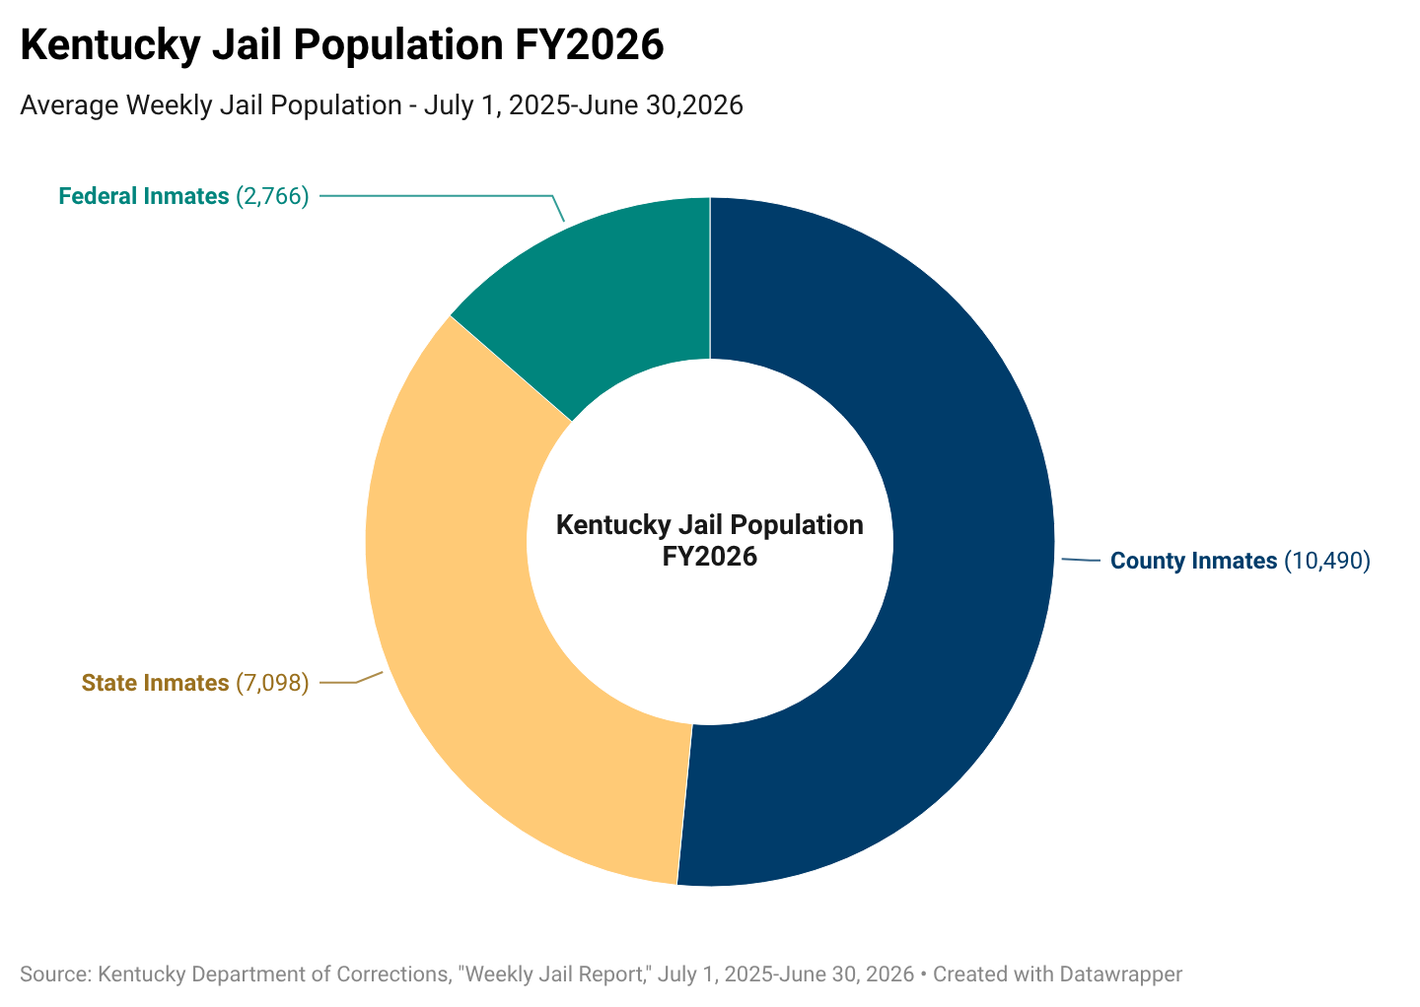
County jail population
Kentucky Department of Corrections, Weekly Jail Report,
July 1, 2025-June 30, 2026

Slide 14
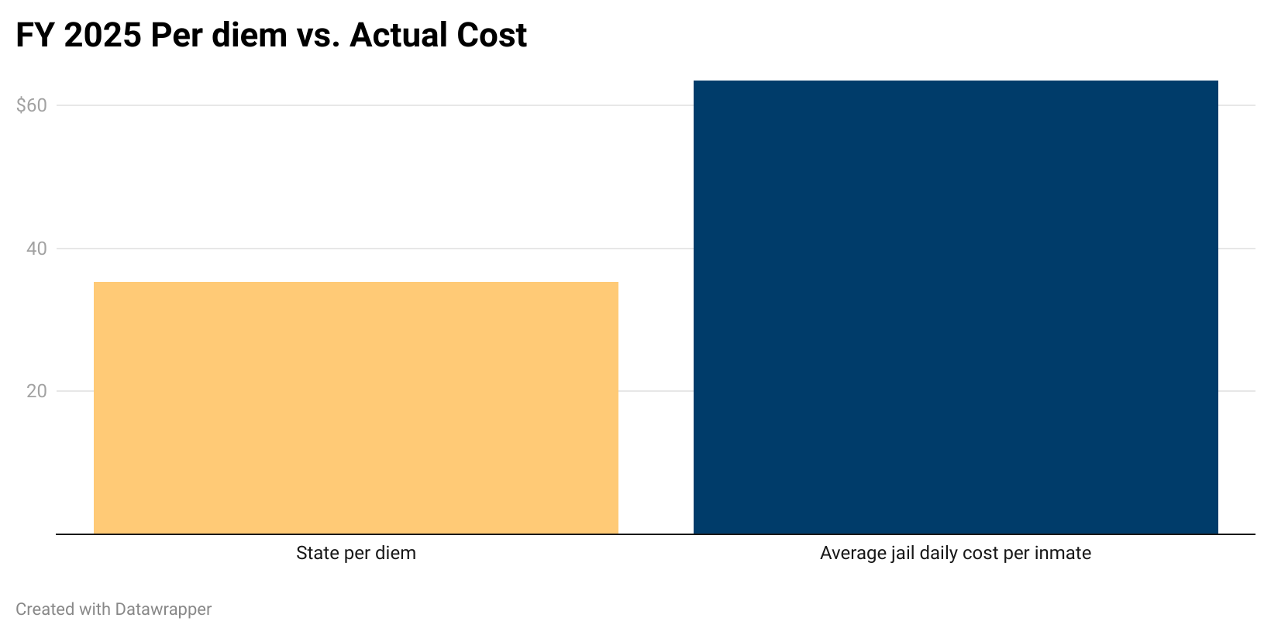
State inmate per diem
FY2025 state per diem vs actual jail costs
$63.44
$63.44
$35.34
Source: KACo analysis of Uniform Financial Information Reports, FY2025 (excludes Fayette and Jefferson)

Slide 15
State inmate medical costs
¬Ò
501 KAR 2:080E
  Emergency regulation took effect Aug. 17, 2026
  New definitions for “routine care”
and “beyond regular and routine care.”
  Previous definitions: counties reimbursed only for care requiring hospital stay of at least one night or general anesthesia.
  Fiscal impact: $12 million additional in county reimbursements
for state inmate medical care based on the new definition.
  Note: New regulation applies to state inmates.

Slide 16
HB 557 – 2026 session
¬Ò
Redefine State Inmate Housing Model:
  Require DOC to have contracts with each fiscal court or regional jail authority based on actual costs.
  Require jails to provide inmate programming and a daily medical presence.
  Limit transfer of state inmates without prior
DOC approval.
  Fiscal impact: Approximately $53 million

Slide 17
Questions?

