Slide 1
Finance and Administration Cabinet
Capital Planning Advisory Board
500 Mero Street, Frankfort, KY
September 18, 2018
  Presented by
  Mike Burnside, Commissioner, Department for Facilities and Support Services
  Andy Casebier, Director, Division of Engineering and Contract Administration
  Scott Aubrey, Director, Division of Real Properties

Slide 3
500 Mero Street
The building is being constructed on the former site of the Capital Plaza Tower.
The building will be 385,000 square feet across 5 floors, and will be LEED Certified.
The building is designed to accommodate 1,500 employees.
Construction will include a parking garage attached to the Transportation Cabinet Office Building parking garage.
The building will have a snack/sundry shop and a health clinic on the first floor. Floors 2 - 5 will have vending areas and collaboration space.
The Commonwealth has entered into a 30-year lease, therefore building maintenance and site services (landscaping, snow removal, etc.) are at the expense of the Building Owner, not the Commonwealth during this time.
Notes:
Final numbers with the Cabinets will be completed as the final footprint is determined. All at the 2 year budget amount of 17.84 per square foot.
Janitorial and Utility Cost may be adjusted in future budgets as the amounts in the first two years is based on Facility experience and cost estimates based on LEED certification.
Lease includes funds to maintain on site facility management.

Slide 4
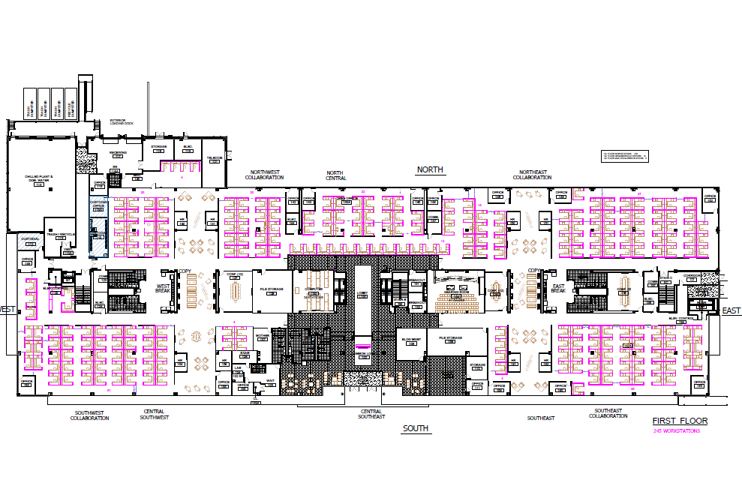
Proposed First Floor Plan

Slide 5
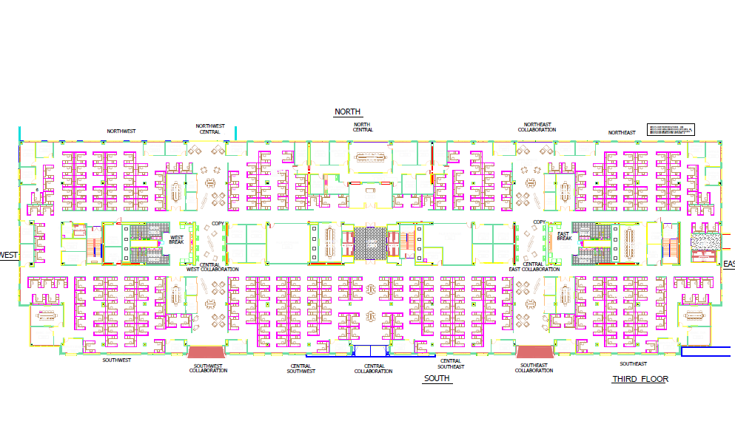
PROPOSED FLOOR PLAN
FOR FLOORS 2-5

Slide 6
Construction Timeline
Demolition of the Capital Plaza Tower occurred on March 11, 2018.
The first beam for the new building was set on June 18, 2018 (originally scheduled for September of 2018).
Last steel beam is to be set tentatively near the end of September 2018
The building is on schedule to be under roof and closed in by the end of this year.
Currently the building is on schedule to be substantially complete in September of 2019.
Total building tentatively scheduled for final completion by October of 2019. Approximately six months ahead of schedule.
Notes:
Final numbers with the Cabinets will be completed as the final footprint is determined. All at the 2 year budget amount of 17.84 per square foot.
Janitorial and Utility Cost may be adjusted in future budgets as the amounts in the first two years is based on Facility experience and cost estimates based on LEED certification.
Lease includes funds to maintain on site facility management.

Slide 7
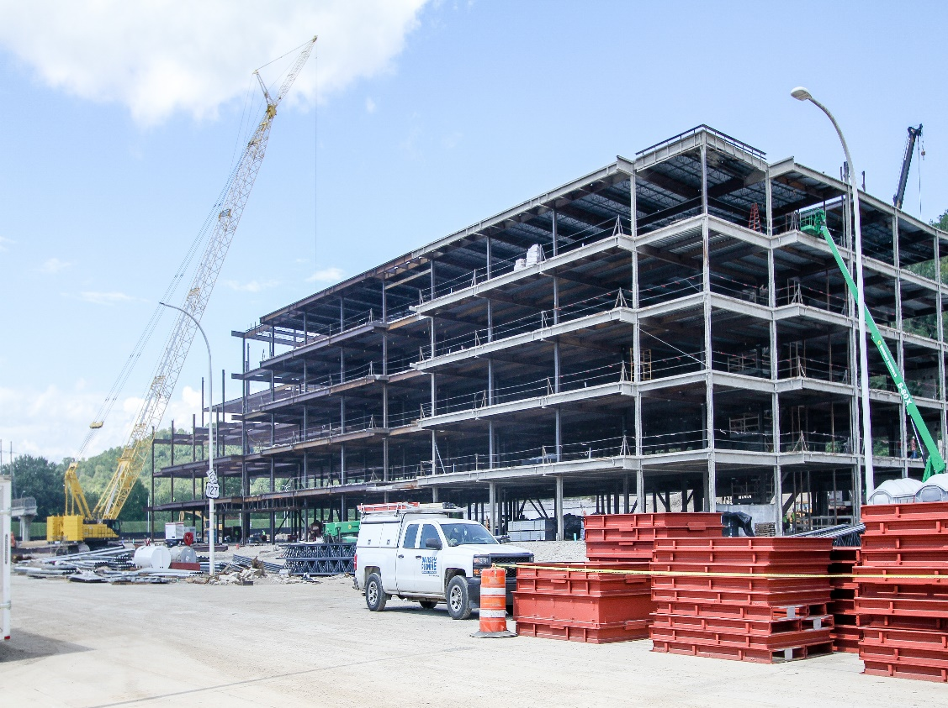
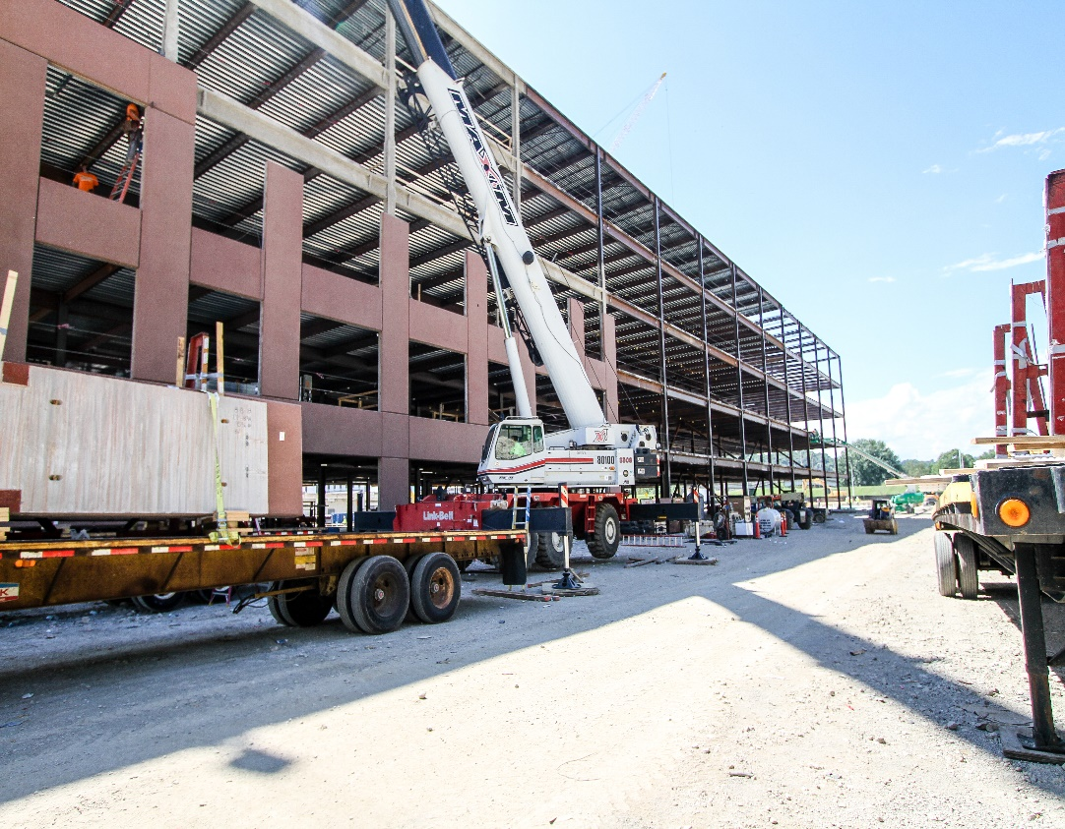
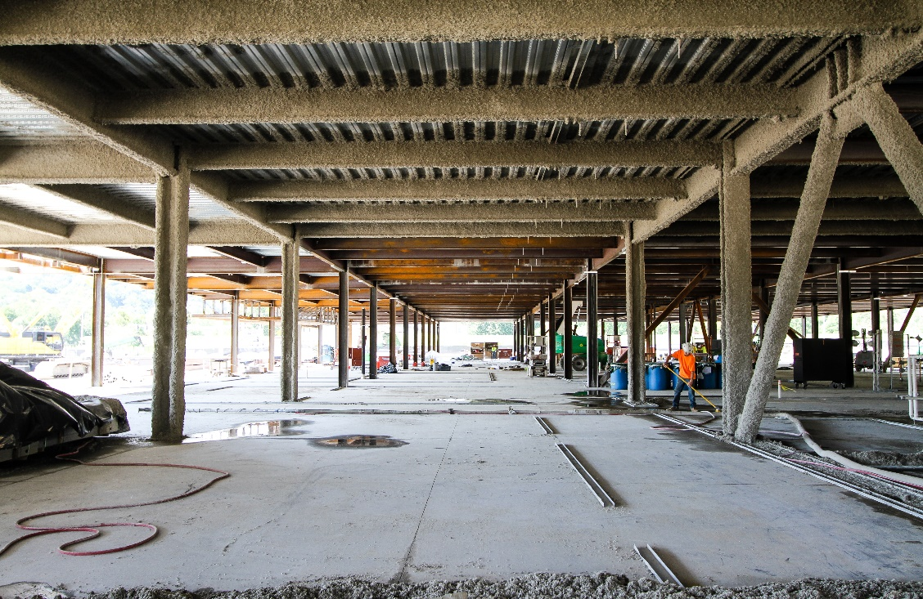
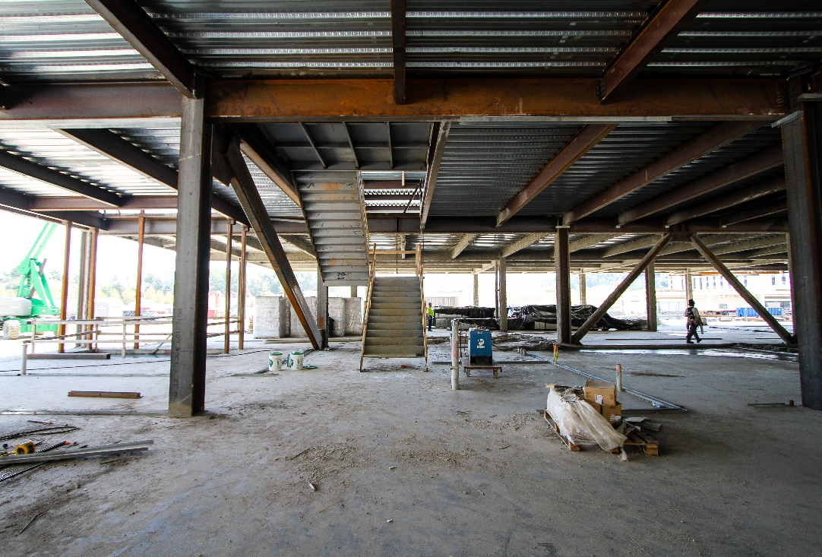

Slide 8
Summary of Financial Impact
The base rent and management and maintenance rent component of additional rent shall never exceed $7,594,492.00 during any fiscal year.
In addition to the above, agencies will incur additional costs for furniture and janitorial services. These items have not been procured to date.
Utility costs were calculated for Budgeting purposes prior to design and construction of building based on $1.90/ gsf. It is anticipated that the Utility costs, once experienced, will be near $1.50/ gsf.
Additional overall costs for the Commonwealth are anticipated to increase. The amount of increase will be determined once the building occupants have been identified.
The increase to the Commonwealth will be due to the anticipated rent increase for the facility to the agencies plus an additional cost for furniture and workstations.
Building maintenance and site services (landscaping, snow removal, etc.) are at the expense of the Building Owner, not the Commonwealth.
Notes:
Final numbers with the Cabinets will be completed as the final footprint is determined. All at the 2 year budget amount of 17.84 per square foot.
Janitorial and Utility Cost may be adjusted in future budgets as the amounts in the first two years is based on Facility experience and cost estimates based on LEED certification.
Lease includes funds to maintain on site facility management.

Slide 9
Anticipated Savings to Offset Increased Costs to Agencies
Reduced square footage per employee due to a more efficient design.
Potential reduced utility costs due to this facility being LEED Certified.
Reduced footprint and current contracts for copiers and scanners.
Consolidation of agencies result in efficiencies with staff duplication; however, each agency would need to provide that information.
Collaboration of staff improves communications and time management.
Notes:
Reduction in travel time
Specific questions regarding the 300 building?

Slide 10
CONSIDERATIONS FOR POTENTIAL OCCUPANTS
Agency Consolidation
  Operational savings
  Time savings
  Improved communications
Reduction of Leased Space
  Reduction of the number of leases to administer.
  500 Mero Street property to be conveyed to the Commonwealth upon completion of the 30 year lease term.
Returning State Employees to Downtown Frankfort
  Relocation of offices outside of City limits
  Capital Plaza Tower housed approximately 900 employees. The new building will potentially return 1,500 employees to downtown Frankfort.

Slide 11
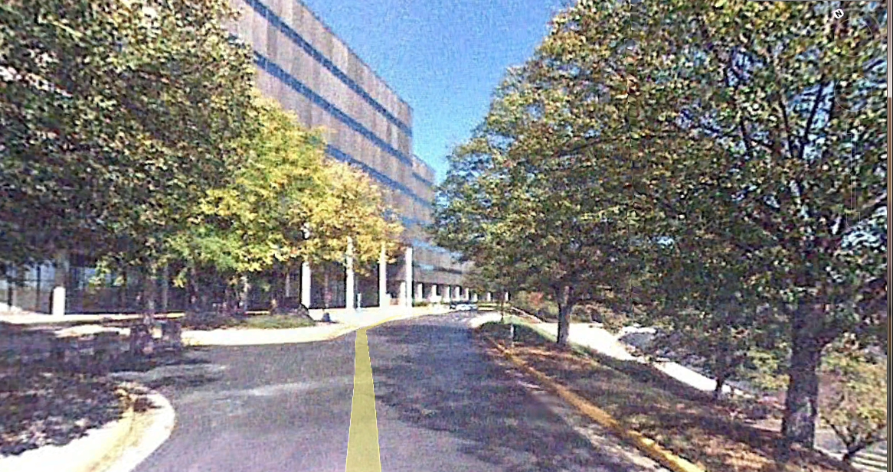
Evaluation Summary
CHR Building and HSB Building Facility Study
Major Issues that need renovation/ upgrade:
  Modifications to seismic structural elements for current building codes.
  Building envelope replacement due to fire hazards, energy efficiency, and to correct failing window conditions.
  Replacement of outdated ceiling system with newer more accessible type.
  Replacement of outdated and worn building finishes.
  Plumbing and Electrical System upgrades for ADA compliance, code compliance, and energy efficiency.
  Reconfiguration of toilet rooms to be ADA compliant and to contain proper fixture counts per plumbing codes.
  Fire Suppression system upgrades and fire alarm upgrades
  Significant fire stopping installation for fire separation requirements.
  Lighting upgrades for code compliance and energy efficiency
  Hazardous materials abatement.
  Door hardware upgrades to meet current code requirements.
  Stair tower modifications, fire separation and exit discharge.
  Installation of fire and smoke separation walls where required by current codes due to building size and configurations.
  Correction of clear exit egress pathways and signage.
  Security system upgrades to provide for adequate building security.
  Isolation of elevator lobbies on each floor to allow for visitor control.
  Upgrade and rework of food services areas and loading dock/ receiving.
  HVAC upgrades are being done(for CHR) in a current project, but there are some aspects of the HVAC that will need to be done at the time of major renovation.
  Reconfiguration of interior spaces for staff efficiency
  Removal of Escalator System, replacement with new elevators.
CHR Building 47.09
Building Structure/ Envelope 37%
Finishes 11%
Building Systems 44%
Code Compliance 5% Functional Standards 3%
HSB Building 35.90
Building Structure/ Envelope 37%
Finishes 12%
Building Systems 43%
Code Compliance 5% Functional Standards 3%
<= 50 Major Renovation Required / <=34 Demolition Recommended

Slide 12
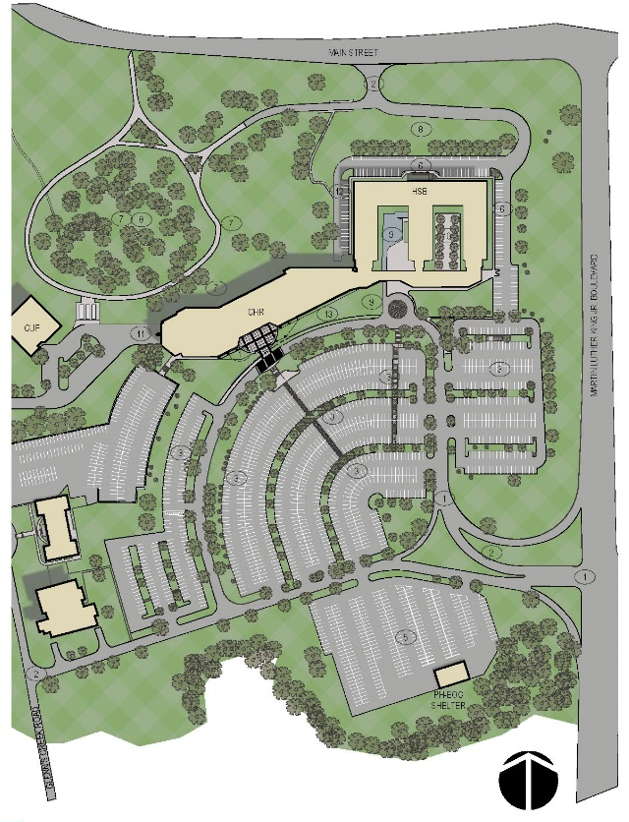
Option 1: Complete Renovation of Existing
Option One consists of alterations, renovations and updates required to meet current functional requirements and to bring existing CHR and HSB into compliance with current Kentucky Building Code, ADA requirements and Energy Code.
Advantages:
Extends life of building for additional 25 years.
Provides new floor to ceiling windows in CHR to increase daylighting.
Creates healthier and more comfortable environment.
Improves energy efficiency.
Corrects Fire stopping and smoke protection for the buildings.
Provides new exterior appearance for CHR and improves construction of exterior of both buildings.
Provides improved interior lighting for dimly lit areas.
Renovation work can be done in phases with swing spaces.
Disadvantages:
Does not address confusion between two buildings.
Travel distance between two buildings continues to be cumbersome.
Existing service chases in CHR remain and disrupt workstation layouts.
Existing F-C heights will make ductwork/ piping difficult to fit above ceilings.
Parking remains inconvenient
Option 1 Costs: $123,660,000. (160m)

Slide 13
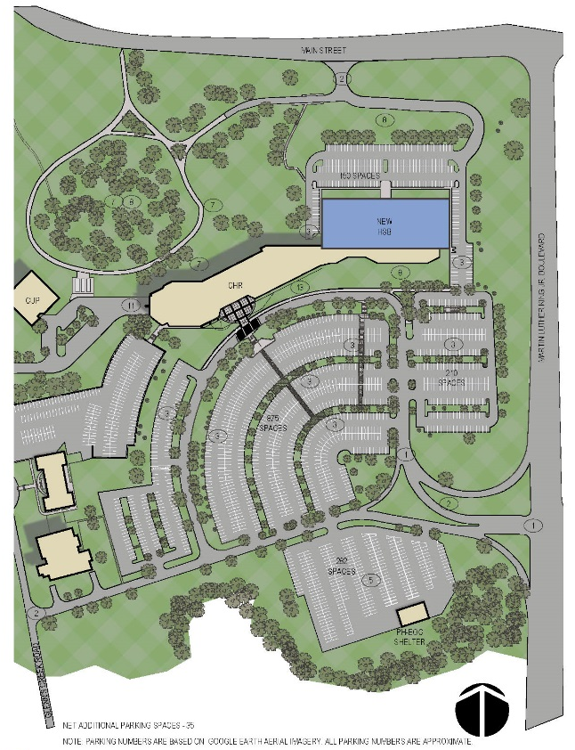
Option 2: Renovation CHR / New HSB Building
Option Two consists of alterations, renovations and updates required to meet current functional requirements and to bring existing CHR into compliance with current Kentucky Building Code, ADA requirements and Energy Code. Also Consists of new HSB (110,040sf) attached to CHR Building.
Advantages:
Extends life of CHR building for additional 25 years. New HSB construction life expectancy of 40 years.
Creates healthier and more comfortable environment.
Improves energy efficiency.
Provides new exterior appearance and energy efficiency for both buildings.
Corrects confusion between the two buildings and makes space more efficient for workstation layouts.
Provides more convenient parking for HSB employees.
Renovation work can be done in phases.
Disadvantages:
Existing service chases in CHR remain and disrupt workstation layout efficiencies.
Existing F-C heights will make ductwork and piping difficult to fit above ceilings. HSB building F-C heights will match CHR.
High Public Use spaces still in main building.
Demolition of HSB makes renovation more difficult in Phases (less swing space available).
Option 2 Costs: $119,030,000. (143m)

Slide 14
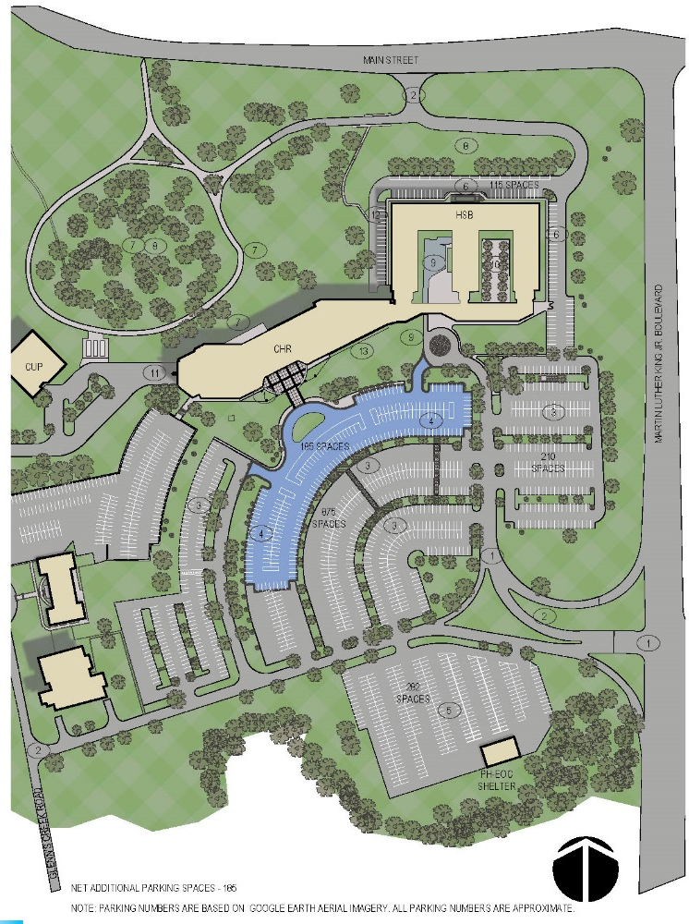
Option 3: Additive Parking Deck
Option Three is an additive option to provide an elevated parking deck with access from the upper level roadway. This will serve an additional 185 parking spaces and have ADA compliant spaces with access to the main building lobby.
Option One with Three combined:
CHR Building Renovation $ 79,295,000. (95.1m)
HSB Building Renovation $ 31,695,000. (43.8m)
CUP Upgrades $ 5,600,000. ( 6.7m)
Site Improvements $ 6,480,000. ( 7.9m)
Hazardous Materials Abatement $ 590,000. ( 0.7m)
Parking Deck $ 4,450,000. (5.6m)
TOTAL OPTION One with Three: $128,110,000. (159.8m)
Option Two with Three combined:
CHR Building Renovation $ 79,295,000. (95.1m)
New HSB Building $ 27,065,000. (32.5m)
CUP Upgrades $ 5,600,000. ( 6.7m)
Site Improvements $ 6,480,000. ( 7.9m)
Hazardous Materials Abatement $ 590,000. ( 0.7m)
Parking Deck $ 4,450,000. (5.6m)
TOTAL OPTION One with Four: $123,480,000. (148.5m)
Option 3 Costs: $ 4,450,000. (5.6m)

Slide 15
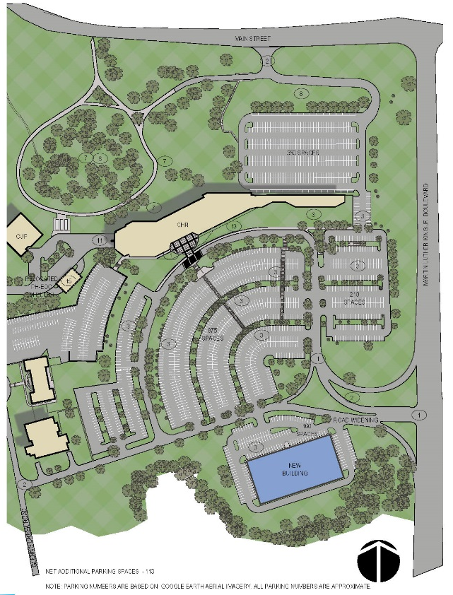
Option 4: Renovation CHR / New Public Info Building
Option Four is an alternative option for the Public information building that consists of a new building (150,000sf) remote to CHR Building, followed by the demolition of the existing HSB building. This would be done in coordination with the renovation of the CHR building as defined in Option One.
Advantages:
Creates healthier and more comfortable environment.
Improves energy efficiency.
New building can be constructed prior to demolition of HSB.
New building can house high public use spaces apart from main building.
Eliminates remote parking areas for both buildings.
Project can be done in multiple phases over time. (Best phased option)
Project funding can be obtained over a period of years.
Option One with Four combined:
New Public Information Building $ 36,105,800. (44.3m) (FY 1)
Demolition of Existing HSB Building $ 749,200. ( 0.9m) (FY 2)
CHR Building Renovation $ 79,295,000. (95.1m) (FY 3)
CUP Upgrades $ 5,600,000. ( 6.7m) (FY 3+)
Site Improvements $ 6,480,000. ( 7.9m) (FY 1/3)
1/3)Hazardous Materials Abatement $ 590,000. ( 0.7m) (FY 1/3)
TOTAL OPTION One with Four: $128,820,000. (155.6m)
Option 4 Costs: $128,820,000. (156.5m)

