Slide 1
KCTCS SIX YEAR CAPITAL PLAN
2022-2028
Presentation to the Capital Planning Advisory Board
July 21, 2021
Presenters:
Brian Wilcox, Assistant Vice President, Facilities Support Services and Capital Projects
Andy Casebier, Director of Major Projects
Sandy Adkins, Director of Capital Projects Budgeting

Slide 2
KCTCS is a statewide system of 16 two-year colleges and has students and employees from every Kentucky county
Current enrollment is approximately 108,000 credit-seeking students
KCTCS has 334 buildings across the Commonwealth
KCTCS buildings contain approximately 8.0 million gross square feet
Average age of KCTCS facilities is approximately 32 years old

Slide 3
KCTCS Capital Planning Criteria
  Protect investment in physical plant and ensure life safety
  Replace outdated, highly inefficient systems (HVAC, roof, etc.)
  Repurpose outdated space with current demand and future programmatic needs
  Provide a return on investment
  Demonstrate community support

Slide 4
#1 Deferred maintenance pool
$40 million
No state support for maintenance since 1998
Each KCTCS College will receive funding from the pool to address major needs, such as:
  Roof Replacements
  Heating, Ventilation and Air Conditioning
  Chiller Replacements
  Electrical and Plumbing

Slide 5
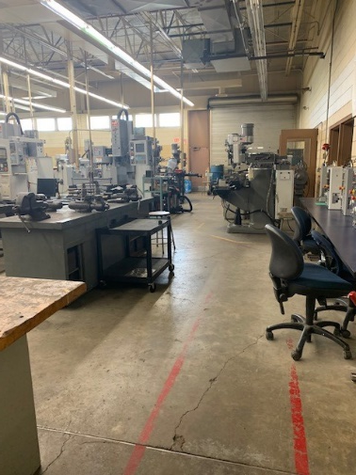
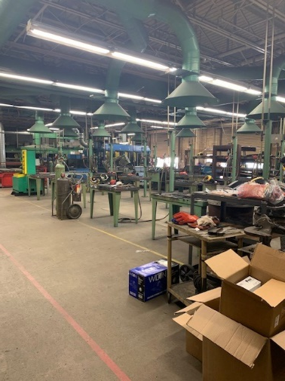
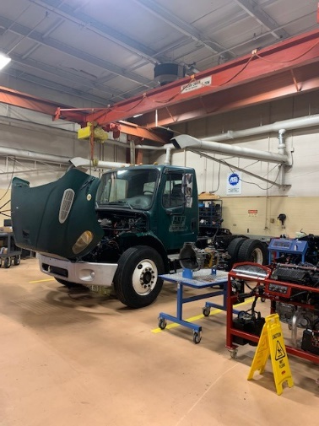
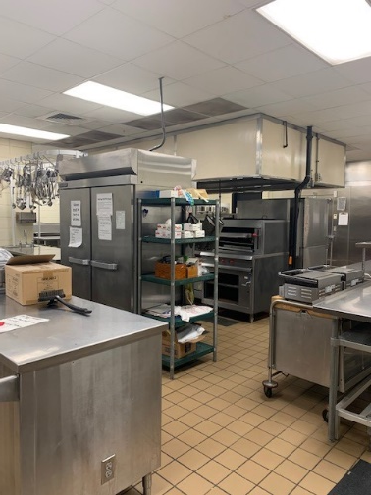
#2 – ELIZABETHTOWN COMMUNITY & TECHNICAL COLLEGE RENOVATE OCCUPATIONAL TECHNICAL BUILDING PHASE I - $14 MILLION
Renovations include electrical, mechanical, plumbing upgrades, roof and window replacement, and restroom upgrades
Allows expansion of programs and addition of new advanced manufacturing program
Existing: Machine Tool
Existing: Welding
Conceptual: New Entrance
Existing: Exterior Elevations
Existing: Auto Diesel
Existing: Culinary

Slide 6
#3 – Jefferson community & technical college renovate and/or replace Hartford building phase I - $15 million
$10 million – GF/$5 million Restricted
** Feasibility Study Underway
ADA
Accessibility
Issues
Science Labs
Outdated
Fenestration Issues
Roof System Issues
Structural Issues
Building Envelope Issues
Structural Issues

Slide 7
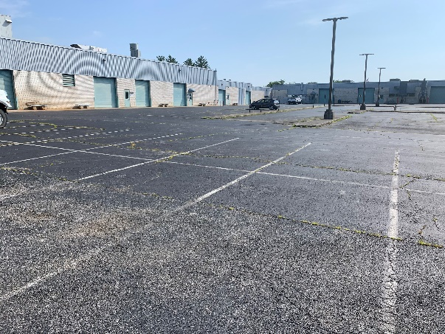
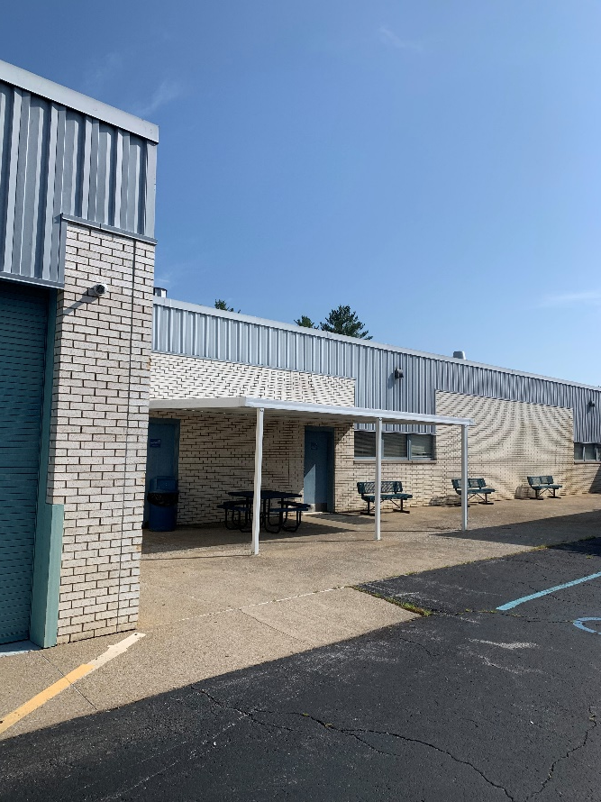
#4 – Somerset Community college renovate laurel south campus phase I – $6 million
$4.8 million – GF/$1.2 million Restricted
Requested previously as new construction at Laurel North but determined that a 3-phase renovation is a better option
Programs housed at Laurel South include diesel technology, welding, electrical technology, automotive technology, industrial maintenance technology, air conditioning technology and construction technology
New building entrance

Slide 8
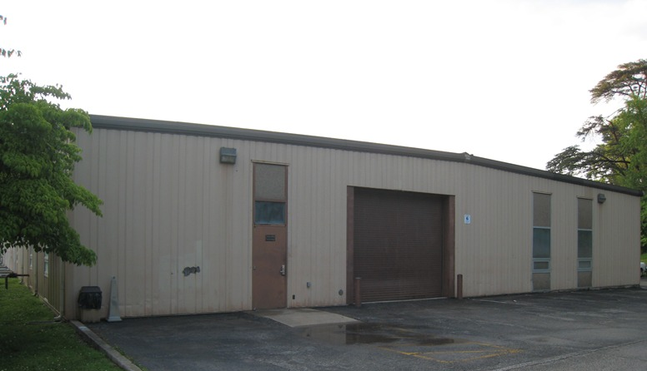
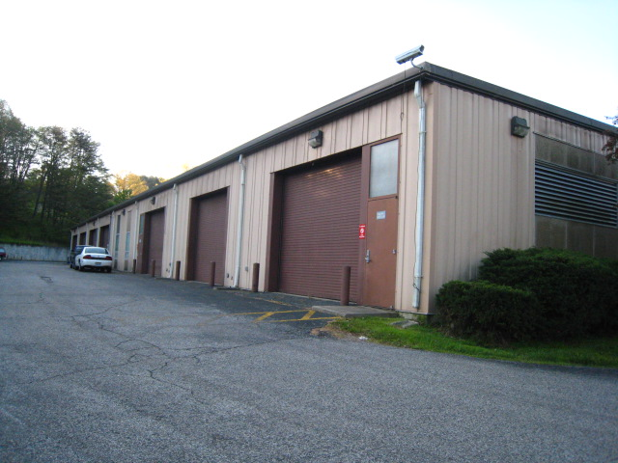
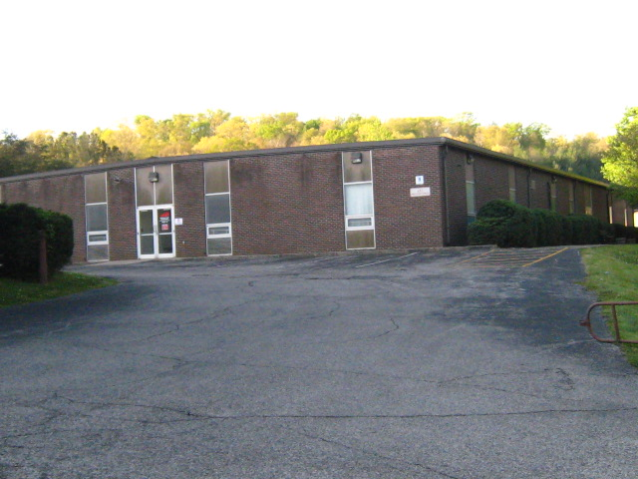
#5 –SOUTHCENTRAL KY COMMUNITY & TECHNICAL COLLEGE MAIN CAMPUS RENOVATION - $10 million
$5 million-GF/$5 million-restricted
Renovates two buildings on the main campus in Bowling Green
No major renovations since these buildings were constructed in 1968
# 6 – Gateway Community & Technical College
Roof Replacements - $6 million
# 7 – Ashland Community & Technical College
Renovate and/or Construct Transportation Training Center - $5.9 MILLION
Renovates the 47,800 square foot Robert's Drive Campus buildings constructed in 1984
Buildings are in need of major repair and are deficient for the programs they house

Slide 9
#8 – Hopkinsville Community College
HVAC Upgrade Academic Building - $3.5 million
#9 – Hazard Community & Technical College
Renovate Jolly Classroom Center - $6.3 million
#10 – Big Sandy Community & Technical College
Roof Replacements - $3.2 million

Slide 10
Questions?

