Slide 1
CAPITAL PLANNING ADVISORY BOARD
ASSET PRESERVATION UNIVERSITY OF KENTUCKY
Sept. 14, 2022

Slide 2
Asset Preservation Funding
 | FY 2022-23 | FY 2023-24 | Total
State Bond Funds | $ 77,098,000 | $ 77,098,000 | $154,196,000
Campus Match, Agency Bonds | 23,130,000 | 23,130,000 | 46,260,000
Grand Total | $100,228,000 | $100,228,000 | $200,456,000
CAPITAL PLANNING ADVISORY BOARD, SEPT. 14, 2022

Slide 3
Principles for the Asset Preservation Pool
Preserve and extend the useful life of existing facilities.
Improve the utilization of space by providing a more flexible array of classrooms to serve our growing student population, creating spaces that are responding to Kentucky’s workforce needs, especially in the STEM+H (science, technology, engineering, math and health) disciplines.
Create better space to increase research collaboration among faculty, staff and students across and among disciplines where ingenuity can unfold.
Efficiently manage repair and maintenance costs.
Upgrade existing infrastructure to improve energy efficient systems that reduce operating costs and lower future maintenance expenses.
.
CAPITAL PLANNING ADVISORY BOARD, SEPT. 14, 2022

Slide 4
Asset Preservation Projects
Projects |  | Estimated Scope
FY 2022-23 | Improve Multi-Disciplinary Science Building | $ 10,000,000
 | Improve White Hall Classroom Building Phase I | 8,000,000
 | Improve Pence Hall | 32,000,000
 | Improve Patterson Office Tower | 5,000,000
 | Improve Miller Hall | 10,000,000
 | Improve Peterson Service Building | 10,000,000
 | Various Infrastructure/System Improvements | 25,000,000
FY 2023-24 | Improve White Hall Classroom Building Phase II | 75,000,000
 | Various Infrastructure/System Improvements | 25,000,000
Grand Total |  | $200,000,000
CAPITAL PLANNING ADVISORY BOARD, SEPT. 14, 2022

Slide 5
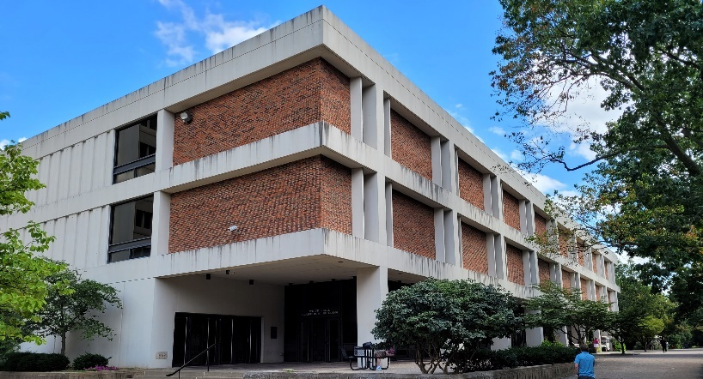
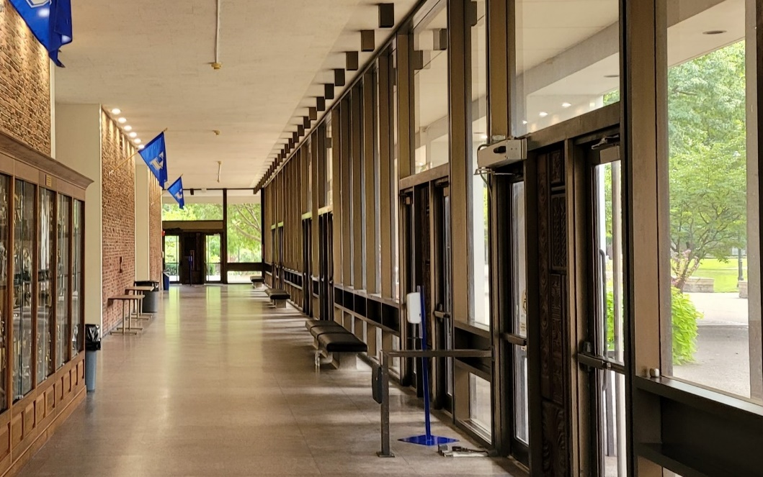
PRESERVATION AT THE UNIVERSITY OF KENTUCKY
WHITE HALL CLASSROOM BUILDING
Built: 1969
Size: 164,338 square feet
Uses: Six large lecture halls on first floor; 56 classrooms/class labs on second and third floors
Previous improvements: Only minor renovation and repair projects since opening
Preservation needs:
Exterior repairs and cleaning​
Mitigate water infiltration
HVAC and electrical systems upgrade
Lighting upgrades and increased natural light
Flexible classroom arrangements that facilitate 21st century learning techniques
Preservation allocations: Phase I FY 2022-23: $8 million Phase II FY 2023-24: $75 million
CAPITAL PLANNING ADVISORY BOARD, SEPT. 14, 2022

Slide 6
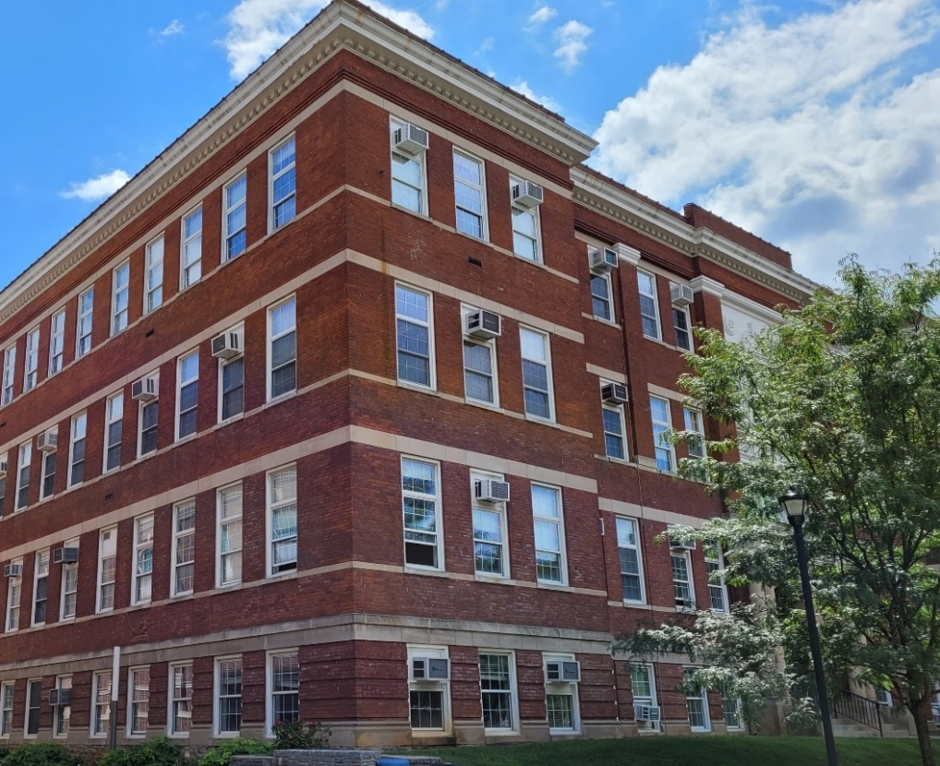
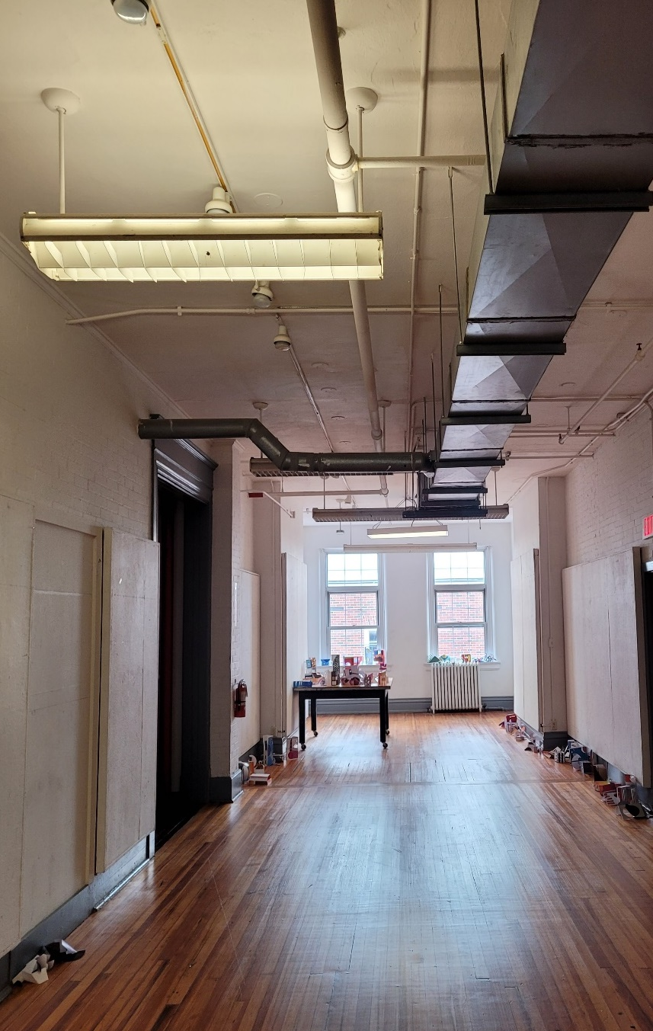
PRESERVATION AT THE UNIVERSITY OF KENTUCKY
PENCE HALL
Built: 1909
Size: 41,649 square feet
Uses: College of Design classrooms, labs, studios, offices and auditorium
Previous improvements: Last major renovation in 1964, with minor repairs and improvements in the years since
Preservation needs:
Resolve American Disability Act accessibility issues
Mechanical systems are beyond end of life. New HVAC system in order to remove window air conditioners
Significant repairs to exterior masonry and building envelope
Preservation allocation: FY 2022-23: $32 million
CAPITAL PLANNING ADVISORY BOARD, SEPT. 14, 2022
Notes:
Pence is primarily used by College of Design at this time
existing configuration:
2 classrooms
1 auditorium
3 class labs
10 open laboratories (studios)
Offices (faculty and staff)
Other support space
Future use will likely include similar uses such as classrooms, class labs, office (faculty and staff) and other support spaces to support academic needs.

Slide 7
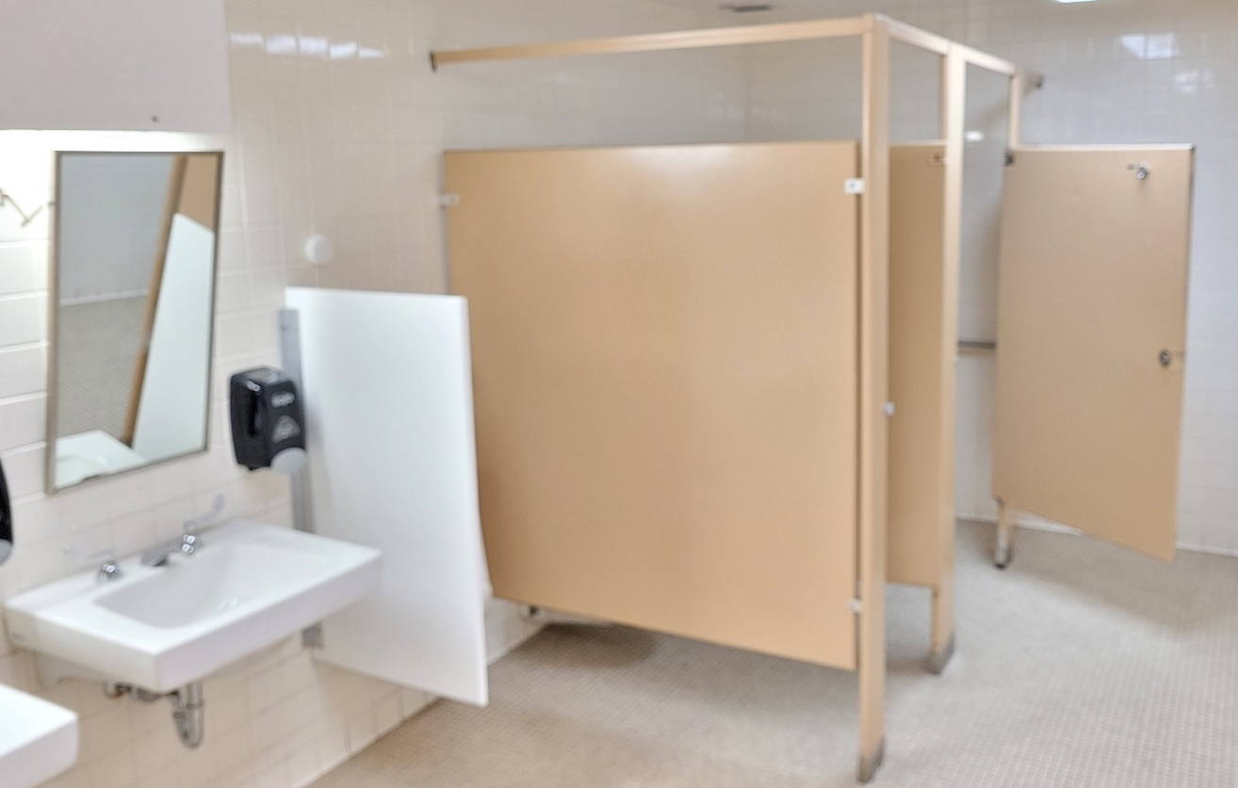
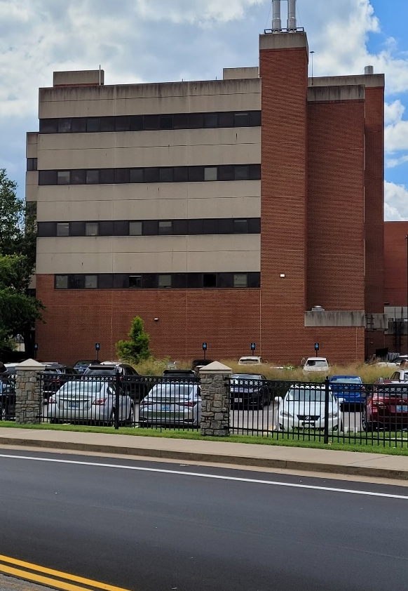
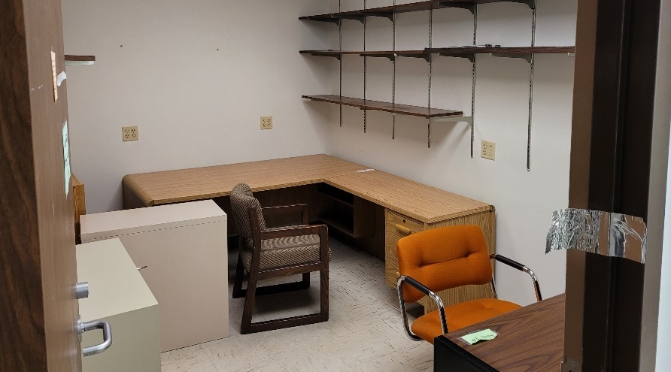
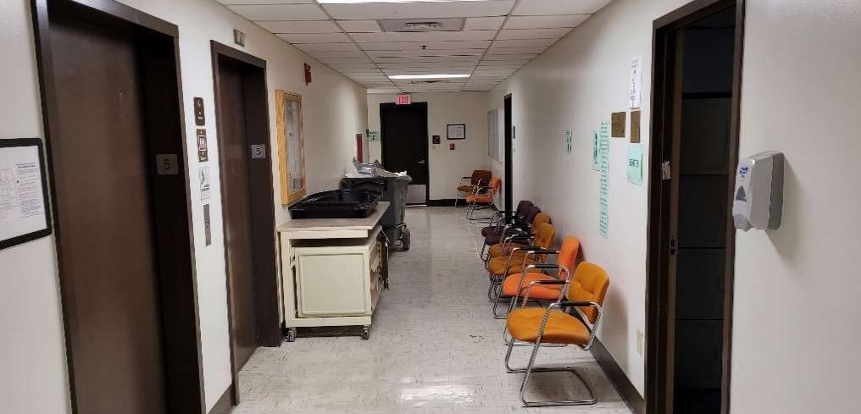
PRESERVATION AT THE UNIVERSITY OF KENTUCKY
MULTI-DISCIPLINARY SCIENCE BUILDING
Built: 1985
Size: 102,167​ square feet
Uses: Classrooms, offices for College of Public Health, College of Arts and Sciences and others
Previous improvements: No major renovation projects completed since opening
Preservation needs:
Upgrade HVAC system
Fifth floor to be repurposed to accommodate College of Nursing and College of Health
Auditorium with about 150 seats
Four class labs for Nursing
Six mock exam rooms
Faculty and staff offices
Upgrade bathrooms, offices and other public spaces
Preservation allocation: FY 2022-23: $10 million
CAPITAL PLANNING ADVISORY BOARD, SEPT. 14, 2022
Notes:
5th floor is 15,750 square feet
MDS: 5th floor – current status - vacant
12 former labs
Approx. 15 offices
Other support space
Building HVAC upgrades/improvements required to support 5th floor occupancy
Highlights from the proposed program for the MDS 5th floor project allow the College of Nursing and College of Health Science to expand their enrollment:
1 Auditorium 150 +- seats
4 class labs for Nursing (these would have mannequins for skills training)
6 mock exam rooms
Faculty and staff offices
Other occupants of the MDS building include:
Student Success
College of Public Health
College of Arts and Science
Department of Kinesiology

Slide 8
Questions?
ASSET PRESERVATION UNIVERSITY OF KENTUCKY
Sept. 14, 2022

